Slide 1
SWAS
Starshift WA Sender
Message hundreds of customers on WhatsApp at once
Chrome Extension
Easy to use
No second number
Full walkthrough and demo
Notes:
Opening slide. One line: a WhatsApp bulk sender that runs inside the seller's own WhatsApp.

Slide 2
The problem
What sending by hand actually costs you
1
You open one chat at a time
200 customers means 200 copy-pastes. Half a day gone.
All of it
on one screen
2
You cannot put the name in
Everyone gets the same message. Without a name, most people skip it.
✓
3
You never know how many landed
Who got it, who did not, where it failed - no record at all.
Starshift WA Sender
does this for you
4
The fear of getting blocked
Fire messages off too fast and WhatsApp can shut the number down.
Notes:
Frame the pain before the product. Every seller has felt all four.

Slide 3
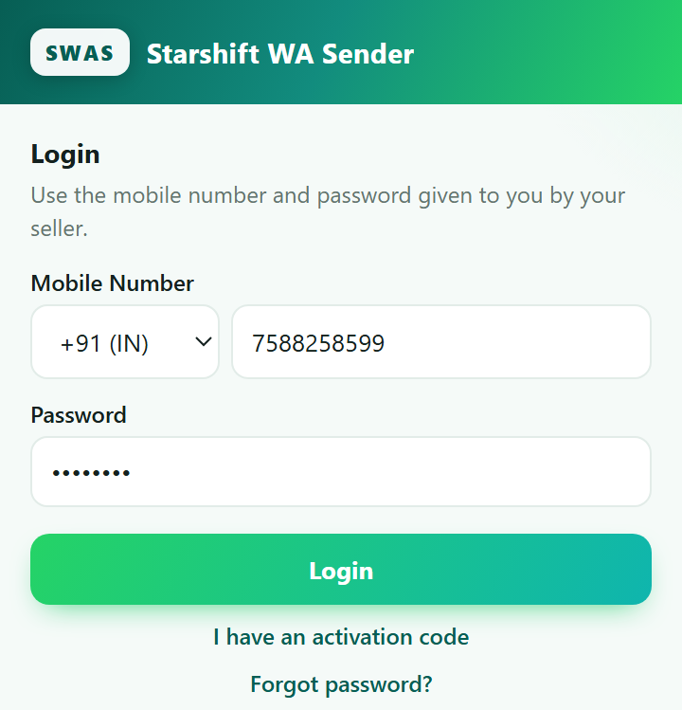
What it is
So what is this, exactly?
◆
A Chrome extension
Messages go out through the WhatsApp already on your computer.
◆
No second number needed
Your own WhatsApp number. No per-message API bill.
◆
Takes an Excel list as it is
An Excel file or Google Sheet with names and numbers works straight away.
◆
Any language you like
Marathi, Hindi, English - there is a translate button too.
Login screen - the number and password we give you
Notes:
Stress that it uses the customer's own WhatsApp number - no per-message API cost.

Slide 4
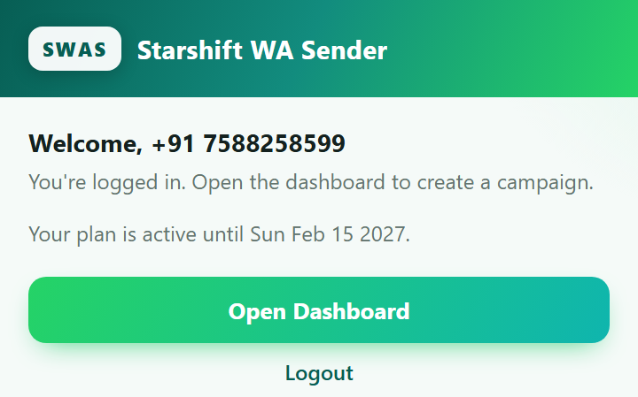
Getting started
How to start - only three steps
1
Install the extension
Drop the file we send you into Chrome. One-time job.
2
Log in
Enter the mobile number and password we gave you.
3
Open the dashboard
Hit Open Dashboard - everything else happens there.
What you see once you are logged in
One thing to remember: keep a WhatsApp Web tab open while messages are going out.
Notes:
Installation is a one-time job you do for the customer at handover.

Slide 5
The map
Six sections on the dashboard - what sits where
1
2
3
New Campaign
Reports
Extract
Where you build and send a message
How many sent, how many failed, Excel report
Pull chats and numbers out into Excel
4
5
6
Chatbot
Quick Replies
Unsubscribers
Auto-reply when a keyword shows up
Your stock answers, one click away
People who asked to be left alone
The rest of this deck walks these six in order.
Notes:
Orientation slide - the rest of the deck follows these six tabs in order.

Slide 6
1
Sending a campaign
New Campaign and Reports - the daily work
1. Who
2. Message
3. File + time
4. Pace
5. Report

Slide 7
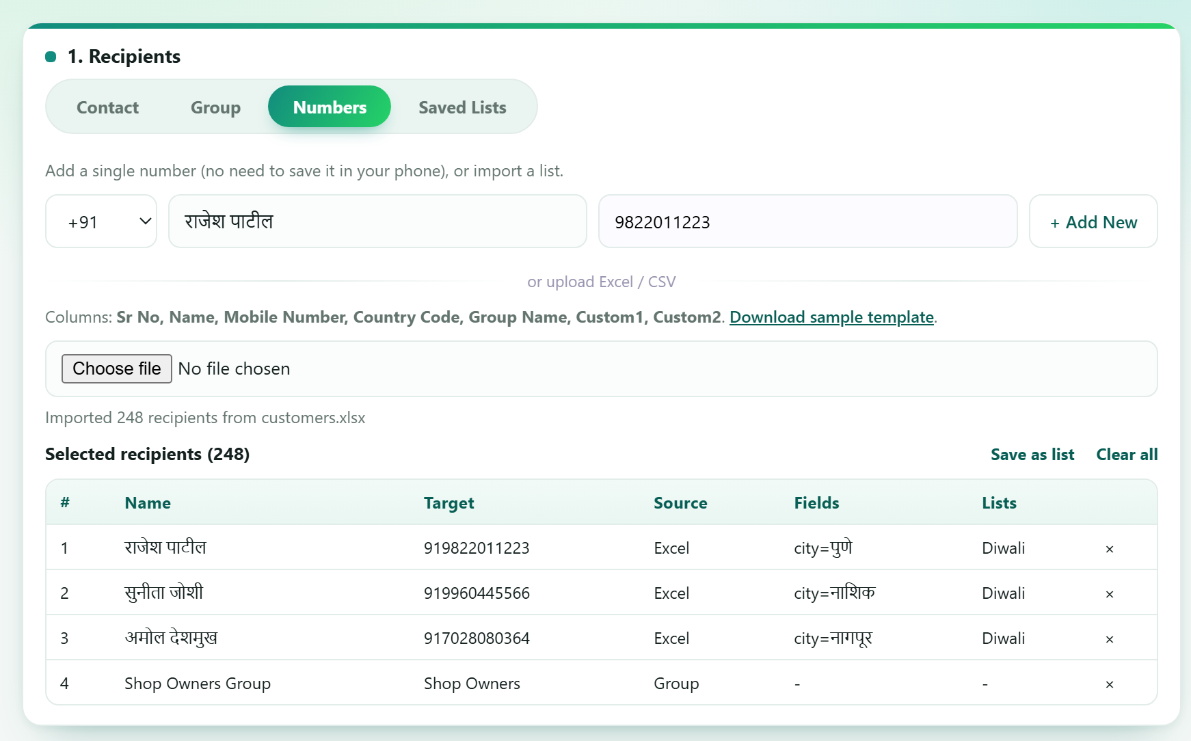
Step 1 - New Campaign
Pick who gets the message
◆
Contact / Group
Your WhatsApp chats and groups show up right here. Hit Sync and the list loads.
◆
Numbers
Type one number by hand, or import an Excel / Google Sheet list. No need to save numbers in your phone.
◆
Saved Lists
Build lists of your regulars - one click next time.
248 customers imported from Excel in one click
Notes:
Excel columns: Sr No, Name, Mobile Number, Country Code, Group Name plus any custom column.

Slide 8
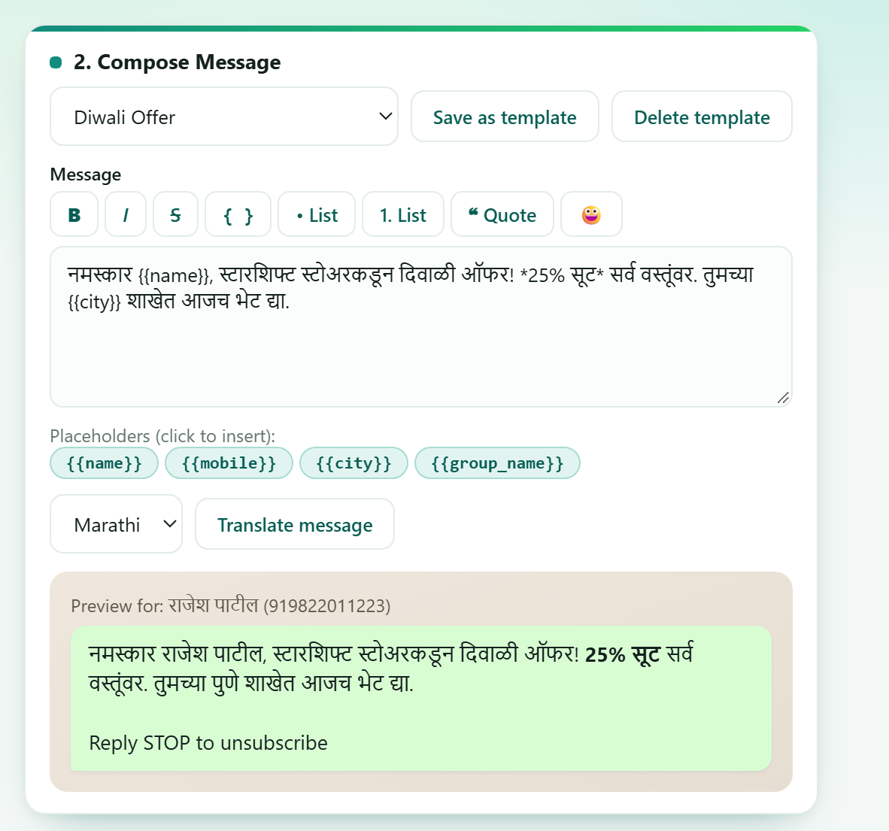
Step 2 - New Campaign
Write the message - the name fills itself in
◆
Type {{name}} and the name appears
Everyone gets their own name. Your own columns like {{city}} work too.
◆
Bold, italic, lists, emoji
Same formatting as WhatsApp. The preview updates as you type.
◆
Save it as a template
Write it once, reuse it whenever.
◆
Translate into 15 languages
Marathi, Hindi, Gujarati, Tamil - one button.
The preview below shows exactly what lands
Notes:
The placeholder feature is the strongest selling point - show the preview updating live.

Slide 9
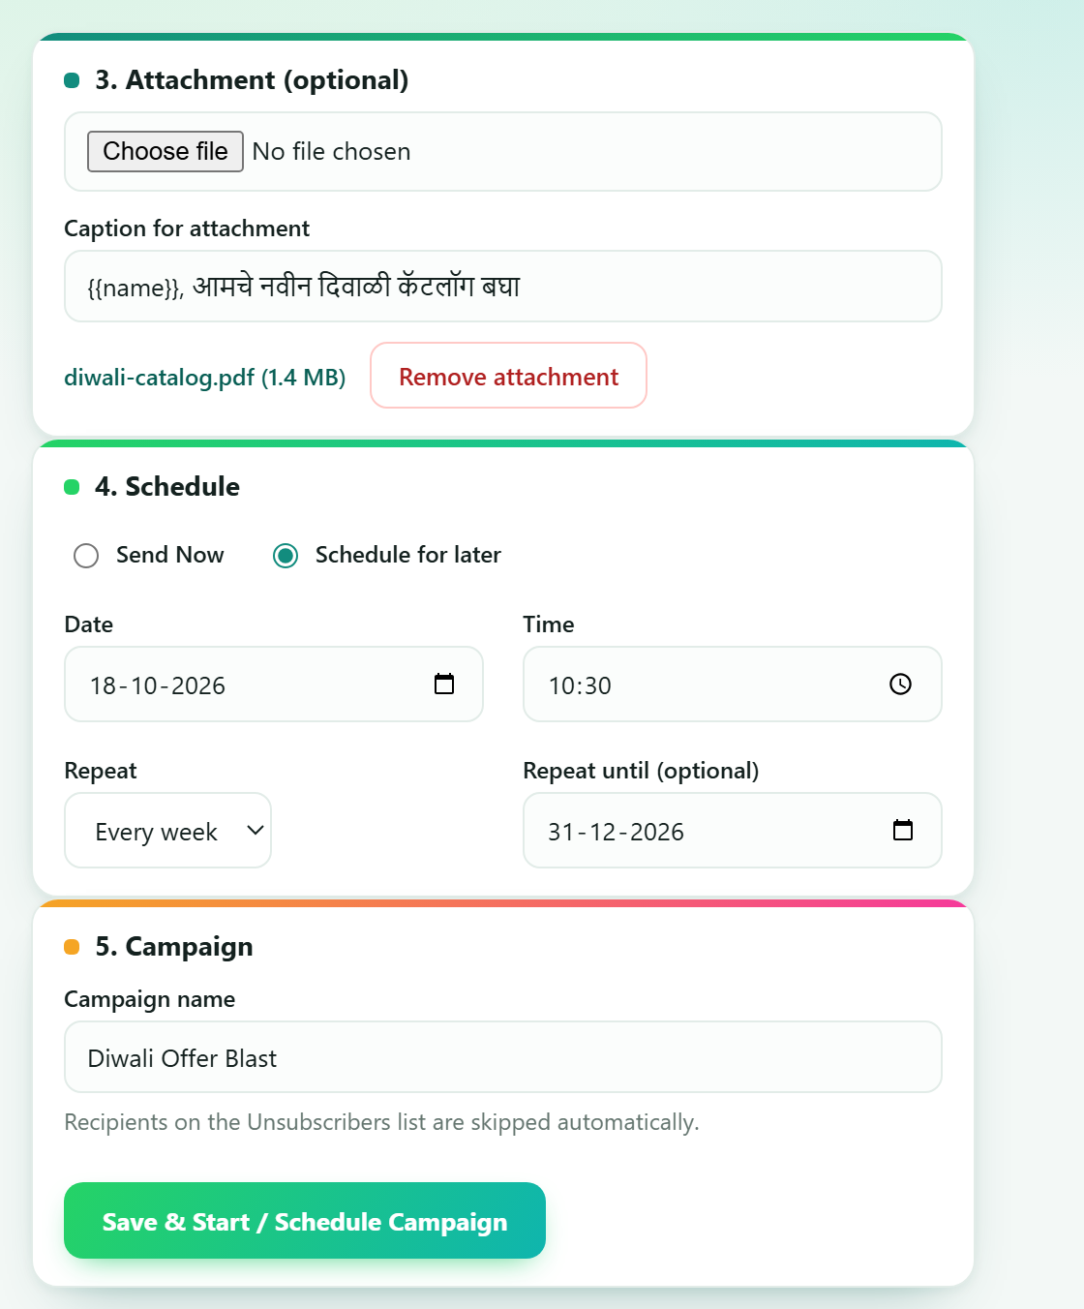
Step 3 - New Campaign
Attach a file, pick the time
◆
Send photos, PDFs, a catalog
Image, video, PDF, Excel - with a caption if you want one.
◆
Send now or schedule it
Set a date and time; it goes out on its own as long as the PC is awake.
◆
Repeat weekly or monthly
Set it once and it runs again by itself.
◆
Give the campaign a name
"Diwali Offer Blast" - easy to find later in Reports.
18 October, 10:30 AM - repeating every week
Notes:
Scheduling needs the PC awake with Chrome running.

Slide 10
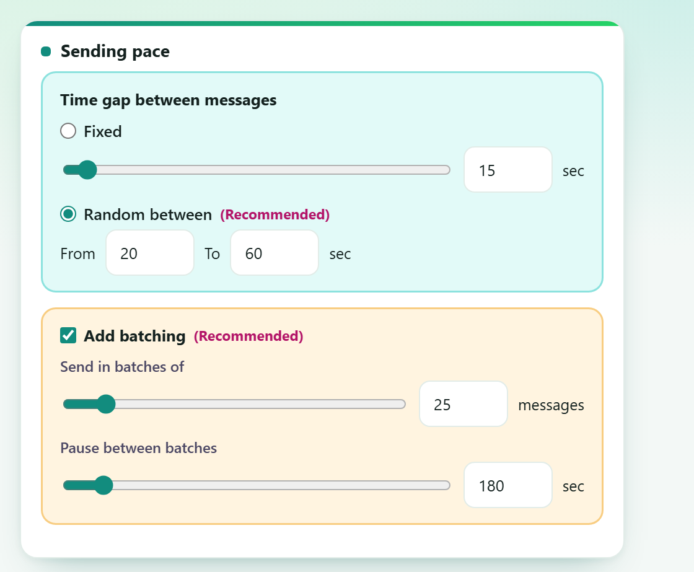
Step 4 - Safety
Keeping your number out of trouble
◆
Put a gap between messages
Fixed, or a range. A range looks more human, so it is the safer choice.
◆
Send in batches
25 messages, then a 3-minute pause, then the next 25.
◆
STOP means skipped
Every message carries an unsubscribe line. Anyone replying STOP drops off the list.
20-60 seconds between messages, a 3-minute break every 25
Notes:
Be honest: no tool can guarantee WhatsApp never bans a number. Pacing greatly lowers the risk.

Slide 11
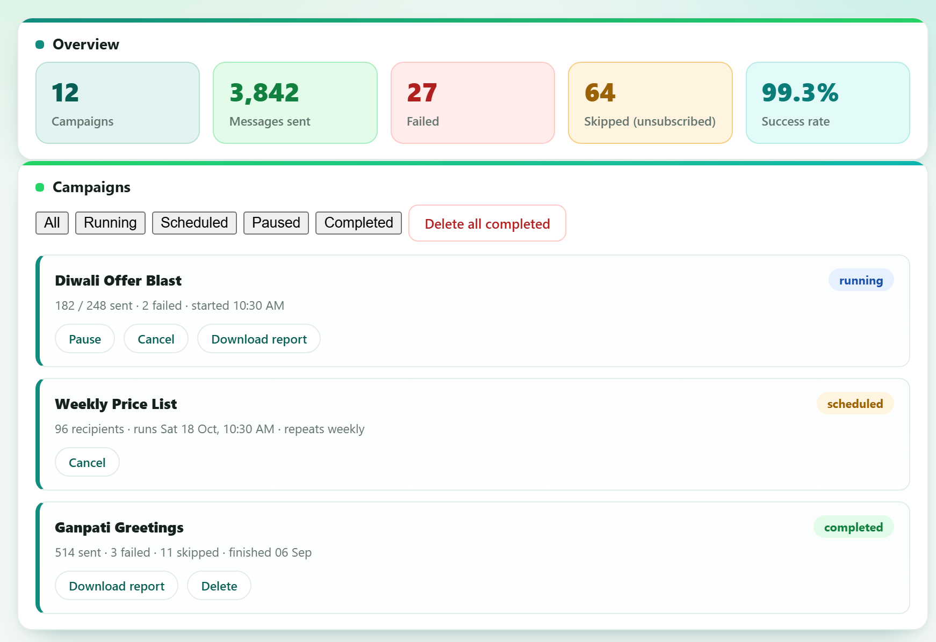
Step 5 - Reports
You know straight away how many landed
◆
Every number at a glance
Sent, failed, skipped - all across the top.
◆
Pause it, resume it
A running campaign can be paused or cancelled mid-way.
◆
Download the Excel report
The full list of who got it, in a file.
Notes:
Reports are what separate this from free scripts - the customer can prove the campaign ran.

Slide 12
2
Automatic replies
Chatbot, Quick Replies and Unsubscribers
Chatbot
Quick Replies
Unsubscribers

Slide 13
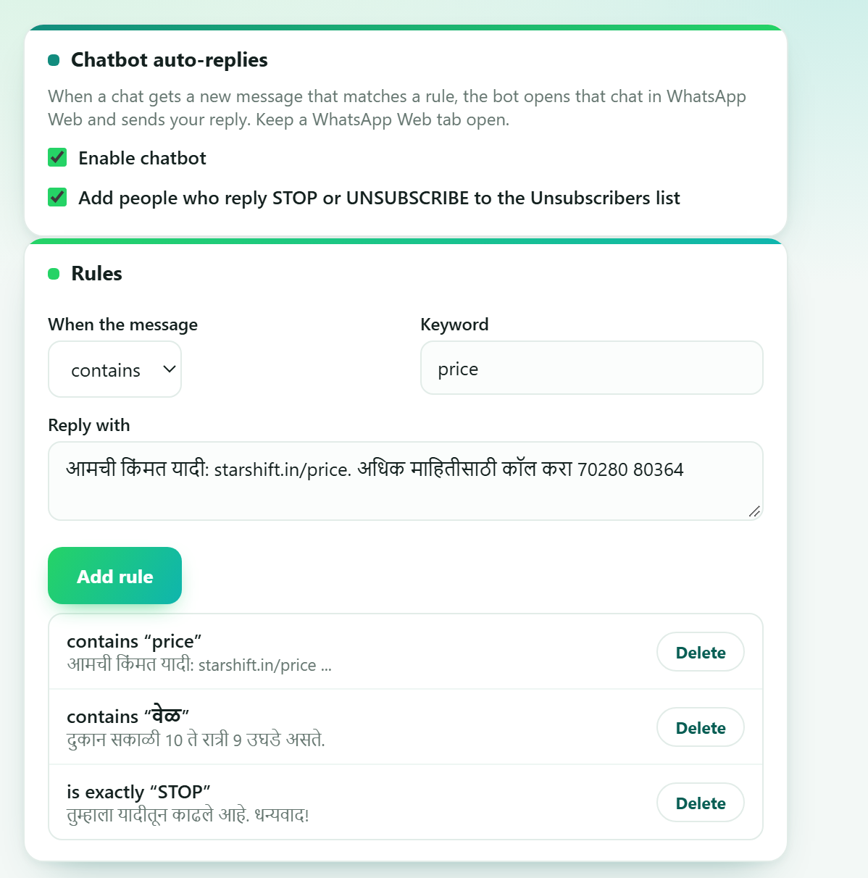
Chatbot
A keyword arrives, the reply goes out
◆
Pick the word, pick the reply
Customer types "price" and your price list goes out. You choose "contains" or "is exactly".
◆
It works while you are away
A late-night enquiry gets an answer immediately. Nobody is left waiting.
◆
It has limits, on purpose
Groups are left alone, chats matching no rule stay unread, and the bot pauses while a campaign runs.
Three rules - price, timing, STOP
Notes:
Chatbot needs a WhatsApp Web tab open; it pauses while a campaign runs and ignores groups.

Slide 14
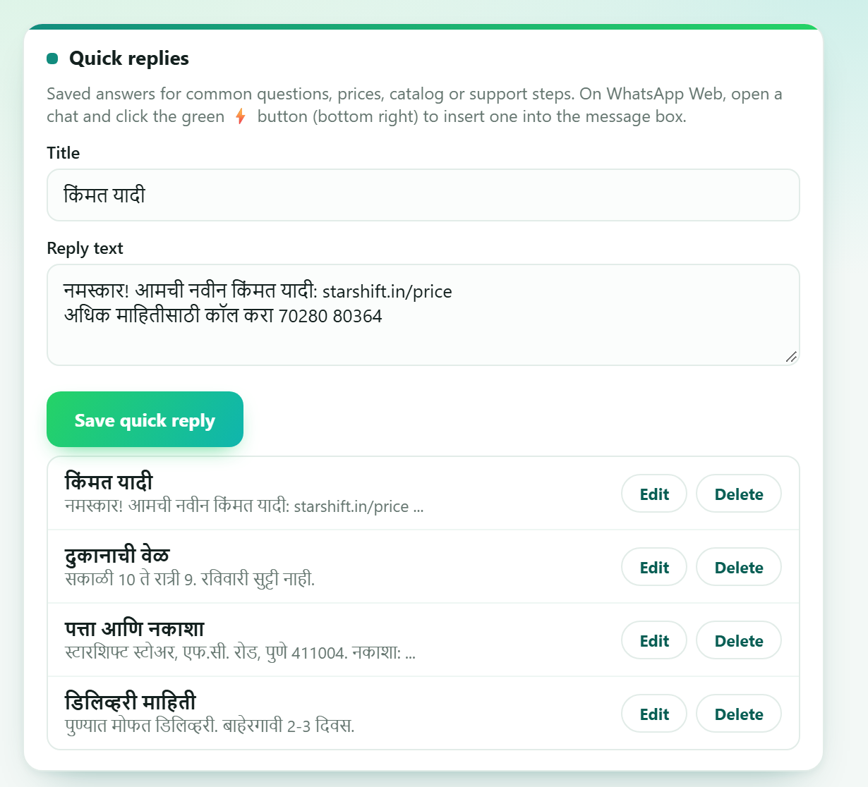
Quick Replies
Your stock answers, one click away
◆
Not the same as the chatbot
The chatbot sends by itself; a Quick Reply you pick and send yourself - you stay in control.
◆
It lives on WhatsApp Web
Open a chat, click the green button at the bottom right, pick an answer - it drops into the message box.
◆
It saves the typing
No more typing the same answer twenty times a day.
Price, timing, address, delivery - write once, use forever
Notes:
Quick replies are manual; the chatbot is automatic. Customers mix them up - make the difference explicit.

Slide 15
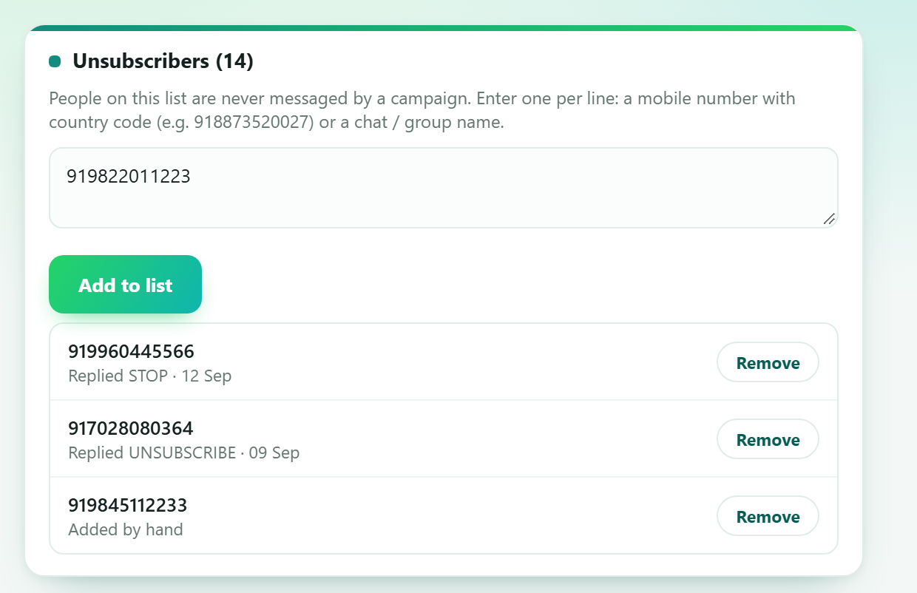
Unsubscribers
People who opted out never hear from you again
◆
It fills itself
Whoever replies with the keyword under your message (STOP) is added here.
◆
You can add people by hand
A number or a chat name - one per line.
◆
Every campaign skips them
No campaign will message anyone on this list - you do not have to watch for it.
Anyone replying STOP lands here on their own
Notes:
This is the trust feature - it keeps the customer's number clean and their audience willing.

Slide 16
3
Pull data into Excel
Extract - reads WhatsApp without sending anything
Chats / messages
Mobile numbers

Slide 17
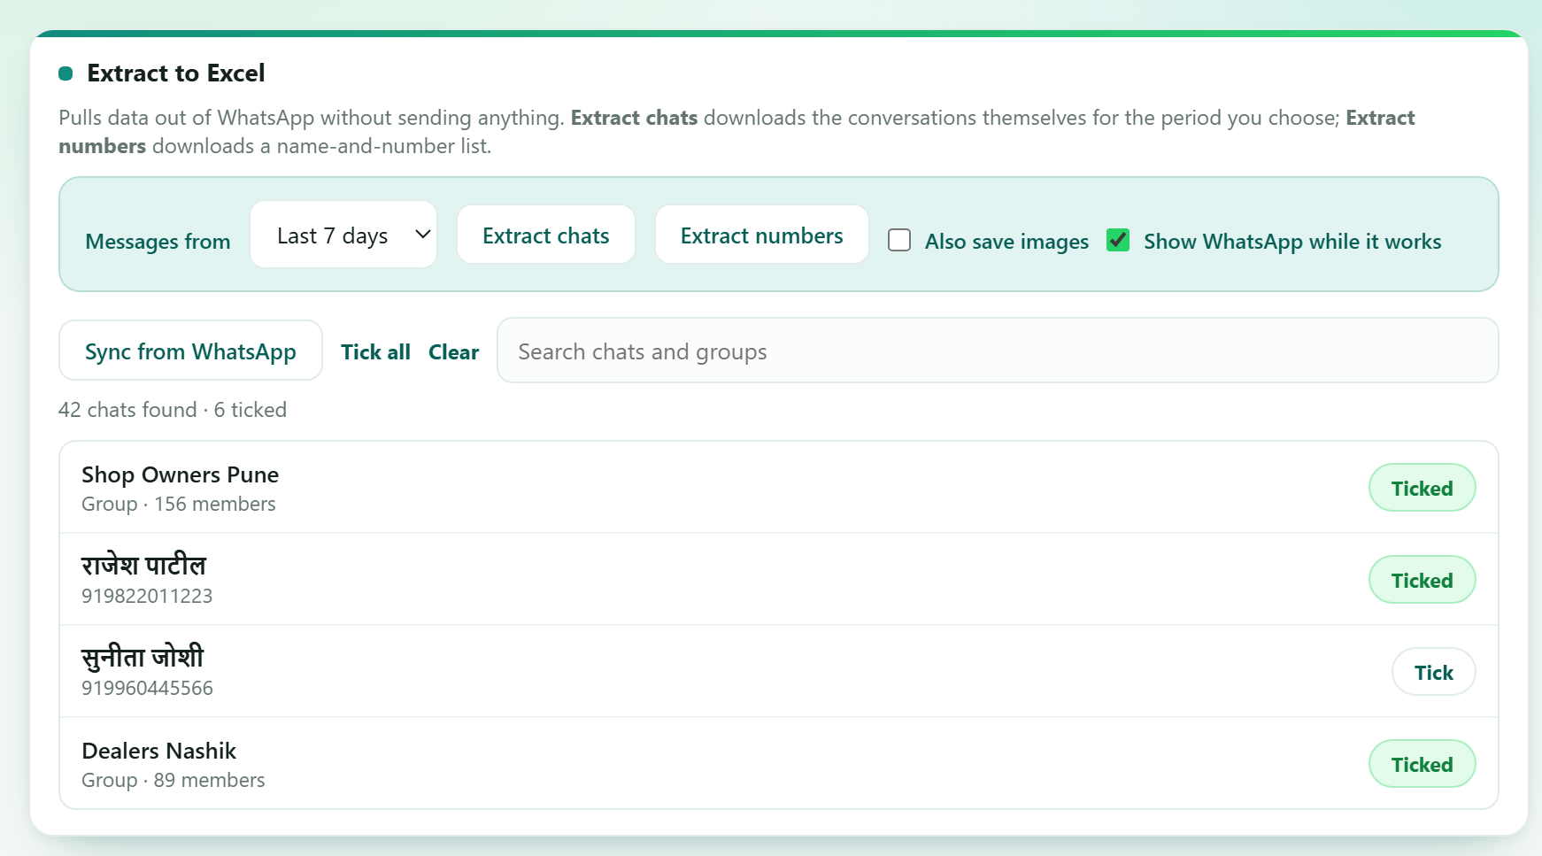
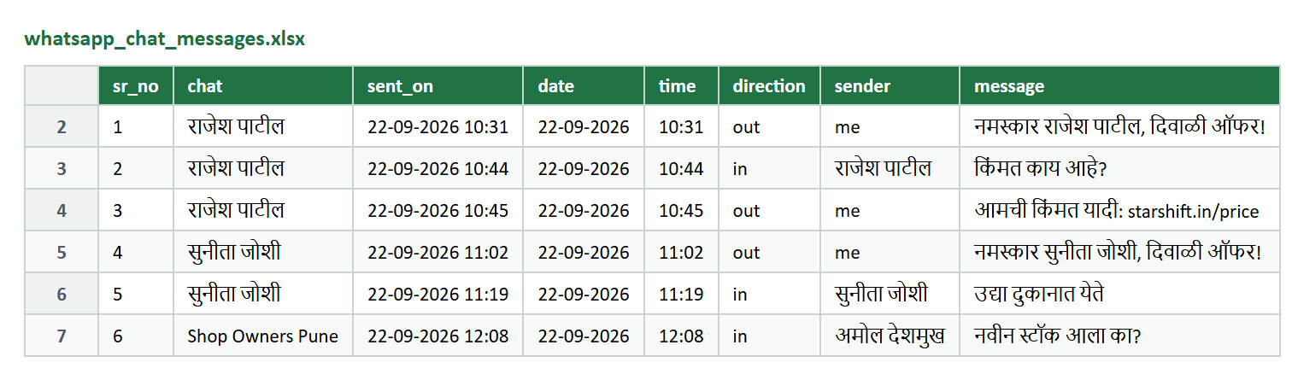
Extract - part 1
Chats and messages into Excel
◆
You choose the period
Today, 3 days, 7 days, 30 days, everything, or your own dates.
◆
The whole conversation comes across
Date, time, direction (in/out), who sent it, and the full text.
◆
Photos too
Tick "Also save images" and the pictures come out as separate files.
Pick the chats, pick the period, hit Extract chats
Nothing is sent - it only reads.
Notes:
File: whatsapp_chat_messages.xlsx - sr_no, chat, sent_on, date, time, direction, sender, message, image_file.

Slide 18
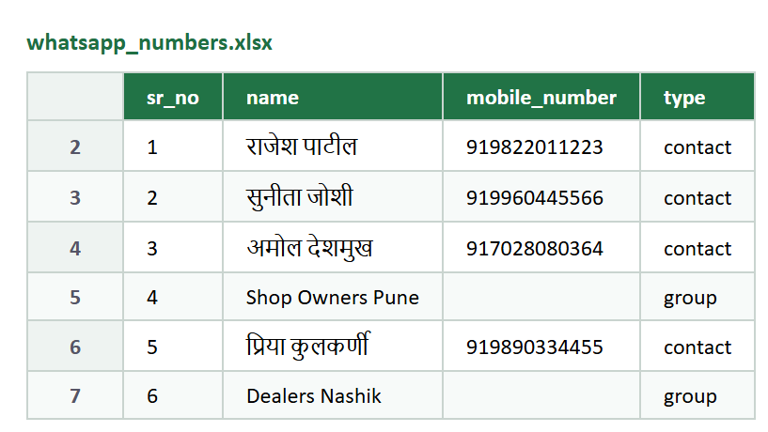
Extract - part 2
A list of mobile numbers in Excel
◆
Name and number together
Every ticked chat's name, number, and whether it is a contact or a group - in one file.
◆
Even the hidden numbers
WhatsApp hides some chats' numbers - those chats get opened so the number can be read.
◆
Group members
On the Group tab hit "Members to Excel" - everyone in that group lands in a file.
whatsapp_numbers.xlsx - the file you get
◆
Your next campaign list, ready
Feed the same file back into the Numbers tab and the loop closes.
A group has no phone number, so that row's number stays blank.
Notes:
File: whatsapp_numbers.xlsx - sr_no, name, mobile_number, type.

Slide 19
Everything else
What else you get
Excel / CSV import
Google Sheets
Group messaging
Thousands of numbers from one file
Paste a link, the list loads itself
To the group, or to members one by one
Saved lists
Message templates
15 languages
Your regulars, one click away
Write once, use again and again
Marathi, Hindi, Gujarati and more
Notes:
Run through these quickly - they answer 'does it also do X?'

Slide 20
The value
Why buy it?
Hours down
to minutes
₹0
per message
Messages
with a name
Reaching 248 customers takes
only as long as writing the message
No per-message cost like SMS.
It uses your own WhatsApp
Everyone gets their own name.
More of them reply
◆
Learn it once and anyone can run it
Your shop assistant can handle it - it is all on one screen.
◆
Support you can actually reach
Stuck? Ask us straight on WhatsApp.
Notes:
Close the value case before the price slide.

Slide 21
Pricing
What it costs
One-time
Monthly
₹1,999 one-time
₹99 per month
Paid once, at the start
Keeps the service running
Extension and licence
Server and licence stay live
We install it for you
New features at no cost
We run your first campaign with you
Support on WhatsApp
Pay ₹1,999 and you are running the same day - install and training included. After that it is ₹99 a month.
Notes:
Rs 1,999 one-time (licence + install + training), then Rs 99 per month.

Slide 22
Start today
Want a demo? Or shall we set you up right now?
Reach us on WhatsApp
+91 70280 80364
We install it and run the first campaign with you.
SWAS
Notes:
Leave this up while taking questions. The number is the support line.

