Slide 1
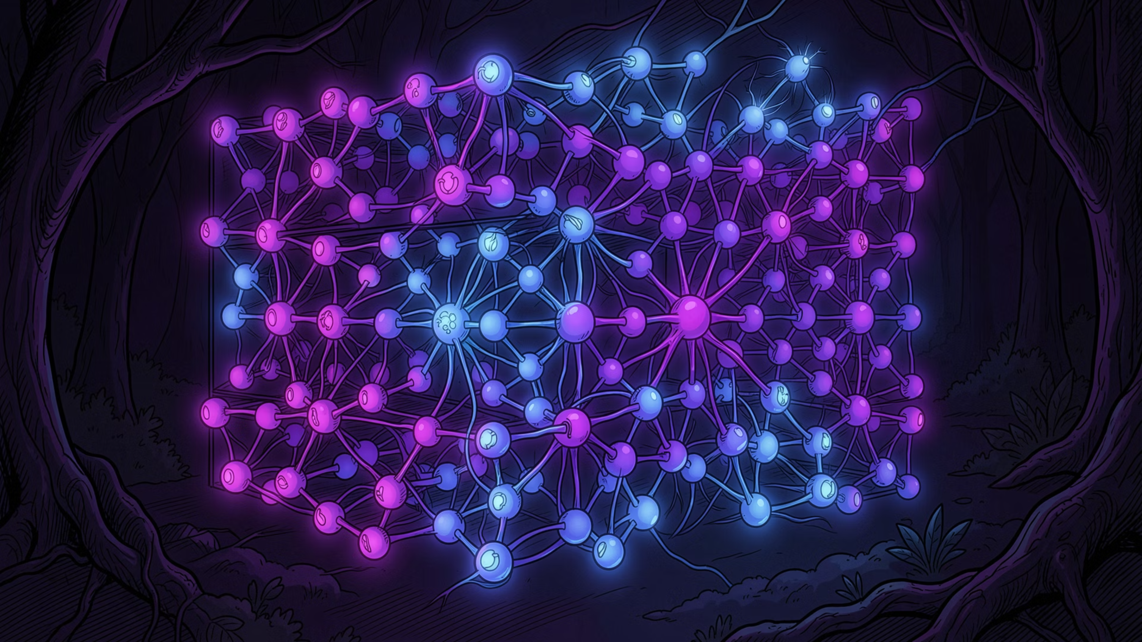
Computer Vision & Deep Learning Lab Notebook
A structured guide through 10 practicals covering OpenCV image processing, convolutional neural networks, and modern face and pose detection — from raw pixel matrices to real-time landmark tracking.
10 PRACTICALS
OPENCV + TENSORFLOW + MEDIAPIPE
STUDENT REFERENCE

Slide 2
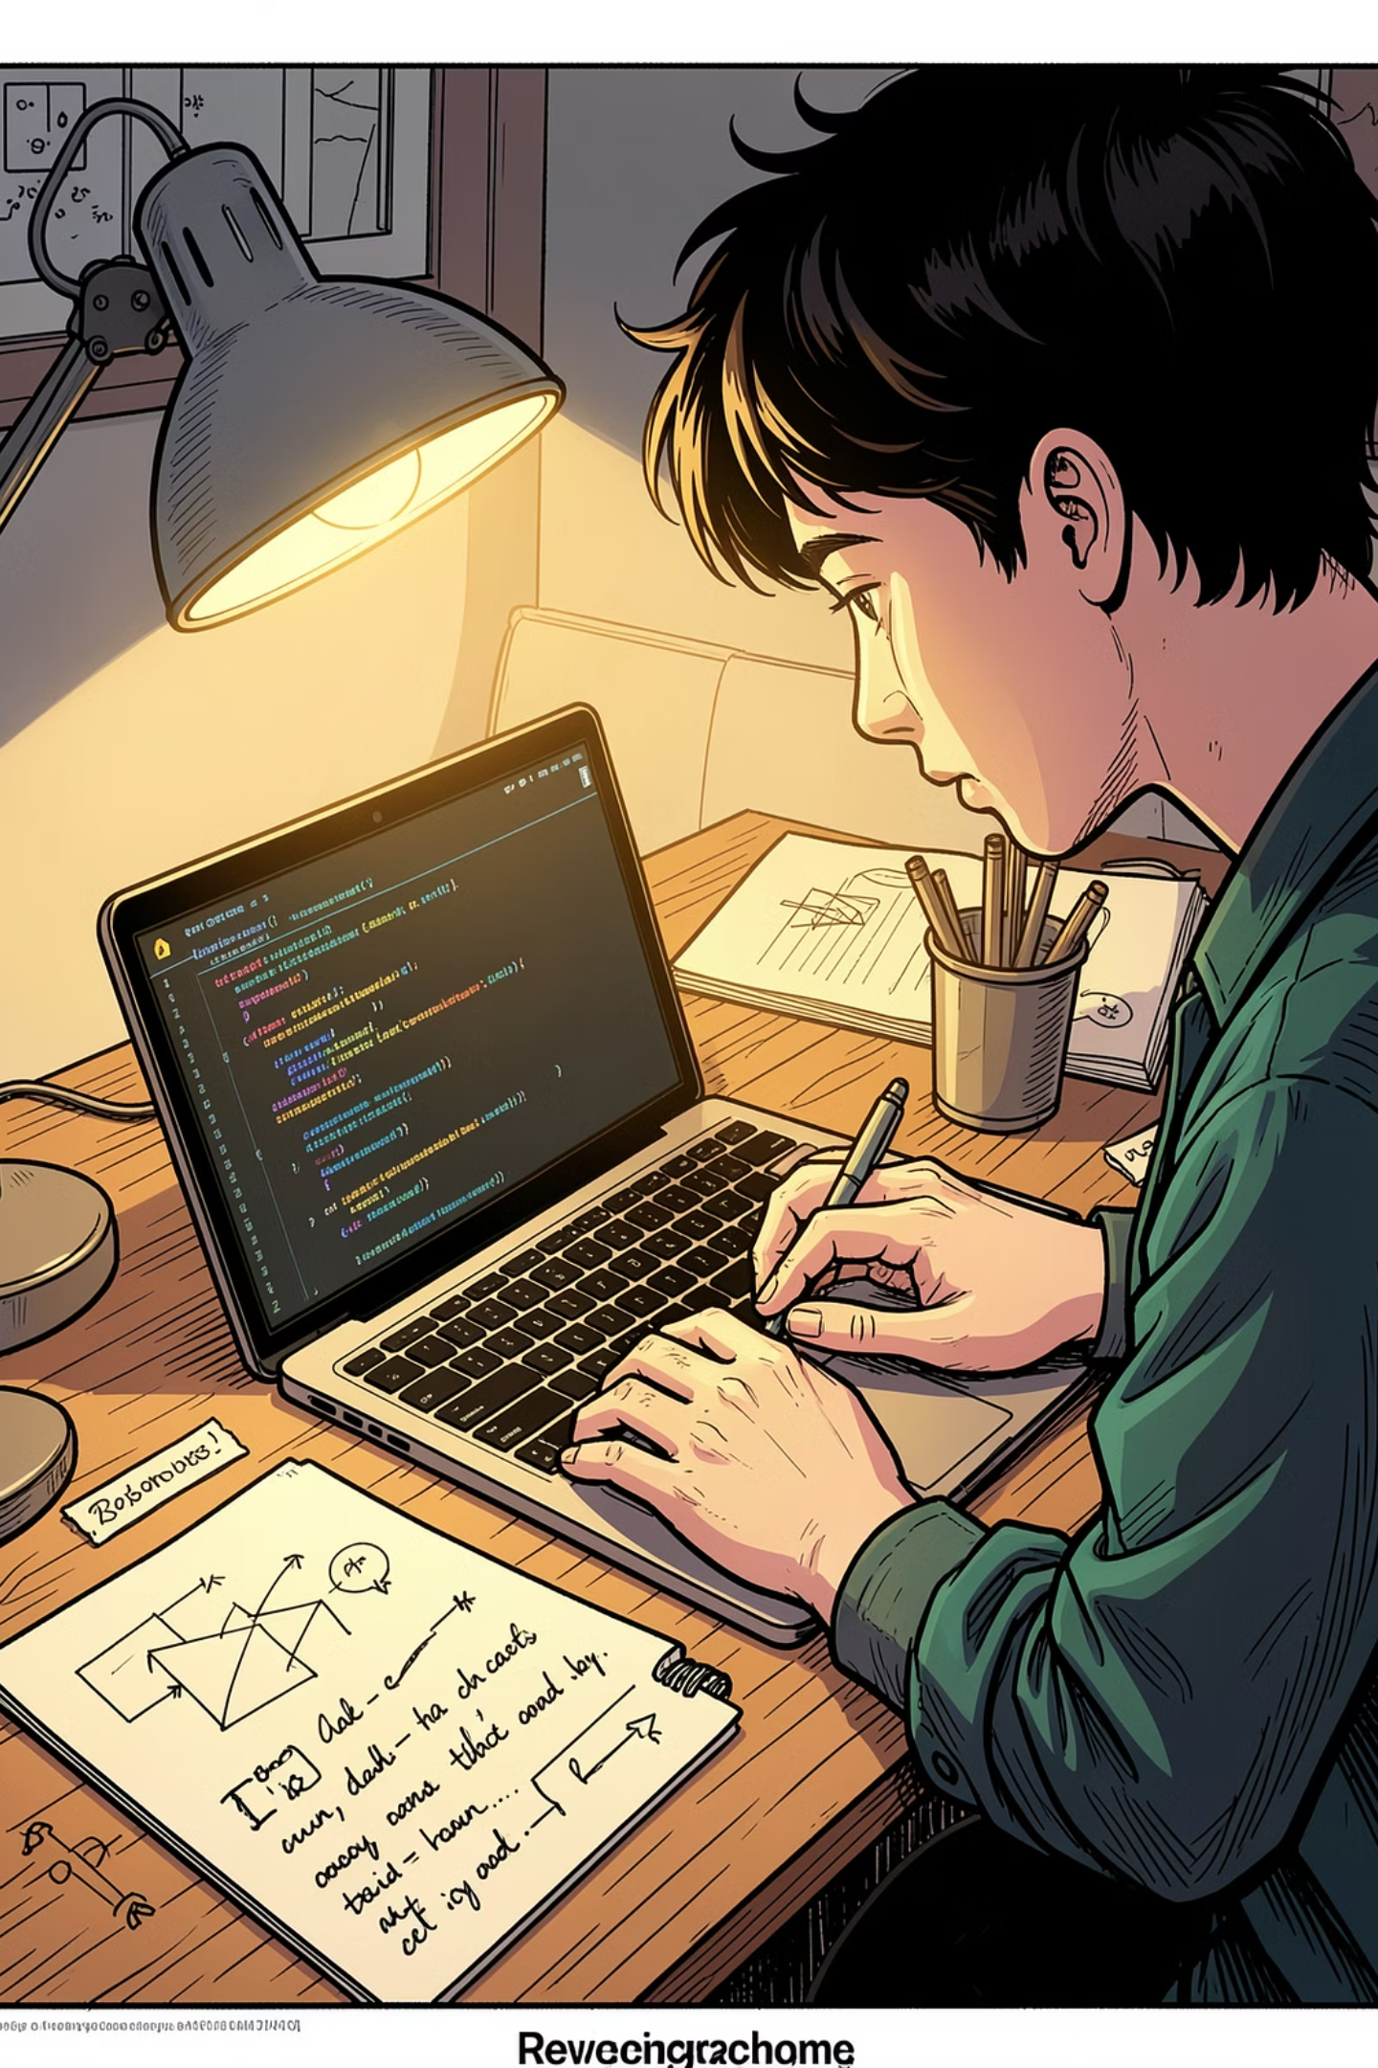
Notebook Overview: What You'll Learn
This notebook is a lab workbook — not a single project. Each practical builds a specific skill, from understanding how computers "see" images to deploying deep learning face detectors. The progression mirrors a real computer vision curriculum.
01
Foundations
Why neural networks, image matrices, flattening, and pixel values
02
CNN Architecture
Conv2D, MaxPooling, Flatten, Dense layers on CIFAR-10
03
Image Processing
Sharpening, contrast adjustment, histogram equalization, segmentation
04
Applied Vision
Face detection (Haar + Deep Learning), pose estimation, compression

Slide 3

PRACTICAL 1
Why Neural Networks Are Needed
The first practical uses the MNIST dataset to reveal a fundamental truth: humans see a digit, but a computer sees a 28×28 grid of numbers. This gap is exactly why neural networks exist.
What the Code Does
Key Insight
Loads 60,000 training + 10,000 test images
Each image is 28×28 pixels (digits 0–9)
Displays the first digit with plt.imshow()
Prints the raw matrix: every value = pixel brightness
Flattens 28×28 → 784-element 1D vector
A traditional neural network requires a 1D vector, not a 2D image. Flattening destroys spatial structure — which is exactly why CNNs were invented to preserve it.
Pixel Value Meaning: 0 = black, 255 = white. Every image is just a matrix of numbers.

Slide 4
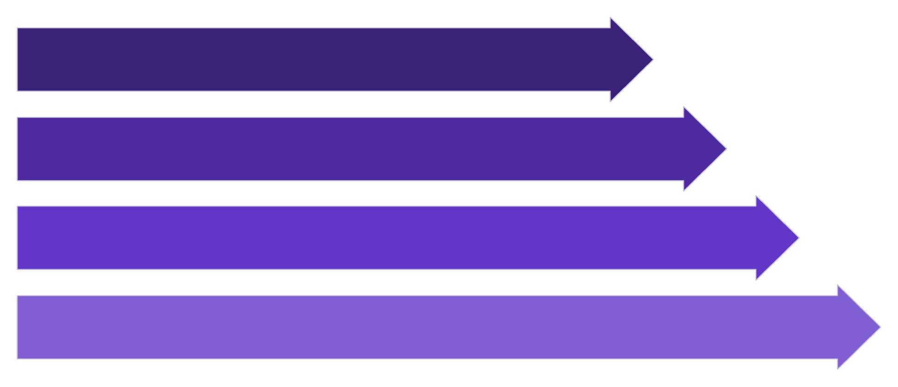
PRACTICAL 1 — CONTINUED
CNN Architecture: From Pixels to Predictions
After understanding raw image matrices, the notebook introduces a CNN trained on CIFAR-10 — a dataset of 60,000 color images across 10 object classes (airplane, car, bird, cat, deer, dog, frog, horse, ship, truck).
Conv2D
MaxPool
Flatten
Dense
Each layer plays a distinct role: Conv2D applies filters that detect edges, corners, and textures. MaxPooling downsamples (e.g., 4×4 → 2×2), reducing memory and speeding training. Flatten converts feature maps to a 1D vector. Dense is the final classification layer outputting a probability for each class.
Conv2D
MaxPooling
Learns edges, corners, textures via convolution filters
Reduces spatial dimensions — less memory, faster training
Flatten
Dense
Converts 2D feature maps into a 1D vector for Dense layers
Final layer — outputs probability distribution over classes

Slide 5

PRACTICAL 2 & 3
Image Sharpening & Contrast Adjustment
Sharpening Kernel
Contrast Stretching
Sharpening enhances edges by applying a 3×3 convolution kernel where the center pixel gets a strong positive weight and neighbors get negative weights. The result: edge intensity increases.
Contrast stretching expands the intensity range of an image to use the full 0–255 spectrum, making it more vivid.
min_val = np.min(img)
max_val = np.max(img)
stretched = (img - min_val) * (255 / (max_val - min_val))
kernel = np.array([
[ 0, -1, 0],
[-1, 5, -1],
[ 0, -1, 0]
])
Example: If pixel values range from 80–150, stretching maps them to 0–255. Darker pixels become darker, brighter ones brighter.
cv2.filter2D() convolves this kernel across the image. The teacher demonstrates: Original → Blur → Sharpen to compare effects visually.
Contrast stretching = linear scaling. Histogram equalization = redistributes pixel frequencies. This distinction is a favorite viva question.

Slide 6

PRACTICAL 4 & 5
Histogram Equalization & Image Segmentation
Histogram Equalization
Image Segmentation via Thresholding
When an image is too dark, its histogram shows pixels clustered at low intensity values. cv2.equalizeHist() redistributes pixel frequencies so the histogram becomes spread across the full range — dramatically improving contrast.
Key difference from contrast stretching: Stretching applies linear scaling; equalization redistributes based on cumulative distribution. Equalization often produces better results on poorly lit images.
Thresholding applies a simple rule to separate objects from background:
cv2.threshold(img, 127, 255, cv2.THRESH_BINARY)
# Pixel > 127 → 255 (white)
# Pixel ≤ 127 → 0 (black)
Example: Input pixels [50, 120, 180, 240] → Output [0, 0, 255, 255]. This binary mask isolates bright regions — a foundational technique in object detection and medical imaging.

Slide 7
PRACTICAL 6 & 7
CNN Assignment & Image Compression
CNN Assignment (Practical 6)
Image Compression (Practical 7)
Build a CNN that classifies at least 3 classes. Follow this pipeline:
JPEG compression reduces file size by sacrificing quality. The IMWRITE_JPEG_QUALITY parameter controls the trade-off:
Collect your dataset
Preprocess with OpenCV (resize, normalize)
Design CNN architecture (Conv2D → Pool → Dense)
Train and evaluate accuracy
Quality Value
Result
100
Best quality, largest file
80
Good quality
50
Medium quality
30
Heavy compression, small file
Lower quality = less storage, bandwidth, and transfer time. Always add if img is None: to prevent crashes on failed loads.

Slide 8

PRACTICAL 8
Face Detection with Haar Cascade
This is one of the most important sections. Haar Cascade is a pretrained classical detector that works on grayscale intensity patterns — no deep learning required.
Convert to Grayscale
detectMultiScale()
cv2.cvtColor(img, COLOR_BGR2GRAY) — Haar Cascade only needs intensity information, not color channels.
Scans the image at multiple scales to find faces of different sizes. Returns bounding box coordinates (x, y, w, h).
scaleFactor = 1.3
minNeighbors = 5
Each iteration shrinks the search window by ~23% (100% → 77% → 59%…). Enables detection of faces at varying distances.
Requires at least 5 nearby detections to confirm a face. Higher value = fewer false positives but may miss some faces.
Viva Tip: Know what scaleFactor and minNeighbors do — these are among the most commonly asked questions from this notebook.

Slide 9
PRACTICAL 9 & 10
Deep Learning Face Detection & MediaPipe Pose
SSD Deep Learning Face Detector
MediaPipe Pose Detection
Downloads deploy.prototxt and a .caffemodel file — an SSD (Single Shot Detector) network. Compared to Haar Cascade:
Installs mediapipe and opencv-python to detect body landmarks in real time:
Shoulders, elbows, wrists
Hips, knees, ankles
Feature
Haar Cascade
SSD Deep Learning
Applications: Yoga pose detection, exercise tracking, gesture recognition, and human pose estimation for sports analytics.
Era
Classical
Modern
Accuracy
Lower
Higher
Low light
Weak
Robust
Features
Handcrafted
Learned

Slide 10

EXAM PREP
Most Important Viva & Exam Questions
These questions are drawn directly from every practical in the notebook. Use them as a study checklist before your exam.
1
2
3
Neural Networks & CNNs
Image Processing
Compression & Detection
Why are neural networks needed for image recognition?
What is image flattening and why is it needed?
Difference between ANN and CNN?
Explain Conv2D and MaxPooling layers.
Explain the sharpening kernel and why 5 is in the center.
What is contrast stretching?
Difference between histogram equalization and contrast stretching.
What is thresholding and image segmentation?
Difference between lossy and lossless compression.
Explain Haar Cascade and detectMultiScale().
What do scaleFactor and minNeighbors control?
Haar Cascade vs. Deep Learning face detection?
What is MediaPipe and its applications?
Pro Tip: The histogram equalization vs. contrast stretching question and the Haar Cascade parameters (scaleFactor, minNeighbors) appear most frequently in viva exams.

