Slide 1
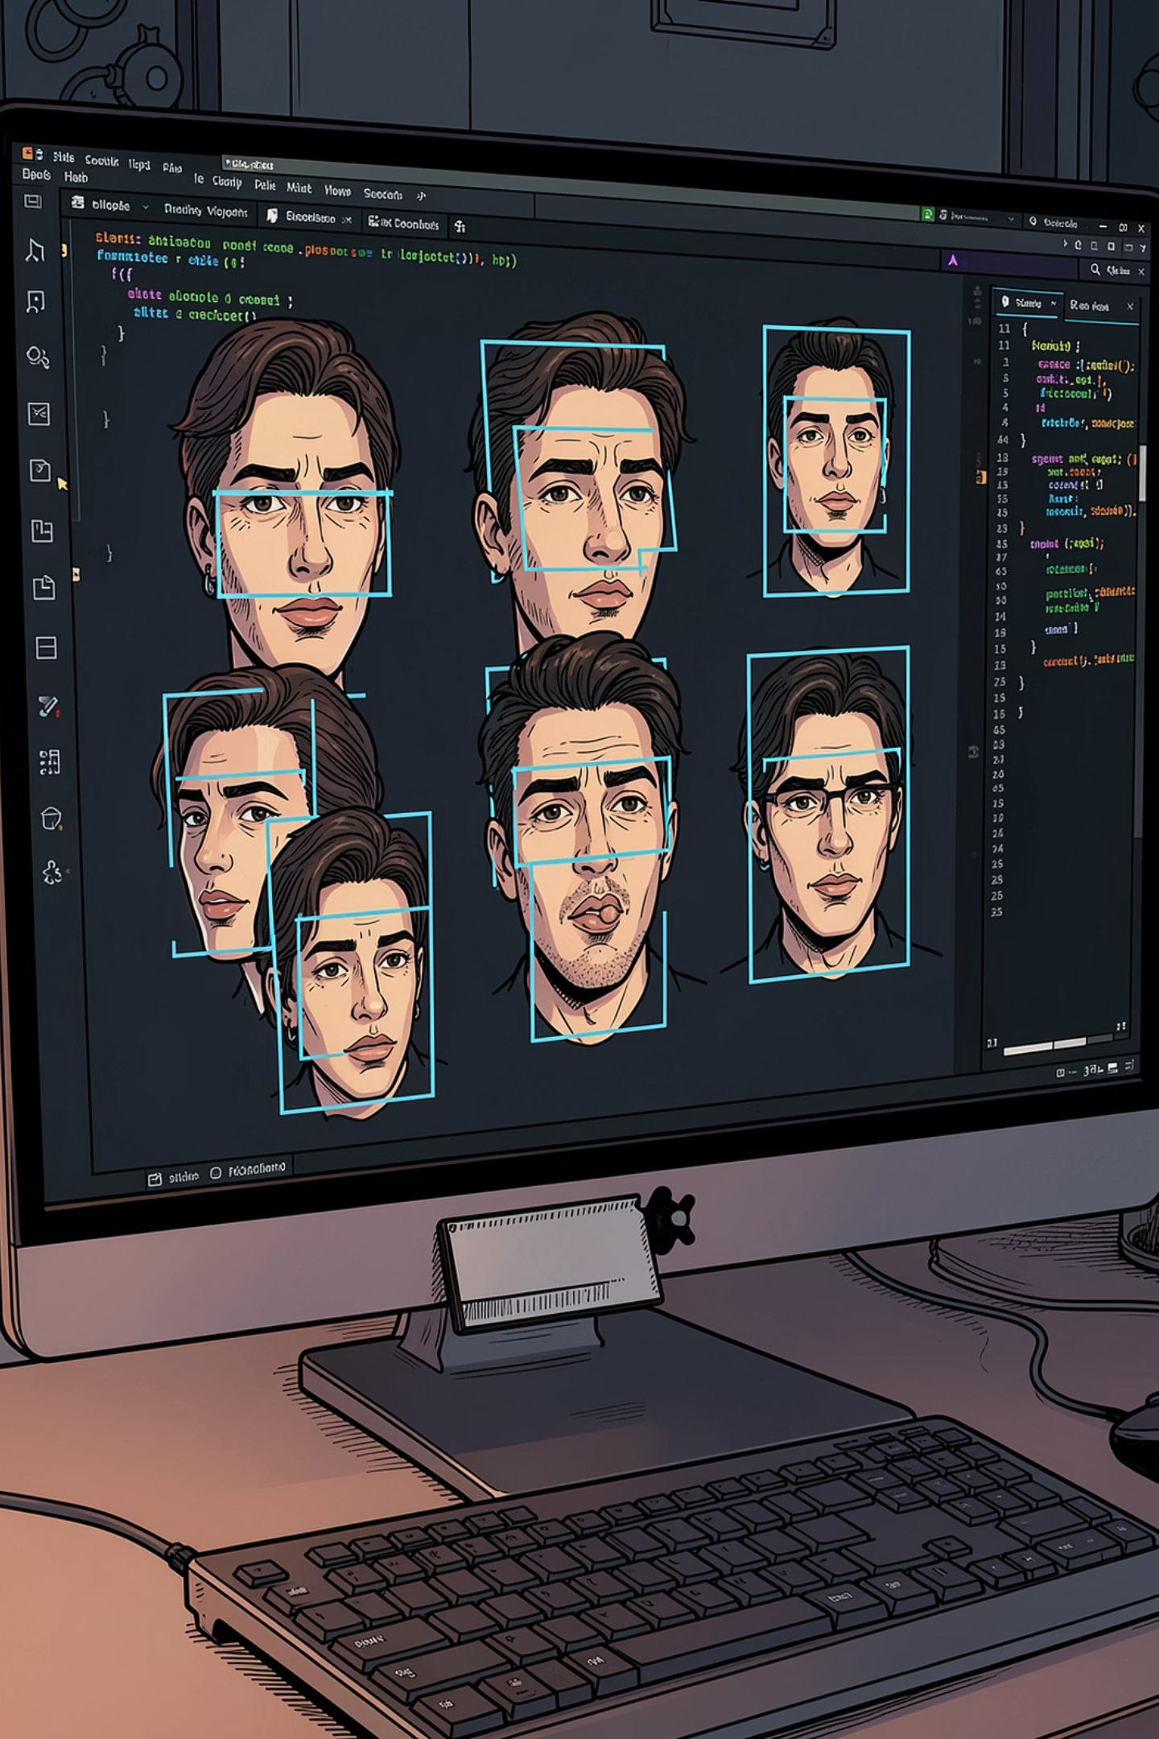
Haar Cascade Face Detection
A beginner-friendly guide to understanding and implementing face detection in Python using OpenCV.

Slide 2
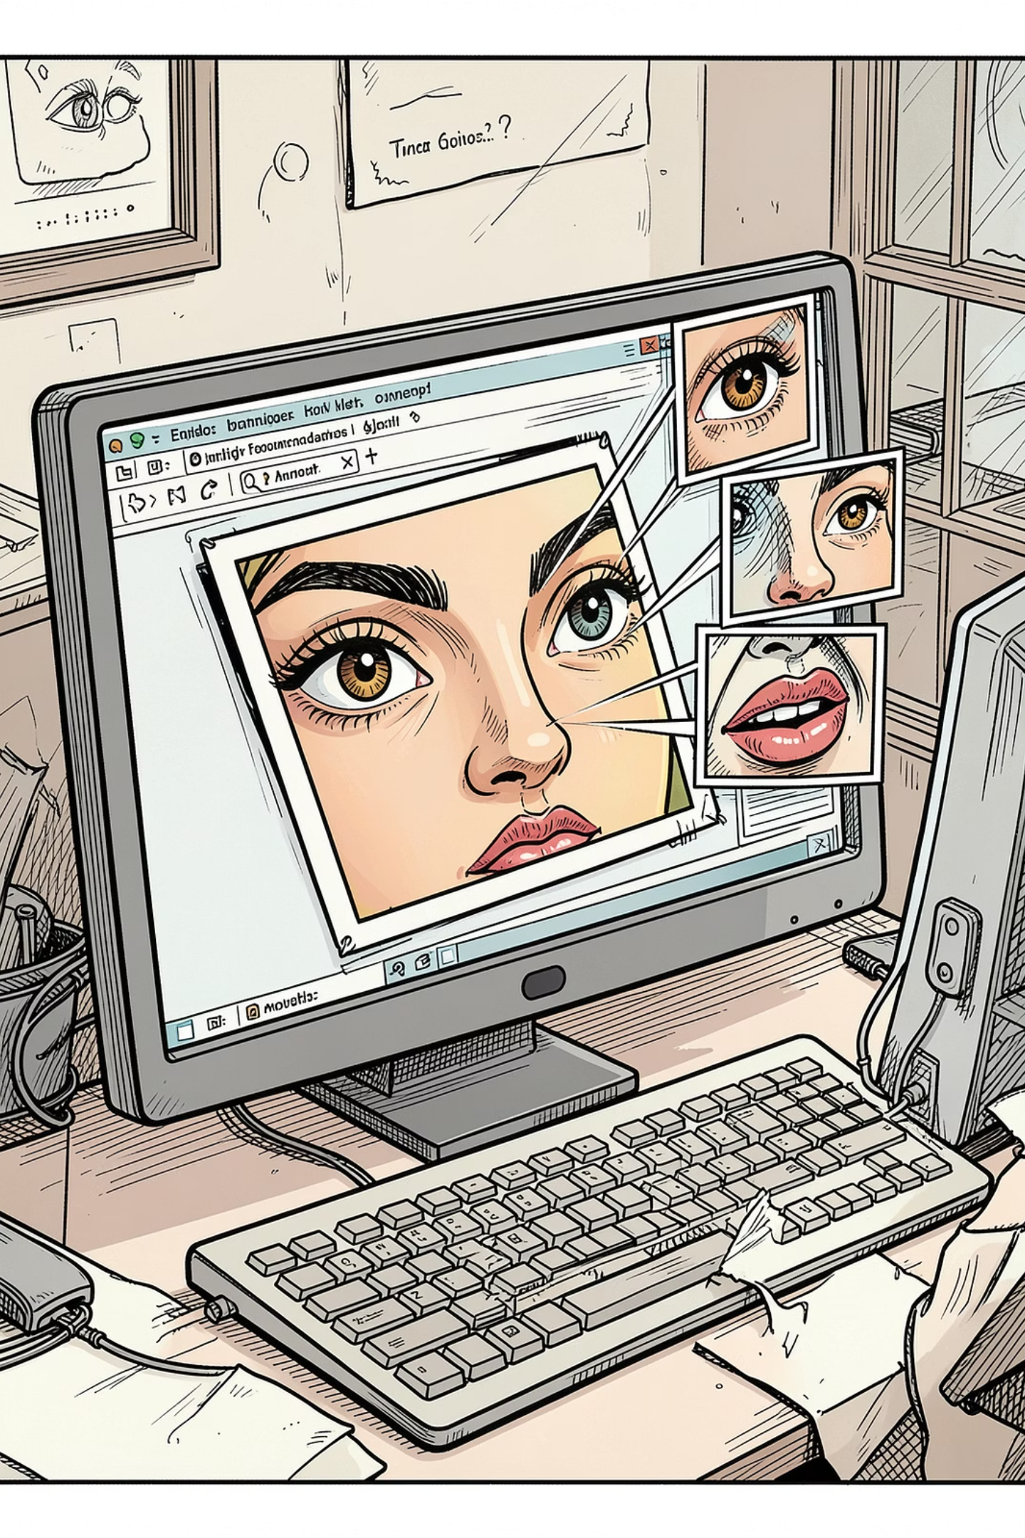
What Is Haar Cascade Face Detection?
Haar Cascade is a fast, classic method for detecting human faces in images or video. The computer slides small windows across the image, checking for face-like patterns — darker eyes, a brighter nose bridge, and characteristic face shapes.
How It Works
Trained Model
Scans the image with many small windows, looking for light/dark patterns that match a face.
Uses a pre-trained XML file that already "knows" what a typical face looks like.
Common Uses
Face, smile, and eye detection — especially in real-time webcam applications.

Slide 3
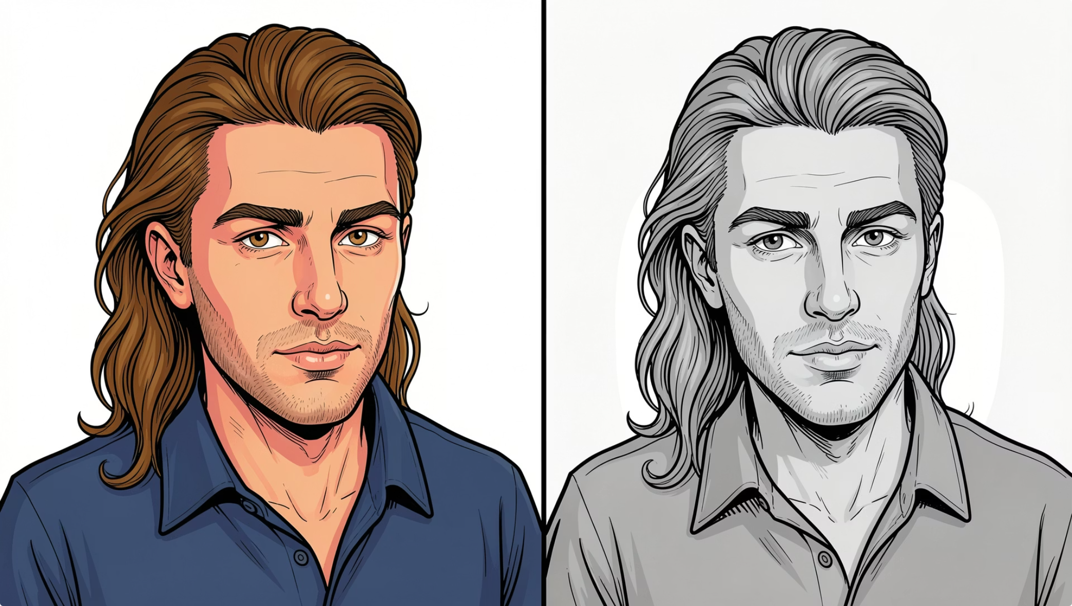

Why Convert to Grayscale First?
Haar Cascade doesn't need color — it only cares about light and dark patterns. Converting to grayscale makes detection faster and simpler.
gray = cv2.cvtColor(img, cv2.COLOR_BGR2GRAY)
Faster Processing
Better Performance
Color images have 3 channels (RGB). Grayscale has just 1 — less data means faster detection.
Face detection relies on intensity patterns, not color. Grayscale removes unnecessary complexity.

Slide 4
Face Detection in Python
Here's the complete code to detect faces in a static image using OpenCV and Haar Cascade.
import cv2
# Load the trained face detector
face_cascade = cv2.CascadeClassifier(
cv2.data.haarcascades + 'haarcascade_frontalface_default.xml'
)
# Read and prepare the image
img = cv2.imread('face.jpg')
gray = cv2.cvtColor(img, cv2.COLOR_BGR2GRAY)
# Detect faces
faces = face_cascade.detectMultiScale(gray, 1.3, 5)
# Draw rectangles around detected faces
for (x, y, w, h) in faces:
cv2.rectangle(img, (x, y), (x+w, y+h), (255, 0, 0), 2)
# Display the result
cv2.imshow('Face Detection', img)
cv2.waitKey(0)
cv2.destroyAllWindows()

Slide 5
Breaking Down the Code
01
02
03
CascadeClassifier()
imread()
cvtColor()
Loads the pre-trained XML file that knows how to recognize faces.
Reads the image file from disk into memory.
Converts the image to grayscale for faster, cleaner detection.
04
05
detectMultiScale()
rectangle() + imshow()
Scans the image and returns the coordinates of any faces found.
Draws bounding boxes around each face and displays the result window.

Slide 6

Understanding detectMultiScale()
This function does the actual face detection. It takes three key arguments:
1
gray
The grayscale image to scan for faces.
2
scaleFactor=1.3
Shrinks the image by 30% each pass, checking multiple sizes to catch faces near and far.
3
minNeighbors=5
Requires 5 nearby detections to agree before confirming a face — reduces false positives.

Slide 7
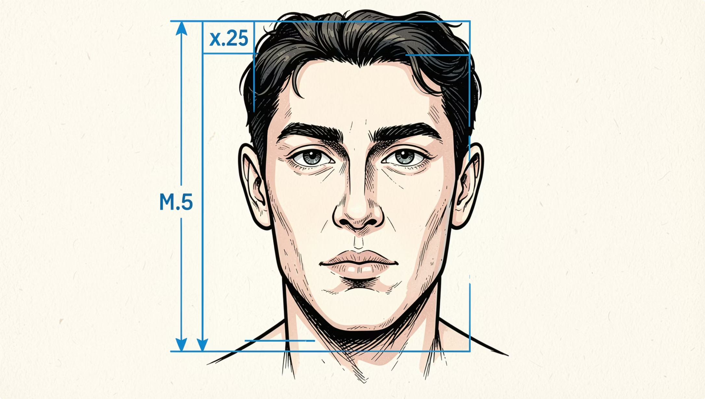
What Does (x, y, w, h) Mean?
When faces are detected, the function returns a list of rectangles — one per face. Each rectangle is defined by four values:
The for loop runs once per detected face, drawing a rectangle around each one. If 3 faces are found, the loop runs 3 times.
x, y
w, h
Top-left corner of the face box
Width and height of the face box

Slide 8

Real-Time Webcam Face Detection
The same logic works on a live webcam feed — just replace imread() with VideoCapture(0) and run detection inside a loop.
import cv2
face_cascade = cv2.CascadeClassifier(
cv2.data.haarcascades + 'haarcascade_frontalface_default.xml'
)
cap = cv2.VideoCapture(0)
while True:
ret, frame = cap.read()
gray = cv2.cvtColor(frame, cv2.COLOR_BGR2GRAY)
faces = face_cascade.detectMultiScale(gray, 1.3, 5)
for (x, y, w, h) in faces:
cv2.rectangle(frame, (x, y), (x+w, y+h), (255, 0, 0), 2)
cv2.imshow('Webcam Face Detection', frame)
if cv2.waitKey(1) & 0xFF == ord('q'):
break
cap.release()
cv2.destroyAllWindows()
Press q to close the webcam window. VideoCapture(0) opens your default camera.

Slide 9
Limitations of Haar Cascade
Haar Cascade is simple and fast — but it has real-world limitations.
Sensitive to Lighting
Frontal Faces Only
Struggles with Occlusion
Poor or uneven lighting significantly reduces accuracy.
Works best on straight-on faces. Side profiles often go undetected.
Masks, glasses, or hands covering the face can break detection.
False Detections
Outdated Technique
Can mistake non-face objects for faces, especially at low minNeighbors values.
Modern methods like CNN, MTCNN, and YOLO are far more accurate.

Slide 10
Key Takeaways
1
Haar Cascade is a classic, fast face detector
It uses a trained XML file and simple light/dark patterns to find faces.
2
Always convert to grayscale first
Grayscale reduces data from 3 channels to 1, speeding up detection.
3
detectMultiScale() handles face sizing
scaleFactor checks multiple sizes; minNeighbors filters false positives.
4
(x, y, w, h) defines each face rectangle
The loop draws a bounding box around every detected face.
5
Know its limits
Lighting, angles, and occlusion challenge Haar Cascade — consider modern AI models for production.

