Slide 1
SLR and LR(1) grammars

Slide 2
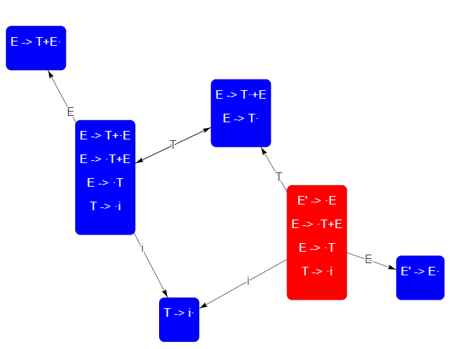
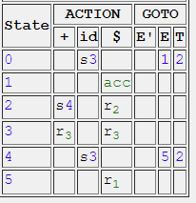


Exercise - 1
Given the following grammar
E → T + E | T
T → i
Is this grammar LR(0),SLR
Ans: Not LR(0), but SLR, and SLR parse table is given below:

Slide 3
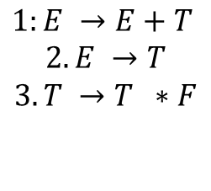

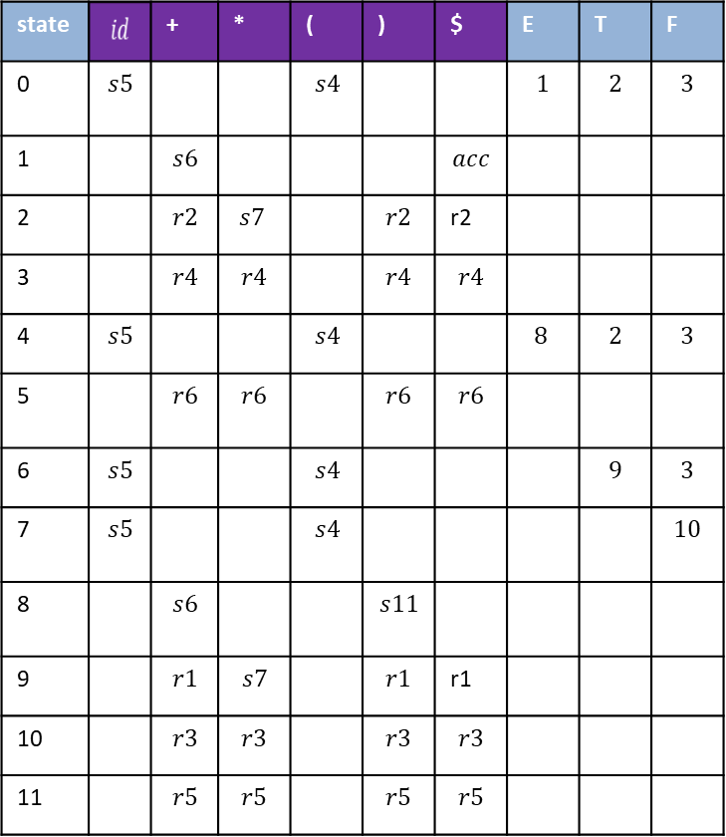

SLR table
ACTION
GOTO
Show that string id + id * id is accepted by using SLR table.
state |  | + | * | ( | ) | $ | E | T | F
0
1
2 |  |  |  |  |  | r2
3
4
5
6
7
8
9 |  |  |  |  |  | r1
10
11

Slide 4
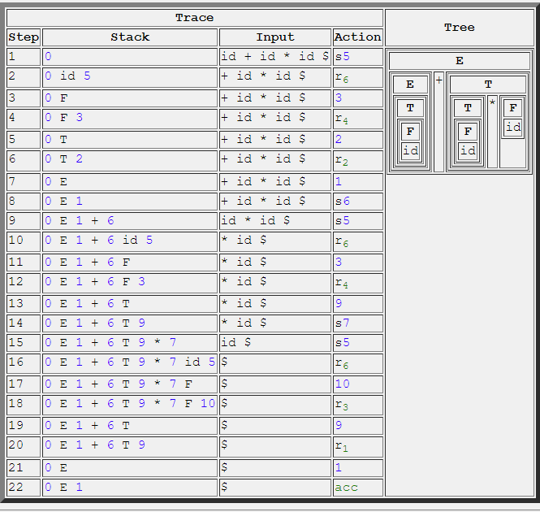
Exercise - 2

Slide 5
Example 3:
Construct CLR(1) automaton for the grammar:
S → AaAb S → BbBa A → ε B → ε
S → AaAb I₀: S’ → .S ,$ I₁: S’ → S. ,$
S → BbBa S → .AaAb ,$
A → ε S → .BbBa ,$ I₂: S → A.aAb ,$
B → ε A → . ,a
B → . ,b I₃: S → B.bBa ,$
I₄: S → Aa.Ab ,$ I₆: S → AaA.b ,$ I₈: S → AaAb. ,$
A → . ,b
I₅: S → Bb.Ba ,$ I₇: S → BbB.a ,$ I₉: S → BbBa. ,$
B → . ,a

Slide 6
Example 4:
Construct CLR(1) automaton for the grammar:
S’ → S
1) S → L=R
2) S → R
3) L→ *R
4) L → id
5) R → L

Slide 7
Example 4: solution
S’ → S
1) S → L=R
2) S → R
3) L→ *R
4) L → id
5) R → L
I₀:S’ → .S,$
S → .L=R,$
S → .R,$
L → .*R,$/=
L → .id,$/=
R → .L,$
I₁:S’ → S.,$
I₄:L → *.R,$/=
R → .L,$/=
L→ .*R,$/=
L → .id,$/=
R
to I₇
S
*
L
I₂:S → L.=R,$
R → L.,$
to I₆
to I₈
L
*
to I₄
id
R
to I₅
I₃:S → R.,$
id
I₅:L → id.,$/=
I₉:S → L=R.,$
I₁₀:R → L.,$
I₁₁:L → *.R,$
R → .L,$
L→ .*R,$
L → .id,$
I₁₂:L → id.,$
R
I₁₃:L → *R.,$
I₆:S → L=.R,$
R → .L,$
L → .*R,$
L → .id,$
to I₉
L
to I₁₀
*
I₄ and I₁₁
I₅ and I₁₂
I₇ and I₁₃
I₈ and I₁₀
to I₁₁
R
to I₁₃
id
L
to I₁₂
to I₁₀
I₇:L → *R.,$/=
*
to I₁₁
id
I₈: R → L.,$/=
to I₁₂
CS416 Compiler Design
7

