Slide 1
TERMINAL BASED TEXT EDITOR

Slide 2
DSA II PROJECT
MEMBERS:
112103111 PRATIMA PORE
112103117 RUJUTA BUDKE
112103119 SAHIL DESHPANDE

Slide 3
OBJECTIVES
To create a text editor with following features:
  Having predictive text input
  It will auto complete the user input
  Also have features of new line, delete (or backspace), insert(give input by typing), etc.
  Along with shortcuts of search, quit and save.
To understand implement the Compressed Tries.
To understand and implement makefile.

Slide 4
BLOCK DIAGRAM
User opens the text editor
If he/she gives file name then open the existing file
If not, then open a new file
Based on user input, provide appropriate word to auto complete the user’s words
Similarly, close the file, save it or search a particular word on input by user.

Slide 5
DATA STRUCTURES USED
Compressed Tries
Character Buffer
Termios From Termios.h

Slide 6
Compressed Tries
Compressed Tries are an optimization of regular tries to reduce memory consumption.
In compressed tries, nodes with only a single child are compressed or merged together, resulting in a more compact representation.
This compression eliminates redundant nodes and reduces the memory overhead associated with storing individual characters.

Slide 7
Character Buffer
A character buffer, also known as a character array or string buffer, is a data structure used to store a sequence of characters in computer programming. It is typically implemented as an array of characters in memory.
The purpose of a character buffer is to hold and manipulate textual data. It allows for efficient operations on strings, such as appending, inserting, deleting, or modifying characters.
Buffers are commonly used in programming languages that do not have built-in string manipulation functions, or in situations where mutable strings are required.

Slide 8
Struct Termios from termios.h
The termios.h header file is a C library that provides functions and data structures for terminal I/O (Input/Output) operations. It is commonly used in Unix-like operating systems, including Linux.
It provides an interface to configure and manage the terminal device, enabling features like raw input/output, non-blocking I/O, and terminal control.
Struct termios represents the terminal attributes. It contains various fields that define the terminal settings, such as input/output modes, control characters, and flags.

Slide 9
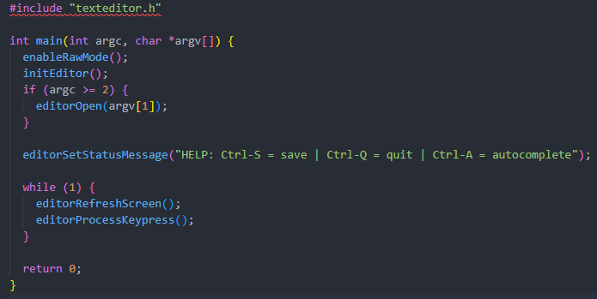
SNAPSHOTS OF CODE
Main Function

Slide 10
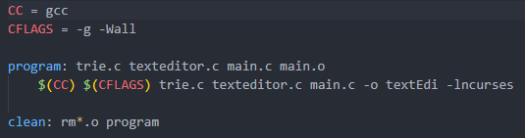
Make File

Slide 11
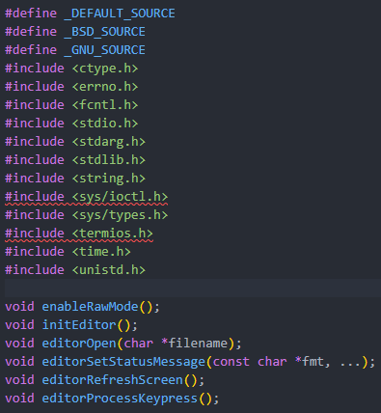
TextEditor .h file

Slide 12
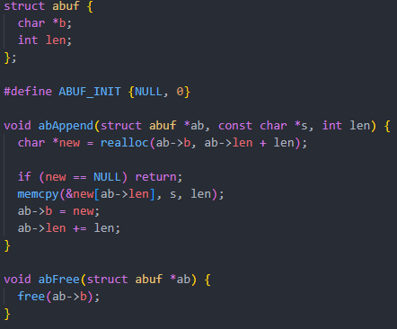
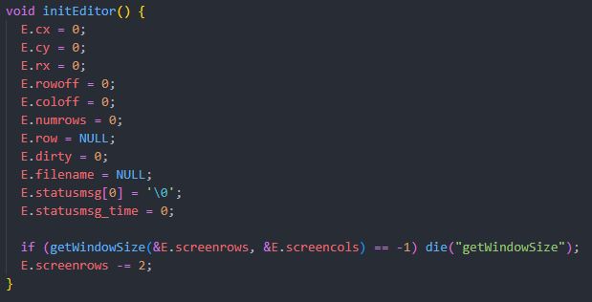
Some Functions From TextEditor .c file

Slide 13
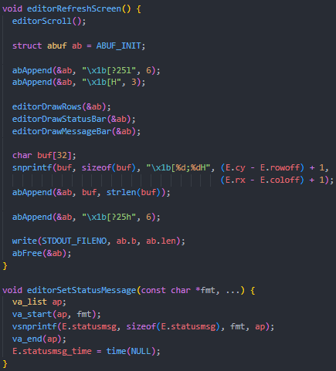
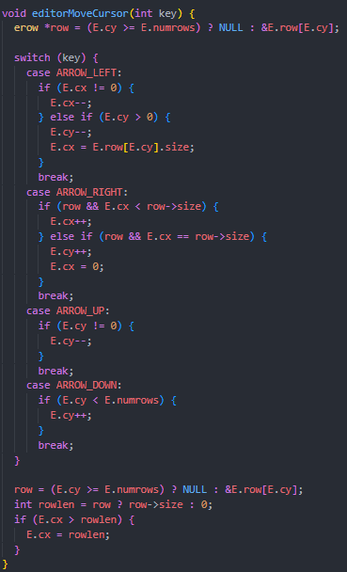

Slide 14
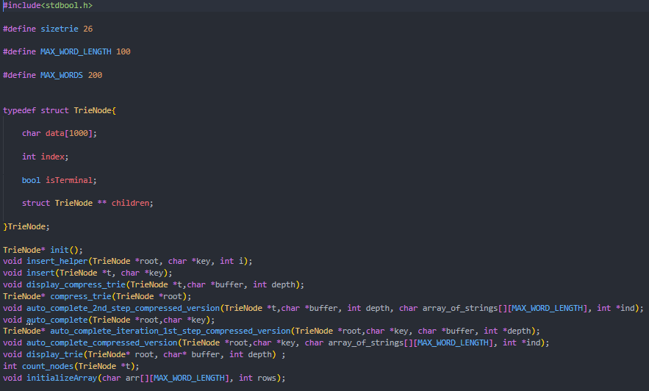
Trie .h file

Slide 15
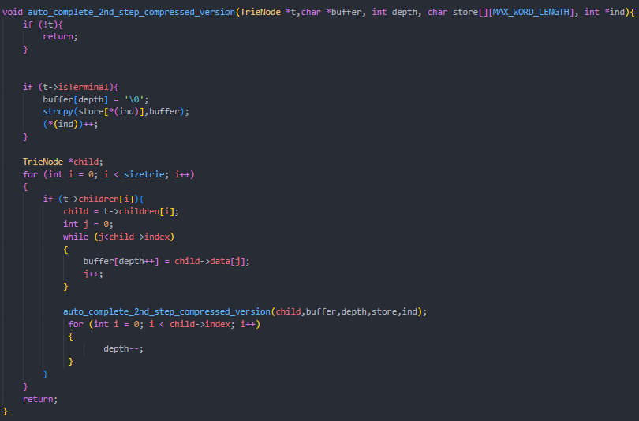
Some Functions From Trie .c file

Slide 16
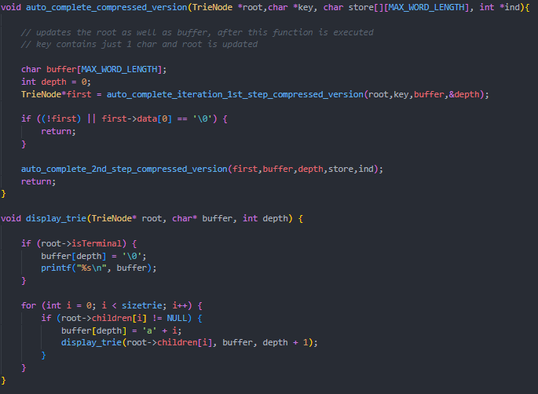

Slide 17
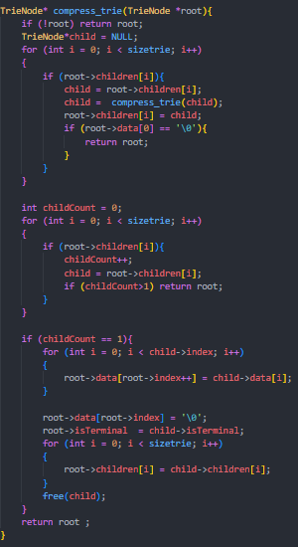

Slide 18
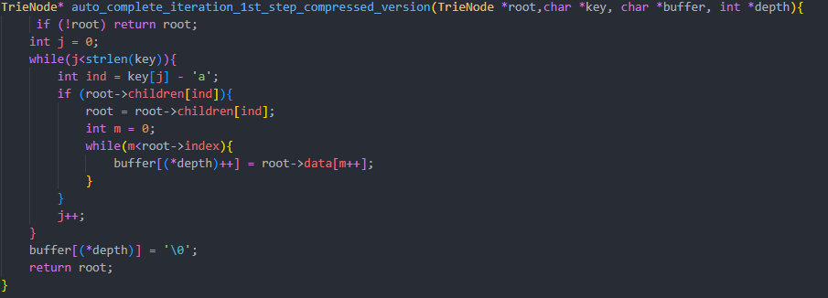

Slide 19
SCOPE
The text editor will have following features:
  Predict and auto complete the text input from the user
  Better context based suggestion coding files.
Can become a very handy tool for text input

Slide 20
THANK
YOU!!

