Slide 1


Digital Marketing Agency
Welcome to our digital marketing agency! We specialize in helping businesses grow their online presence through innovative strategies and creative campaigns.
S
by Sahil Salunkhe

Slide 2
About Our Agency
Mission and Values
Services We Offer
Our mission is to empower businesses by providing tailored, result-driven digital marketing solutions. We value transparency, collaboration, and continuous learning.
We offer a wide range of digital marketing services including SEO, PPC advertising, social media marketing, content creation, and web design.
Our Approach to Digital Marketing
Why Choose Our Agency
We combine data-driven insights, market research, and creative strategies to develop custom-made campaigns that deliver tangible results.
Our team of experts is dedicated to achieving your business goals, providing exceptional customer service, and staying up-to-date with the latest industry trends.

Slide 3
Success Stories
Case Studies of Our Past Clients
Results Achieved for Those Clients
Discover how our digital marketing strategies have helped businesses across various industries achieve their goals and exceed their expectations.
See the measurable impact we've had on our clients' brand awareness, website traffic, lead generation, and overall business growth.

Slide 4

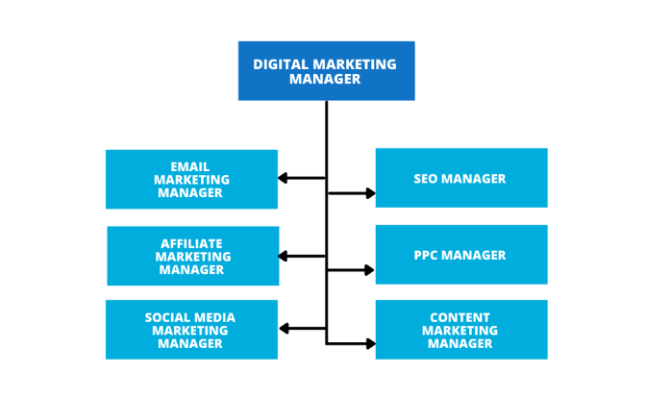
Our Team
Expertise and Experience
Roles and Responsibilities
Meet our team of skilled professionals with diverse backgrounds in marketing, design, analytics, and technology.
Learn about the specific roles within our team and how each member contributes to our clients' success.

Slide 5
Client Testimonials
Feedback from Our Satisfied Clients
Listen to what our clients have to say about their experience working with our agency and the positive impact it has had on their businesses.

Slide 6
Contact Us
1
How to Get in Touch
Reach out to our team through our website, email, or phone to discuss your digital marketing needs and explore how we can help you.
Request a Consultation
2
Schedule a consultation session with our experts to gain valuable insights and develop a customized strategy for your business.

Slide 7

FAQs
1
Common Questions About Digital Marketing
2
Answers and Explanations
Get in-depth explanations and insights into the complex world of digital marketing, provided by our knowledgeable experts.
Discover the answers to frequently asked questions about digital marketing, from budgeting and ROI to content strategy and social media advertising.

