Slide 1
FitLife ProActive – Gym Portal
Submitted By:
Group No. 112
Sahil Jaiswal(233197)
Nikhil Rajput(233174)

Slide 2
INTRODUCTION
The Gym Portal and Management System for Gym web application is intended to provide complete solutions for owners as well as customers through a single get way using the internet.
It allows owners to manage their gym, customer to view the packages provided by gym and booking their session online as per requirement.
The administrator module will able to manage branch activity, gym activity, trainer activity, facility activity.

Slide 3
Scope of Project
TECHNOLOGY USED
Spring Boot
ReactJs
MySql
FEATURES:
We can Add any numbers of users and can update or delete their information.
This system allows admin to manage users and full application, manage gym shifts and the members to search gyms, apply for membership and view workouts while it allows trainer to create schedule, diet chart and add workout plans.

Slide 4
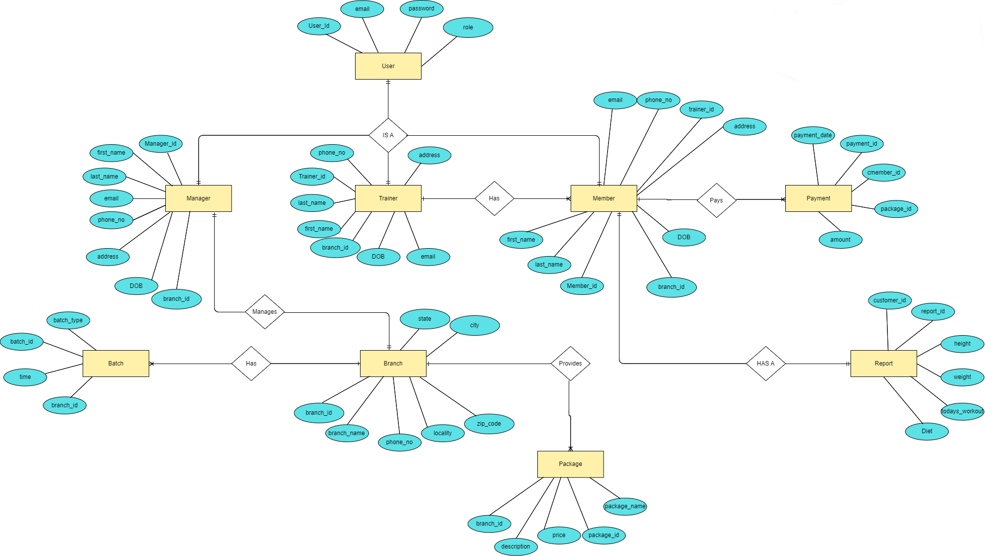
E-R Diagram

Slide 5
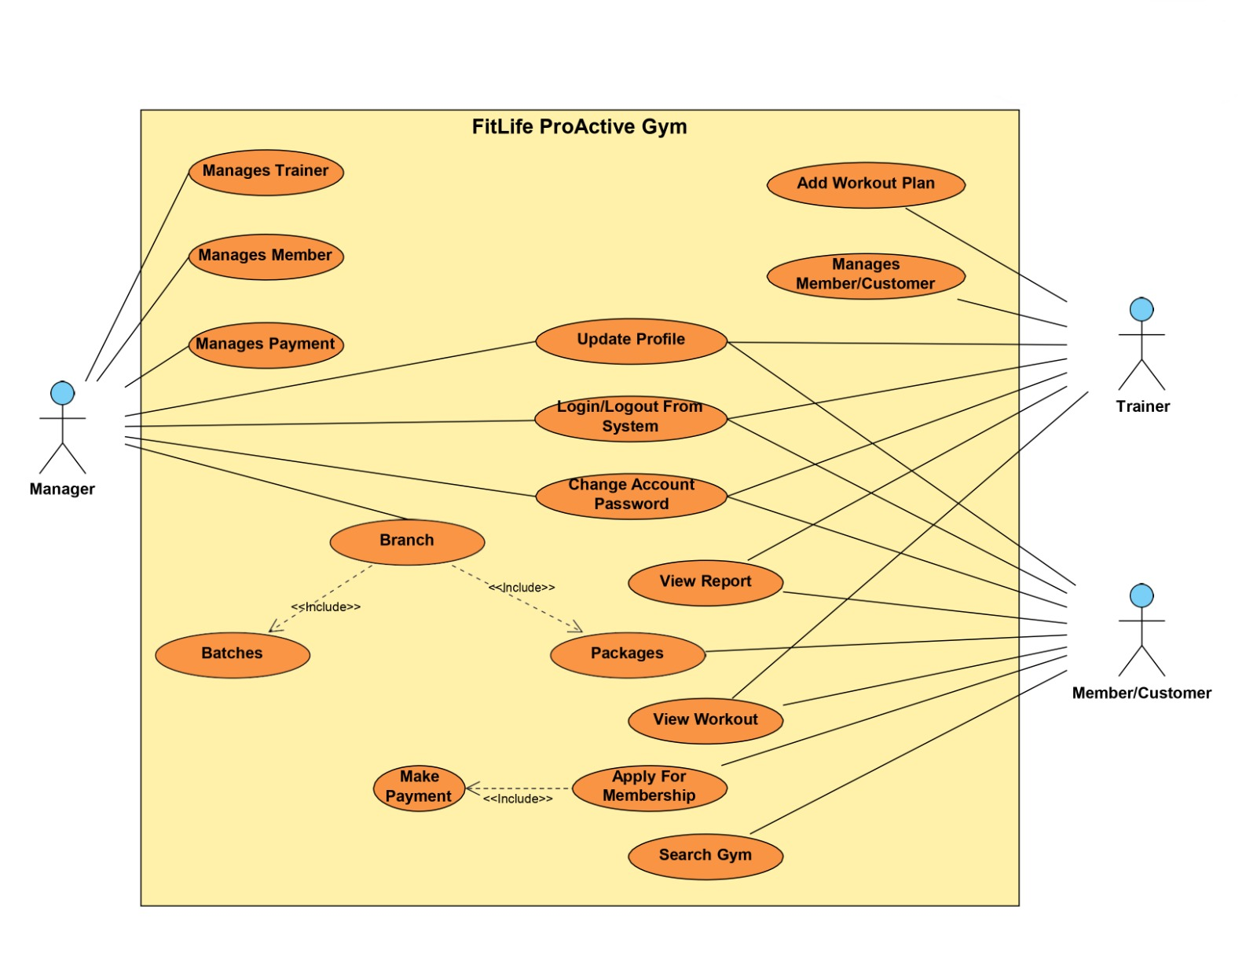
Use Case Diagram

Slide 6
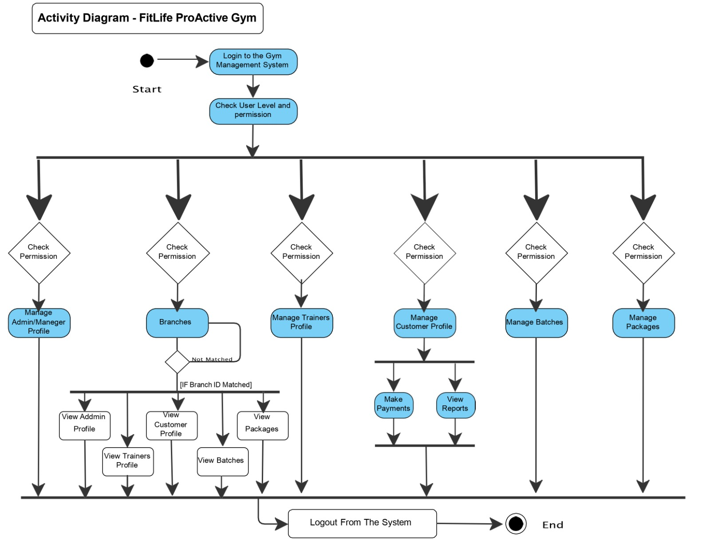
Activity Diagram-

Slide 7
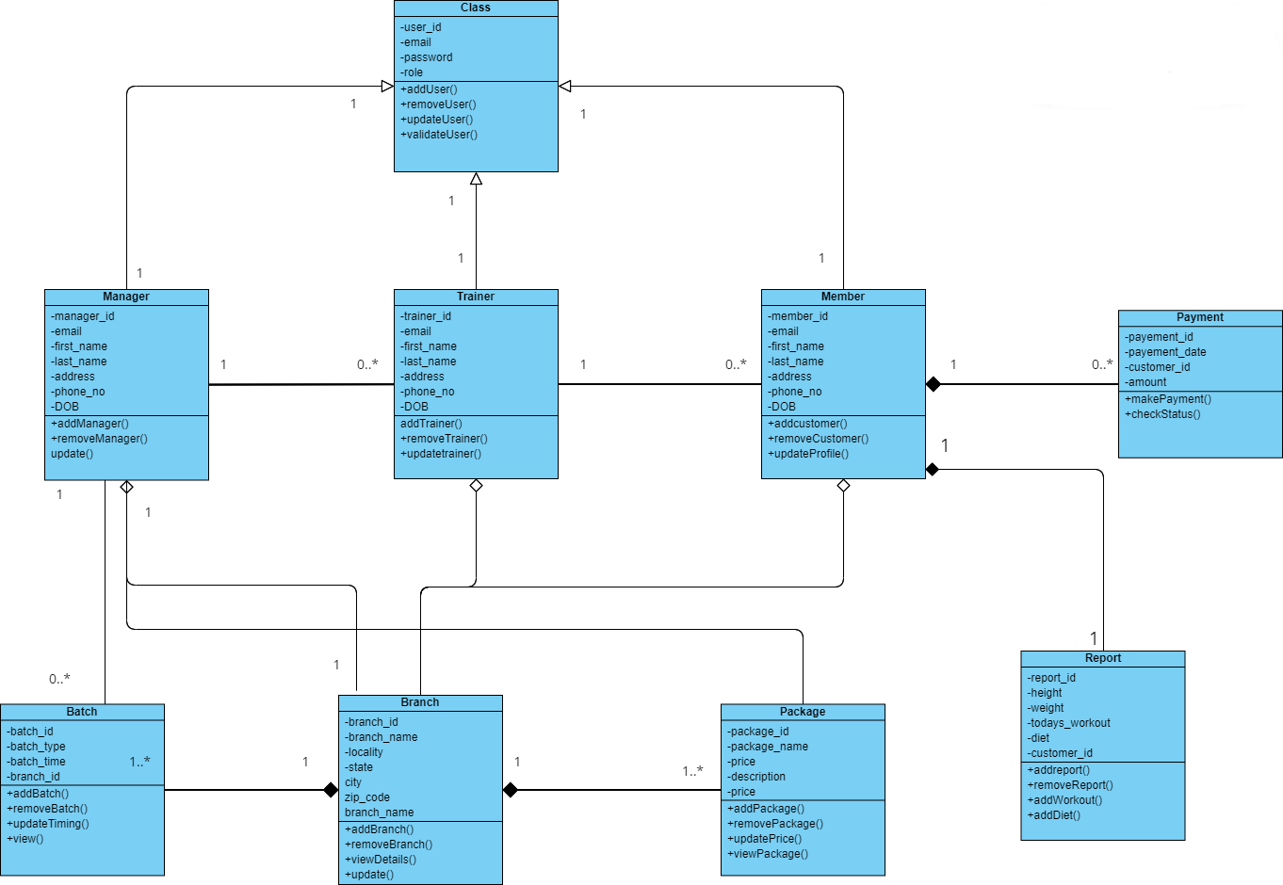
Class Diagram -

Slide 8
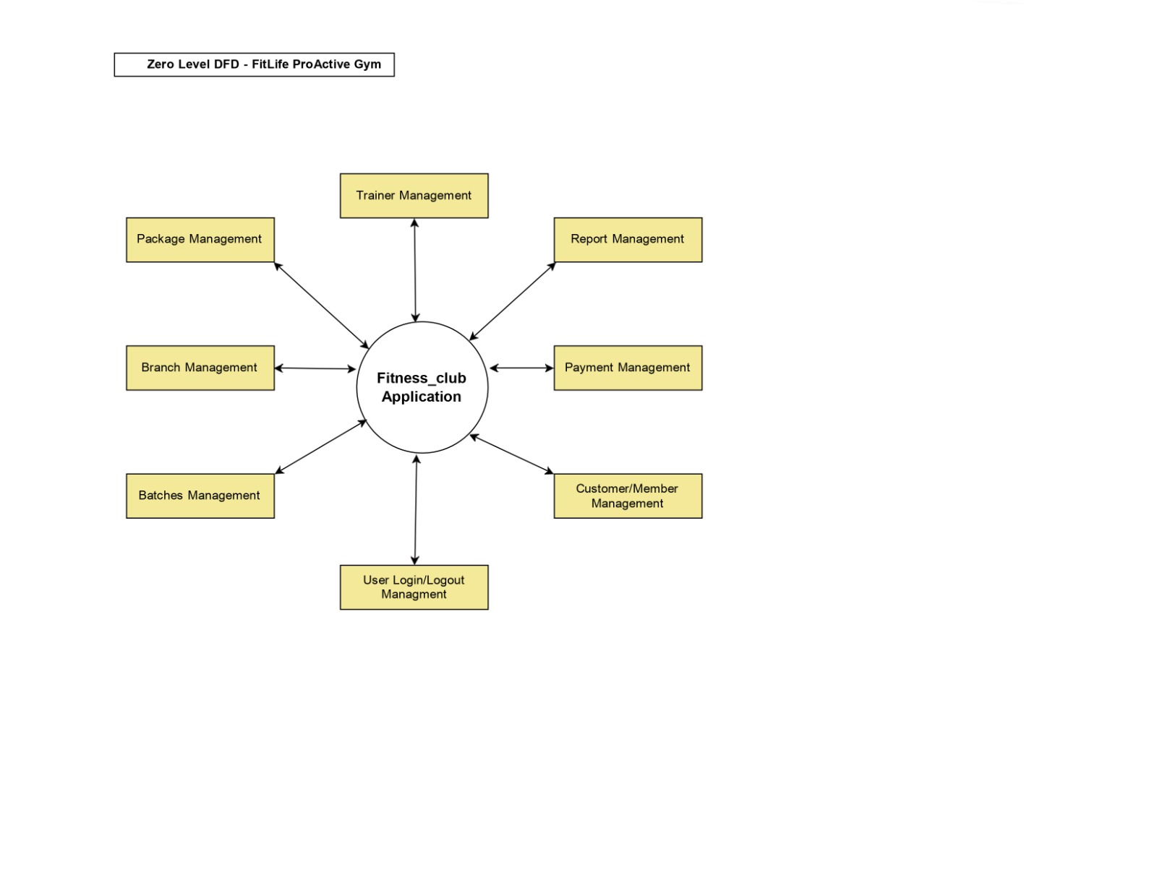
Zero Level DFD – Fitness_club

Slide 9
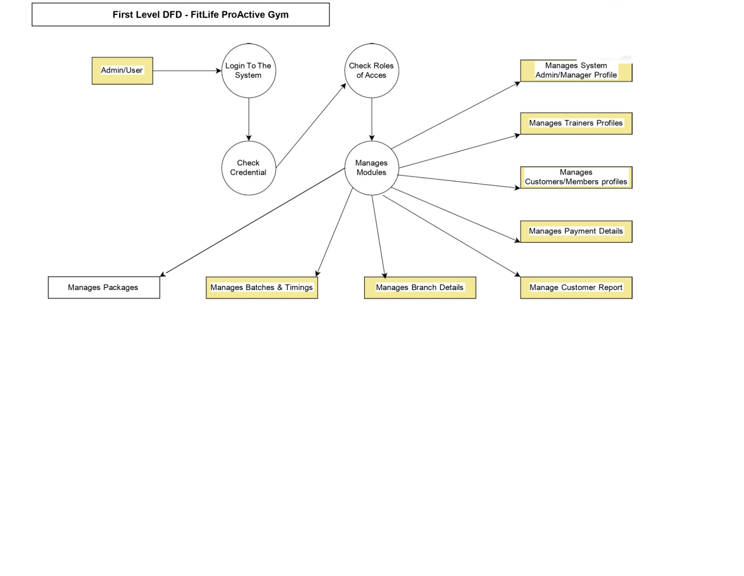
First Level Diagram – Fitness_club

Slide 10
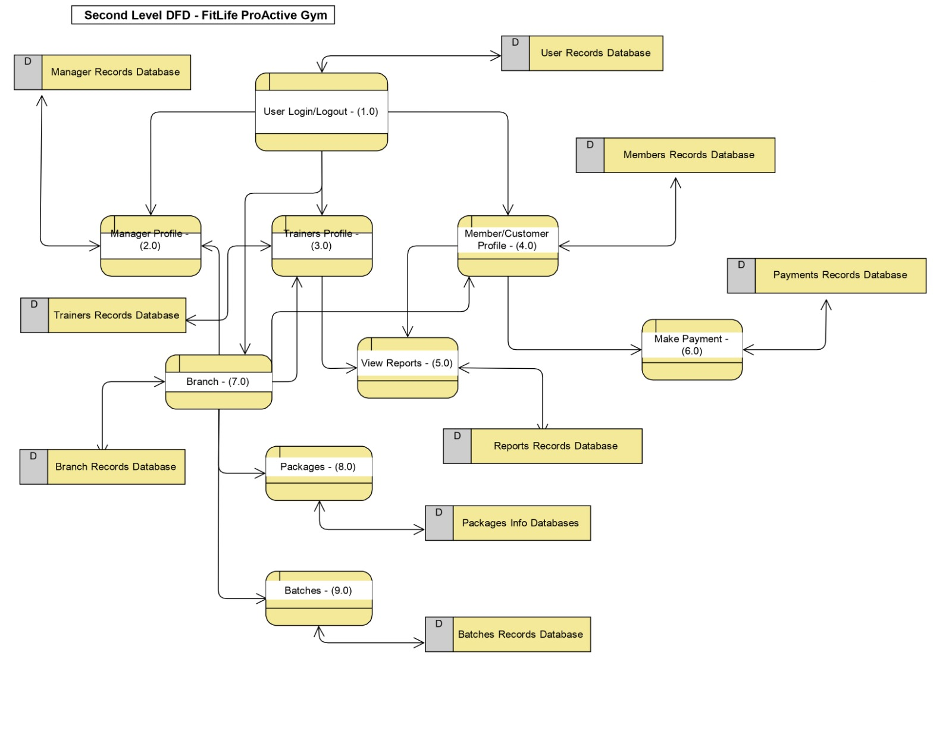
Second Level DFD – Fitness_club

Slide 11
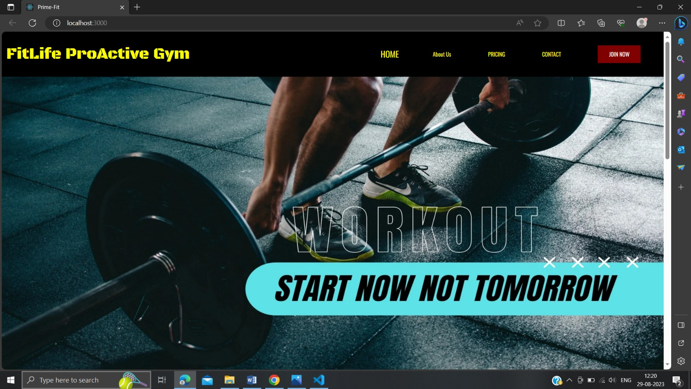

Slide 12


Slide 13
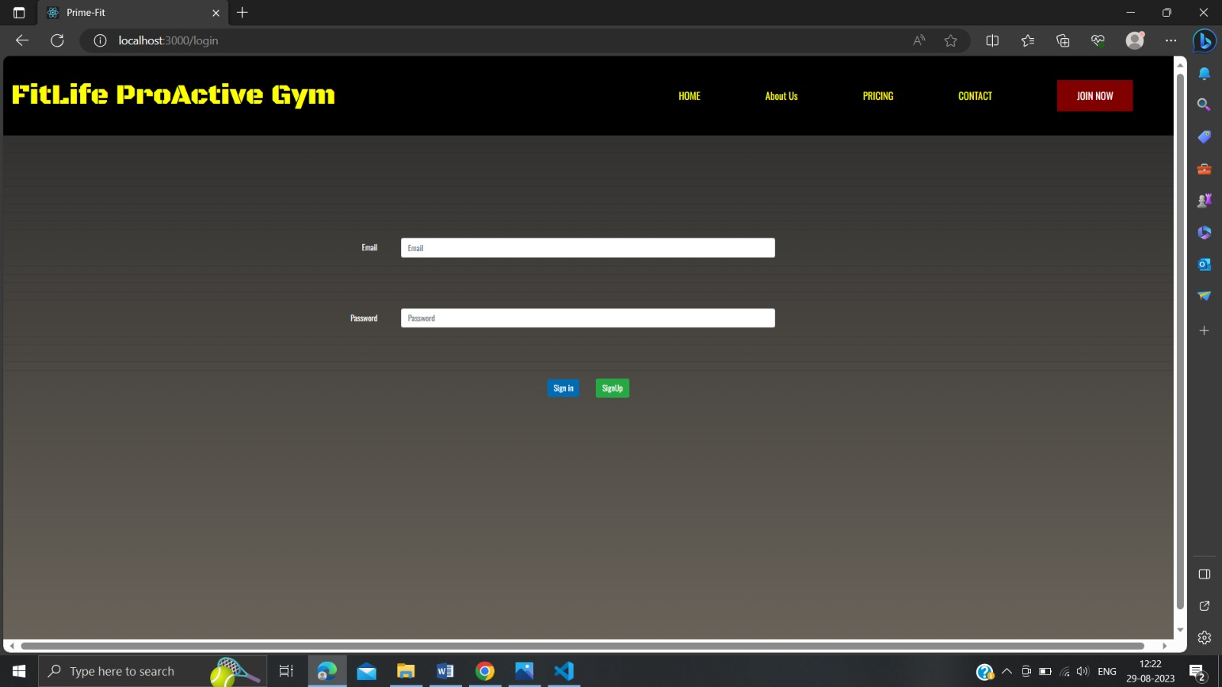

Slide 14
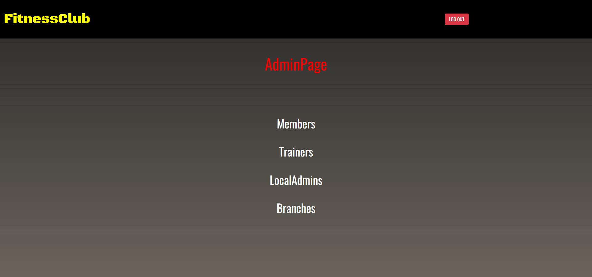
Admin Role:
Login
Members
Trainers
Local-admin
Branches
Packages
Logout

Slide 15
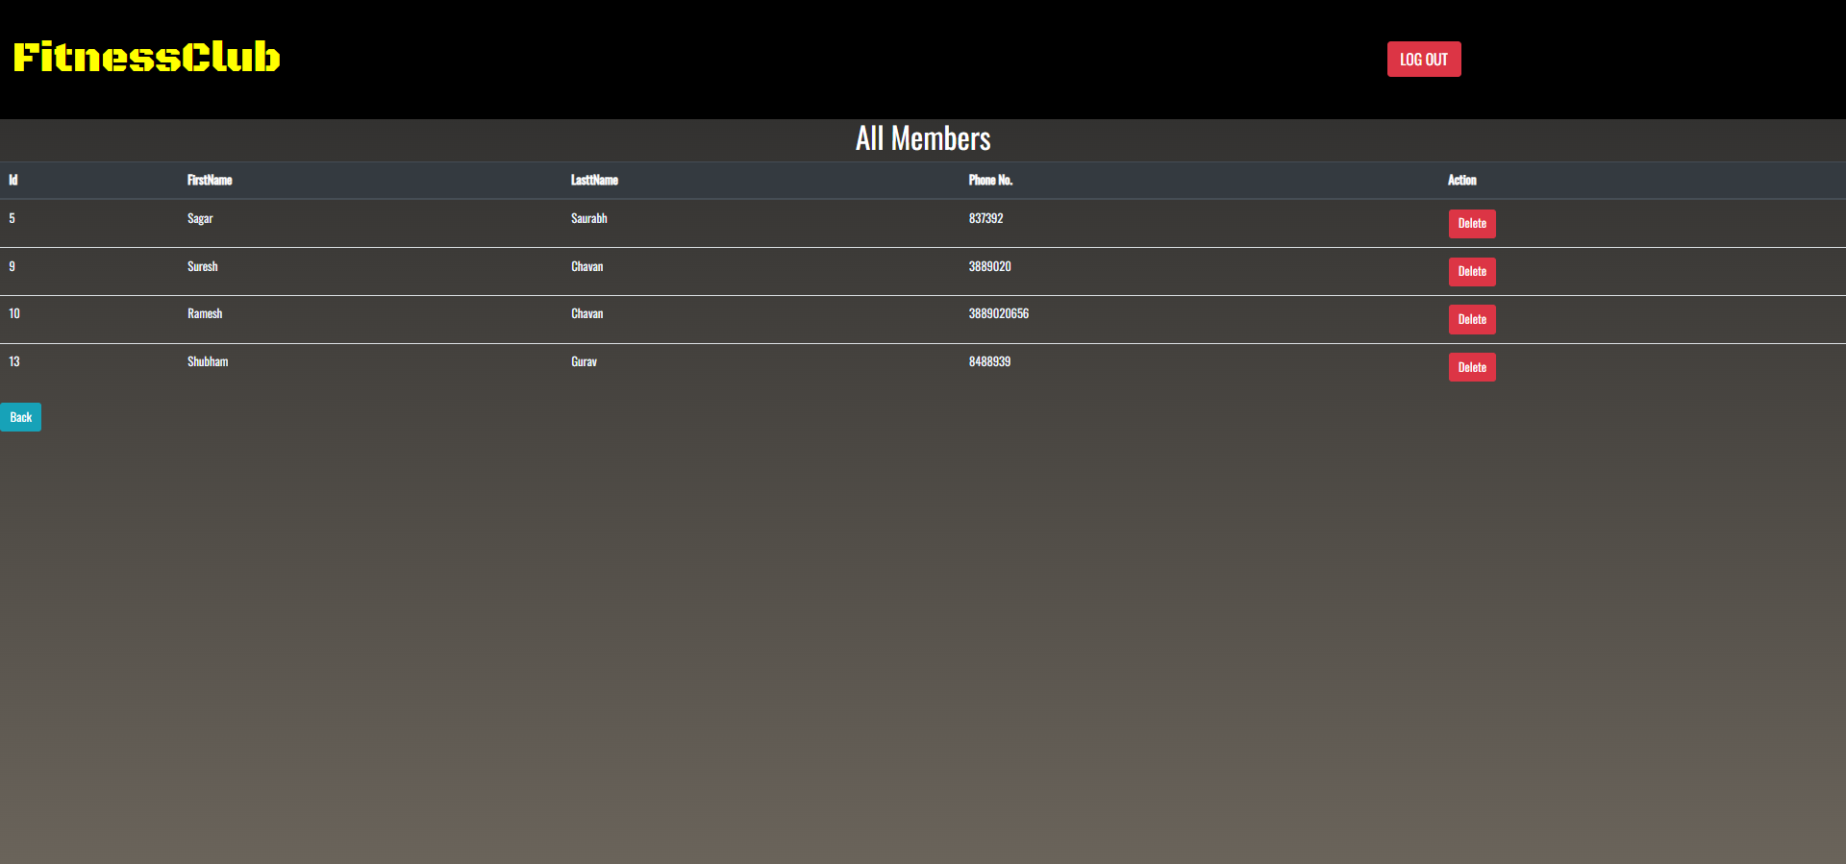

Slide 16
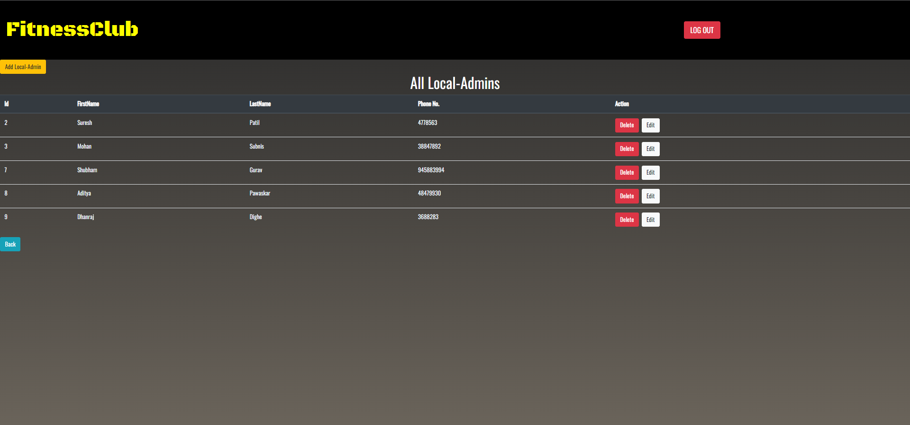
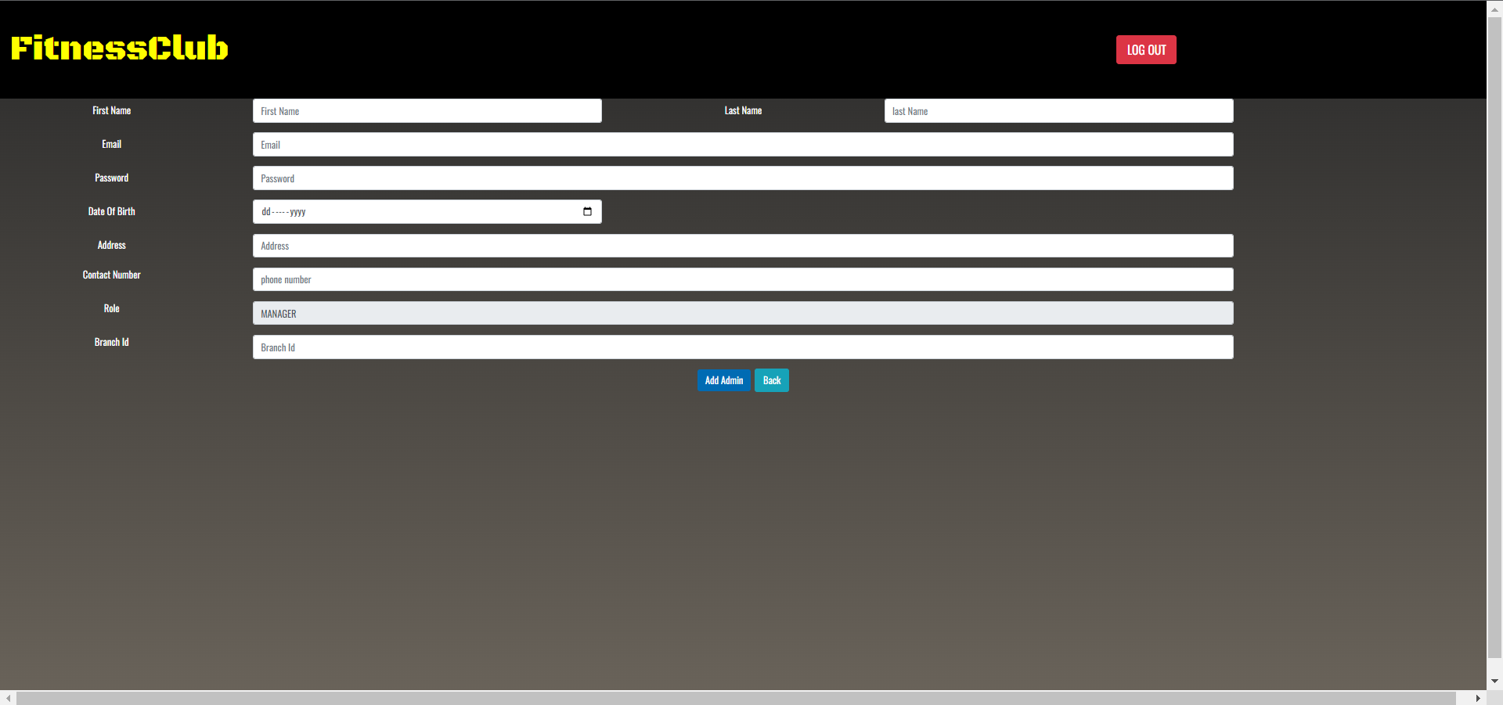

Slide 17
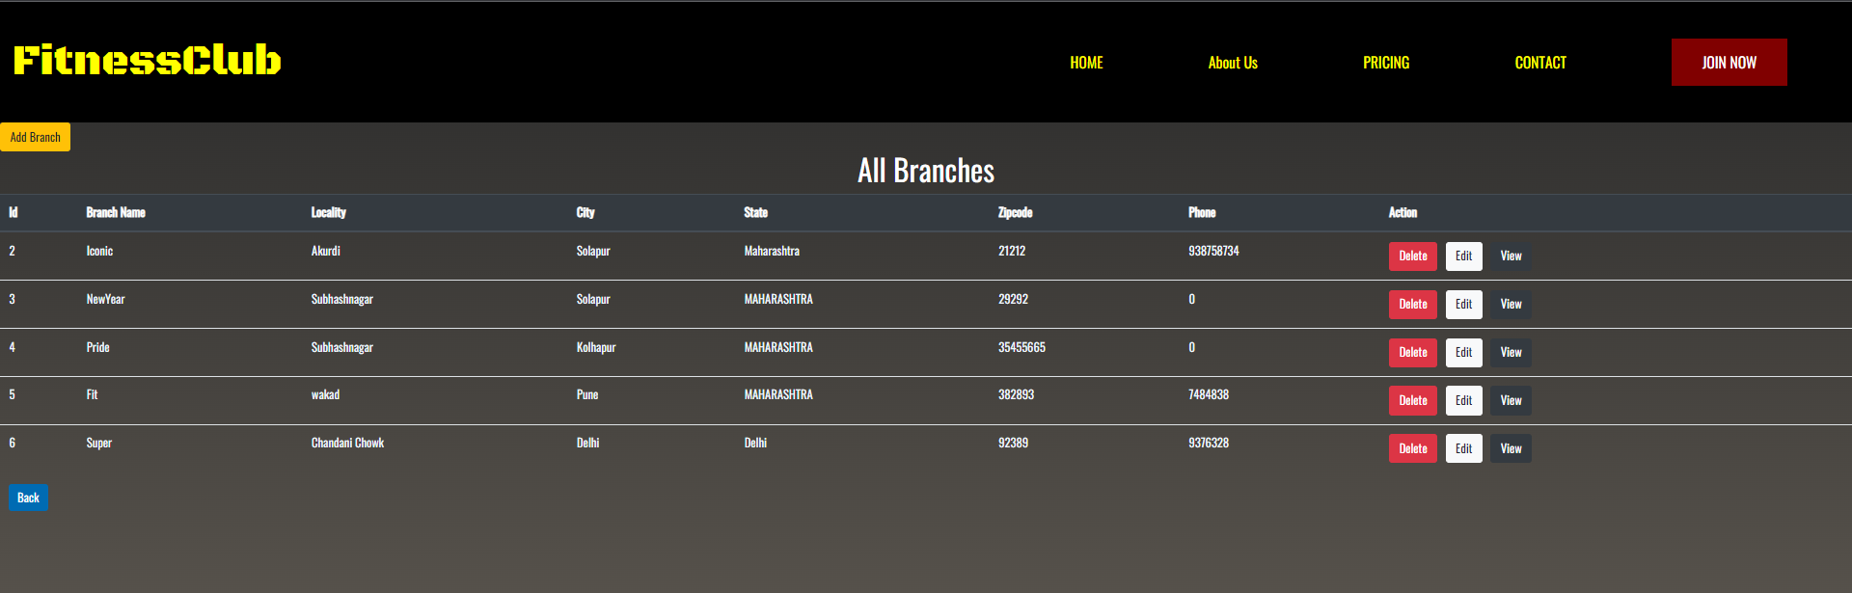
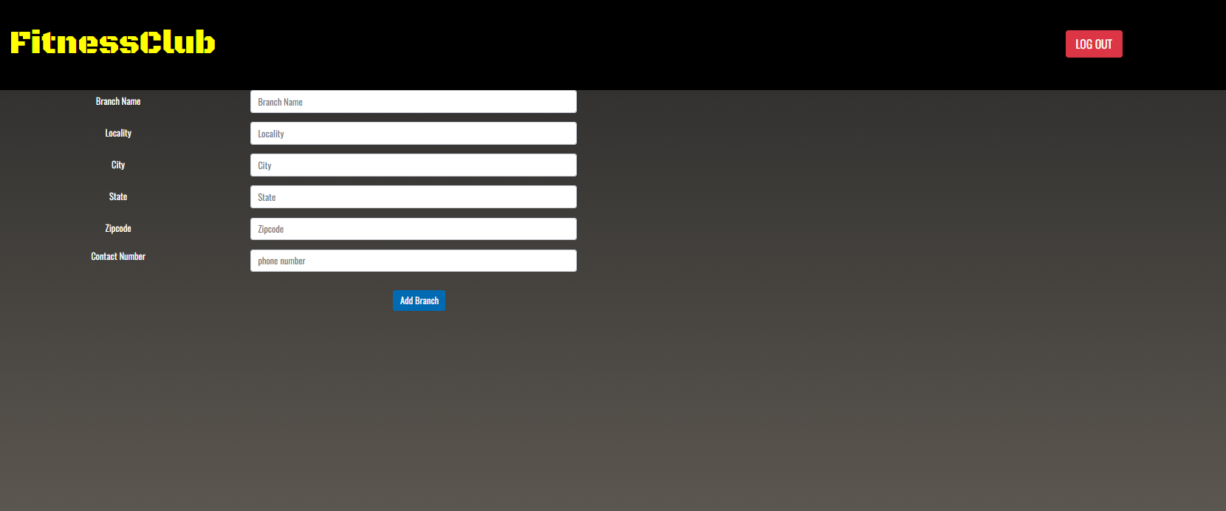

Slide 18
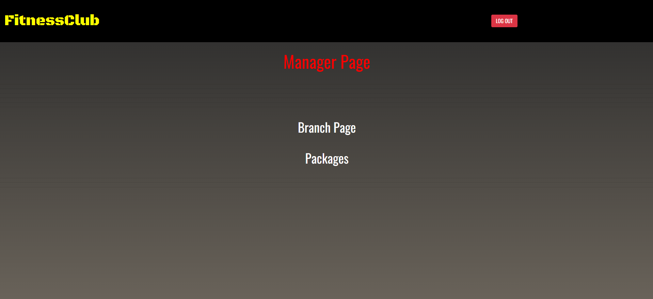
Manager Role-
Login
Branch Page
Branches
Packages
Logout

Slide 19
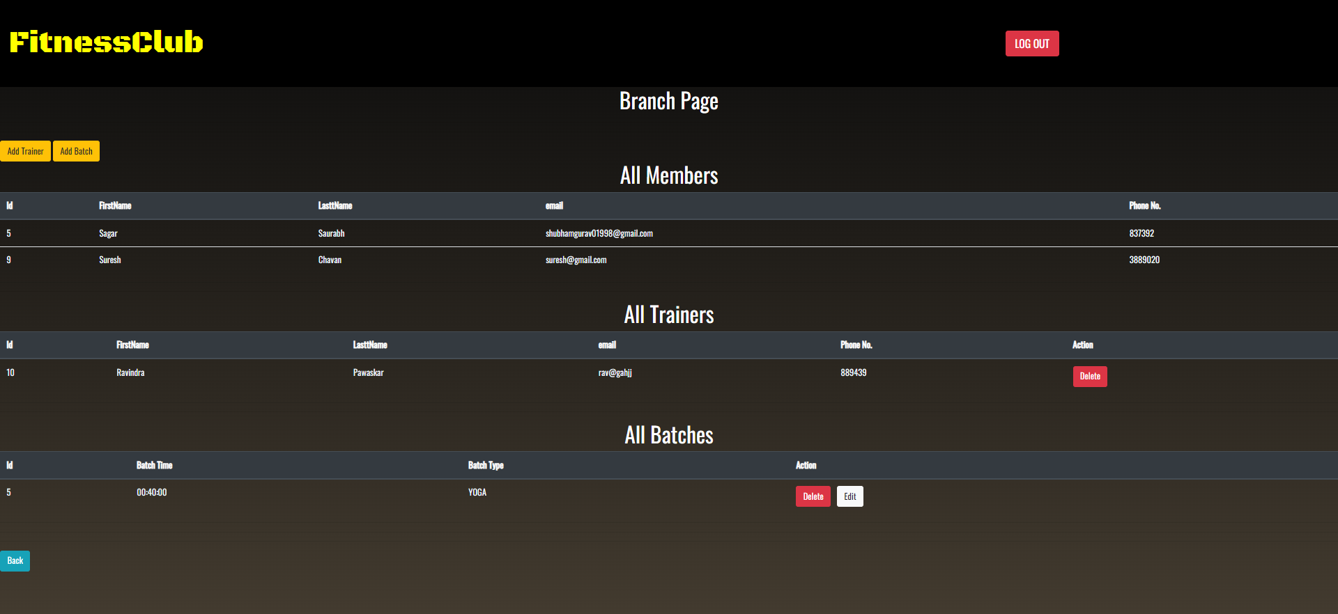

Slide 20
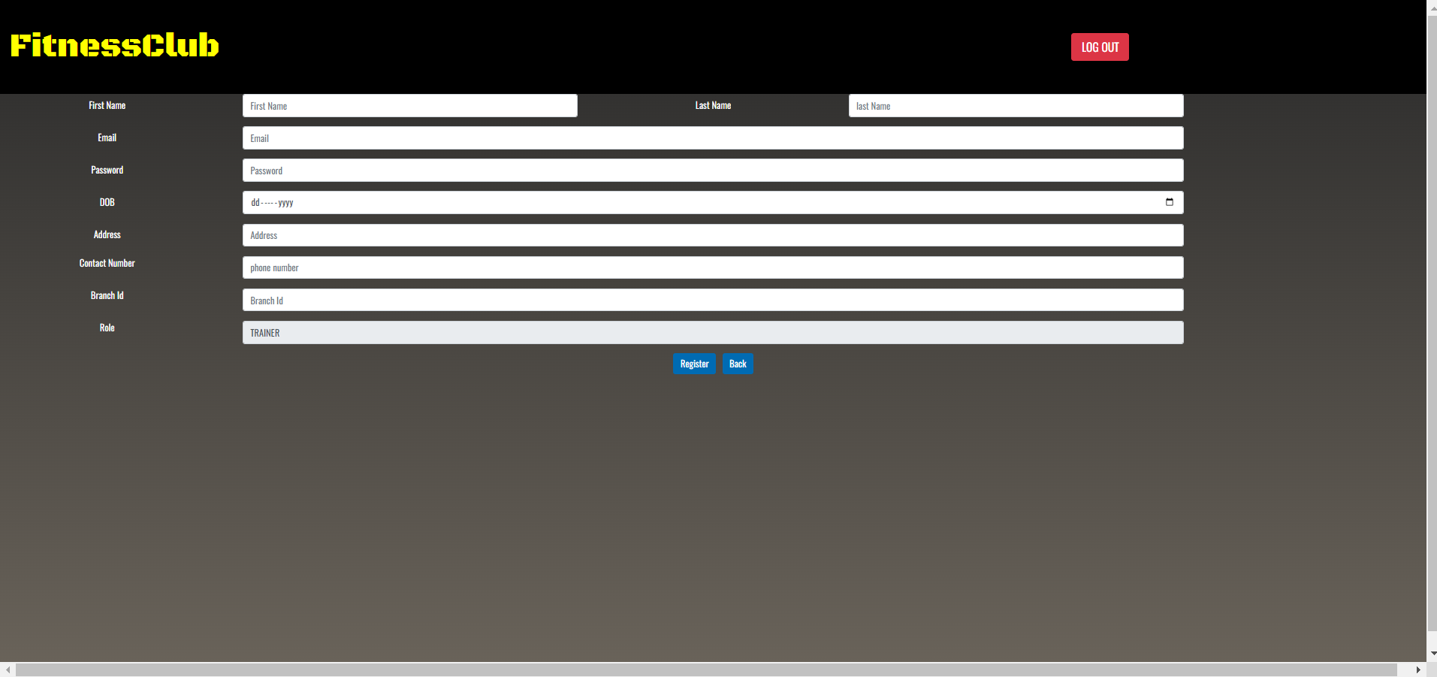

Slide 21
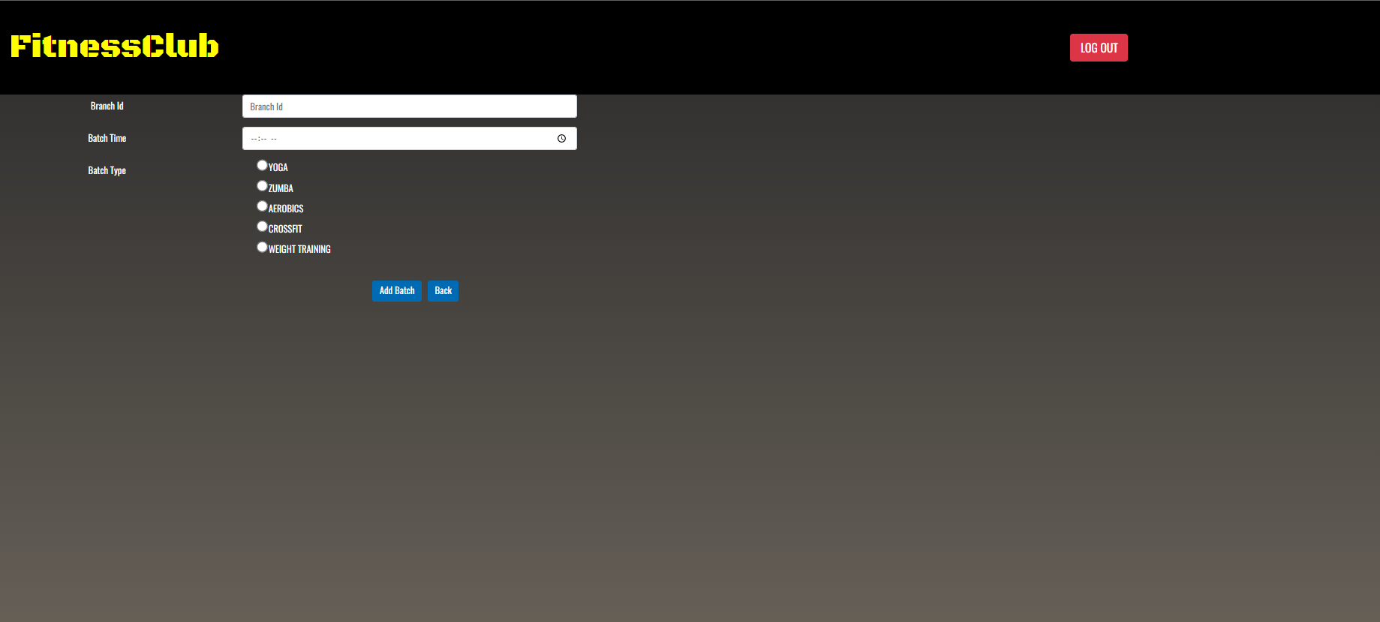

Slide 22
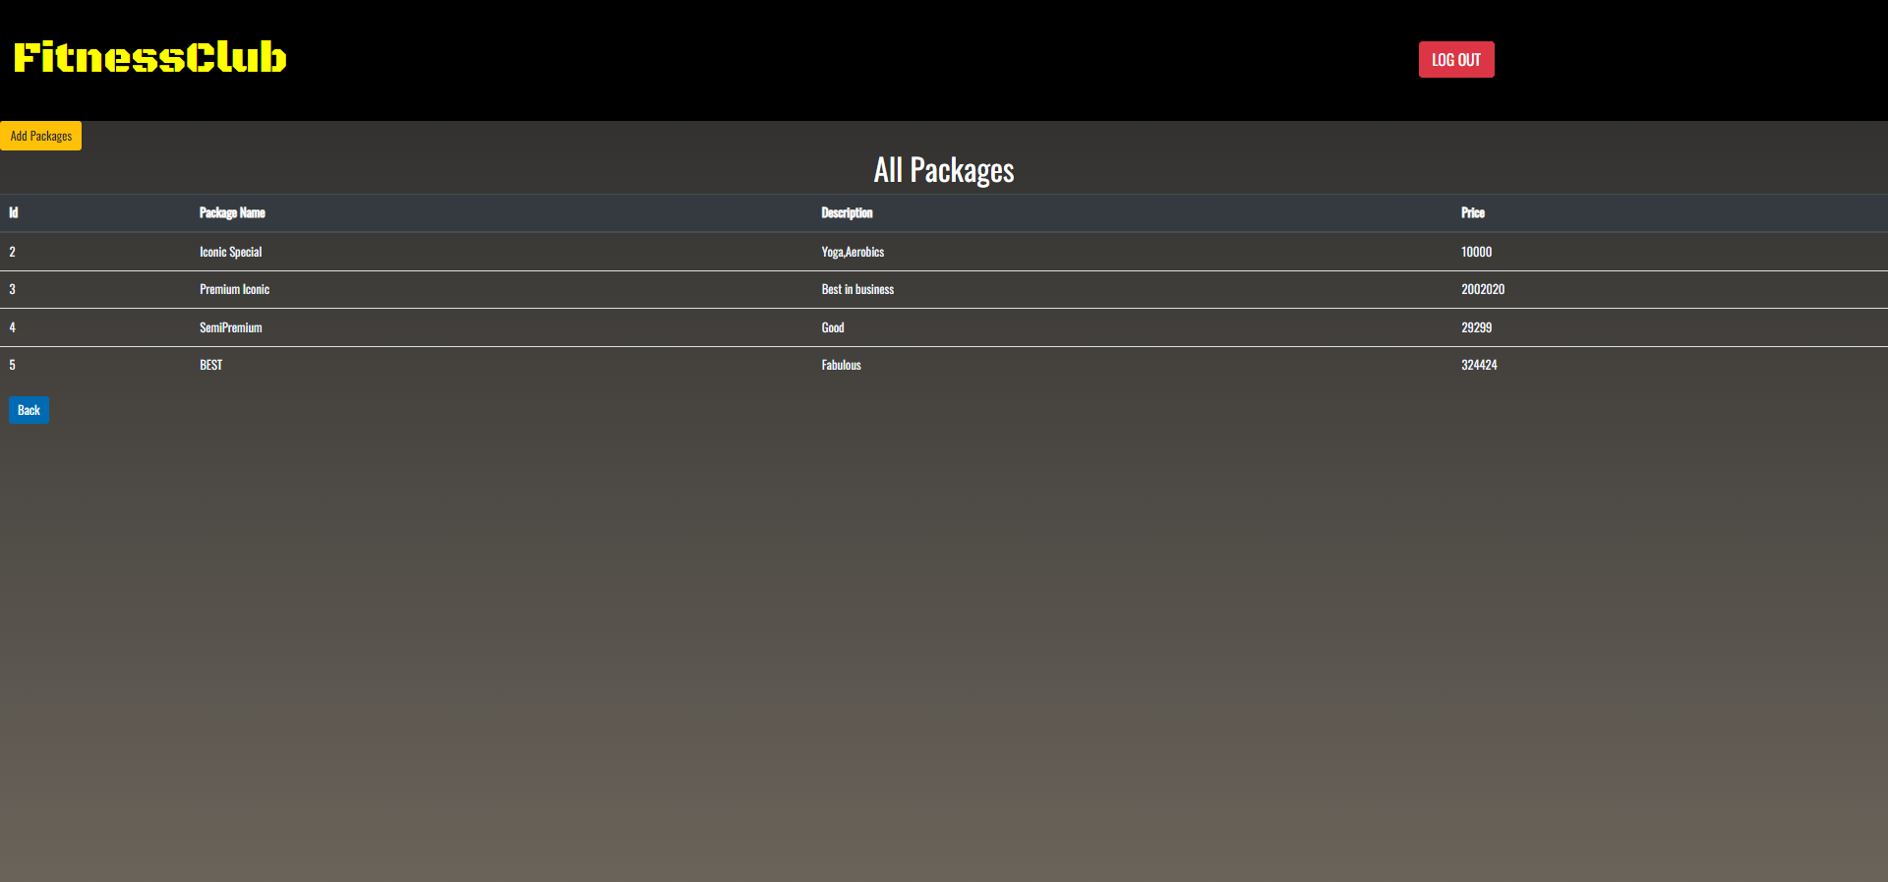

Slide 23
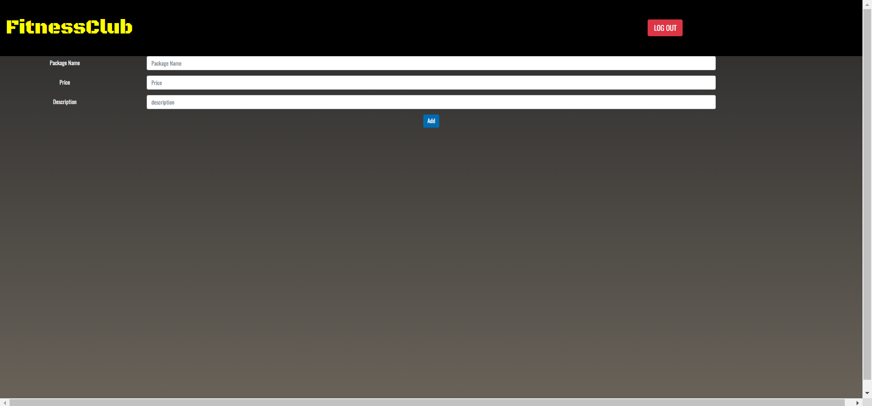

Slide 24
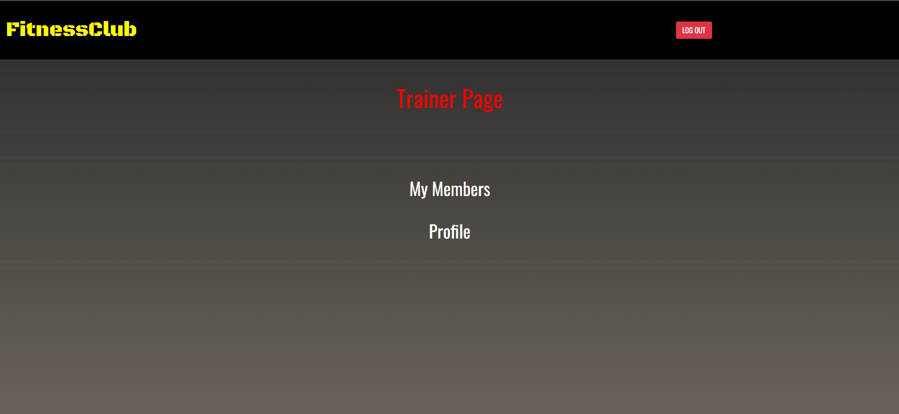
Trainer Role:
Login
Trainers
Branches
Package
Profile
Logout

Slide 25
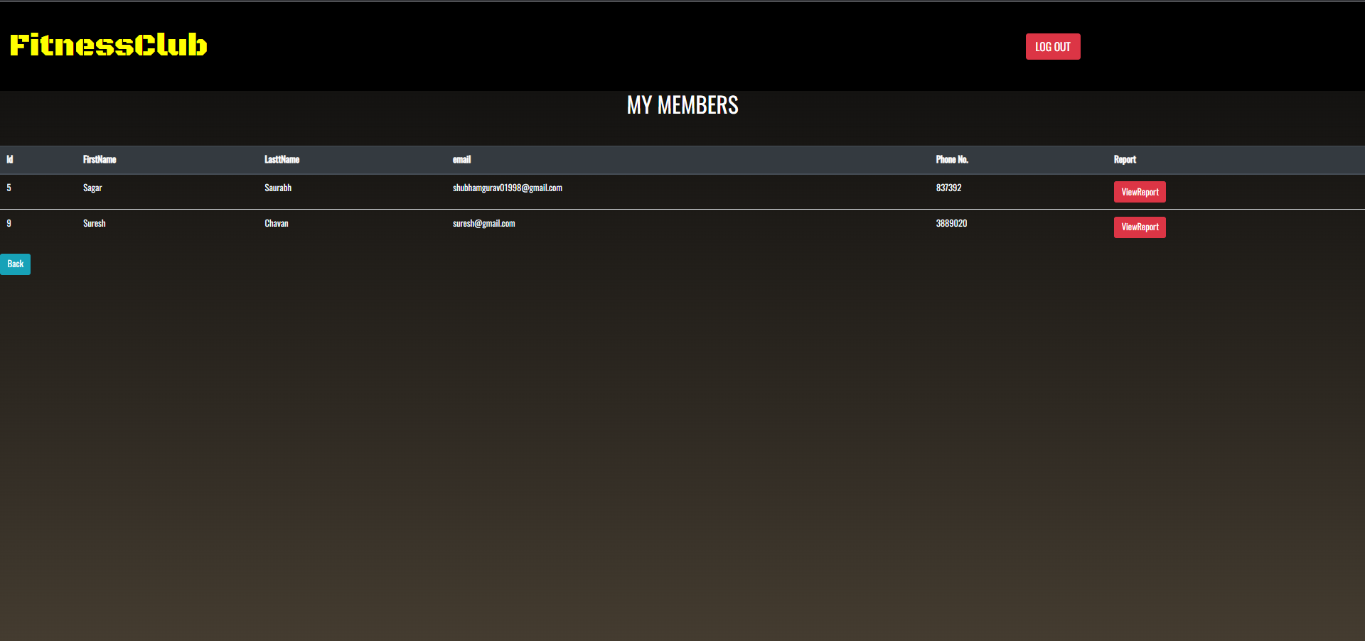

Slide 26
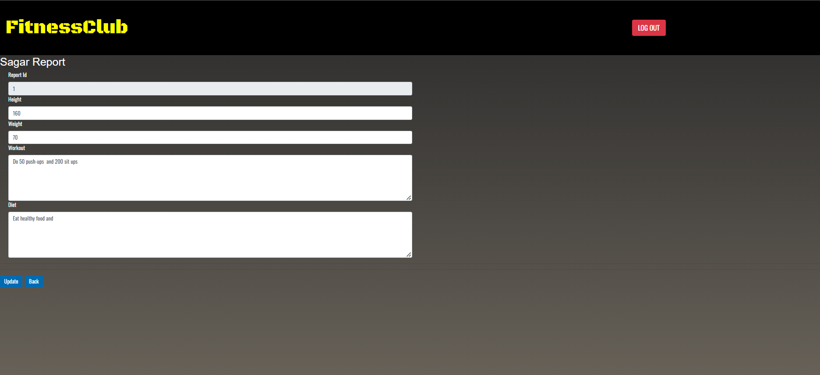

Slide 27
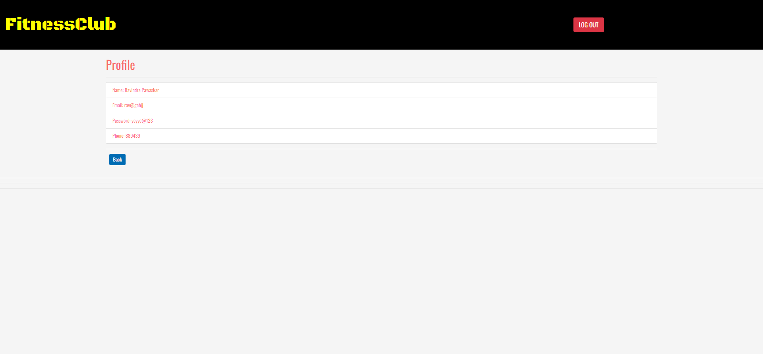

Slide 28
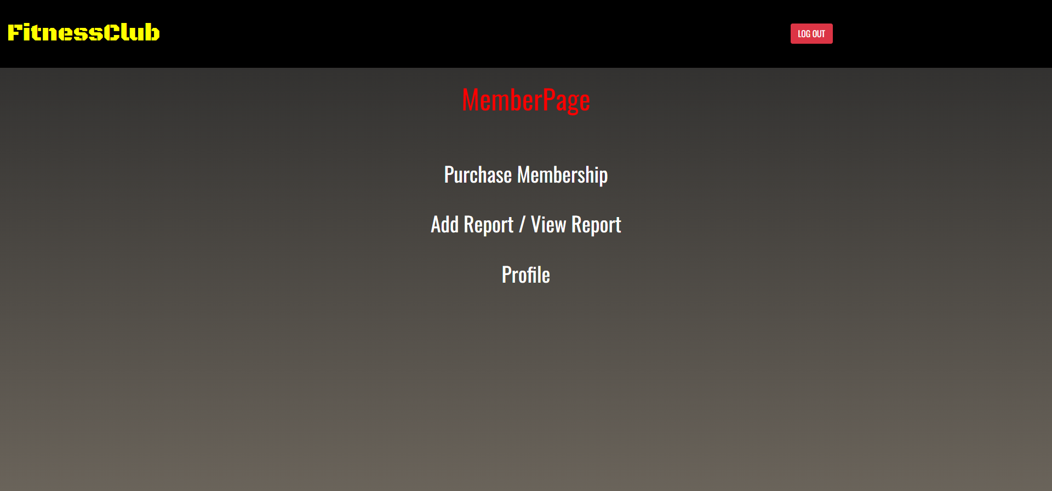
Member Role:
Login
Membership
Branches
Packages
Profile
Logout

Slide 29
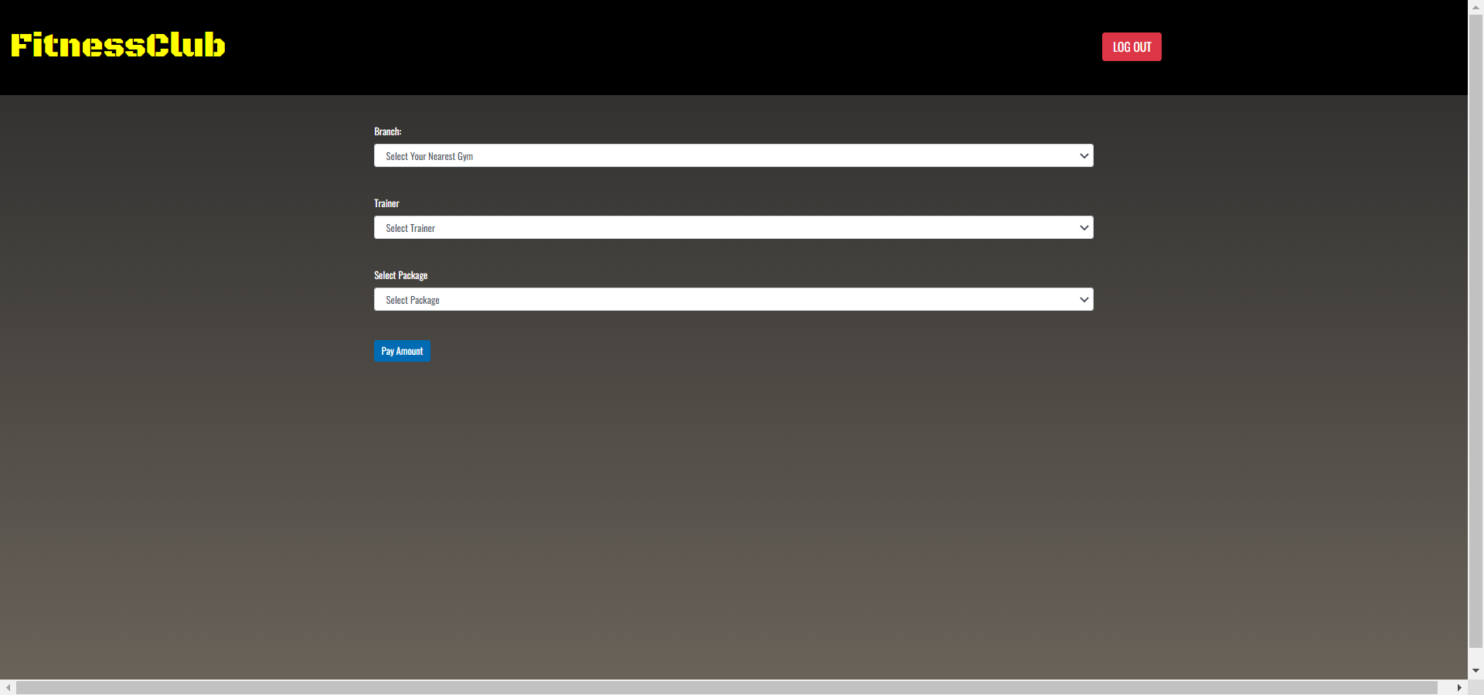

Slide 30
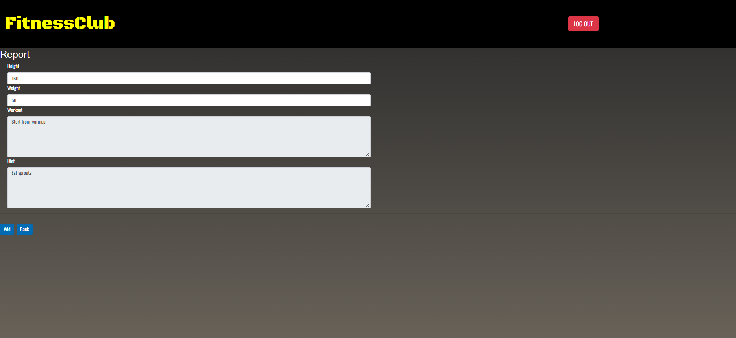

Slide 31
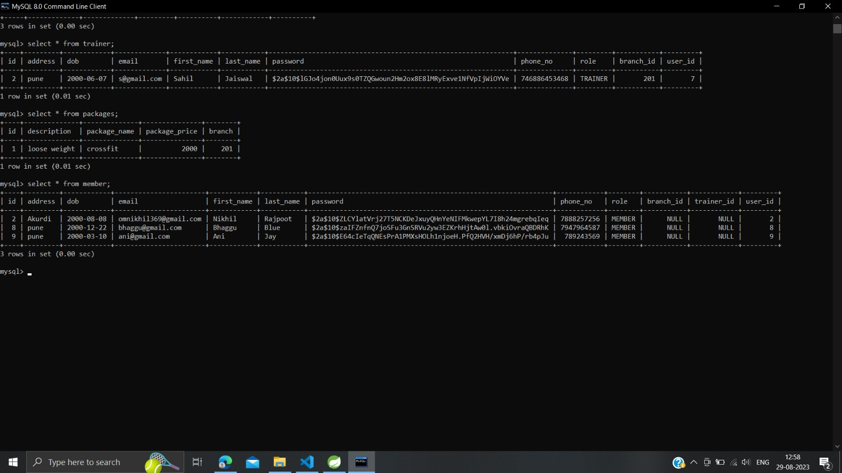
Password Encryption

Slide 32
Conclusion
It is efficient and less time consuming. The purpose of this project was to develop a web application for easy access to gym.
This project helps us in gaining practical knowledge and we a got a hands on experience on several topics like designing a web page using ReactJs, use of responsive templates ,using bootstrap components easily and helps in management of database using MySQL.
It allows owners to manage their gym, customer to view the packages provided by gym and booking their session online as per requirement. The administrator module will able to manage branch activity, gym activity, trainer activity, facility activity.

Slide 33
Future Scope
This project can be enhanced further by adding payment gateway to reduce the maintenance of cash for Membership purchase payments. Online Workout tutorials and online Expert sessions can be hosted on this site for better customer satisfaction. The software is flexible enough to be modified and implemented as per future requirements. We have tried our best to present this free and user–friendly website to Institutes.

Slide 34
THANK YOU

