Slide 1

SWOYAMBU INTERNATIONAL COLLEGE
LAGANKHEL, LALITPUR
Presented By : Srijana Bista

Slide 2
1
OVERVIEW
Intoduction
Objectives and Features.
Problem Statement.
Methodology
Feasibility study
Tier Architecture
Gantt Chart
Working Mechanism.
Use Case Diagram
Physical DFD
Database Schema
Linear Search
Binary Search
References
Conclusion

Slide 3

2
INTRODUCTION
Hotel Booking System
The Hotel Reservation System is a web-based system that allows users to search for hotels, check availability, and make online reservations.
It includes admin and user modules where customers can explore hotels, verify room availability, and make reservations using the User Module by room type and price.
This include processing bookings, maintaining room availability, adding and updating room details and managing users.

Slide 4
3
OBJECTIVE & FEATURES
Objectives
To Simplify the booking process by giving customers quick reservations.
To enhance hotel management by automating room allocation and bookings.
Features
It includes user sign up and login.
It includes room searching and booking rooms. It includes adding user, rooms.
It includes searching bookings and rooms and manage bookings.

Slide 5
4
PROBLEM STATEMENT
No guarantee of room availability.
Manual Booking Errors.
Limited Customer Reach.

Slide 6
5
Methodology
Study of Existing System
Requirement Collection
The study of the existing hotel booking system involves analyzing traditional manual booking methods and current online platforms to identify inefficiencies, such as manual errors, double bookings, and lack of real-time availability updates.
Questionnaire
Focus Group Discussion

Slide 7
6
Feasibility Study
Technical Feasibility.
HTML, CSS, Javascript, Jquery for frontend. PHP for backend and MySql for database.
Operational Feasibility.
Need of minimum number of staffs. Need of a web browser.
Economical Feasibility.
Depends on the number of population. Not a huge budget project.

Slide 8
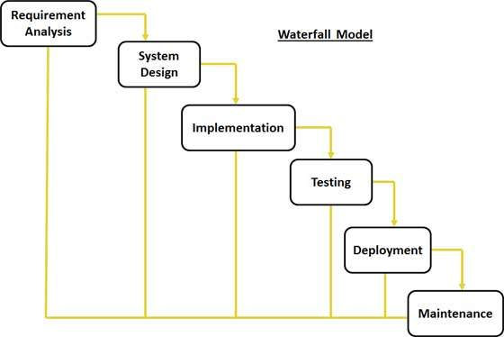
7
WATERFALL METHODOLOGY
Easy to implement.
Perfect methodology for small projects.
It can be used when the requirements are well known.
It has a clear work structure.

Slide 9
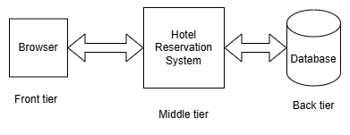
8
TIER ARCHITECTURE
Three Tier Architecture.
It is a widely used software architecture pattern that divides an application into three distinct layers.
Each layer has distinct responsibilities, making it easier to manage and update specific functionalities without affecting others.

Slide 10
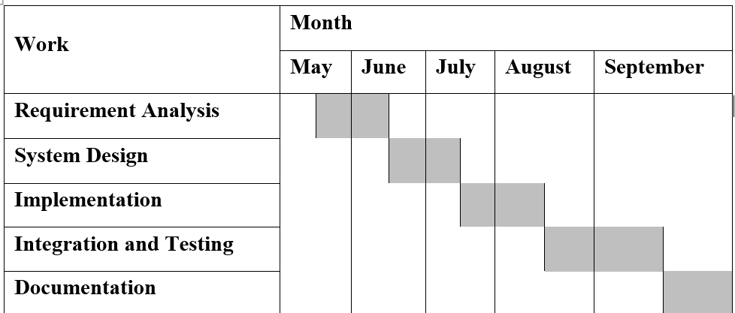
Gantt Chart
9

Slide 11
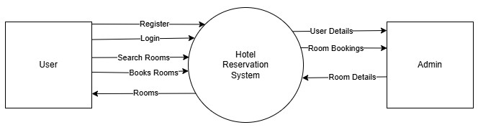
Working Mechanism
10

Slide 12
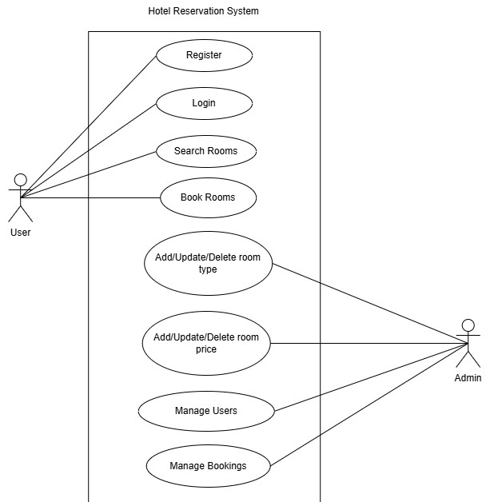
Use Case Diagram
11

Slide 13
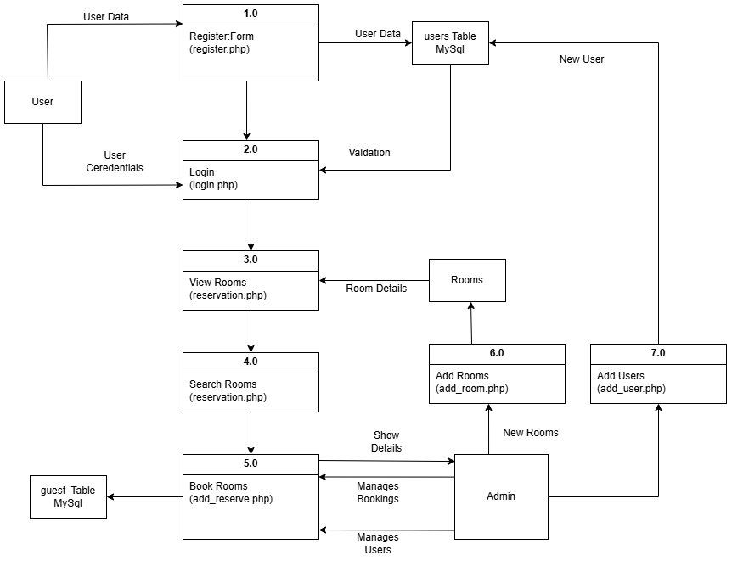
Physical DFD
12

Slide 14
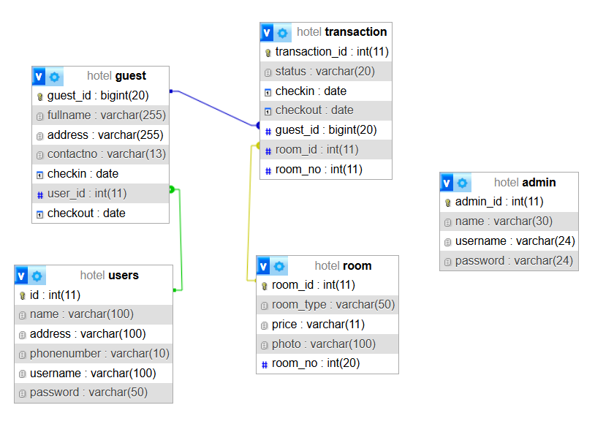
Database Schema
13

Slide 15
Linear Search
14
It is a simple sequential search technique used on the admin side to locate bookings by attributes like name, address, or contact number. It checks each element in the list one by one until a match is found or the end is reached.
The admin side of the Hotel Reservation (HRS) has integrated linear search to look for reservations using visitor information like name, address, phone number, and other pertinent details. This enables the administrator to swiftly access particular reservations by manually searching through booking records.

Slide 16
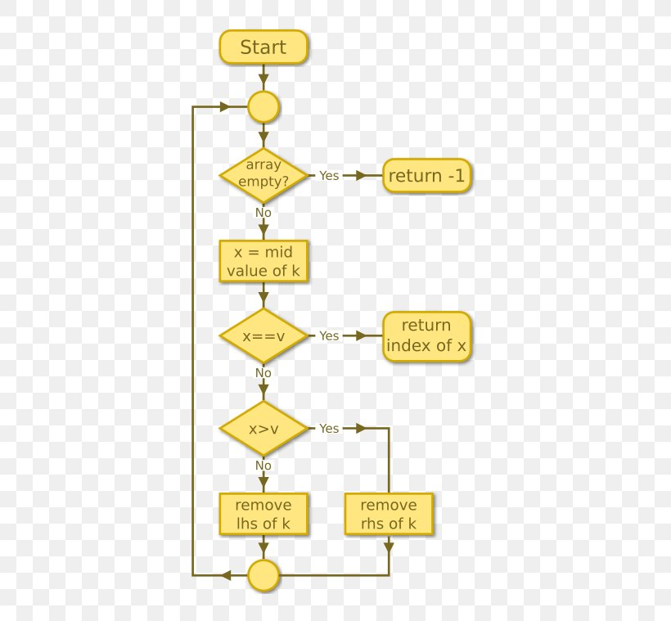
Linear Search
15

Slide 17
Binary Search
16
It is a fast and efficient algorithm used on the user side to search hotel rooms by room type or price. It works by repeatedly dividing a sorted list in half to locate the target value.
In the HRS, binary search has been implemented on the user side to efficiently search for rooms based on specific criteria such as room type and price. Since the list of available rooms is sorted by either room type or price, binary search allows users to quickly find rooms that match their preferences.

Slide 18
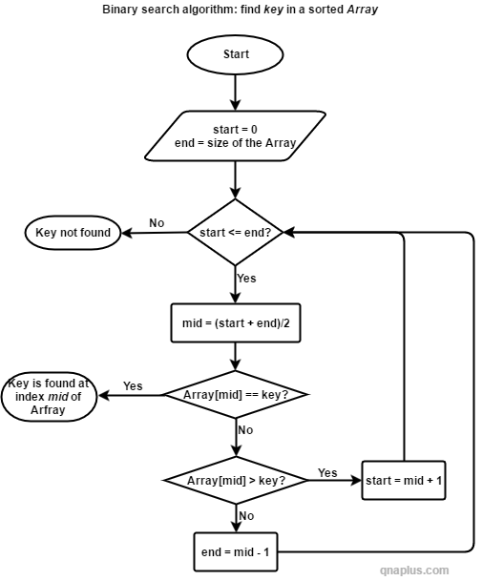
Binary Search
17

Slide 19
References
18
K. Ahmad, "ResearchGate," ResearchGate, 12 12 2023. [Online]. Available: https://www.researchgate.net/publication/376544146_Hotel_Booking_Intentions_A_ Literature_Review.
G. R. ,. J. Z. F. U. K. Z. A. Irfan Ullah, "Science Direct," 5 2019. [Online]. Available: https://www.sciencedirect.com/science/article/abs/pii/S0969698918310282#preview -section-introduction.
C. Audits, "Control Audits," 3 3 2024. [Online]. Available: https://www.controlaudits.com/blog/what-are-the-security-risks-and-solutions-for-online-hotel-booking-platforms/#:~:text=%E2%80%93%20Ensure%20the%20booking%20website%20is%20legitimate%20and,unsolicited%20contact%20prompting%20for%20personal%20or%20payment.
C. Infotech, "Vooinc," 29 8 2024. [Online]. Available: https://vooinc.com/hotel-booking-app-development-key-challenges-and-solutions/.

Slide 20
Conclusion
19
The development and implementation of a Hotel Reservation System represent a significant step toward efficiently and effectively managing hotel bookings. The successful completion of this project helps the user to search the rooms and book the rooms at their convenience.
As we move forward to the project, we found that there are many features and functionalities that can be added in the future. We couldn’t add every functionalities in the given period of a time but later in the future development of this project, all those functions and features can be added.

Slide 21

20

