Slide 1

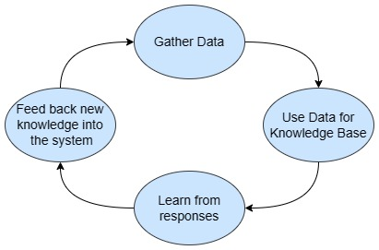

Team Members
Sahil Kale (Team Leader)
Saurabh Shete
Gautam Khaire
Sara Shaikh
Shrikant Bhadgaonkar
Tanmay Jadhav
Objectives
1.Improve Customer Service Quality
2. Reduce the average response time
3. Standardize the responses for all customers
4. Minimize training time and cost for call center employees
5. Create an all in one management platform for any call center agency with multiple advantages
Organization Name: Ministry of Commerce and Industries
PS Code: SIH1359 Problem Statement : Contact center knowledge management tool with decision tree
Team Name: TechAngels Institute Code (AISHE): C-42072 Institute Name: Pune Institute of Computer Technology
Category: Software
Technology Bucket: Smart Automation
Benefits and Impact
Can benefit call center employees to start service with minimal training requirements
Can solve challenges of contact center knowledge management.
Can potentially save time, reduce errors, and increase access to customer support.
Video Teaser: Click here for a YouTube teaser
UI Prototype: Click Here for a Figma Prototype
Figure 1: Life cycle of contact center knowledge management system

Slide 2
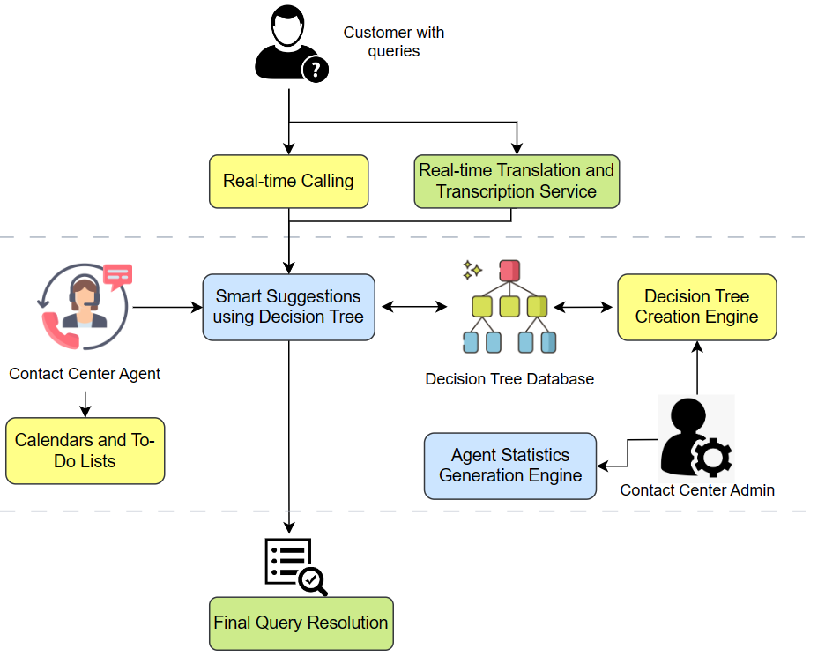
Idea Details
Our proposed solution of a knowledge management tool for call centers has the following main functionalities:
Real-time Smart Suggestions: Accelerate issue resolution with this decision-tree powered automated suggestion feature.
Detailed Agent Statistics: Gain comprehensive insights into agent performance with detailed statistics for informed decision-making.
Voice Integration: Enable seamless communication between customers and agents with real-time speech transcription and calling
Auto-Decision Tree Generator: Streamline the creation of detailed decision trees with an easy-to-use, automated visual tool
Multi-lingual Support: Enable instant support to a wide customer base in India across multiple languages
Figure 2: Architecture Diagram

Slide 3
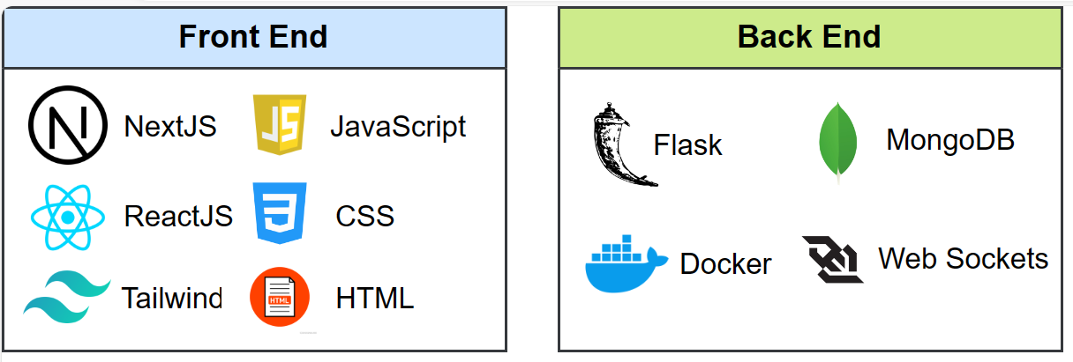
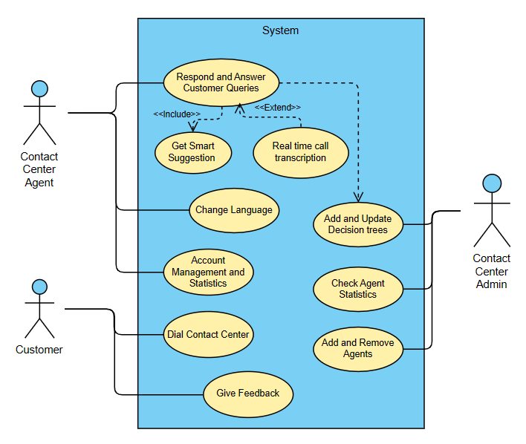
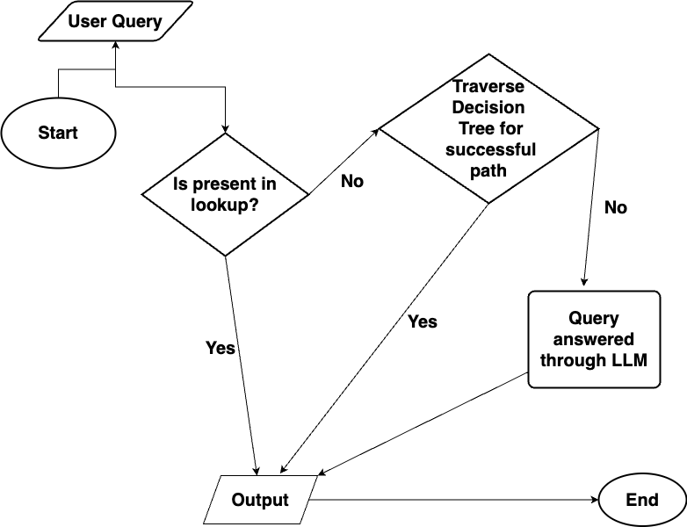
Approach Details
Figure 4: Tech Stack
Figure 3: Use Case Diagram
Figure 5: FlowChart

Slide 4
Approach Details
Business Potential - full details here
Innovativeness
Subscription-based (27%): The tool can be provided on a subscription model with varying feature levels which can charge a monthly fee.
Pay-per-use (72%): Charge contact centers based on the actual usage of the tool, such as the number of queries processed or the time agents spend using it.
Lack of a comprehensive, automated solution with wide-ranging features will make our software solution attractive and market-worthy.
With the above business potential, high profit margins are expected. (~110 crore INR revenue)
Faster Response time provided to the user base by implementing a lookup infrastructure to speed up lookup process.
Decision tree infrastructure for uniform and consistent responses from any domain
Smart search and suggestions for queries with which the agent can access answers quickly
Auto-creation of decision trees using a simple, easy-to-visualise tool
Utilizes predictive analytics to grade and analyze agent performance
Horizontal scalability of solution through docker and other cloud services
Multilingual capability of solution to cater to wide customer base
Simple, navigable UI to cater to agents with varying knowledge and training levels from diverse domains
Show stoppers
Privacy and security of customer data should be done with care
Managing and maintaining a large decision tree can be challenging and time-consuming.

