Slide 1
Efficient Video Moment Retrieval
From subtitle-only retrieval to multimodal XML + staged retrieval
Goal: given a natural-language query, predict the correct video moment (start_time, end_time) efficiently.
TVR Dataset · Systems-focused Independent Study
Queries
Videos
Main result
10,895
2,179
Dense → XML
Sahil Shroff · Advisor: Dr. Mark Zhao · CU Boulder

Slide 2
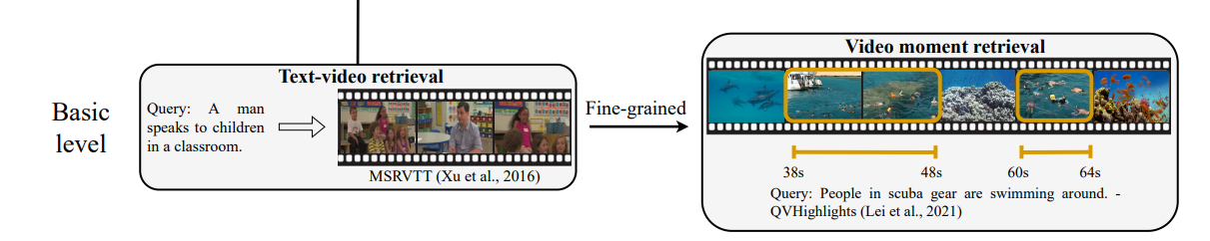
Goal: Video Retrival
IoU (Intersection over Union) = (Intersection / Union)

Slide 3
Problem setup
Task
Dataset
Metrics
Input: natural-language query
Output: moment span (start_time, end_time)
Evaluation on official TVR validation split
10,895 validation queries
2,179 unique videos
Query types: v, t, vt
Text baselines: mean IoU, R@K@IoU
XML family: VR, VCMR, SVMR
Runtime / speedup for systems view
Query
Retriever
Candidates
Predicted span

Slide 4
Full-val text baselines
Subtitle-only retrieval is useful, but limited.
Method | R@1@0.5 | R@3@0.5 | Mean IoU | Latency ms
BM25 | 0.0777 | 0.1581 | 0.1280 | 0.19
Dense | 0.0946 | 0.1922 | 0.1579 | 0.33
Fusion | 0.0980 | 0.1934 | 0.1617 | 0.70
Oracle | 0.3450 | 0.3450 | 0.4251 | 0.00
Takeaway
Dense > BM25
Fusion adds a small gain
Large oracle gap shows remaining headroom
subtitle-only methods are not enough as the main baseline for TVR.

Slide 5
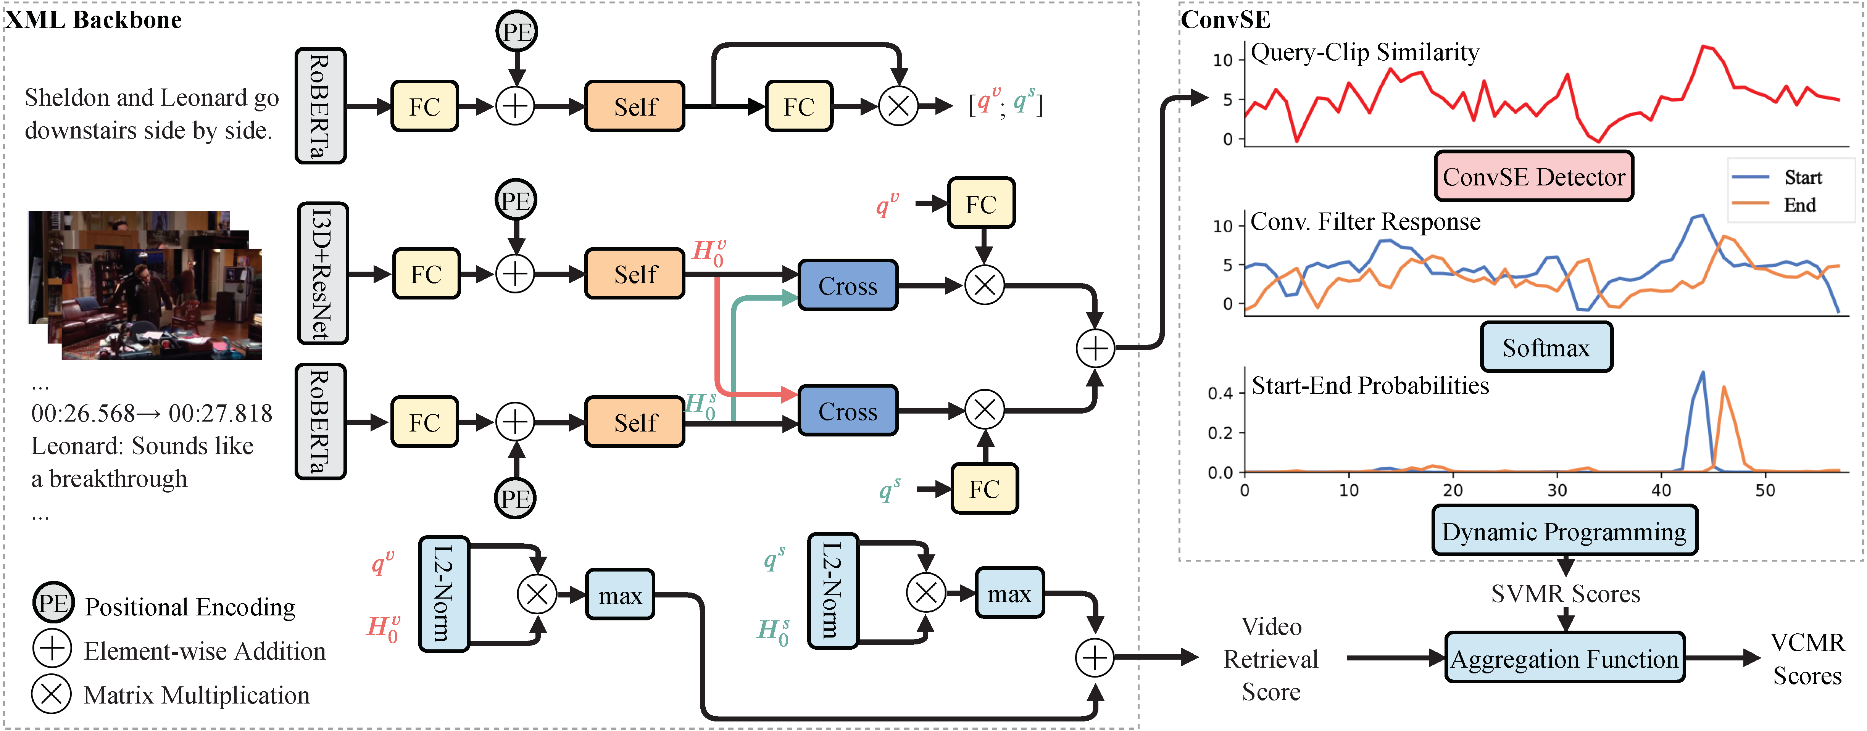
Official XML baseline
Multimodal reference baseline on official full validation.

Slide 6
Official XML baseline
Multimodal reference baseline on official full validation.
VR R@1
VCMR R@1@0.5
SVMR R@1@0.5
Runtime
1.69
0.38
15.60
80.15s
Metric intuition
What XML is good at
What XML is weak at
VR = retrieve the right video
VCMR = retrieve the right moment in the corpus
SVMR = localize within the video
Strong within-video localization
Reference multimodal baseline
Paper-like full-val result reproduced
Cross-video retrieval is weak
Expensive compared with text retrieval
Motivates staged retrieval

Slide 7
Main contribution: Dense → XML
Use Dense for video retrieval, XML for within-video localization.
Query
Dense retriever
Top-5 videos
XML
Final moment
Method | VR R@1 | VCMR R@1@0.5 | SVMR R@1@0.5 | Runtime | Speedup
XML full | 1.69 | 0.38 | 15.60 | 80.15s | 1.00x
Dense→XML top-1 | 11.56 | 1.57 | 15.60 | 53.22s | 1.51x
Dense→XML top-5 | 11.56 | 1.43 | 15.60 | 54.05s | 1.48x
Dense→XML top-10 | 11.56 | 1.45 | 15.60 | 54.77s | 1.46x
Why this matters
Preserves SVMR
Improves VR + VCMR
Cuts runtime by ~1.5×
Best overall tradeoff

Slide 8
Side experiment: shared compaction
A valid systems baseline, but weaker than hierarchical pruning.
Method | SVMR R@1@0.5 | Runtime | Speedup
XML full | 15.60 | 80.15s | 1.00x
Shared compaction keep 0.6 | 11.23 | 121s | 0.66x
Dense→shared compaction→XML | 11.56 | 114s | 0.70x
Interpretation
Compaction plumbing works.
Current selector is too crude.
Does not beat dense shortlist alone.
Bottom line
Main novelty path: hierarchical dense shortlist → XML
Shared compaction stays as supporting evidence / future work
Final message: Dense is better for video retrieval. XML is better for localization. Combining them gives the clearest systems win.

