Slide 1
MVP · PHINITE AGENT GRAPH · NEXT.JS FRONTEND
Dolfin
Your AI Store Manager
A merchant-facing frontend that displays, formats, routes and captures approval.
Phinite reasons. Dolfin never invents a stock figure.
What to restock
How much to buy
Who to buy from
Why — then approve
DOLFIN · TECHNICAL DEMO
1

Slide 2
THE PROBLEM
Merchants don’t need another dashboard
They need someone who connects inventory, demand and suppliers — then acts.
Stock risk
Buying decisions
Products run out before anyone notices. Days of supply is invisible until the shelf is empty.
The cheapest vendor is not always the best. Lead time and reliability get ignored.
Scattered systems
No time to analyse
Inventory, sales and suppliers live in different places. Nobody joins them up.
Owners spend the morning checking spreadsheets instead of running the store.
DOLFIN · TECHNICAL DEMO
2

Slide 3
THE SOLUTION
An AI employee, not another dashboard
One merchant-facing manager. Two specialist agents. Human approval before money moves.
01
02
03
04
Merchant
Dolfin
Inventory
Vendor
→
→
→
Asks in plain language
or clicks a demo card
Routes, formats, displays.
Never invents a number.
Stock, velocity, days of
supply, reorder qty
Price, lead time,
reliability, PO lines
CORE LOOP
Detect shortage → forecast need → compare suppliers → prepare a purchase → merchant approves
DOLFIN · TECHNICAL DEMO
3

Slide 4
SYSTEM ARCHITECTURE
Dolfin displays. Phinite reasons.
Merchant browser
Dashboard · Chat · Inventory · Vendors · Procurement
Five featured prompts. Ten more chips on /chat.
Dolfin · Next.js 16
App Router pages → /api/* → lib/phinite (client · mapper · errors)
In-memory PO store. server-only credentials. Zod on the way out.
Phinite · app.phinite.ai
POST /ai/trigger/start/{ws}/{trig}/{env} then poll status every 3s
Store Manager graph: Orchestrator → Inventory + Vendor specialists
DOLFIN · TECHNICAL DEMO
4

Slide 5
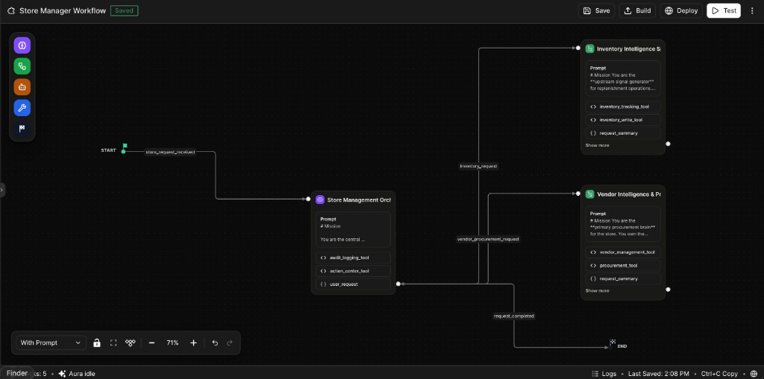
PHINITE STORE MANAGER WORKFLOW
One trigger. Three nodes. Two specialists.
Nodes
Orchestrator
Routes the merchant message. Audit log + action centre.
Inventory Intelligence
Stock, velocity, days of supply, reorder, dead stock.
Vendor & Procurement
Scores, price changes, alternates, PO lines, actions.
DOLFIN · TECHNICAL DEMO
5

Slide 6
THE DATA RULE
No business dataset lives in Dolfin
Inventory, sales, vendors, prices and recommendations come only from the Phinite response.
Unconfigured = empty
Missing = —
Every screen shows “connect your Store Manager”. Placeholder numbers would misrepresent a real store.
If the graph omits days of supply, the UI says it does not have that figure. Never zero. Never a local formula.
Hardcoded in Phinite
Mapper is the seam
The demo catalogue lives inside the graph (tools / session vars), not in Next.js. tests/fixtures.ts is test-only.
lib/phinite/mapper.ts is the only file that knows inventory_data, po_lines, actions. Pages never see Phinite shapes.
DOLFIN · TECHNICAL DEMO
6

Slide 7
WIRE CONTRACT
What the graph actually returns
Session variables the mapper reads
Transport
inventory_data
Background mode (default)
POST …/trigger/start/…
GET …/trigger/status/…
Poll every 3s, cap 180s
Runs take 15–65 seconds
Environment is case-sensitive
development ≠ DEVELOPMENT
A wrong case 200s the start,
then fails on the first poll.
Bearer key is server-only.
Never NEXT_PUBLIC_.
SKU, on-hand, ROP, velocity, days of supply
reorder_recommendation
Qty, urgency, justification (often a JSON string)
demand_forecast
30 / 60 / 90 day units by SKU
vendor_data / vendor_summary
Reliability, lead time, products supplied
po_lines + alternates
Chosen supplier and trade-off options
actions + action_summary
ACT013… pending approval, rupee totals
DOLFIN · TECHNICAL DEMO
7

Slide 8
AGENT 1 · INVENTORY INTELLIGENCE
What do I need — and how soon?
Responsibilities
LIVE GRAPH · TODAY
▸ Current stock and availability
Tata Salt 1kg P001
18 on hand · ROP 40 · 14 units / day
▸ Low-stock / reorder-point detection
▸ Stock-out prediction (days of supply)
1.29
124
CRITICAL
days of supply
recommended qty
status
▸ Demand forecast (30 / 60 / 90d)
▸ Dead-stock detection
Also critical today: Fortune Oil (12 / 1.33d),
Maggi Noodles (20 / 2.5d), Thums Up (9 / 1.12d).
Amul Taaza Milk is LOW at 8 units.
▸ Recommended reorder quantity
DOLFIN · TECHNICAL DEMO
8

Slide 9
AGENT 2 · VENDOR INTELLIGENCE & PROCUREMENT
Who should I buy from — and why not the cheapest?
SUPPLIER
UNIT COST
LEAD
RELIABILITY
ROLE
V001 Metro Wholesale
₹23.50
2 days
94%
Preferred for Tata Salt
V002 Shree Balaji
₹248
3 days
91%
Atta, milk, oil
V003 Bharat FMCG
₹33.50
4 days
88%
Thums Up, Maggi
V004 CityMart
₹24.00
3 days
85%
Alternate — slower, dearer
Recommendation is a trade-off, not a min(price). Metro wins Tata Salt on landed cost + 2-day lead + 94% reliability.
CityMart is cheaper on some lines and still loses — slower, higher defect, weaker on-time.
DOLFIN · TECHNICAL DEMO
9

Slide 10
THE HERO DEMO
One question. Two agents. One decision.
MERCHANT
“What products do I need to restock today?”
1 Inventory
2 Vendor
3 Dolfin
Tata Salt · 18 on hand
1.29 days left · order 124
Metro Wholesale
₹23.50 · 2 days · 94%
PO line ready
₹2,914 · pending approval
APPROVE → PO-10024
Dolfin re-reads the recommendation from Phinite and requires the graph to acknowledge before recording the order. Nothing is approved locally first.
DOLFIN · TECHNICAL DEMO
10

Slide 11
MERCHANT UI
Five cards a demo should start from
What needs restocking today?
Find products that need attention right now. → What products do I need to restock today?
What will run out next week?
Predict upcoming stock-outs before they happen. → Which products are likely to run out in the next 7 days?
Who should I buy from?
Compare vendors on price, reliability and delivery time. → Which vendor gives me the best combination of price and reliability?
Prepare my next purchase order
Turn inventory needs into an actionable procurement plan. → Prepare a purchase order for the most urgent stock-outs.
Give me my morning briefing
Tell me what needs my attention today. → Give me my morning store briefing.
DOLFIN · TECHNICAL DEMO
11

Slide 12
FULL DEMO SET
Fifteen prompts that exercise the graph
Secondary chips on /chat — plus the five featured messages.
What should I reorder this week?
Why do you think I need to reorder Tata Salt?
How much Tata Salt should I order?
Who should I buy Tata Salt from?
Find the best vendor for Aashirvaad Atta.
Can I get a cheaper supplier for Fortune Sunflower Oil?
Have any of my suppliers increased their prices recently?
Show me my pending procurement decisions.
Create a purchase recommendation for the products that need urgent restocking.
What inventory is sitting unsold in my store?
DOLFIN · TECHNICAL DEMO
12

Slide 13
DEMO SCRIPT
A three-minute story
00:00
Morning briefing
Open / and click “Give me my morning briefing.” Dolfin summarises what needs attention.
00:30
Restock today
“What needs restocking today?” — Tata Salt, Fortune Oil, Maggi, Thums Up.
01:00
Why Tata Salt?
“Why do you think I need to reorder Tata Salt?” — 18 vs ROP 40, 1.29 days, velocity 14.
01:30
Who to buy from
Vendor card: Metro vs CityMart. Not the cheapest — the trade-off.
02:15
Approve
/procurement → Review → Approve. Graph must ack. PO-10024 appears.
02:45
Dead stock
“What inventory is sitting unsold?” — clearance, not replenishment.
DOLFIN · TECHNICAL DEMO
13

Slide 14
WHAT SHIPPED
Frontend + adapter, not the graph
In this repo
In Phinite
Deliberately out
▸ Next.js 16 / React 19 / Tailwind v4
▸ Store Manager Agent Graph
▸ No ERP or accounting
▸ Six merchant surfaces + six APIs
▸ Inventory + vendor specialists
▸ No auth platform yet
▸ Phinite adapter (start / poll / map)
▸ Hardcoded demo catalogue
▸ No supplier marketplace
▸ Approval state machine
▸ Action centre (ACT013…)
▸ No Dolfin-side database
▸ 52 Vitest tests
▸ Background trigger IAd_800fK
▸ POs are in-memory only
▸ Demo prompt cards
▸ Workspace 1TFgc2b / development
▸ LLM orchestration stays in Phinite
DOLFIN · TECHNICAL DEMO
14

Slide 15
VALIDATION
Prove the graph, not just the happy path
CHECK
WHAT GOOD LOOKS LIKE
BAR
Routing
Correct specialist(s) selected
≥ 95%
Inventory accuracy
Stock / reorder figures match tools
≥ 95%
Vendor quality
Recommendation is explainable
≥ 90%
Cross-agent reasoning
Inventory + vendor context combined
≥ 85%
Hallucination
No invented business data
≥ 95%
Action safety
Purchase requires merchant approval
100%
DOLFIN · TECHNICAL DEMO
15

Slide 16
FROM “WHAT’S LOW?” TO “ORDER IT.”
Dolfin
Inventory intelligence + vendor intelligence + human approval —
connected in one Phinite Agent Graph, presented by a Next.js app that holds no store of its own.
Inventory
Vendor
Approval
DOLFIN · TECHNICAL DEMO
16

