Slide 1
Firm’s performance forecasting and impact of financial crisis 2008
Presentation for MSc Thesis Project
Presented by :
Sahil Kumar, MSc Economics (Yr. II)
Supervisor:
Dr Abhishek Samantray
Assistant Professor
IIT Roorkee

Slide 2
Outline
Introduction
Research Objectives/Questions
Data and Methodology
Empirical Result

Slide 3
Firm performance
What is it?
Performance measurement refers to the process of measuring the action’s efficiency and effectiveness (Neely, Gregory & Platts, 1995).
Financial performance is a subjective measure !
Importance
Amendola et al. (2018): Firm performance is one of the critical aspects of firm welfare
Performance measurement is critical for effective management of any firm (Demirbag, Tatoglu, Tekinus and Zaim, 2006). Process improvement is not possible without measuring the outcomes
Evaluating firm performance is a powerful tool for decision-makers, including business analysts, creditors, investors, and financial managers.

Slide 4
Research Question(s)
forecast next year firm performance.
Banking sector is excluded.
Is there a significant difference between across all industries combined performance before (2001- 2008) and after (2009-2016) US financial crisis 2008 ?
Is there a significant difference between performance before (2001- 2008) and after (2009-2016) US financial crisis 2008 in Real Estate, Mortgage Bankers, commercial Bank Industries respectively
Is there a significant difference between performance before (2001- 2008) and after (2009-2016) US financial crisis 2008 in those industries which higher leverage(debt to equity ratio) before US financial crisis 2008?

Slide 5
Data & Methodology
Data.
US firms historical accounting details data from the Compustat (WRDS) database from the financial year 2001 to 2016.
Measure for firm performance.
Use Return on Assets (ROA) as a proxy to measure firm performance
Return on Assets (ROA) = Net earning before Tax/ Total Asset
Why ROA?
ROA explicitly takes into account the assets used to support business activities. It determines whether the company is able to generate an adequate return.
Methods for forecasting firm performance
OLS
Decision Trees

Slide 6
Data & Methodology
Dependent variable(s): Next year ROA
Independent variables:
ROA , short term Debt to Total
Assets(STDTA) , Long term debt to total
assets (LDTA) , Total Debt to Total Assets
(TDTA) , Net income to Total liabilities
(NILT) , Standard Industrial Classification
Number(SIC), Fyear ….
Performance Metrics
Root Mean Squared Error (RMSE)
= (MSE)^{1/2}
MSE (mean squared error) = mean((error)²)
error = actual value – predicted value.
Null Hypothesis
H1 : there is no significant difference between the time period (2001- 2008) and the period(2009-2016) across all industries combined performance.
H2 : There is no significant difference between the performance in the period(2001- 2008) and the period(2009-2016) in Real Estate, Mortgage Bankers, commercial Bank Industries respectively.
H3 : There is no significant difference between the performance in the period(2001- 2008) and the period(2009-2016) in those industries which had higher leverage(debt to equity ratio) before US financial crisis 2008.

Slide 7
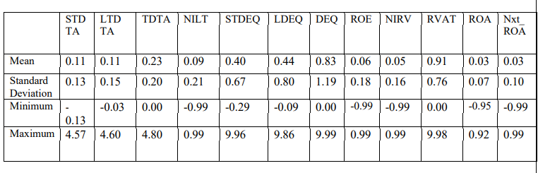
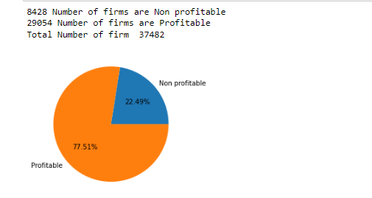
Empirical Result
Descriptive Statistics
Total number of observations in the sample 319933 and total number of firms is 37482.

Slide 8
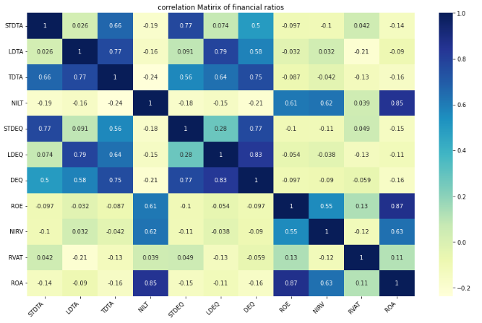

Slide 9
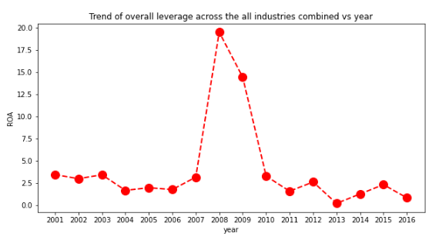
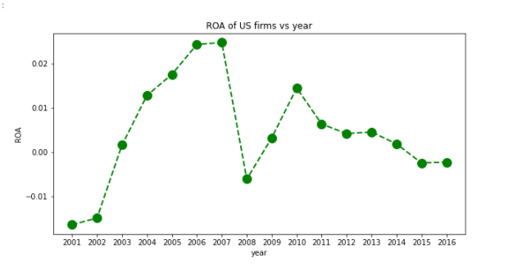
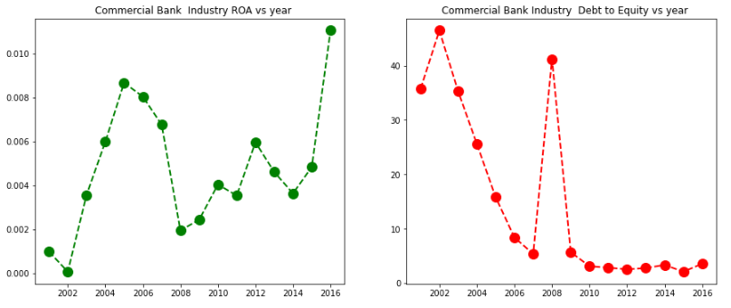
RoA and Debt to Equity Ratio Trend
1
2
3
4

Slide 10
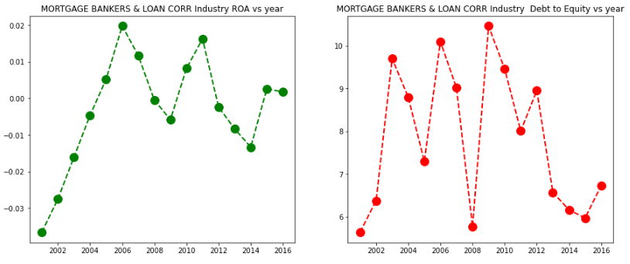
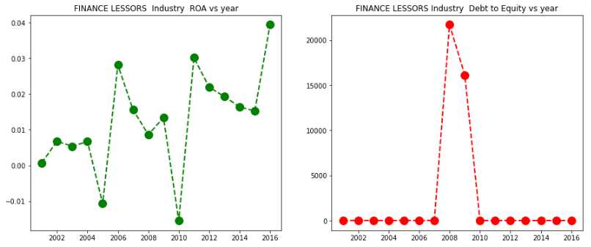
5
6
7
8

Slide 11
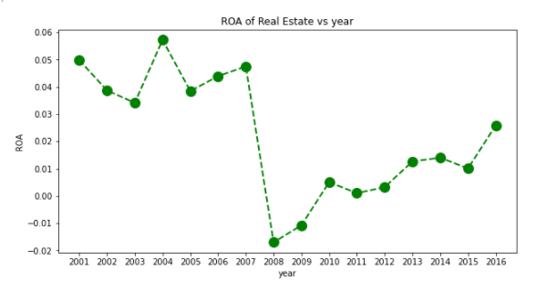
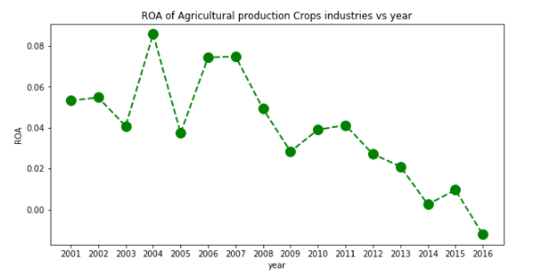
9
10

Slide 12
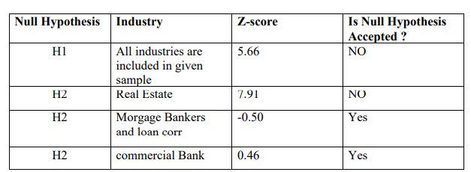
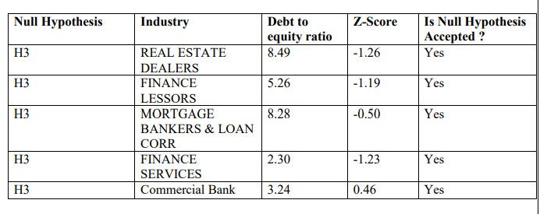
. Hypothesis testing Result

Slide 13
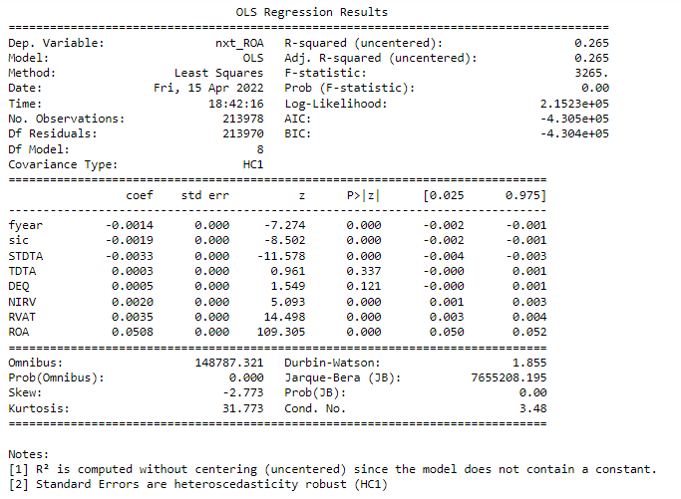
OLS – Result

Slide 14
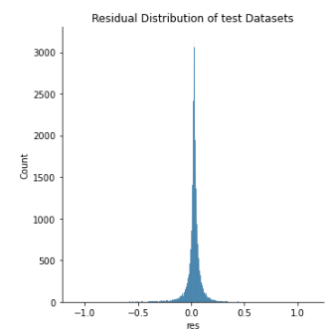
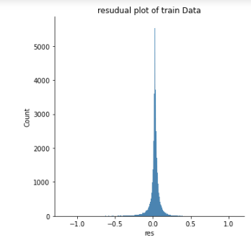
Residual distribution using OLS method

Slide 15
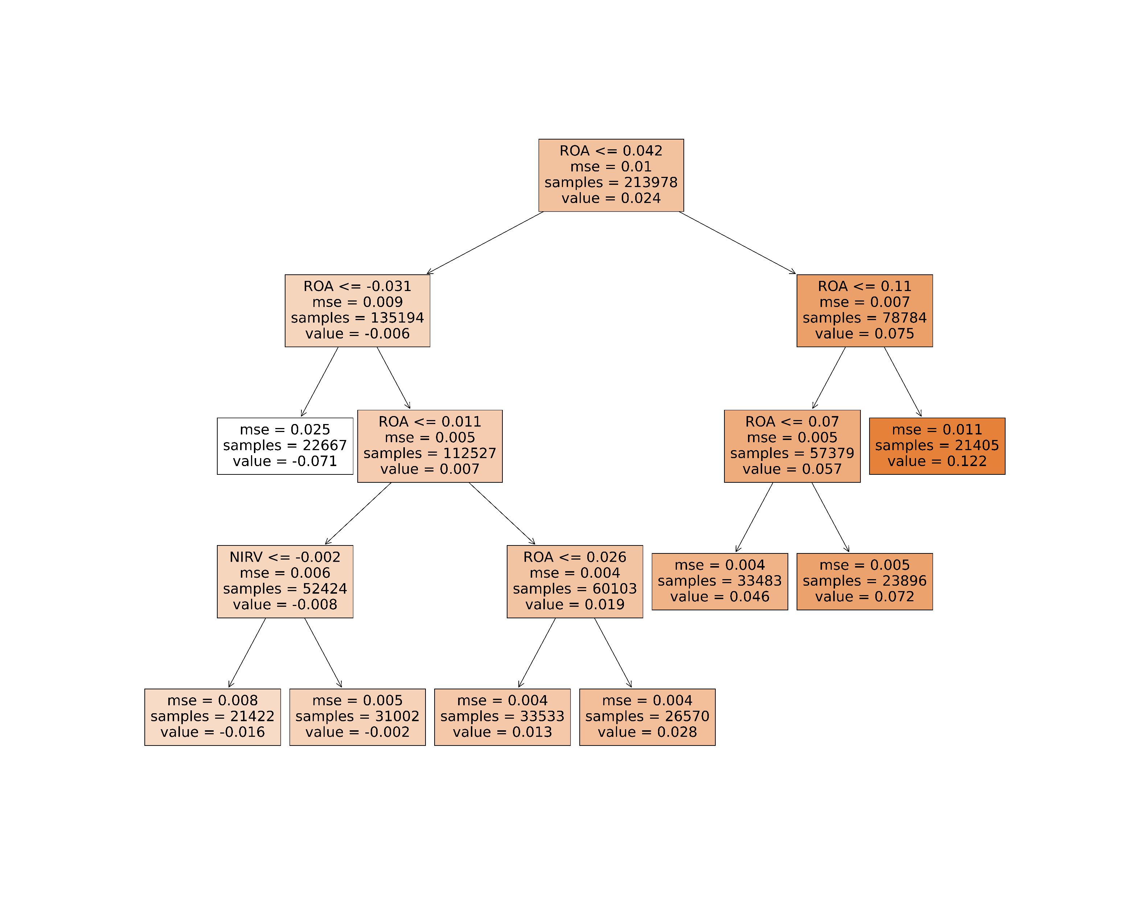
Results -- Decision Tree

Slide 16
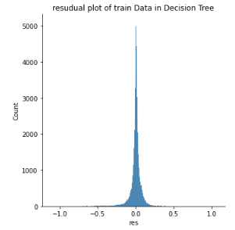
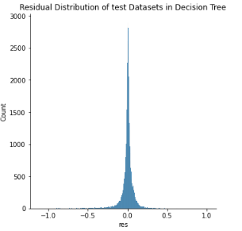
Residual distribution using Decision Tree

Slide 17
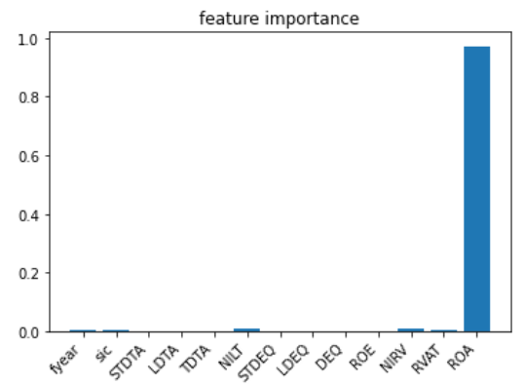
Results -- Decision Tree
Observation: Today’s cashflows are best predictors of tomorrow’s ROA
Industry affect the firm performance
Macroeconomic factors affect the firm future performance

Slide 18
Conclusions :
The mean of ROA of all firms in sample in period 2001-2008 is significantly higher than in period 2009-2016. which implies, the financial crisis 2008 may cause for some structural change in economy.
Real estate industry performance which yet did not recover to the level before financial crisis 2008 performance level. it might be because of real estate property price in period 2009-2016 is in saturation state while price was highly inflated before financial crisis.
Mortgage Bankers, commercial Bank ,Real estate dealers, Finance lessors , Finance Service industries performance recovered to the level in period 2001-2008. Which may be because of during crisis, US government bailout packages in these most affected industries.

Slide 19
Total debt proportion in total Asset does not affect significantly to the firm performance, while short term debt impact negatively to the firm’s ROA .
Decision Tree model perform as good as OLS model to forecast next year ROA of firm with respect to Root Mean square error value as a performance measure of model.
Current year ROA of firm is the most important factor to forecast next year ROA of firm and impact positively to next year performance of firms. which tell us the present cash flow predict future cash flow.
Financial year is significant to forecast firm performance. Which implies macroeconomic condition (incorporated in Financial year) like government policy, interest rate and other economic activity which is not controlled by firm impact the future performance of firms.
Industry effect on next year firm performance is significant, which implies two firm from two different industries with same financial data in current year impact differently firm next year performance.

Slide 20
Thank You!

