Slide 1
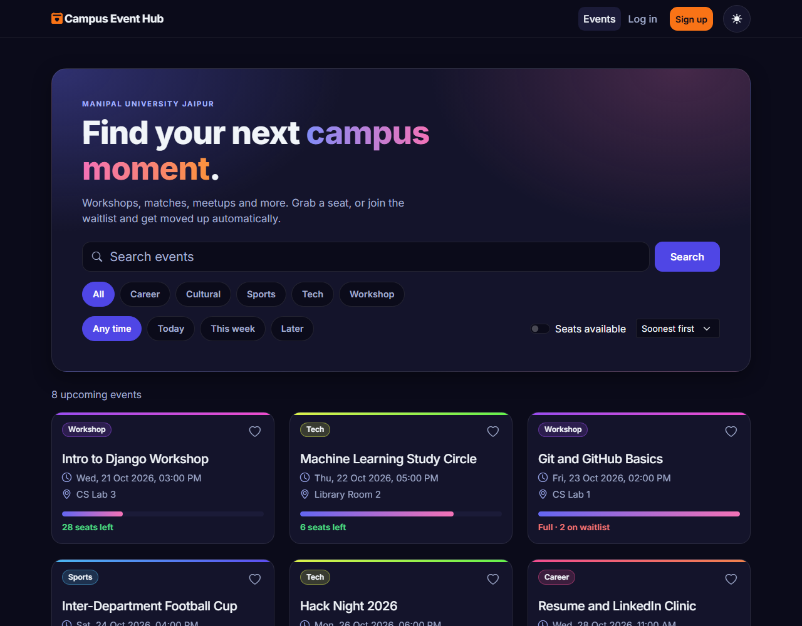
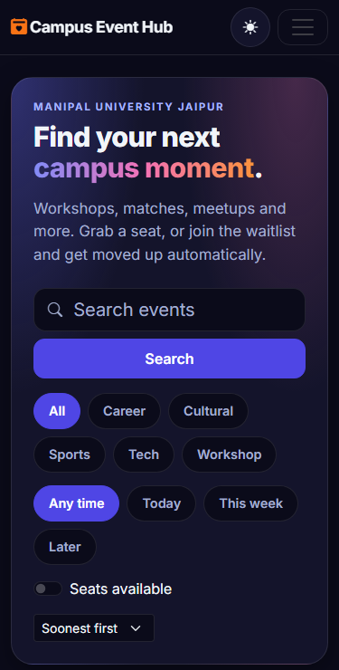
WEB TECHNOLOGIES · AIM3140 · PROJECT
Campus
Event Hub
Find it. Join it. Host it.
An event platform for campus life, with a waitlist that moves by itself.
Sahil Lenka
Reg. no. 2427010391 · B.Tech AIML, Section C
Manipal University Jaipur
Notes:
Introduce yourself and the project in one line: Campus Event Hub, a web app where students find events, get a seat or join a waitlist, and hosts manage who comes. It is live on the internet, and I will show real screens from it.

Slide 2



Campus events live on posters and chats
Events are hard to find
Seats are a guess
Hosts fly blind
Events are spread across posters, WhatsApp groups and word of mouth.
Students arrive to a full room, or skip an event that had plenty of space.
Organisers cannot see who is coming, who is waiting or who really showed up.
The goal: one place where students find events and get a seat, and hosts stay in control.
Notes:
Explain the problem from both sides. Students do not know what is on or if there is space. Hosts do not know who is coming. The project puts all of that in one place.

Slide 3




One place, four moments
01
02
03
04
Discover
Register
Wait
Check in
Search, filter and sort upcoming events with live results.
One click takes a seat, and the seat meter updates at once.
Event full? Join the queue. A cancellation promotes you automatically.
Hosts tick people off at the door and download a CSV.
Notifications
Saved events
Add to calendar
Dark and light themes
Notes:
Walk through the four moments a student or host goes through: find an event, register, wait if it is full, and check in on the day. The chips are the extras around that core.

Slide 4
Discover: search that keeps up
1
Live search
Results change as you type, with no page reload (jQuery and JSON).
2
Smart filters
Category, today or this week, seats only, and sort by most popular.
1
2
3
Seat meter
See how full an event is at a glance, with a warning when seats run low.
4
4
Save for later
3
A heart button, a Saved page and a calendar file for every event.
Notes:
The numbered dots on the screenshot match the list. Show the live search first because it is the AJAX part of the syllabus: the page does not reload, jQuery asks the server for JSON and redraws the cards.

Slide 5
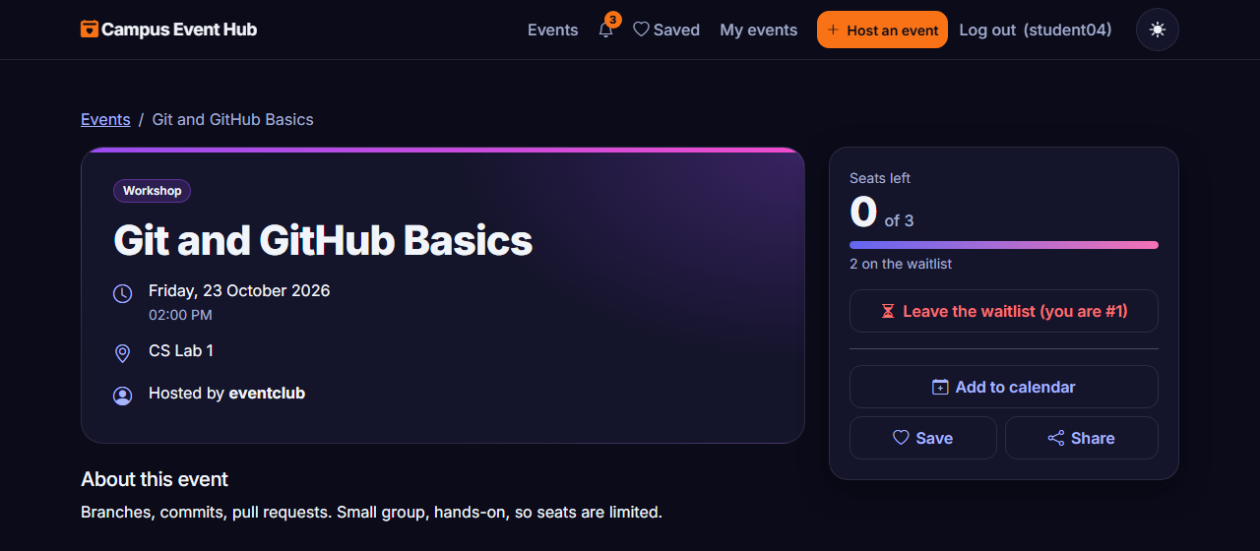
Register, or join the waitlist
One button, three states
Register for this event
Seats are free.
Join the waitlist
The event is full.
Cancel my registration
Add to calendar (.ics)
Save
Share link
Every event page also has a seat meter, host name and a clear time and place.
You are in. Cancel any time.
Notes:
This is a full event, so the person is on the waitlist at position one. The same button is used for register, join waitlist and cancel, and the server decides which one applies.

Slide 6
The waitlist moves by itself
Two people, one last seat
Git and GitHub Basics · capacity 3
waitlist, in order
Register and cancel run inside a database transaction that locks the event. Two clicks at the same moment cannot both get the last seat.
A
B
C
D
E
confirmed
#1
#2
with transaction.atomic():
event = Event.objects
.select_for_update()
.get(pk=pk)
if event.is_full:
status = WAITLISTED
else:
status = CONFIRMED
1
A cancels
2
A seat frees up
3
D is confirmed
4
D gets a notification
Notes:
Left: three seats are taken, two people wait. When A cancels, the first person on the waitlist is confirmed and told. Right: the lock is what makes the last seat safe. The code shown is a simplified version of the real view.

Slide 7
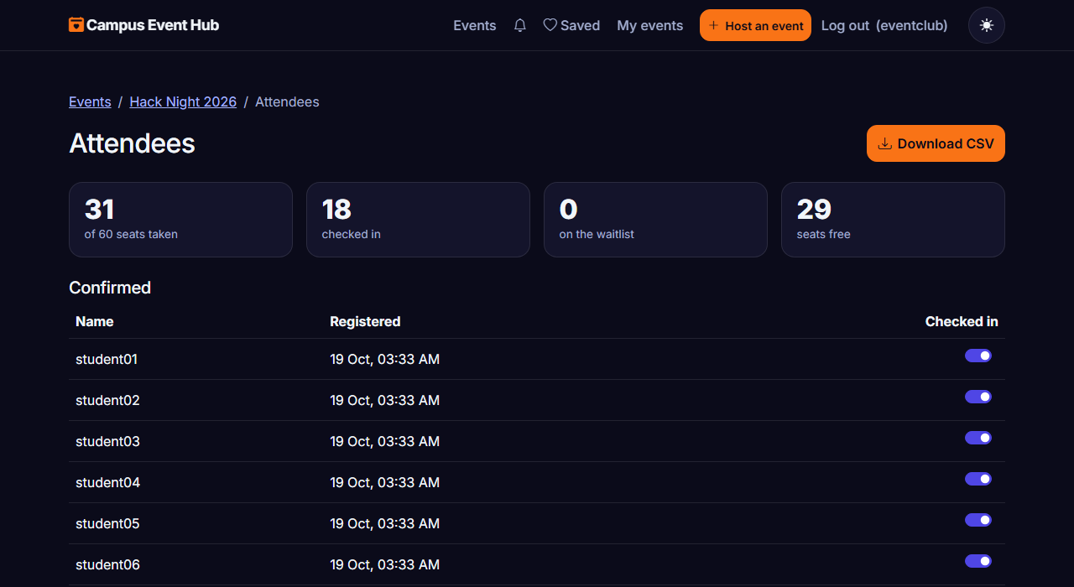


Hosts see who is coming
Live check-in
A switch per person, saved at once with AJAX.
Waitlist view
See who is queued and in what order.
CSV download
Spreadsheet-safe: names that start with = + - or @ are escaped.
Notes:
Only the person who created the event can open this page. Everyone else gets a 403 error. The check-in switch calls the server without reloading, and the CSV protects against spreadsheet formula injection.

Slide 8
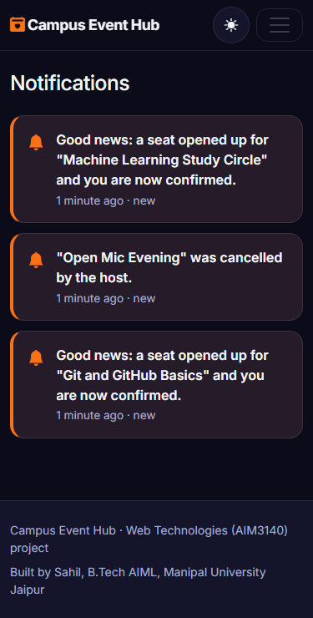
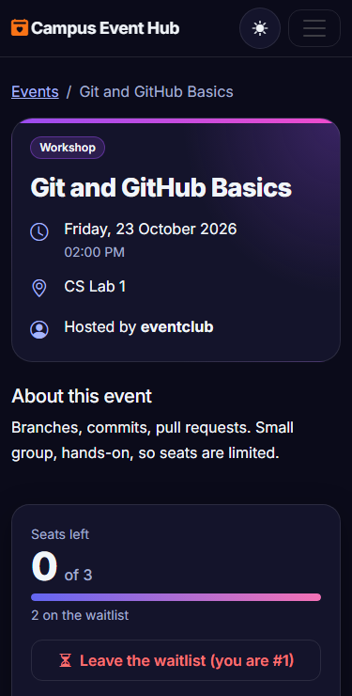



Never miss a seat
A bell with a count
Unread alerts show in the menu on every page.
Sent when it matters
A seat opens for you, or an event you joined is cancelled.
Email when set up
If you gave an address and the site has mail settings.
SMS is not included: it needs a paid provider.
Notes:
The bell is the main channel and works on the live site today. Email is built and tested but only sends when mail settings are added, so on the live site the alerts show in the bell. SMS is out of scope.

Slide 9








The syllabus, mapped to the project
HTML and forms
CSS and Bootstrap
JavaScript and DOM
jQuery, AJAX, JSON
Templates, sign up, log in and event forms with validation.
Responsive grid from phone to desktop, dark and light themes.
Cards, seat counts, toasts and the theme switch built live.
Search, register, save and check-in with no reload.
Python for the web
MySQL and CRUD
Django MVT and ORM
Admin interface
GET and POST views, sessions, cookies and CSRF.
MySQL is supported; the schema and CRUD queries are in sql/schema.sql.
Models, views, templates, URL routing and ORM queries.
Search, filters and drill-down for every table.
Notes:
Map each tile to the course outline. NodeJS and AngularJS are in the syllabus but are not used in this project. MySQL is supported by the code and the schema file, but the tested setups are SQLite on a computer and PostgreSQL on the live site.

Slide 10
How the pieces fit
Browser
Django (Python)
Database
GET / POST
HTML
URLs
Views
SQLite
on a computer
PostgreSQL
live (Supabase)
MySQL
supported
ORM
CSS + Bootstrap
JavaScript
Models + ORM
Templates
HTML + JSON
jQuery
From code to live site
git push to GitHub
Vercel builds and deploys
Migrations run
Live at the Vercel address
Notes:
Django follows Model, View, Template. The browser sends GET and POST requests with a CSRF token and gets HTML pages or JSON back. Django talks to the database only through the ORM, so the same code runs on SQLite, MySQL or PostgreSQL. Every push to GitHub is built and deployed by Vercel.

Slide 11
Five tables, one clear model
Category
Event
User (Django)
groups
hosts
name
title, description
venue, start time
capacity
category, organiser
username, email
password (hashed)
has many
receives
SavedEvent
Registration
Notification
user, event
one save per pair
event, user
status: confirmed or waitlisted
checked_in
one seat per pair
user, message, link
created and read time
Notes:
Event is the centre. A category groups events and a user hosts them. Registration links a user to an event and holds the status and check-in flag, and a database constraint stops one person taking two seats. SavedEvent and Notification are the two newest tables.

Slide 12




Built to be trusted
84
CSRF token on every POST
Including the AJAX calls.
Owner-only pages
401 without login, 403 for other users.
automated tests
Spreadsheet-safe CSV
Waitlist rules, filters, permissions, CSV, notifications, forms and login.
Formula characters are escaped.
HTTPS and secure cookies
Secret key comes from the environment.
Found by testing: a filter crash on a superscript digit, and a “just now” label that never showed. Both fixed.
Notes:
The tests run with python manage.py test on an in-memory database. Two real bugs came out of the review and testing rounds: a crash when a filter value was a superscript digit, and a time label that never showed just now. Both have tests now.

Slide 13



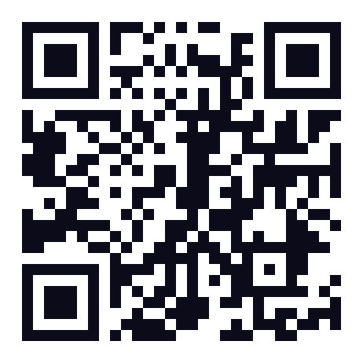
Live on the internet
GitHub
Vercel
Supabase
source code
build and host
PostgreSQL data
Every push to the main branch deploys by itself.
Database changes are applied during the build.
Data lives in Supabase PostgreSQL, in the Mumbai region.
Accounts are per site: the live site and a local copy have separate users.
Scan to try it live
campus-event-hub-lake.vercel.app
Notes:
Show the live site on a phone by scanning the code. The repository link is on the last slide. Accounts on the live site are separate from any account on a local computer, because each has its own database.

Slide 14
Thank you
What is next
Email on the live site
Questions?
needs mail settings added
Poster images
Sahil Lenka
needs cloud file storage
Reg. no. 2427010391 · B.Tech AIML, Section C
Manipal University Jaipur
MySQL end to end
a full test run on MySQL
Live campus-event-hub-lake.vercel.app
Code github.com/Sahil-u07/campus-event-hub
Notes:
Close by saying what you would do next. Each item needs something outside the code: mail settings, file storage, or a MySQL server. Then take questions.

