Slide 1
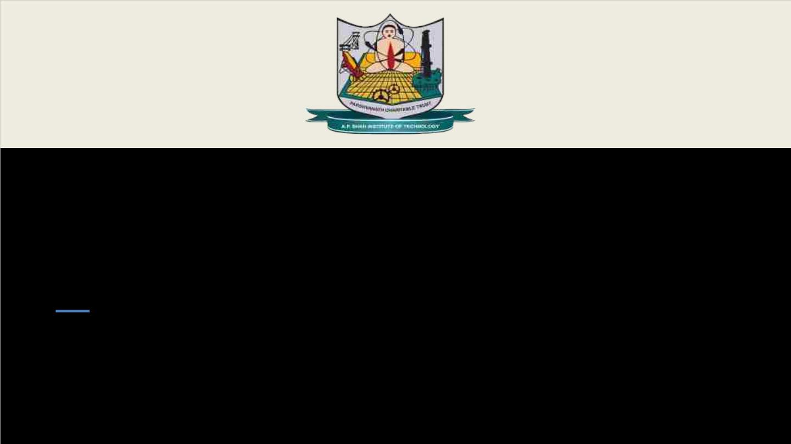
Department of Information Technology
NBA Accredited
A.P. Shah Institute of Technology
G.B.Road, Kasarvadavli, Thane (W), Mumbai-400615
UNIVERSITY OF MUMBAI
Academic Year 2025-2026

Slide 2
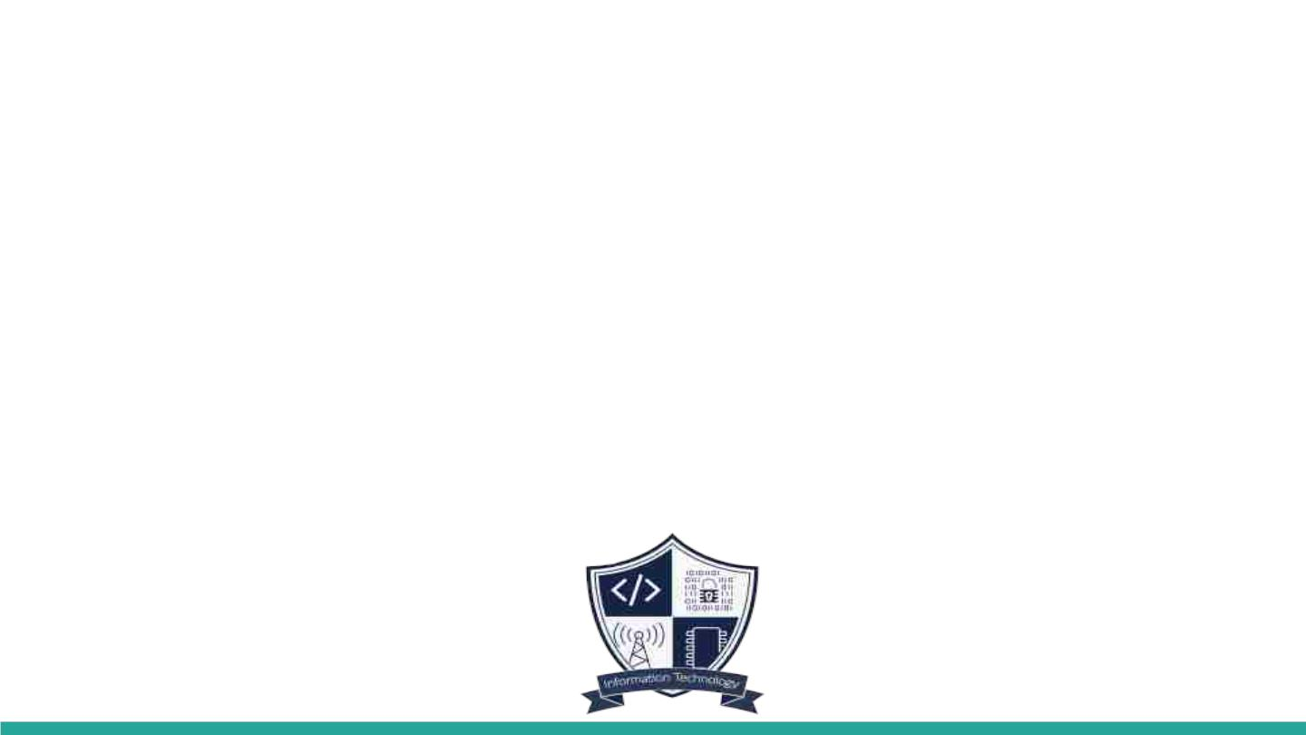
A Project Presentation on
Infrasage – AI-Augmented DevSecOps with Natural Language Iac and Drift resilient CI/CD
Submitted in partial fulfillment of the degree of
Bachelor of Engineering(Sem-8)
In
INFORMATION TECHNOLOGY
By
Sahil Gada (23204019)
Swayam Shah (23204005)
Kushagra Singh (22104182)
Pranav Patil (21104134)
Under the Guidance of
Dr. Vaibhav Yavalkar

Slide 3

1.Project Conception and Initiation

Slide 4
1.1 Abstract
InfraSage is an AI-augmented DevSecOps framework designed to automate cloud infrastructure creation and management through natural language inputs. It enables users to generate Terraform Infrastructure-asCode (IaC) automatically from plain text prompts, ensuring secure and efficient infrastructure deployment. The system integrates multiple security validation tools such as Checkov, tfsec, Terrascan, and OPA to prevent misconfigurations and compliance issues. Using a GitOps-based CI/CD pipeline, InfraSage ensures smooth deployment and continuous validation, while Prometheus and Grafana provide monitoring and anomaly detection. The goal is to create a free-tier-friendly, production-ready platform that simplifies DevSecOps for developers, students, and small teams.

Slide 5
1.2 Objectives
•To generate Terraform Infrastructure as Code (IaC) from
natural language prompts.
•To integrate multiple security scanning tools like Checkov,
tfsec, Terrascan, and OPA for compliance validation.
•To design a GitOps-based CI/CD pipeline for automated and
secure deployments.
•To incorporate monitoring tools like Prometheus and Grafana
for drift detection and anomaly tracking.
•To develop a cost-effective and user-friendly DevSecOps
framework accessible to small teams and students.

Slide 6

1.3 Literature Review
No. | Paper Title | Author | Year | Findings
[1] | AI-Augmented DevSecOps | S. K. Chinnam | 2024 | Introduced AI-based automation, telemetry-driven threat detection and compliance
[2] | Using Large Language Models for Generating IaC | K. Ganesh Srivatsa et al. | 2024 | Demonstrated that LLMs can translate natural language to IaC, simplifying infrastructure provisioning.
[3] | DevSecOps Automation for Secure Cloud Infrastructure | S. Rao et al. | 2023 | Proposed automated security enforcement and remediation workflows.
[4] | Automated IaC Validation using Policy-as-Code | A. Sharma, N. Gupta | 2022 | Implemented automated validation using OPA and static analysis tools.
[5] | InfraSage (This Work) | Sahil Gada et al. | 2025 | Developed an AI-native framework combining NLP-based IaC generation, multi-layer security scanning, GitOps CI/CD and monitoring.

Slide 7
1.4 Problem Definition
Manual Infrastructure-as-Code creation is error-prone, time-consuming,
and prone to security flaws. Developers must manage multiple tools for
code generation, validation, and deployment, which increases complexity
and risk. There is currently no unified system that can automatically
generate, validate, deploy, and monitor secure cloud infrastructure using
natural language. InfraSage aims to solve this problem by developing an
AI-powered framework that integrates these processes seamlessly,
reducing human error and improving reliability.

Slide 8
1.5 Scope
•AI-driven DevSecOps framework automating secure cloud
infrastructure creation using Terraform.
•Uses NLP to convert user prompts into Terraform IaC, reducing manual
coding.
•Implements GitOps-based CI/CD via Digger and GitHub Actions with
drift detection and remediation.
•Enables real-time monitoring and alerting through Prometheus,
Grafana, Slack, and Email.
•Integrates multi-layer security with Checkov, tfsec, Terrascan, and OPA
for validation and compliance.

Slide 9
1.6 Technology stack
•IaC: Terraform
•Security Tools: Checkov, tfsec, Terrascan, OPA
•CI/CD & GitOps: GitHub Actions, Digger
•Containerization: Docker
•Monitoring: Prometheus, Grafana
•Alerts & Notifications: Slack, Email

Slide 10
1.7 Benefits for environment & Society
InfraSage promotes sustainable cloud computing by reducing resource wastage through drift detection and anomaly monitoring. It enhances societal cybersecurity by enforcing secure infrastructure deployment before production. Additionally, it democratizes access to DevSecOps automation for students and small organizations, contributing to inclusive innovation aligned with SDG 9.
More stable digital service (banking,education, health apps, e-commerce).

Slide 11
SDG Mapped with Contribution
InfraSage aligns with the United Nations’ Sustainable Development Goal
(SDG) 9: Industry, Innovation, and Infrastructure.
This project contributes to digital transformation by promoting innovation in the field of secure infrastructure automation. It helps build sustainable, reliable, and costefficient DevSecOps solutions that support industrial growth and technological advancement. By making such tools accessible to students, developers, and startups, InfraSage contributes to building robust digital infrastructure that encourages innovation and inclusive development.

Slide 12
2. Project Design

Slide 13
2.1 Proposed System
InfraSage proposes an integrated AI-native DevSecOps solution that:
• Translates natural language prompts into validated, secure Terraform code.
• Embeds multi-layer security scanning across the CI/CD pipeline.
• Implements GitOps (Digger + GitHub Actions) for compliant, auditable deployment flows.
• Runs scheduled drift detection with automated remediation PRs.
• Uses Prometheus + Grafana telemetry and ML-based anomaly detection for observability and alerts.

Slide 14

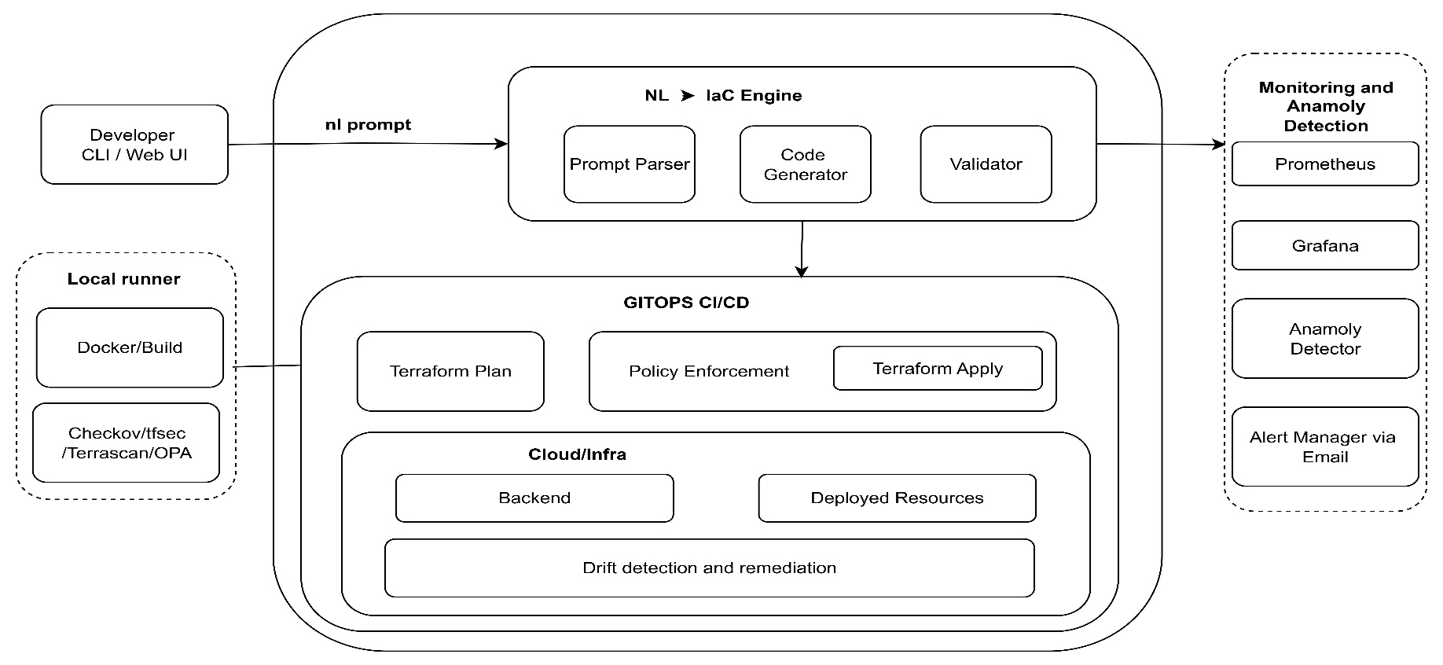
2.2 Design(UML Diagram)

Slide 15
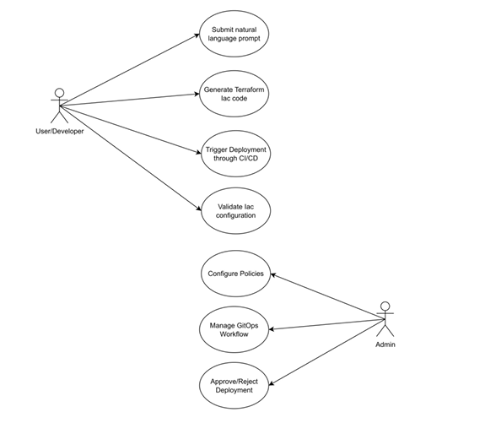
2.3 Description Of Use Case

Slide 16
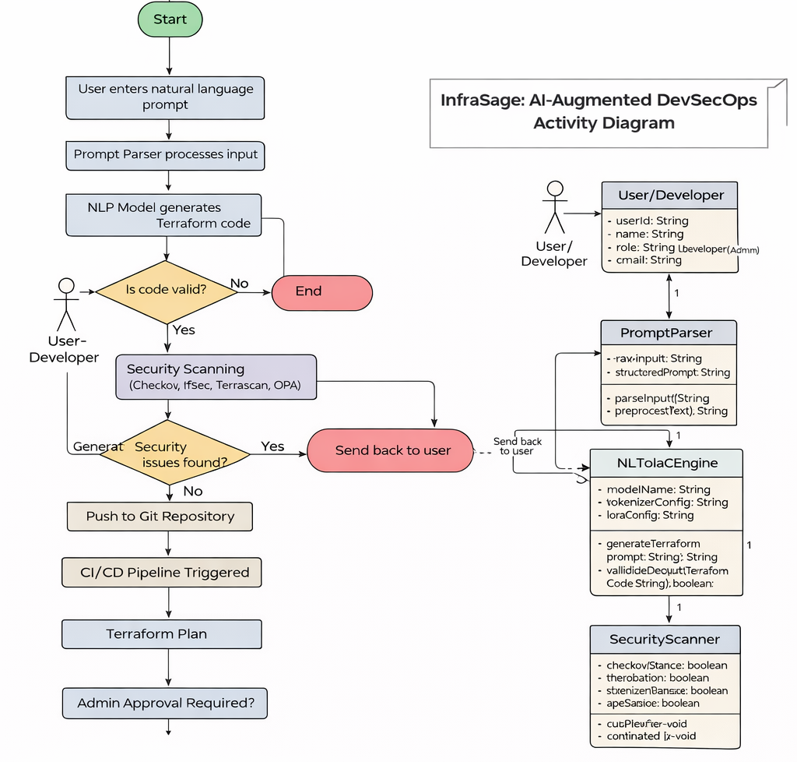
2.4 Activity diagram

Slide 17
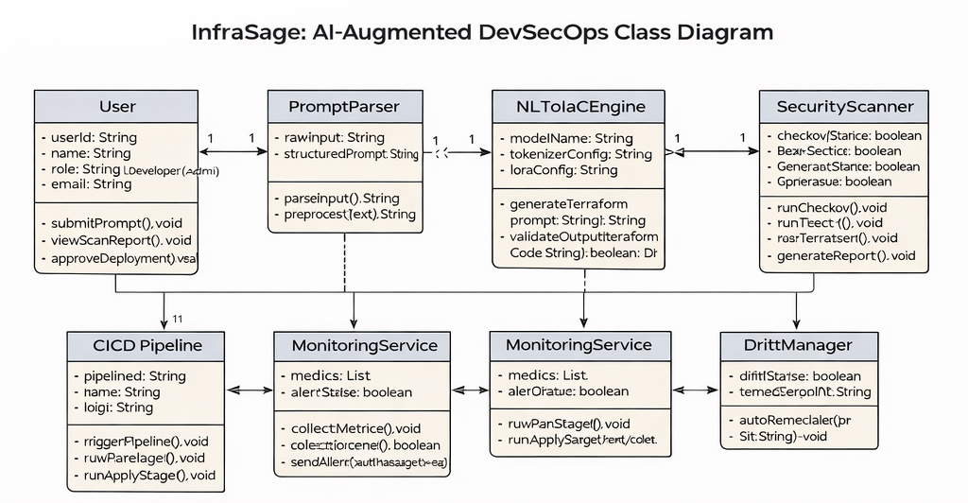
2.5 Class Diagram

Slide 18
3. Implementation

Slide 20
Cost Estimation using COCOMO-II Model
No. | Cost Component | Calculation | Amount(Rs)
[1] | Paid Software Costing | -- | 0
[2] | Developer Cost | 2 × 30,000 × 4 | 2,40,000
[3] | System Cost | 4×55,000 = 2,20,000 → 25% = 55,000 | 55,000
[4] | Additional H/W | -- | 0
[5] | Miscellaneous Costs | -- | 10,000

Slide 21
4. Testing

Slide 22
4.1 Testing:
Testing ensures that each component of the Natural Language to IaC Automation System performs correctly, integrates smoothly, and meets both functional and non-functional requirements.
The testing process was divided into unit testing, integration testing, system testing, and user acceptance testing (UAT)

Slide 23
5. Result

Slide 24
5.1 Result:
The developed system successfully demonstrates the conversion of natural language (NL) prompts into Terraform-based Infrastructure-as-Code (IaC) configurations, followed by automated validation and deployment through a GitOps CI/CD workflow.
All components — from prompt parsing to monitoring — functioned cohesively to achieve the intended automation and governance objectives.

Slide 25
6. Conclusion and Future
Scope

Slide 26
6.1 Conclusion
The InfraSage Framework represents an innovative approach to intelligent infrastructure automation, designed to streamline the management, deployment, and monitoring of cloud resources through a blend of artificial intelligence and Infrastructure-as-Code (IaC) practices.
By integrating natural language processing, automated policy validation, and self-healing workflows, the system redefines how infrastructure is created, governed, and maintained.
At its foundation, InfraSage introduces a command-line interface capable of generating Terraform code through natural language input, allowing users to translate plain-text intent into precise, executable configurations.

Slide 27
References
[1] S. K. Chinnam, “AI-Augmented DevSecOps: Automating Threat Detection and Compliance in Cloud-Native Pipelines Using Telemetry and Policy-as-Code,” International
Journal of Computer Engineering and Technology (IJCET), Vol. 15, No. 1, Jan–Feb
2024.
[2] K. Ganesh Srivatsa, S. Mukhopadhyay, G. Katrapati, and M. Shrivastava, “A Survey of Using Large Language Models for Generating Infrastructure as Code,” arXiv
preprint, March 2024.
[3] X. Yu, H. Xu, and Z. Wu, “Research on the Integration Technology of Complex MultiSchedule Scheduling: A Case Study of Exam Scheduling in Colleges,” 2024.
[4] A. Sharma and N. Gupta, “Automated IaC Validation using Policy-as-Code,” IEEE
Conference on Cloud Computing Technologies, 2022.
[5] S. Rao, P. Mehta, and R. Deshmukh, “DevSecOps Automation for Secure Cloud Infrastructure,” International Journal of Advanced Research in Computer Science, 2023.

Slide 28
Paper Publication

Slide 29
Thank You

