Slide 1
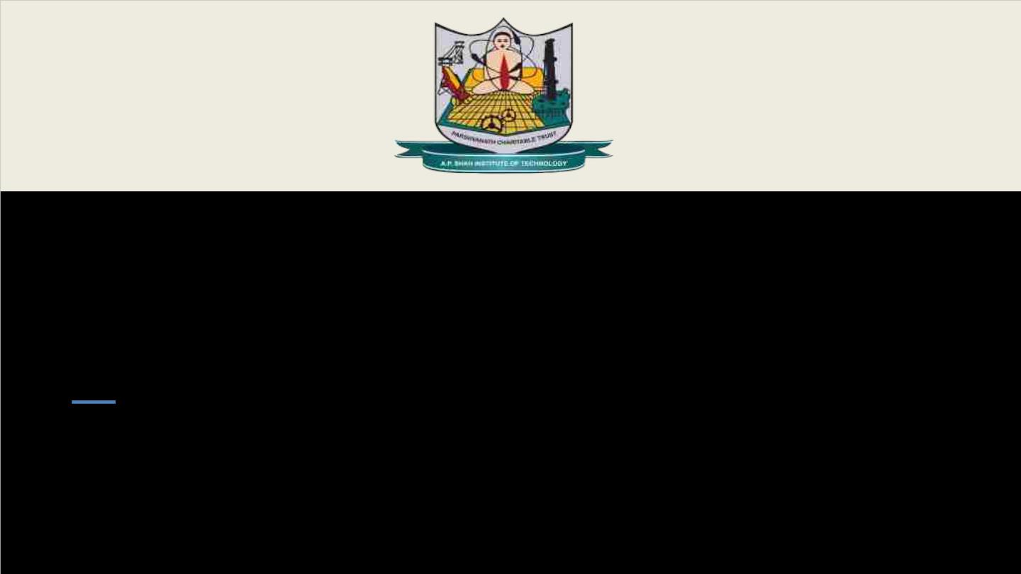
Department of Information Technology
NBA Accredited
A.P. Shah Institute of Technology
G.B.Road, Kasarvadavli, Thane (W), Mumbai-400615
UNIVERSITY OF MUMBAI
Academic Year 2025-2026

Slide 2
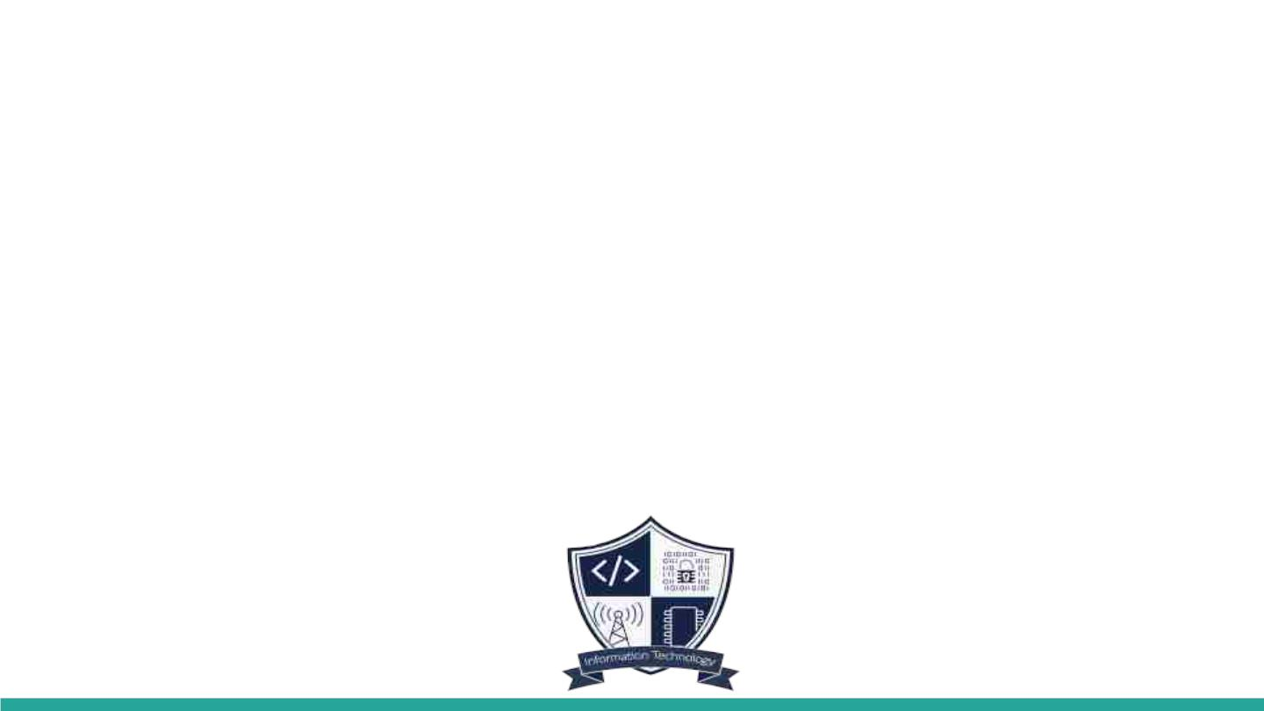
A Project Presentation on
Infrasage – AI-Augmented DevSecOps with Natural Language Iac and Drift resilient CI/CD
Submitted in partial fulfillment of the degree of
Bachelor of Engineering(Sem-8)
In
INFORMATION TECHNOLOGY
By
Sahil Gada (23204019)
Swayam Shah (23204005)
Kushagra Singh (22104182)
Pranav Patil (21104134)
Under the Guidance of
Dr. Vaibhav Yavalkar

Slide 3

1.Project Conception and Initiation

Slide 4
1.1 Abstract
InfraSage is an AI-driven DevSecOps framework that transforms natural-language infrastructure requests into Terraform code, automatically validates and secures that code using multiple scanners, and streamlines remediation, deployment, and observability through an integrated workflow. It combines local LLM-powered generation, policy-aware security checks, CI/CD automation, and Prometheus-Grafana monitoring to provide a practical end-to-end framework for secure Infrastructure as Code delivery.

Slide 5
1.2 Objectives
•To convert natural-language infrastructure requirements into production-ready Terraform with minimal manual effort.
•To enforce security-by-default through integrated multi-scanner validation across generated IaC.
•To design a GitOps-based CI/CD pipeline for automated and
secure deployments.
•To provide end-to-end operational observability through Prometheus metrics and Grafana dashboards.
•To develop a cost-effective and user-friendly DevSecOps
framework accessible to small teams and students.

Slide 6

1.3 Literature Review
No. | Paper Title | Author | Year | Findings
[1] | AI-Augmented DevSecOps | S. K. Chinnam | 2024 | Introduced AI-based automation, telemetry-driven threat detection and compliance
[2] | Using Large Language Models for Generating IaC | K. Ganesh Srivatsa et al. | 2024 | Demonstrated that LLMs can translate natural language to IaC, simplifying infrastructure provisioning.
[3] | DevSecOps Automation for Secure Cloud Infrastructure | S. Rao et al. | 2023 | Proposed automated security enforcement and remediation workflows.
[4] | Automated IaC Validation using Policy-as-Code | A. Sharma, N. Gupta | 2022 | Implemented automated validation using OPA and static analysis tools.
[5] | InfraSage (This Work) | Sahil Gada et al. | 2025 | Developed an AI-native framework combining NLP-based IaC generation, multi-layer security scanning, GitOps CI/CD and monitoring.

Slide 7
1.4 Problem Definition
Modern infrastructure teams often struggle with slow, error-prone, and insecure Infrastructure as Code workflows, where translating requirements into correct Terraform, validating security, fixing issues, and deploying through CI/CD require fragmented tools and significant manual effort. This creates delays, inconsistent quality, and higher operational risk. InfraSage addresses this problem by providing a unified framework that automates the full IaC lifecycle from intent-to-code through scanning, remediation, deployment orchestration, and observability in one coordinated pipeline.

Slide 8
1.5 Scope
•AI-driven DevSecOps framework automating secure infrastructure creation using Terraform.
•Uses NLP to convert user prompts into Terraform IaC, reducing manual
coding.
•Implements GitOps-based CI/CD via GitHub Actions.
•Enables real-time monitoring and alerting through Prometheus and Grafana.
•Integrates multi-layer security with Checkov, tfsec, Terrascan, and OPA
for validation and compliance.

Slide 9
1.6 Technology stack
•IaC: Terraform
•Security Tools: Checkov, tfsec, Terrascan
•CI/CD & GitOps: GitHub Actions
•Containerization: Docker
•Monitoring: Prometheus, Grafana
•Language: Go
•AI Model: Qwen2.5-coder:3b

Slide 10
1.7 Benefits for environment & Society
InfraSage promotes sustainable cloud computing by reducing resource wastage through drift detection and anomaly monitoring. It enhances societal cybersecurity by enforcing secure infrastructure deployment before production. Additionally, it democratizes access to DevSecOps automation for students and small organizations, contributing to inclusive innovation aligned with SDG 9.
More stable digital service (banking,education, health apps, e-commerce).

Slide 11
SDG Mapped with Contribution
InfraSage aligns with the United Nations’ Sustainable Development Goal
(SDG) 9: Industry, Innovation, and Infrastructure.
This project contributes to digital transformation by promoting innovation in the field of secure infrastructure automation. It helps build sustainable, reliable, and costefficient DevSecOps solutions that support industrial growth and technological advancement. By making such tools accessible to students, developers, and startups, InfraSage contributes to building robust digital infrastructure that encourages innovation and inclusive development.

Slide 12
2. Project Design

Slide 13
2.1 Proposed System
InfraSage proposes an integrated AI-native DevSecOps solution that:
• Translates natural language prompts into validated, secure Terraform code.
• Embeds multi-layer security scanning across the CI/CD pipeline.
• Implements GitOps for compliant, auditable deployment flows.
• It unifies generation, verification, deployment orchestration, and observability into a single framework for consistent and auditable IaC delivery.
• It uses an open-source AI model running locally for secure and controlled infrastructure code generation.

Slide 14

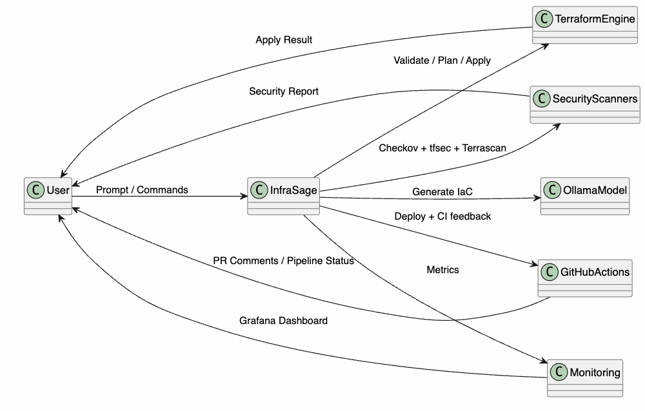
2.2 Design(UML Diagram)

Slide 15
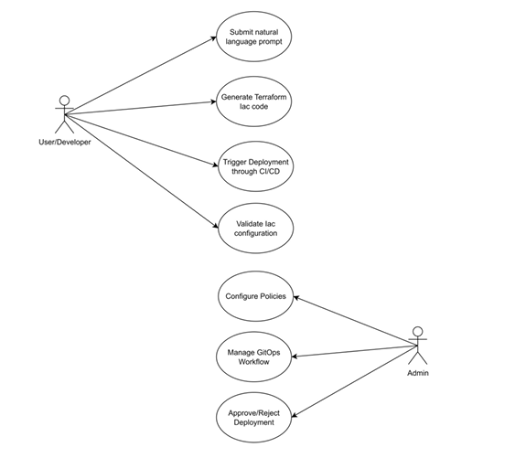
2.3 Description Of Use Case

Slide 16
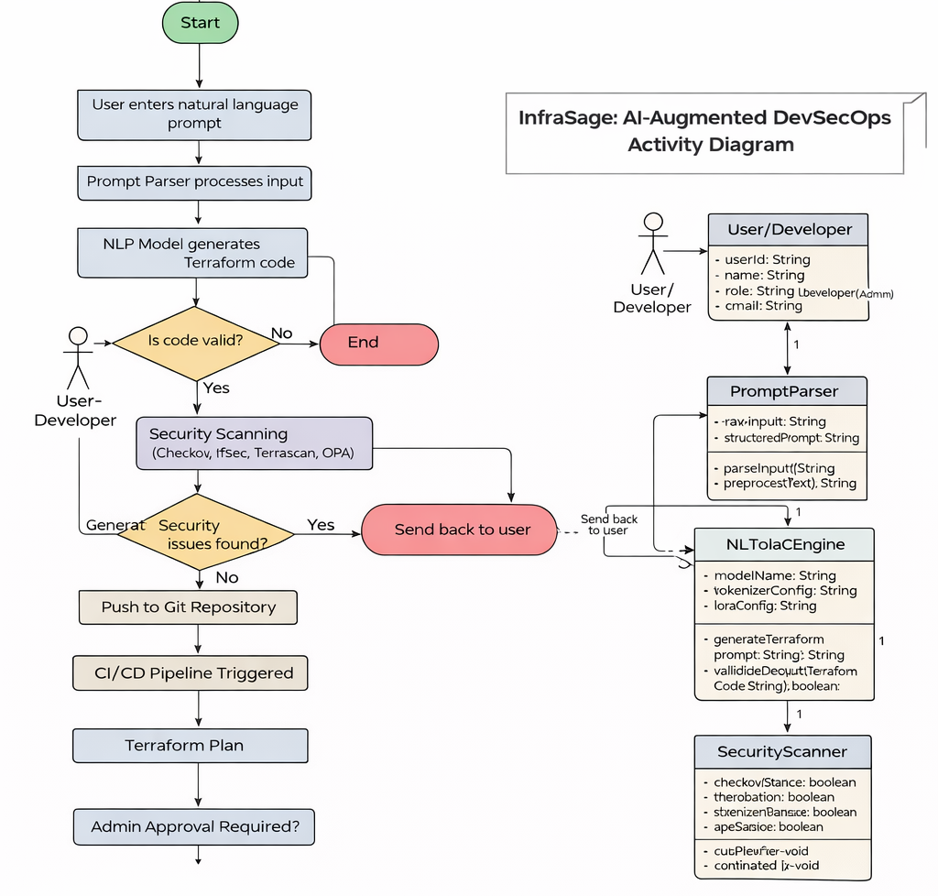
2.4 Activity diagram

Slide 17
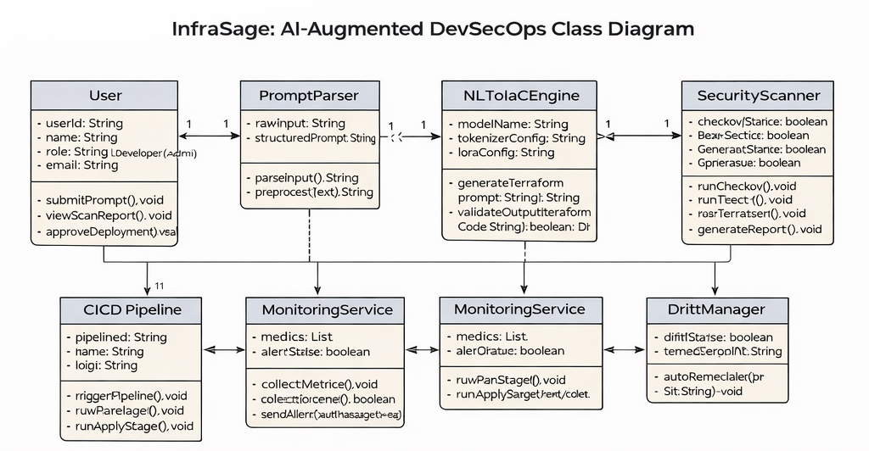
2.5 Class Diagram

Slide 18
3. Implementation

Slide 19
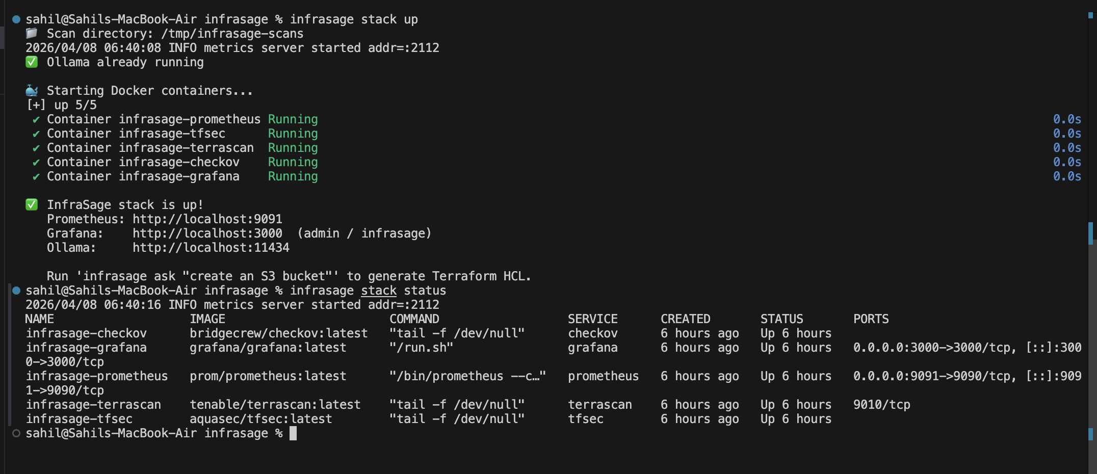

Slide 20
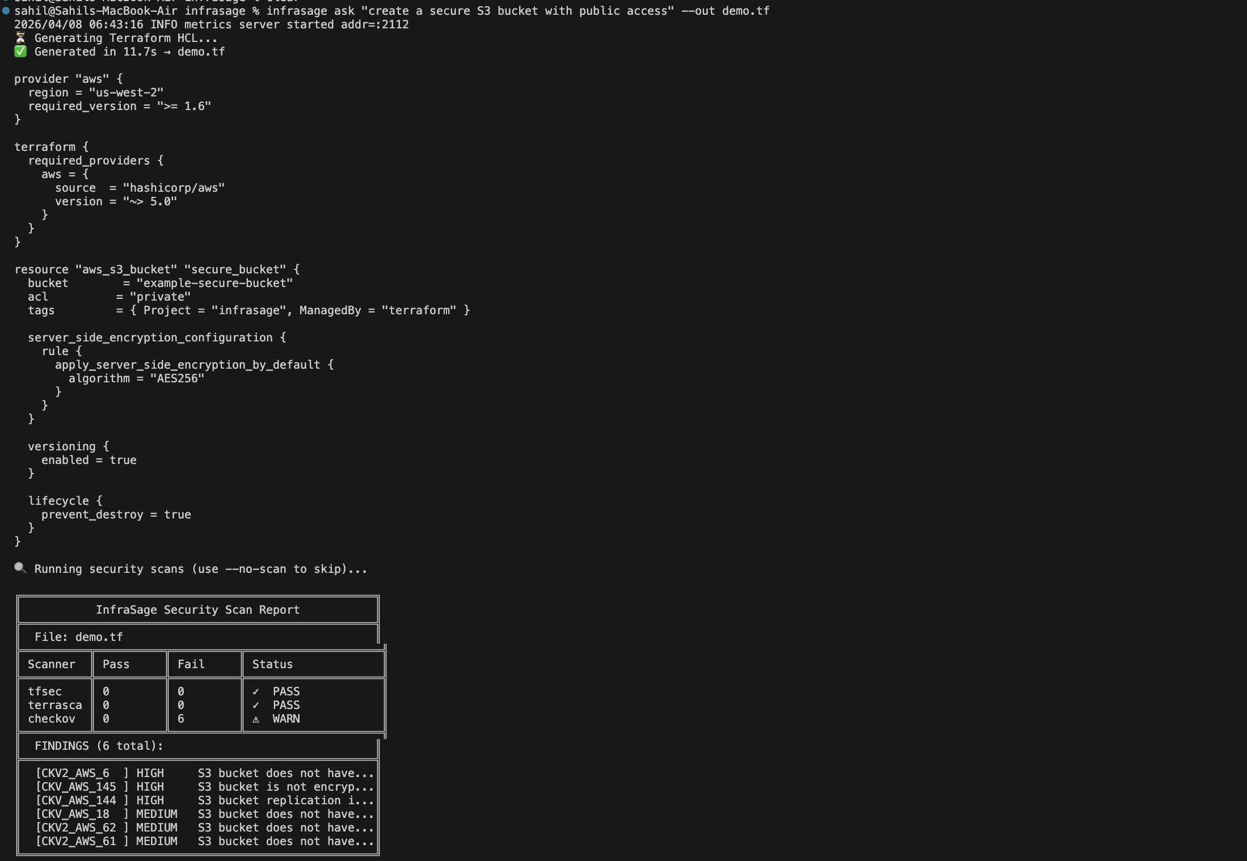

Slide 21
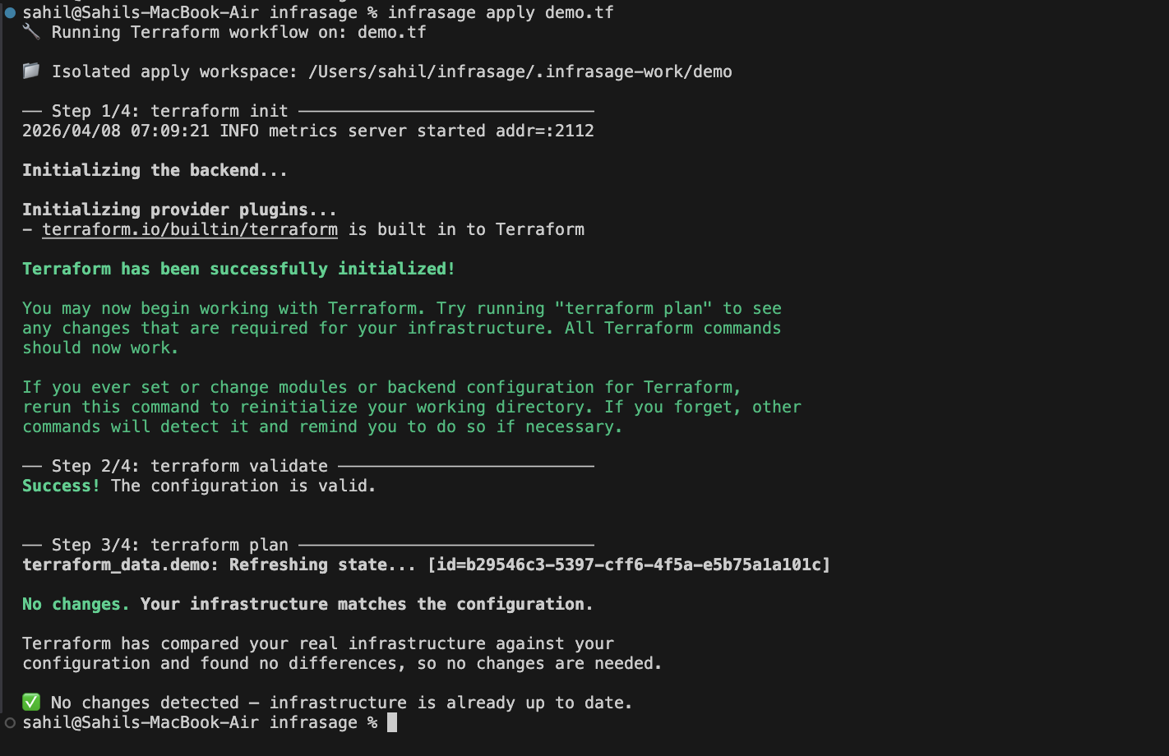

Slide 22
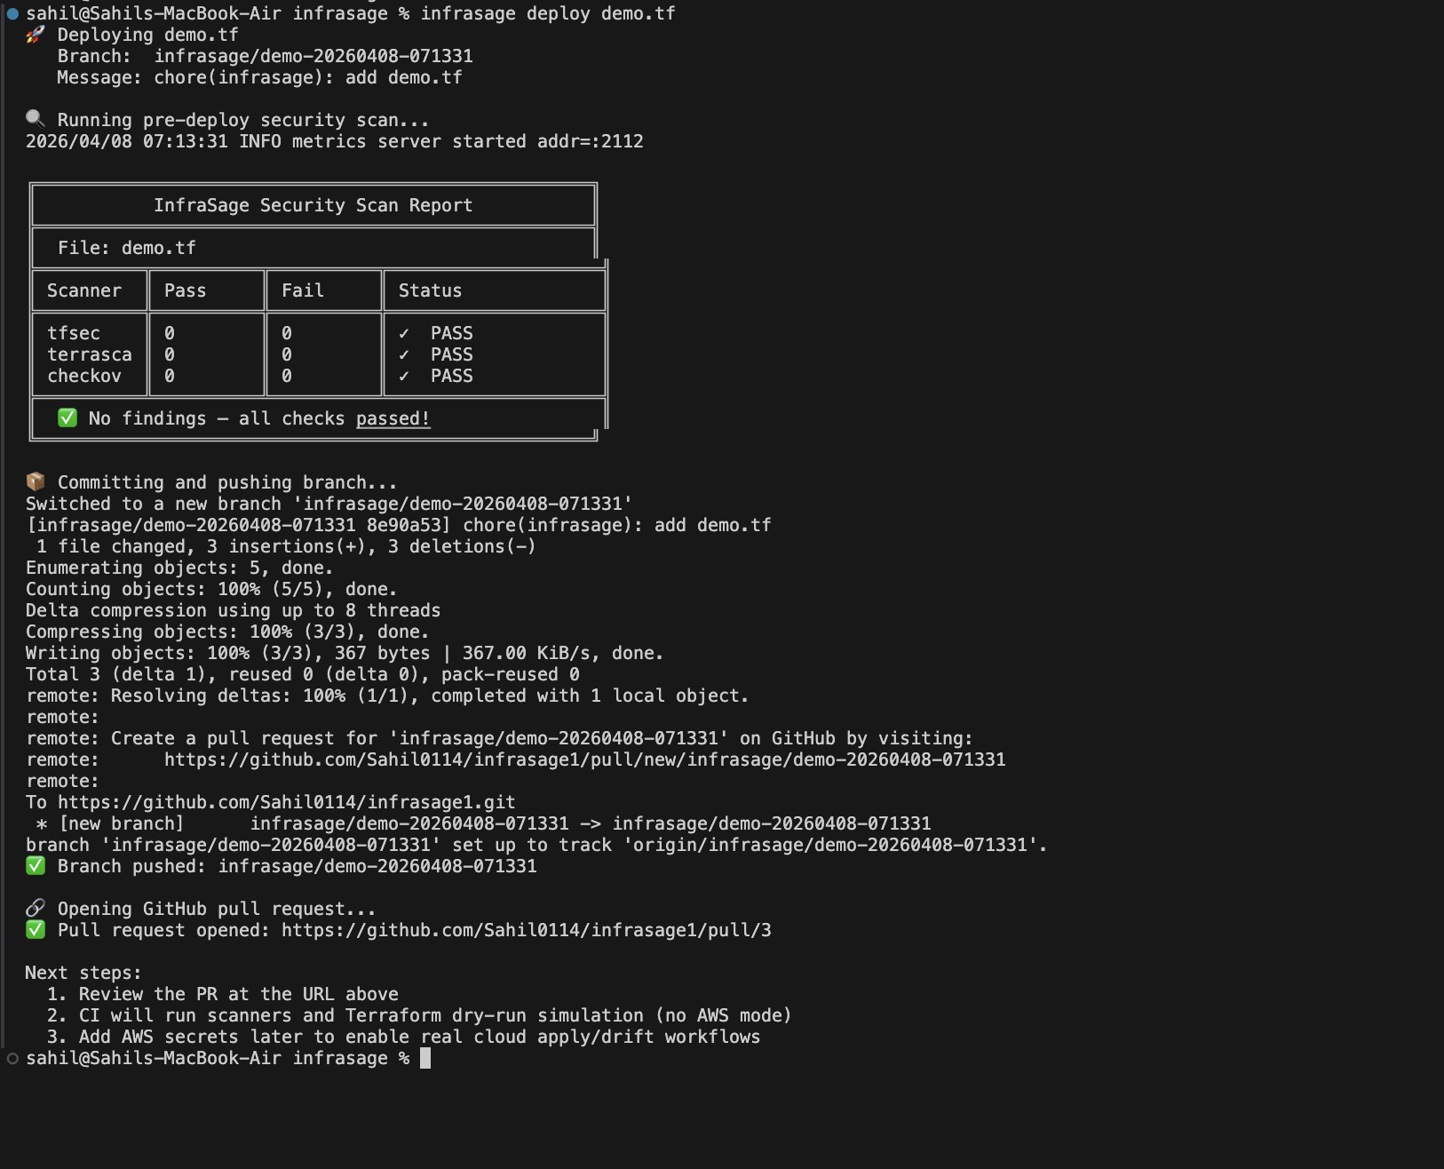

Slide 23
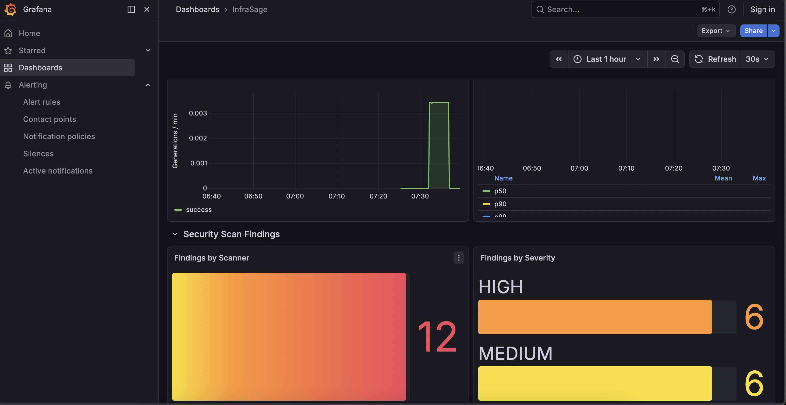

Slide 24
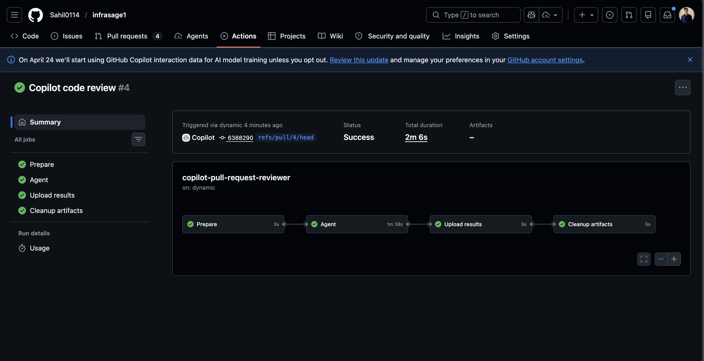

Slide 25
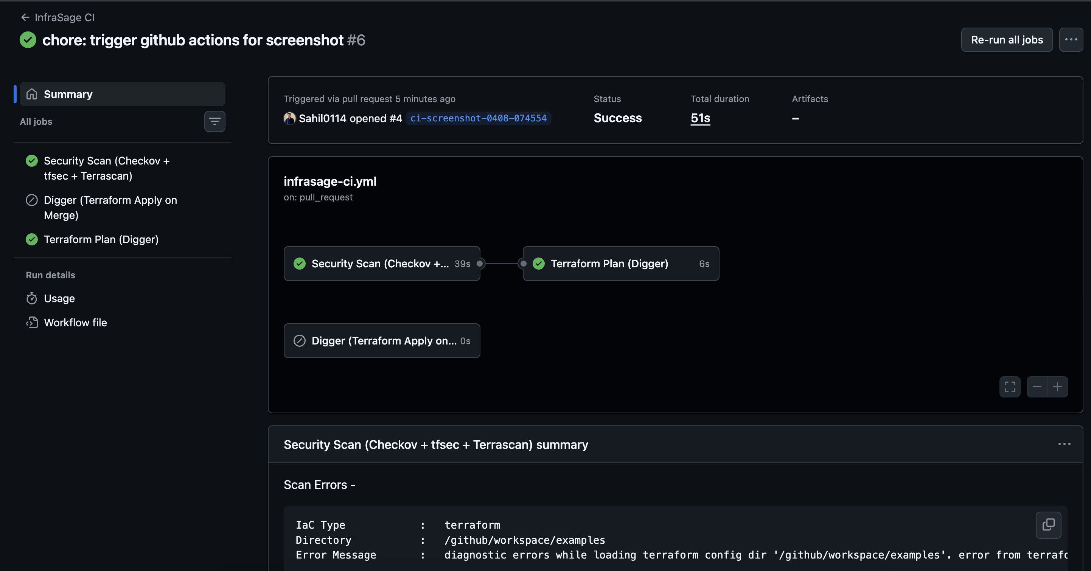

Slide 26
Cost Estimation using COCOMO-II Model
No. | Cost Component | Calculation | Amount(Rs)
[1] | Paid Software Costing | -- | 0
[2] | Developer Cost | 2 × 30,000 × 4 | 2,40,000
[3] | System Cost | 4×55,000 = 2,20,000 → 25% = 55,000 | 55,000
[4] | Additional H/W | -- | 0
[5] | Miscellaneous Costs | -- | 10,000

Slide 27
4. Testing

Slide 28
4.1 Testing:
Testing ensures that each component of the Natural Language to IaC Automation System performs correctly, integrates smoothly, and meets both functional and non-functional requirements.
The testing process was divided into unit testing, integration testing, system testing, and user acceptance testing (UAT)

Slide 29
5. Result

Slide 30
5.1 Result:
The developed system successfully demonstrates the conversion of natural language (NL) prompts into Terraform-based Infrastructure-as-Code (IaC) configurations, followed by automated validation and deployment through a GitOps CI/CD workflow.
All components from prompt parsing to monitoring functioned cohesively to achieve the intended automation and governance objectives.

Slide 31
6. Conclusion and Future
Scope

Slide 32
6.1 Conclusion
InfraSage demonstrates how an AI-driven framework can simplify and secure the complete Infrastructure as Code lifecycle by unifying generation, validation, remediation, deployment, and monitoring into one coherent workflow. By combining a local open-source model, automated multi-scanner security checks, CI/CD integration, and observability, the framework improves delivery speed, consistency, and governance while reducing manual effort and operational risk.

Slide 33
References
[1] S. K. Chinnam, “AI-Augmented DevSecOps: Automating Threat Detection and Compliance in Cloud-Native Pipelines Using Telemetry and Policy-as-Code,” International Journal of Computer Engineering and Technology (IJCET), Vol. 15, No. 1, Jan–Feb 2024.
[2] K. Ganesh Srivatsa, S. Mukhopadhyay, G. Katrapati, and M. Shrivastava, “A Survey of Using Large Language Models for Generating Infrastructure as Code,” arXiv
preprint, March 2024.
[3] X. Yu, H. Xu, and Z. Wu, “Research on the Integration Technology of Complex MultiSchedule Scheduling: A Case Study of Exam Scheduling in Colleges,” 2024.
[4] S. Rao, P. Mehta, and R. Deshmukh, “DevSecOps Automation for Secure Cloud Infrastructure,” International Journal of Advanced Research in Computer Science, 2023.

Slide 34
FUTURE SCOPE
1. Add multi-cloud support beyond AWS (Azure and GCP modules), so InfraSage can generate, scan, and deploy provider-specific Terraform from one prompt.
2. Improve AI quality with policy-aware generation, where outputs are automatically aligned to organization guardrails
3. Introduce autonomous remediation workflows that not only detect drift/vulnerabilities but also open fix branches, generate patches, and create approval-ready pull requests.
4. Build enterprise governance features such as role-based access control, audit trails, compliance dashboards, and approval gates for production-grade team adoption.

Slide 35
Paper Publication

Slide 36
Thank You

