Slide 1


Web Development & Designing Intern
Sahil Sachin Donde
B.tech - CSE
Task 1 – Basic Banking System
#GRIPJULY21
@ The Sparks Foundation

Slide 2
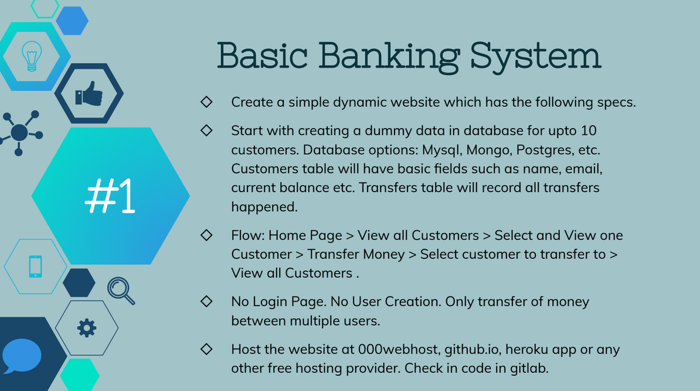

Slide 3





Tools and technologies used
Frontend: - HTML, CSS, JavaScript and jQuery
Backend: - PHP
Database: - MySQL
Server: - XAMPP (phpMyAdmin)
Text-editor: - Sublime Text

