Slide 1
OBJECT ORIENTED PROGRAMMING IN C++
-Sahil Kumar Singh
Ist year UG
Mechanical Dept

Slide 2
What exactly is OOP?
“Object-Oriented Programming” (OOP) was coined by Alan Kay circa 1966 or 1967 while he was at grad school. Ivan Sutherland's seminal Sketchpad application was an early inspiration for OOP. It was created between 1961 and 1962 and published in his Sketchpad Thesis in 1963.
Object-oriented programming (OOP) is a programming paradigm that uses "Classes" and "Objects". It is merely a method of developing software or a program that appears difficult in Procedural programming. When you wish to develop a complicated software with numerous entities interacting with each other and calling functions of each other, the OOP method is usually used.
There are numerous programming languages that support OOP like Java, C++, C#, Python, R, PHP, VisualBasic.NET, JavaScript, Ruby, Pearl, SIMSCRIPT, Object Pascal, Objective-C, Dart, Swift, Scala, Kotlin, Matlab, etc

Slide 3
Why in C++?
A few of the reasons why learning object-oriented programming in C++ is a wise idea:
For versatility and skill and usefulness in the job market, you cannot do better than C++ as the main Object-Oriented language in the world today.
Java may be easier to learn, but its use is limited to certain sub-fields (most web-related) whereas standard C and C++ at the bottom level underlie most of the code used in the world today, including the Internet itself.
If you were going to create a huge new project, such as a new operating system (like Linux?), a new database server, or a massive multi-physics simulation, you would probably start with C++. It is the hardest of the major OO languages in widespread use but also the most valuable/rewarding.
Python would be easy to learn but it has one of the smallest user community worldwide.
C++ is preferred for future employment/versatility/job-applicability in today's world since it is a clean language, you can see things happening.

Slide 4
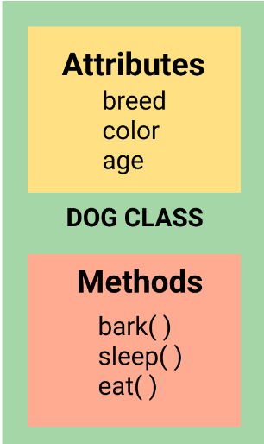
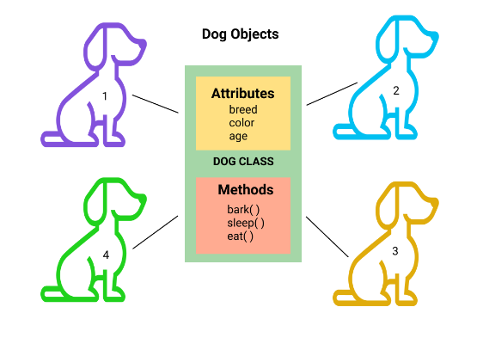
Two important concepts of OOP in C++:
Class:
A class is a user-defined blueprint or prototype from which real-world objects are created. It represents the set of properties or methods that are common to all objects of one type. We can call class as a collection of objects, which is a logical entity and does not take space in the memory.
Objects:
It is a basic unit of Object-Oriented Programming and represents the real-life entities. A typical C++ program creates many objects, which as you know, interact by invoking functions. Objects having memory addresses and take up some space. They can interact with each other without knowing the data and code.

Slide 5
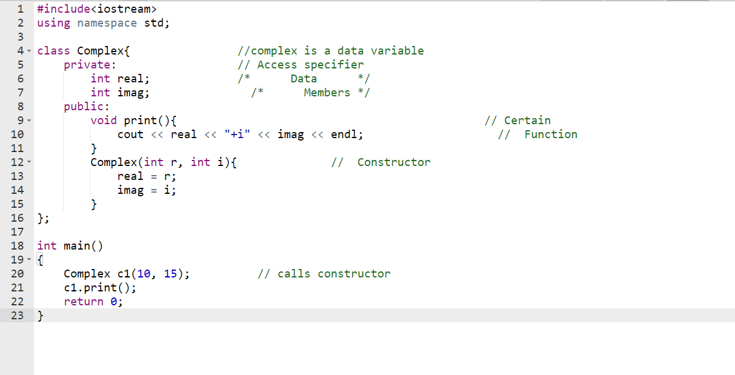

Slide 6
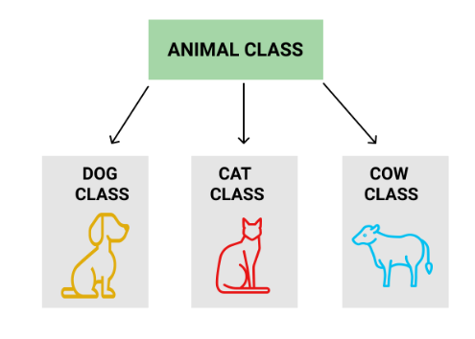
Four Pillars of OOP:
Inheritance: The capability of a class to derive properties and characteristics from another class is called Inheritance. Inheritance is one of the most important feature of Object-Oriented Programming.
Sub Class
Super Class
Reusability
2. Abstraction: Data Abstraction is the property by virtue of which only the essential details are displayed to the user. The trivial or the non-essentials units are not displayed to the user. Ex: A car is viewed as a car rather than its individual components.
It reduces the complexity of viewing things.
Helps to increase the security of an application or program as only the important details are provided to the user.

Slide 7
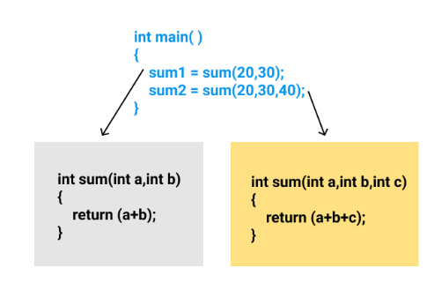
3. Encapsulation: Encapsulation is defined as the wrapping up of data under a single unit. It is the mechanism that binds together the code and the data it manipulates.
Technically in encapsulation, the variables or data of a class are hidden from any other class and can be accessed only through any member function of own class in which they are declared.
As in encapsulation, the data in a class is hidden from the other classes, so it is also known as data-hiding.
Encapsulation can be achieved by declaring all the variables in the class as private and writing public functions in the class to set and get the values of the variables.
4. Polymorphism: The word polymorphism means having many forms. In simple words, we can define polymorphism as the ability of a message to be displayed in more than one form.

Slide 8
Constructors
A Constructor is a member function of a class that initializes objects of a class. In C++, Constructor is automatically called when an object (instance of the class) is created. It is a special member function of the class.
A constructor differs from member-functions in the following ways:
Constructor has the same name as the Class itself.
Constructors don’t have a return type.
A Constructor is automatically called when an object is created.
If we do not specify a constructor, C++ compiler generates a default constructor for us (expects no parameters and has an empty body).

Slide 9
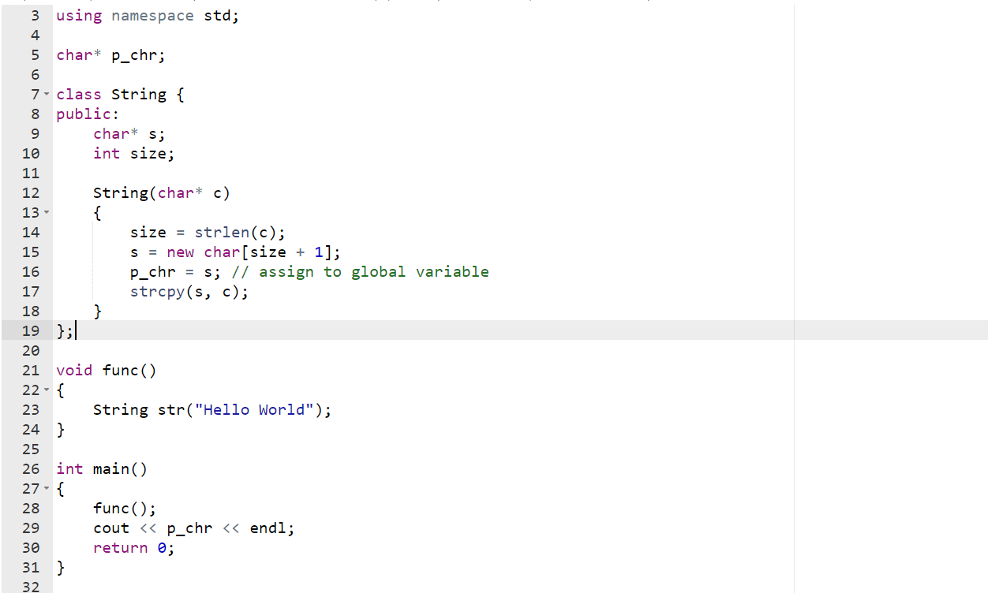
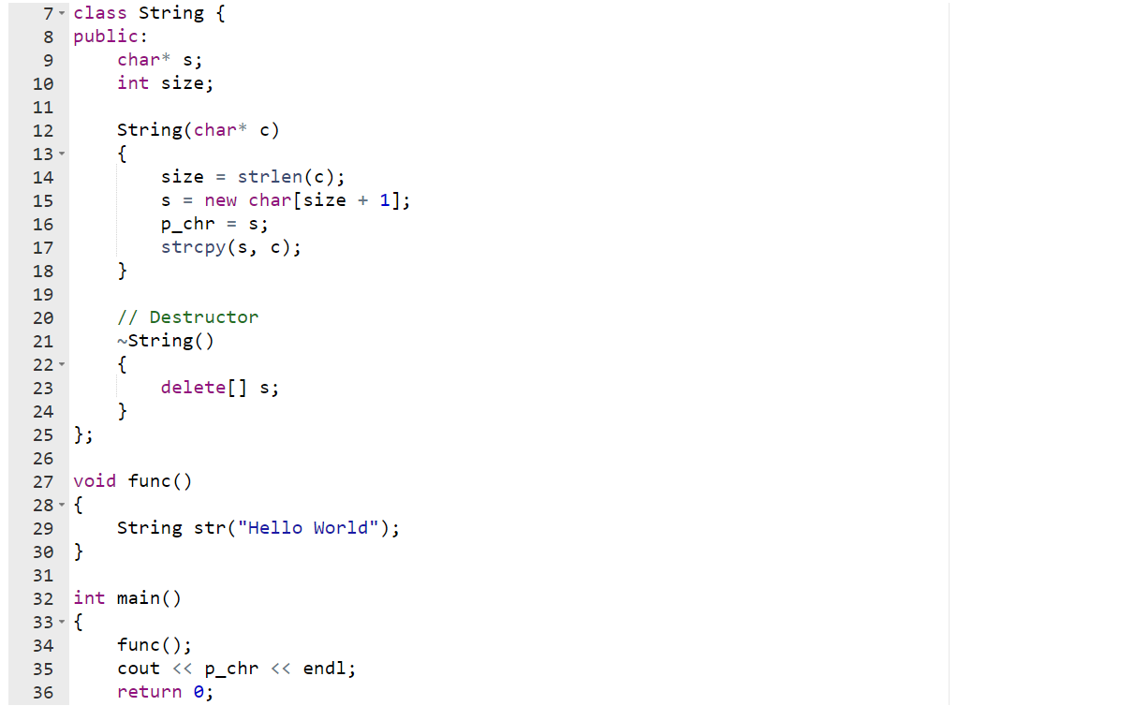
Destructors
Destructors like constructors are special members of a class that is executed once the lifetime of the object expires. It is like the final clean-up code required before deleting the class instance. Unlike JAVA, C++ doesn't perform automatic garbage collection. Hence, it often becomes the responsibility of the developer to de-allocate memory (not required further)

Slide 10
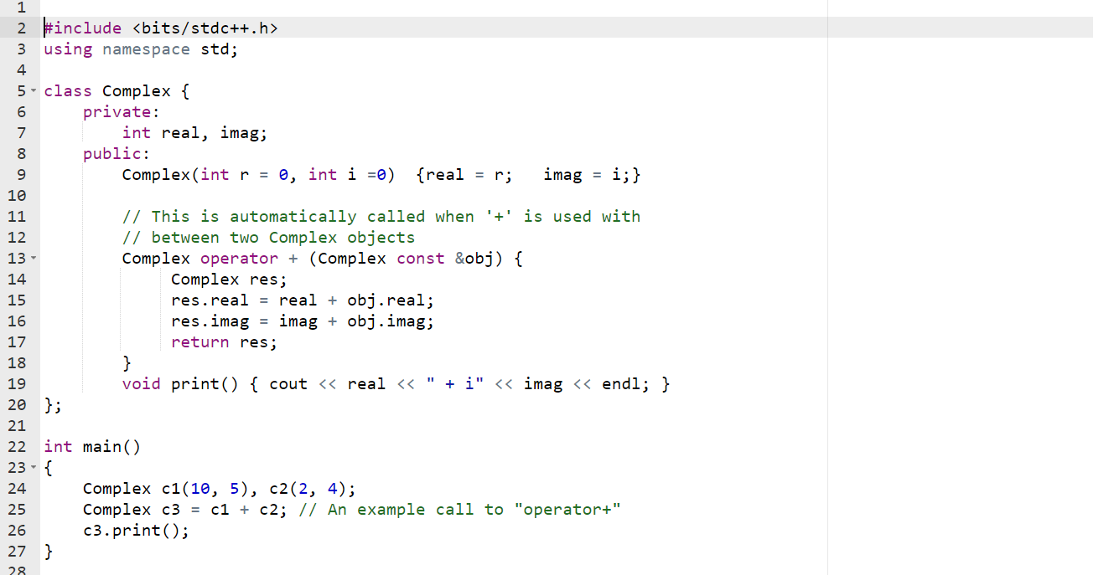
Operator and Method Overloading
Operator Overloading: In C++, we can make operators work for user-defined classes. This means C++ has the ability to provide the operators with a special meaning for a data type, this ability is known as operator overloading. For example, we can overload an operator '+' in a class like String so that we can concatenate two strings by just using +.

Slide 11
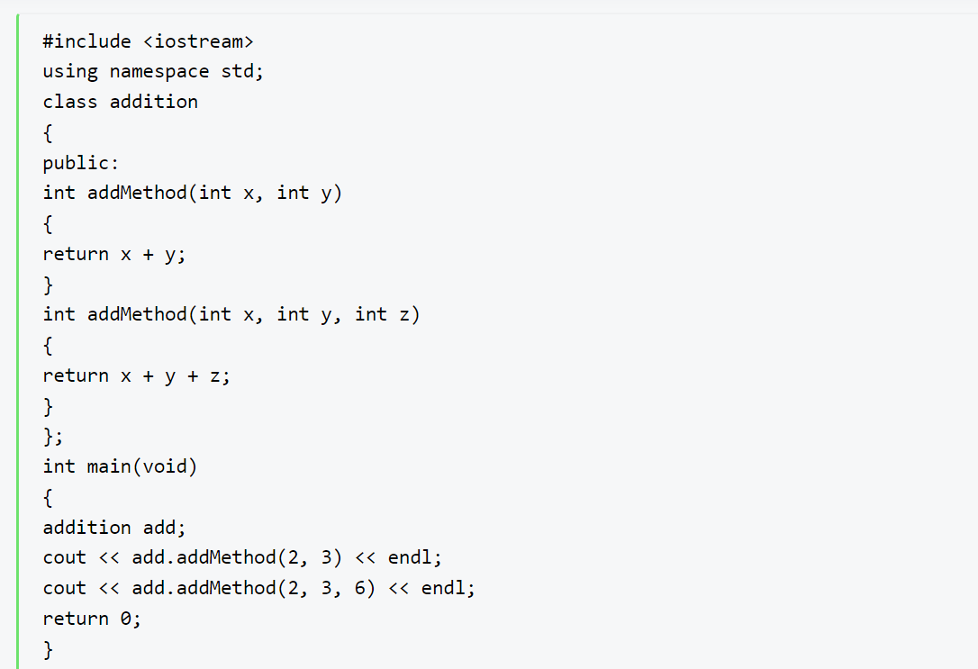
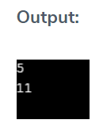
Method Overloading: Method overloading is the process of overloading the method that has the same name but different parameters. C++ provides this method of overloading features. Method overloading allows users to use the same name to another method, but the parameters passed to the methods should be different.

Slide 12
Access Specifiers
There are 3 types of access modifiers in C++, namely:
Public: All the class members declared under public will be available to everyone. The data members and member functions declared public can be accessed by other classes too. The public members of a class can be accessed from anywhere in the program using the direct member access operator (.) with the object of that class.
Private: The class members declared as private can be accessed only by the functions inside the class. They are not allowed to be accessed directly by any object or function outside the class. Only the member functions or the friend functions are allowed to access the private data members of a class.
Protected: Protected access modifier is similar to that of private access modifiers, the difference is that the class member declared as Protected are inaccessible outside the class but they can be accessed by any subclass(derived class) of that class.

Slide 13
Abstract and Virtual functions
Sometimes implementation of all function cannot be provided in a base class because we don’t know the implementation. Such a class is called abstract class. For example, let Shape be a base class. We cannot provide implementation of function draw() in Shape, but we know every derived class must have implementation of draw(). Similarly an Animal class doesn’t have implementation of move() (assuming that all animals move), but all animals must know how to move. We cannot create objects of abstract classes.
A pure virtual function (or abstract function) in C++ is a virtual function for which we can have implementation, But we must override that function in the derived class, otherwise the derived class will also become abstract class . A pure virtual function is declared by assigning 0 in declaration.

Slide 14
Virtual Functions
A virtual function is a member function which is declared within a base class and is re-defined (overridden) by a derived class. When you refer to a derived class object using a pointer or a reference to the base class, you can call a virtual function for that object and execute the derived class’s version of the function.
Virtual functions ensure that the correct function is called for an object, regardless of the type of reference (or pointer) used for function call.
They are mainly used to achieve Runtime polymorphism.
Functions are declared with a virtual keyword in base class.
The resolving of function call is done at runtime.

Slide 15
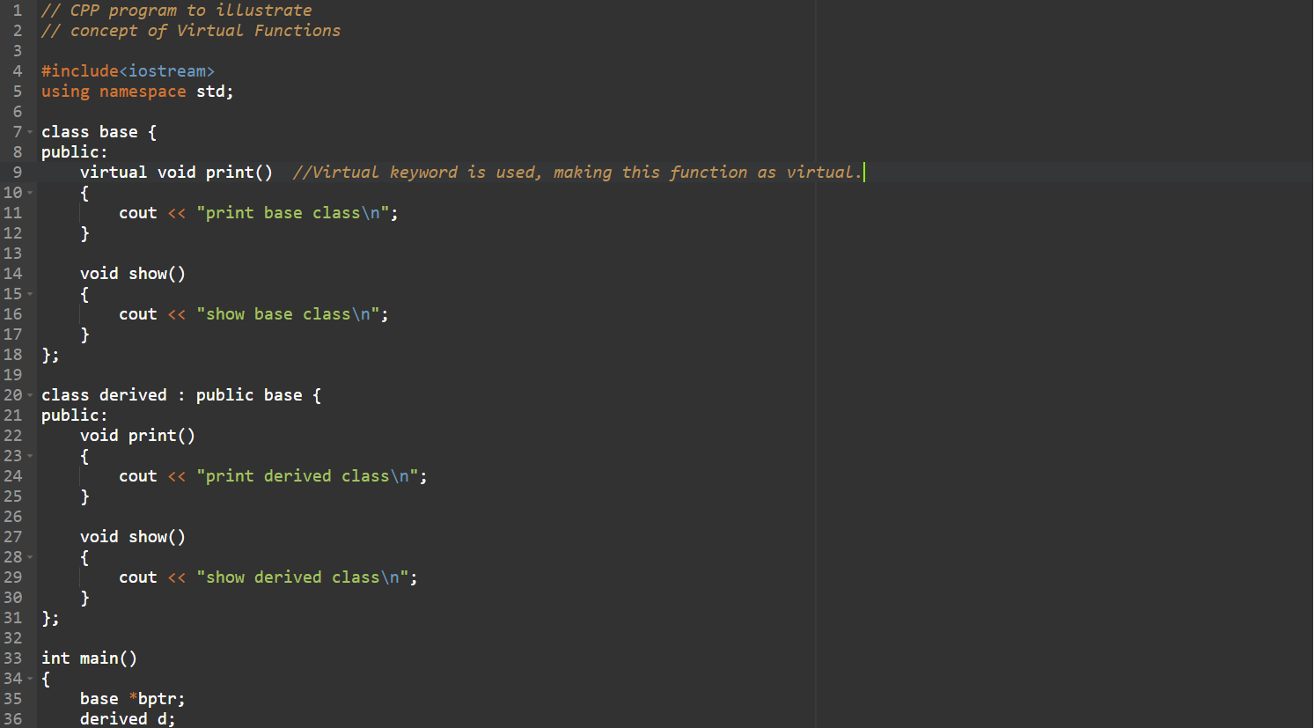
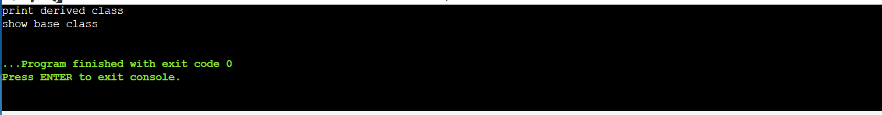
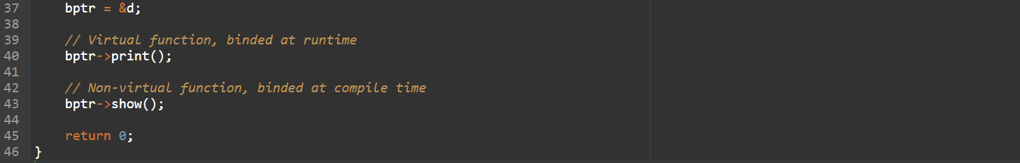

Slide 16
Garbage Collection in OOP languages
Garbage collection is the process in which programs try to free up memory space that is no longer used by objects. Garbage collection is implemented differently for every language. Most high-level programming languages have some sort of garbage collection built in.
In C++, programmer is responsible for both creation and destruction of objects.
But in Java, the programmer need not to care for all those objects which are no longer in use. ...
Garbage collector is best example of Deamon thread as it is always running in background.

Slide 17
Structure vs Class in C++
In C++, a structure is the same as a class except for a few differences. The most important of them is security. A Structure is not secure and cannot hide its implementation details from the end user while a class is secure and can hide its programming and designing details. Following are the points that expound on this difference:
A class is declared using the class keyword, and a structure is declared using the struct keyword.
Members of a class are private by default and members of a struct are public by default
When deriving a struct from a class/struct, default access-specifier for a base class/struct is public. And when deriving a class, the default access specifier is private.

Slide 18
Benefits of OOP
OOP language allows to break the program into the bit-sized problems that can be solved easily (one object at a time).
The new technology promises greater programmer productivity, better quality of software and lesser maintenance cost.
OOP systems can be easily upgraded from small to large systems.
It is possible that multiple instances of objects co-exist without any interference,
It is very easy to partition the work in a project based on objects.
It is possible to map the objects in problem domain to those in the program.
The principle of data hiding helps the programmer to build secure programs which cannot be invaded by the code in other parts of the program.
By using inheritance, we can eliminate redundant code and extend the use of existing classes.
Message passing techniques is used for communication between objects which makes the interface descriptions with external systems much simpler.
The data-centered design approach enables us to capture more details of model in an implementable form.

Slide 19
THANKYOU

