Slide 1
RELATIONAL ALGEBRA
Course Code: INT306

Slide 2
Contents
2
What is Relational Algebra?
Operations in Relational Algebra
Extended Relational Algebra Operations

Slide 3
Relational Algebra
The relational algebra is a procedural query language
It consists of a set of operations that take one or two relations as input and produce a new relation as their result.
These operations enable a user to specify basic
retrieval requests (or queries)

Slide 4
Cont.
The fundamental operations in the relational algebra are select, project, union, set difference, Cartesian product, and rename
The select, project, and rename operations are called unary operations, because they operate on one relation
The other three operations operate on pairs of relations and are, therefore, called binary operations

Slide 5
What is a Query Language?
4
Database language.
Use for retrieving informations from database.
Two types:-
Procedural
Specifies what data are needed & how to get those data.
Non-procedural
Specifies what data are needed except how to get those data.

Slide 6
Basic concepts
Domain: There are set of permitted values for every attribute, called its domain.
Exp- Domain of roll number{10,11,23,56,78}
Domain of branch{CSE,IT,ME,ECE}
Tuple: Each row in a relation is called tuple.
Relation: Collection of homogeneous tuples.
Degree or Arity: Number of attributes in relation R.
Cardinality: Number of tuples in relation R.

Slide 7
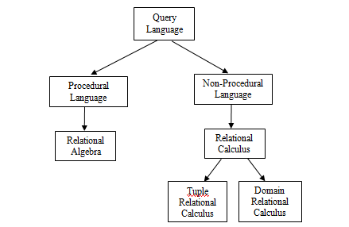

Slide 8
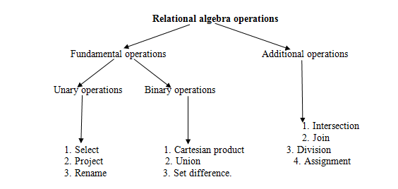
INTRODUCTION

Slide 9


Operations
5
Select
Project
Union
Set Difference
Cartesian Product
Rename
Set Intersection
Natural Join
Semi Join
Theta Join
Assignment
Outer Join
Division
FUNDAMENTAL
OPERATIONS
OTHER OPERATIONS

Slide 10
Unary Relational Operations
SELECT (symbol: σ (sigma))
Selects a subset of rows from relation
PROJECT (symbol: π (pi))
Selects columns from relation
RENAME (symbol: ρ (rho))

Slide 11
Select Operation (σ)
6
Unary operation.
Selects tuples (rows) that satisfy the given predicate
(condition) from a relation (table).
σ_{p}(r)
PREDICATE RELATION
There can be more than one predicate connected by connectors (and [^], or [v], not [¬]).
Comparisons are performed using relational operators (=, ≠, ≥, <, >, ≤).

Slide 12
Examples
7
person(name, age, weight)
Find the details of all persons having age greater than equals to 34.
Ans: σ_{age≥34}(person)
Find the details of all persons having age greater than 34 & weight equals to 54.
^{Ans: σ}age>34 ^ weight=54^{(person)}

Slide 13
Illustrations
8
person
б_{age>=34}(person)
name | age | weight
Harry | 34 | 80
Sally | 28 | 64
George | 29 | 70
Helena | 54 | 54
Peter | 34 | 80
name | age | weight
Harry | 34 | 80
Helena | 54 | 54
Peter | 34 | 80
^{б} age>34 ^ weight=54^{(person)}
name | age | weight
Helena | 54 | 54

Slide 14
Project Operation (Π)
9
Unary operation.
Selects specified attributes (columns) from a relation.
^{Π}A1, A2, An^{(r)}
RELATION
ATTRIBUTES

Slide 15
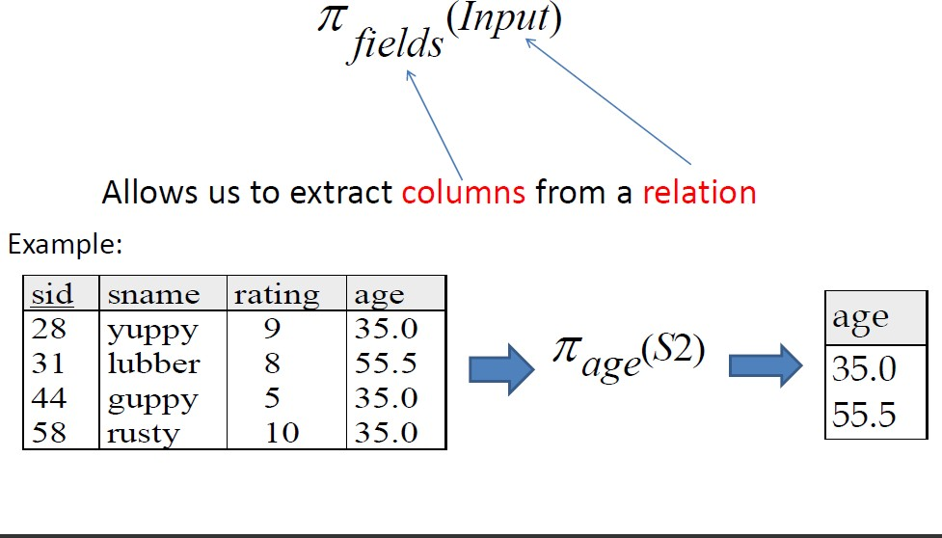
PROJECTION

Slide 16
Example
10
employee(name, age, salary)
1. Find the name of all employees. Ans: Π_{name}(employee)
employee
∏_{name}(employee)
name | age | salary
Harry | 34 | 80,000
Sally | 28 | 90,000
George | 29 | 70,000
Helena | 54 | 54,280
Peter | 34 | 40,000
name
Harry
Sally
George
Helena
Peter

Slide 17
EXAMPLE
Example: To list each employee’s first and last name and salary, the following is used:
^{π}LNAME, FNAME,SALARY^{(EMPLOYEE)}

Slide 18
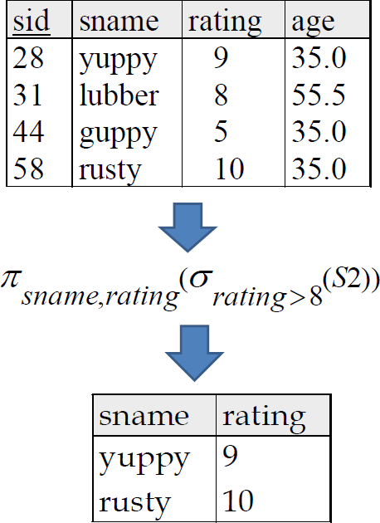
Composition of Relational Operations

Slide 19
Example
“Find the name of all instructors in the Physics department.
π name (σ dept name =“Physics”
(instructor))

Slide 20
Combination of Select & Project Operations - Example
11
employee(name, age, salary)
1. Find the name of employees earning more than 80,000
Ans: Π_{name}(σ_{salary>80000}(employee))
employee
^{б}salary>80,000^{(employee)}
name | age | salary
Harry | 34 | 80,000
Sally | 28 | 90,000
George | 29 | 70,000
Helena | 54 | 54,280
Peter | 34 | 40,000
name | age | salary
Sally | 28 | 90,000
∏ name^{(б}salary>80,000^{(employee))}
name
Sally

Slide 21
Rename Operation (ρ)
20
Unary operation
ρ _{a / b} (r)
where,
r is a relation
a and b are attributes
The result is identical to r except that the b field in the relation is renamed to an a field.

Slide 22
Example
21
employee
ρ_{ename / name}(employee)
name | age | salary
Harry | 34 | 80,000
Sally | 28 | 90,000
George | 29 | 70,000
Helena | 54 | 54,280
Peter | 34 | 40,000
ename | age | salary
Harry | 34 | 80,000
Sally | 28 | 90,000
George | 29 | 70,000
Helena | 54 | 54,280
Peter | 34 | 40,000

Slide 23
Relational Algebra Operations Set Theory
Union
Intersection
Set Difference / Minus
Cartesian Product

Slide 24
Union Operation (U)
12
Binary operation.
Returns the union of two compatible relations (say r
& s).
r U s
where,
r & s must have the same number of attributes.
Attribute domains must be compatible.
Duplicate tuples are automatically eliminated.

Slide 25

UNION
– The two operand relations R and S must be “type compatible” (or UNION compatible)
Two relations are union compatible if
Relation R and S should have same arity, Both have same number of columns
Names of attributes and the domain type are the same in both

Slide 26
Example
13
course(name, semester, teacher)
1. Find the name of all courses taught in the 1st semester, the 2nd semester, or both.
^{Ans: Π}name^{(σ}semester=“1st"^{(course))} U
^{Π}name^{(σ}semester=“2nd"^{(course))}

Slide 27
Illustration
14
course
∏ name^{(б}semester=“1st"^{(course))}
name | semester | teacher
C1 | 1st | T1
C2 | 2nd | T2
C3 | 3rd | T3
C4 | 4th | T4
C1 | 2nd | T1
name
C1
∏ (б
(course))
name semester=“2nd"
name
C2
C1
∏ name^{(б}semester=“1st"^{(course)) U ∏}name^{(б}semester=“2nd"^{(course))}
name
C1
C2

Slide 28


Example
Tables:
Person (SSN, Name, Address, Hobby) Professor (Id, Name, Office, Phone)
are not union compatible. However
Π _{Name} (Person) and Π _{Name} (Professor) are union compatible and
15

Slide 29
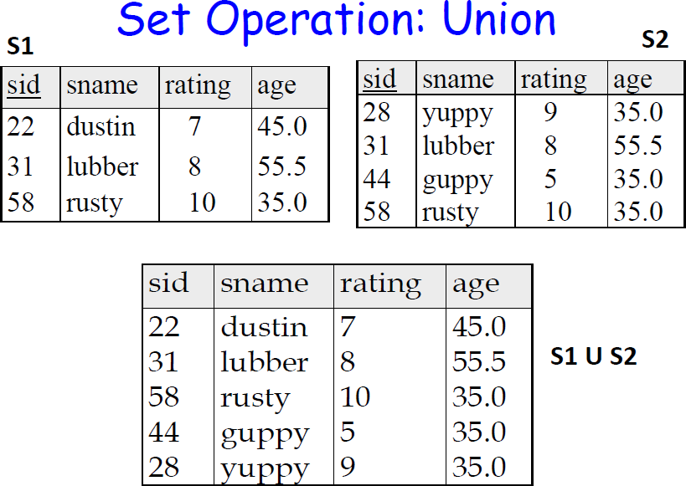

Slide 30
Set Difference (-)
15
Binary operation.
Returns the tuples which are present in first relation
(r) but are not in the second relation (s).
r − s
Like union the conditions are same for a valid r – s
operation.

Slide 31
Example
16
course(name, semester, teacher)
1. Find the name of all courses taught in the 1st semester but not in 2nd semester.
^{Ans: Π}name^{(σ}semester=“1st"^{(course))}
-
^{Π}name^{(σ}semester=“2nd"^{(course))}

Slide 32
Illustration
17
course
∏ name^{(б}semester=“1st"^{(course))}
name | semester | teacher
C1 | 1st | T1
C2 | 2nd | T2
C3 | 1st | T3
C4 | 4th | T4
C1 | 2nd | T1
name
C1
C3
∏ (б
(course))
name semester=“2nd"
name
C2
C1
∏ name^{(б}semester=“1st"^{(course)) - ∏}name^{(б}semester=“2nd"^{(course))}
name
C3

Slide 33
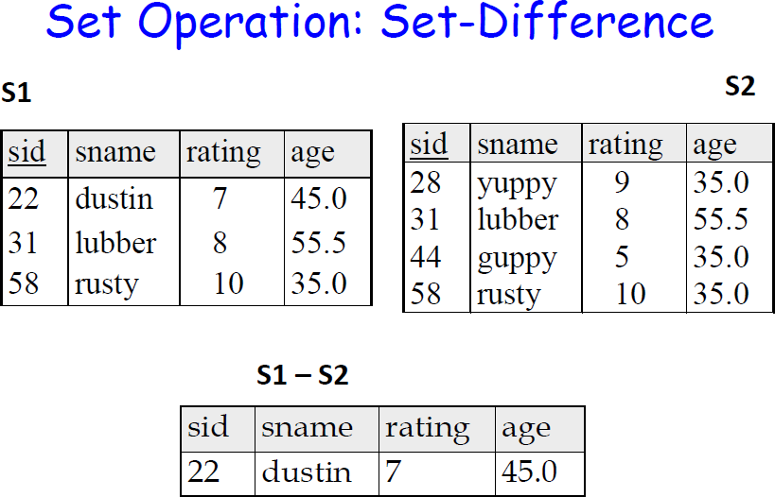

Slide 34
Set Intersection (∩)
22
Binary operation.
r ∩ s
Defines a relation consisting of the set of all tuples that are in both r and s.
Like union the conditions are same for a valid r ∩ s
operation.
Expressed using basic operations:
r ∩ s = r – (r – s)

Slide 35
Example
23
course(name, semester, teacher)
1. Find the name of all courses taught in both the 1st & 2nd semesters.
^{Ans: Π}name^{(σ}semester=“1st"^{(course))}
∩
^{Π}name^{(σ}semester=“2nd"^{(course))}

Slide 36
Illustration
24
course
∏ name^{(б}semester=“1st"^{(course))}
name | semester | teacher
C1 | 1st | T1
C2 | 2nd | T2
C3 | 1st | T3
C4 | 4th | T4
C1 | 2nd | T1
name
C1
C3
∏ (б
(course))
name semester=“2nd"
name
C2
C1
∏ name^{(б}semester=“1st"^{(course)) ∩ ∏}name^{(б}semester=“2nd"^{(course))}
name
C1

Slide 37
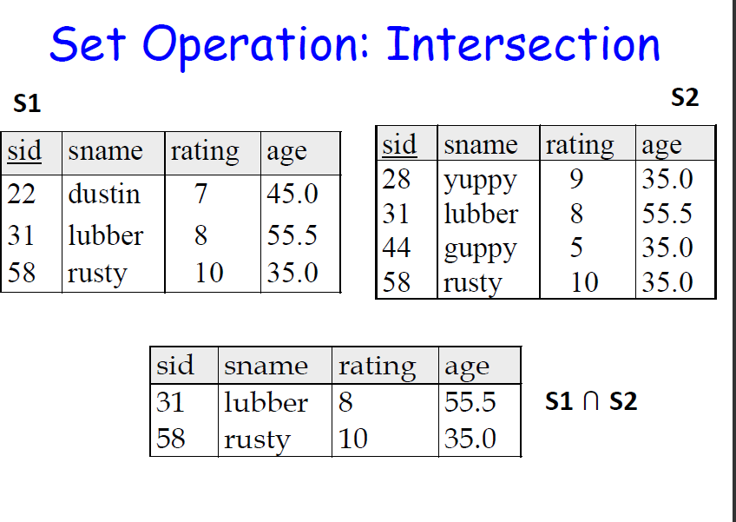

Slide 38
Cartesian Product (x)
18
Binary operation.
Combines information from any two relations (r & s). r x s
It defines a relation by concatenating every tuple of relation r with every tuple of relation s.

Slide 39
Illustration
19
person
city
name | age | weight
Harry | 34 | 80
Sally | 28 | 64
George | 29 | 70
city
San Jose
Austin
person X city
name | age | weight | city
Harry | 34 | 80 | San Jose
Harry | 34 | 80 | Austin
Sally | 28 | 64 | San Jose
Sally | 28 | 64 | Austin
George | 29 | 70 | San Jose
George | 29 | 70 | Austin

Slide 40
SQL Built in Functions
NUMERIC FUNCTIONS:
abs(n) – returns absolute value of n
SQL> select abs(-2) from dual; - 2
ceil(n) – ceil(3.78) - 4
floor(n) – floor(2.4) - 2
sqrt(n)
power(n,m)
SQL> select power(5,2) from dual; - 25
mod(a,b)
cos(n)

Slide 41
SQL Built in Functions
String/Character FUNCTIONS:
initcap(string)
SQL > select initcap(‘hello’) from dual; - Hello
upper(string)
lower(string)
ltrim(string)
SQL > select ltrim(‘
rtrim(string)
replace( )
hello’) from dual; - hello
SQL > select replace(‘hello’, ’ll’, ’r’) from dual; - hero
length( )
SQL > select length(‘hello’) from dual; - 5

