Slide 1
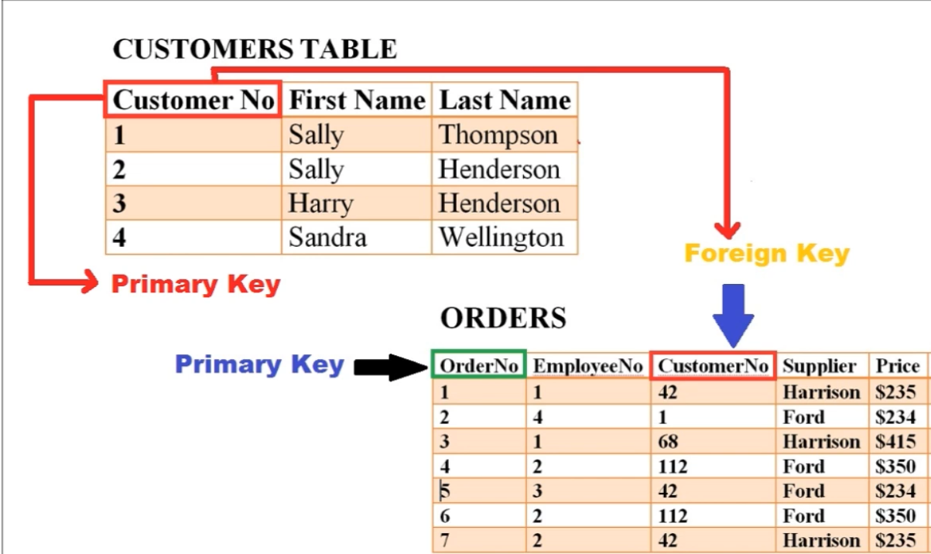
DBMS Keys

Slide 2
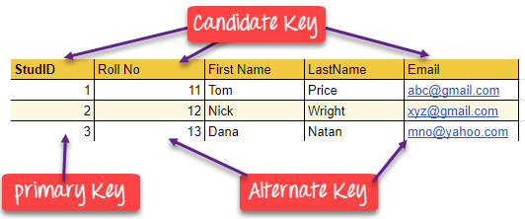
Def- DBMS Key
KEYS in DBMS is an attribute or set of attributes which helps you to identify a row(tuple) in a relation(table).

Slide 3
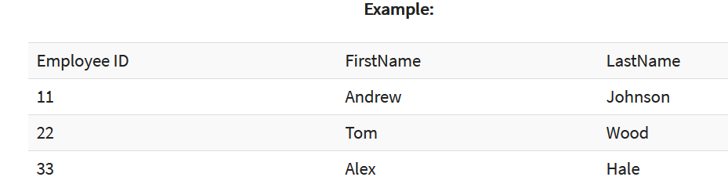
In the above-given example, employee ID is a primary key because it uniquely identifies an employee record.
In this table, no other employee can have the same employee ID.

Slide 4
Why we need a Key?
Here are some reasons for using sql key in the DBMS system.
Keys help you to identify any row of data in a table. In a real-world application, a table could contain thousands of records. Moreover, the records could be duplicated. Keys ensure that you can uniquely identify a table record despite these challenges.
Allows you to establish a relationship between and identify the relation between tables
Help you to enforce identity and integrity in the relationship.

Slide 5
Types of Keys in Database Management System
Super Key - A super key is a group of single or multiple keys which identifies rows in a table.
Primary Key - is a column or group of columns in a table that uniquely identify every row in that table.
Candidate Key - is a set of attributes that uniquely identify tuples in a table. Candidate Key is a super key with no repeated attributes.
Alternate Key - is a column or group of columns in a table that uniquely identify every row in that table.
Foreign Key - is a column that creates a relationship between two tables. The purpose of Foreign keys is to maintain data integrity and allow navigation between two different instances of an entity.

Slide 6
Types of Keys in Database Management System
Compound Key - has two or more attributes that allow you to uniquely recognize a specific record. It is possible that each column may not be unique by itself within the database.
Composite Key - COMPOSITE KEY is a combination of two or more columns that uniquely identify rows in a table\
Surrogate Key - An artificial key which aims to uniquely identify each record is called a surrogate key. These kind of key are unique because they are created when you don't have any natural primary key.

Slide 7
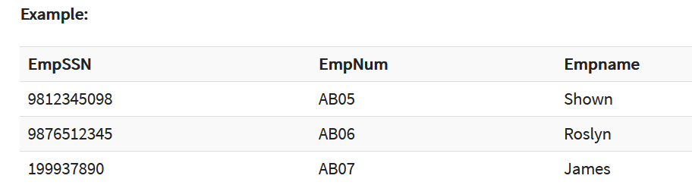
What is the Super key?
A superkey is a group of single or multiple keys which identifies rows in a table. A Super key may have additional attributes that are not needed for unique identification.
In the above-given example, EmpSSN and EmpNum name are superkeys.

Slide 8
What is a Primary Key?
PRIMARY KEY is a column or group of columns in a table that uniquely identify every row in that table. The Primary Key can't be a duplicate meaning the same value can't appear more than once in the table. A table cannot have more than one primary key.
Rules for defining Primary key:
Two rows can't have the same primary key value
It must for every row to have a primary key value.
The primary key field cannot be null.
The value in a primary key column can never be modified or updated if any foreign key refers to that primary key.

Slide 9
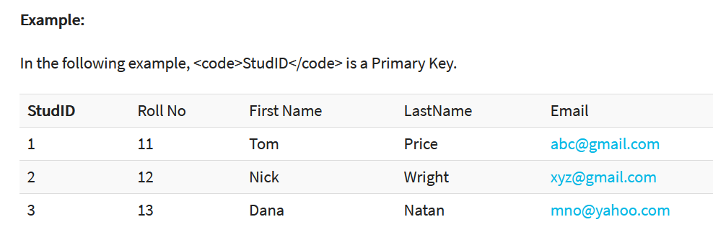

Slide 10
What is a Candidate Key?
CANDIDATE KEY is a set of attributes that uniquely identify tuples in a table. Candidate Key is a super key with no repeated attributes.
The Primary key should be selected from the candidate keys.
Every table must have at least a single candidate key.
A table can have multiple candidate keys but only a single primary key.
Properties of Candidate key:
It must contain unique values
Candidate key may have multiple attributes
Must not contain null values
It should contain minimum fields to ensure uniqueness
Uniquely identify each record in a table

Slide 11
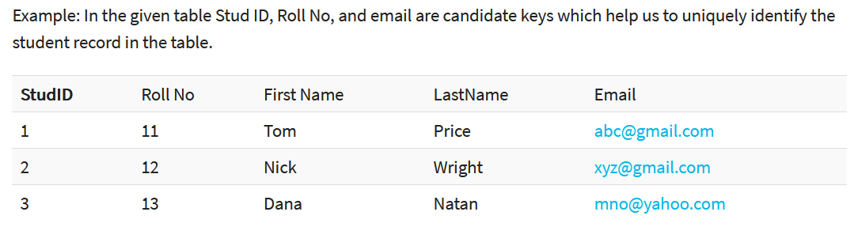

Slide 12
What is the Alternate key?
ALTERNATE KEYS is a column or group of columns in a table that uniquely identify every row in that table.
A table can have multiple choices for a primary key but only one can be set as the primary key.
All the keys which are not primary key are called an Alternate Key.

Slide 13
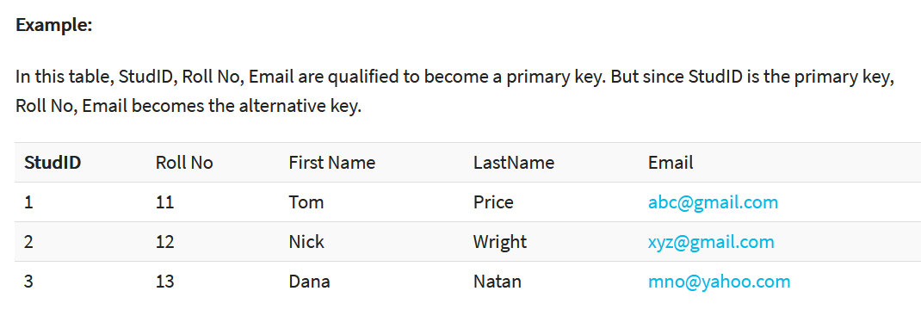

Slide 14
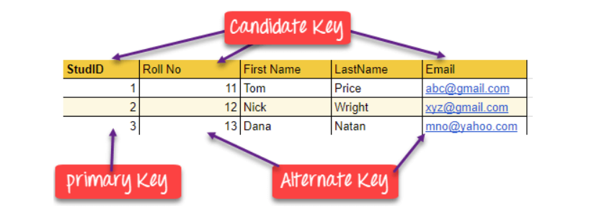

Slide 15
What is the Foreign key?
FOREIGN KEY is a column that creates a relationship between two tables.
The purpose of Foreign keys is to maintain data integrity and allow navigation between two different instances of an entity.
It acts as a cross-reference between two tables as it references the primary key of another table.

Slide 16
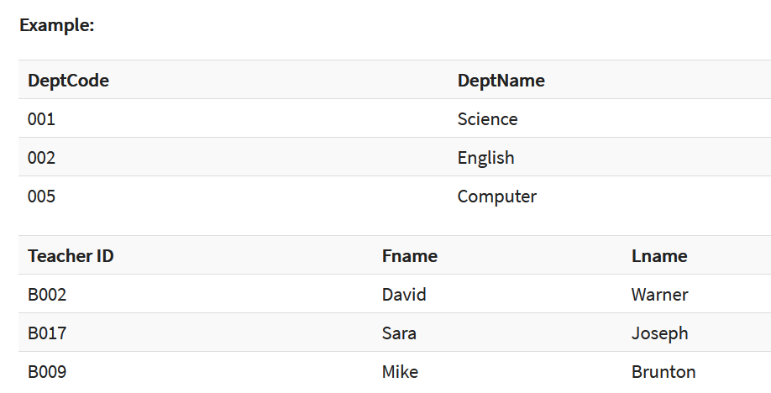

Slide 17
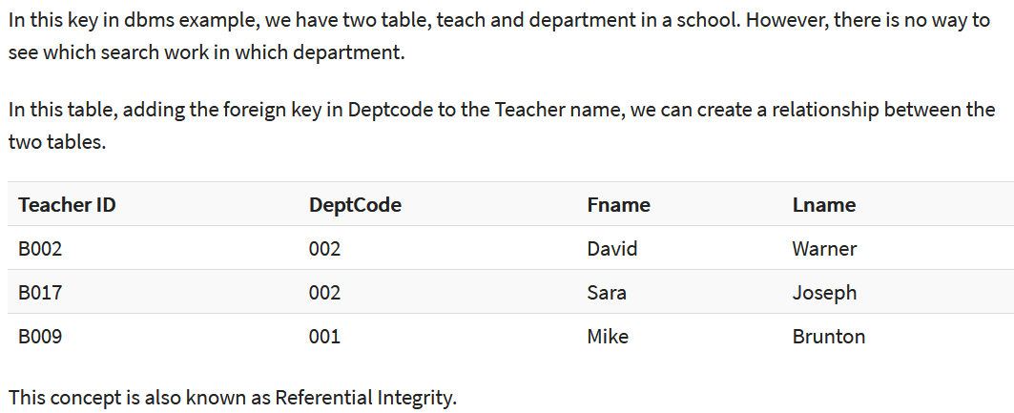

Slide 18
What is the Compound key?
COMPOUND KEY has two or more attributes that allow you to uniquely recognize a specific record.
It is possible that each column may not be unique by itself within the database. However, when combined with the other column or columns the combination of composite keys become unique.
The purpose of the compound key in database is to uniquely identify each record in the table.

Slide 19
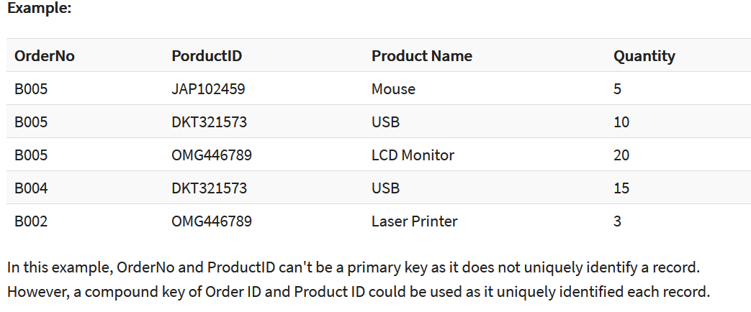

Slide 20
What is the Composite key?
COMPOSITE KEY is a combination of two or more columns that uniquely identify rows in a table. The combination of columns guarantees uniqueness, though individually uniqueness is not guaranteed. Hence, they are combined to uniquely identify records in a table.
The difference between compound and the composite key is that any part of the compound key can be a foreign key, but the composite key may or maybe not a part of the foreign key.

Slide 21
What is a Surrogate key?
SURROGATE KEYS is An artificial key which aims to uniquely identify each record is called a surrogate key.
This kind of partial key in dbms is unique because it is created when you don't have any natural primary key.
They do not lend any meaning to the data in the table.
Surrogate key is usually an integer.
A surrogate key is a value generated right before the record is inserted into a table.

Slide 22
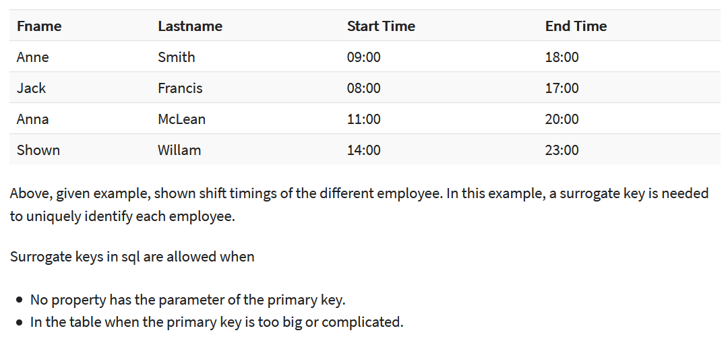

Slide 23
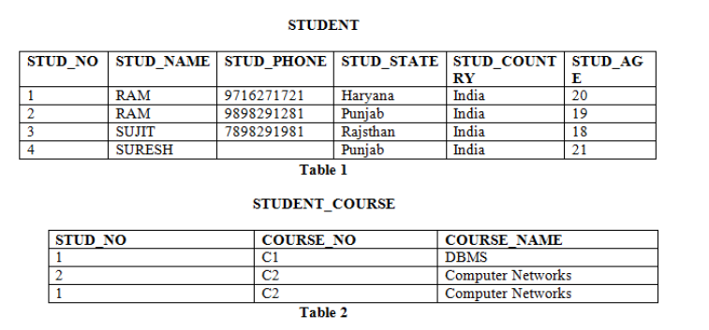



Slide 24
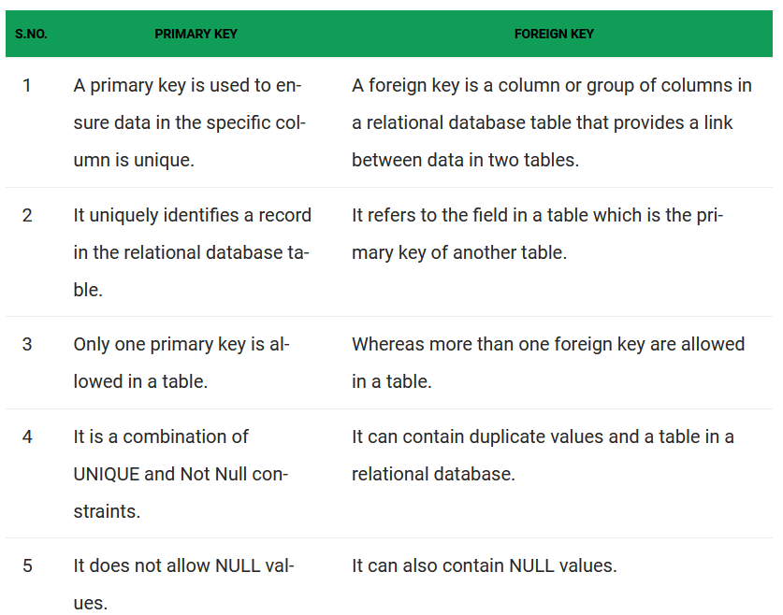


Slide 25
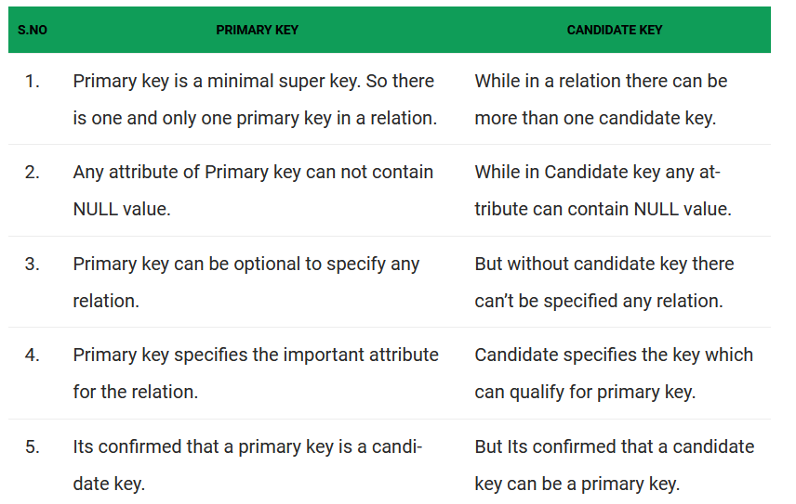

Slide 26
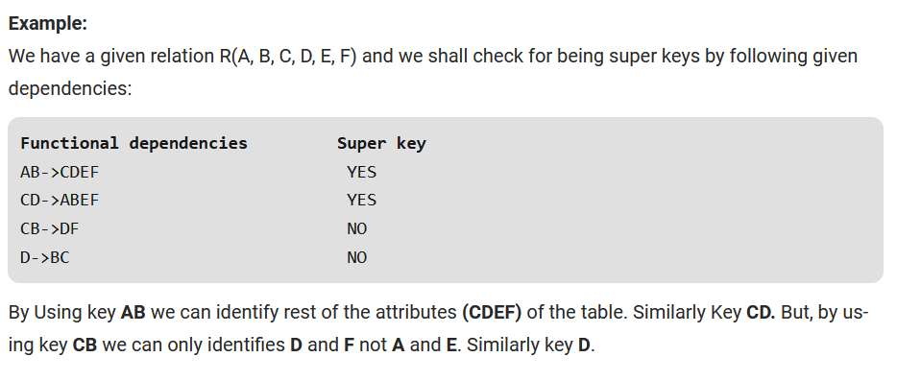
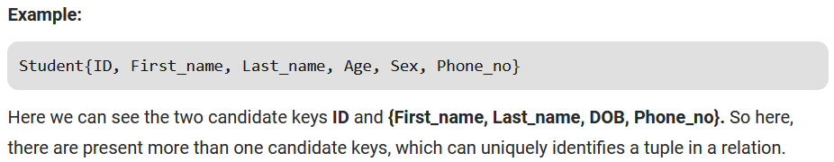

Slide 27
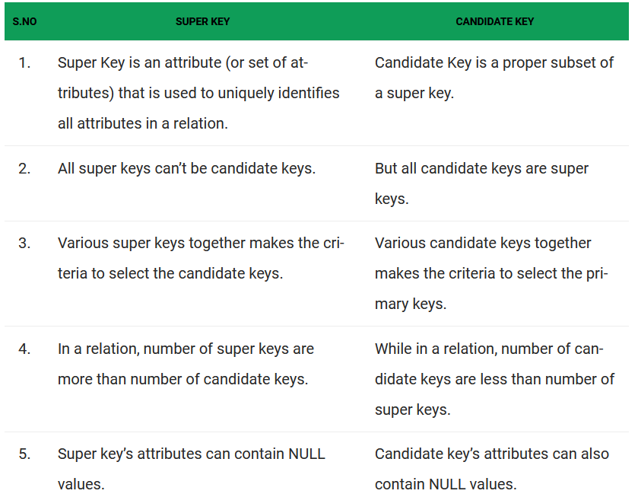

Slide 28
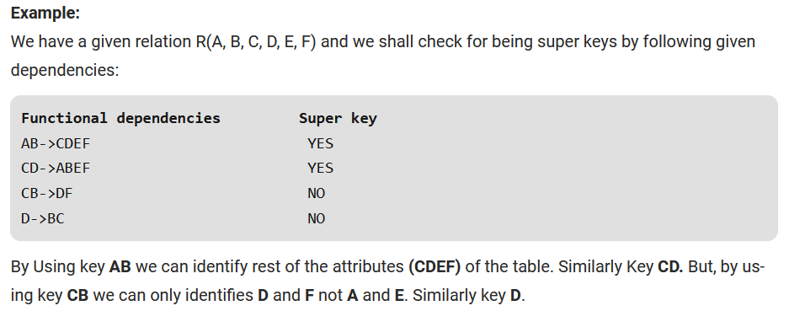
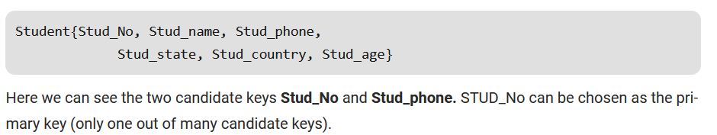

Slide 29
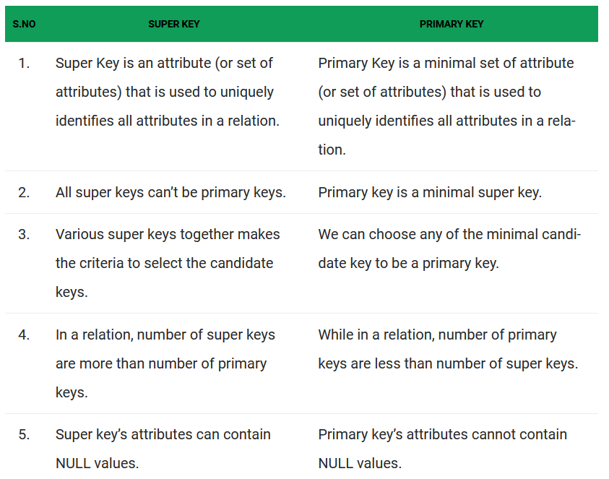

Slide 30
Summary
A key in SQL is an attribute or set of attributes which helps you to identify a row(tuple) in a relation(table)
DBMS keys allow you to establish a relationship between and identify the relation between tables
Seven Types of DBMS keys are Super, Primary, Candidate, Alternate, Foreign, Compound, Composite, and Surrogate Key.
A super key is a group of single or multiple keys which identifies rows in a table.
A column or group of columns in a table which helps us to uniquely identifies every row in that table is called a primary key
All the keys which are not primary key are called an alternate key
A super key with no repeated attribute is called candidate key
A compound key is a key which has many fields which allow you to uniquely recognize a specific record
A key which has multiple attributes to uniquely identify rows in a table is called a composite key
An artificial key which aims to uniquely identify each record is called a surrogate key
Primary Key never accept null values while a foreign key may accept multiple null values.

