Slide 1
File Organization

Slide 2
File Organization
A database consist of a huge amount of data.
The data is grouped within a table in RDBMS, and each table have related records.
A user can see that the data is stored in form of tables, but in acutal this huge amount of data is stored in physical memory in form of files.
File – A file is named collection of related information that is recorded on secondary storage such as magnetic disks, magnetic tables and optical disks.
The File is a collection of records.
Using the primary key, we can access the records.

Slide 3
File Organization
The type and frequency of access can be determined by the type of file organization which was used for a given set of records.
File organization is a logical relationship among various records.
This method defines how file records are mapped onto disk blocks.
File organization is used to describe the way in which the records are stored in terms of blocks, and the blocks are placed on the storage medium.
The first approach to map the database to the file is to use the several files and store only one fixed length record in any given file.
An alternative approach is to structure our files so that we can contain multiple lengths for records.
Files of fixed length records are easier to implement than the files of variable length records.

Slide 4
Types of file organization
File organization contains various methods.
These particular methods have pros and cons on the basis of access or selection.
In the file organization, the programmer decides the best-suited file organization method according to his requirement.
Types of file organization are as follows:
Sequential file organization
Heap file organization
Hash file organization

Slide 5
Sequential File Organization
This method is the easiest method for file organization.
In this method, files are stored sequentially.
This method can be implemented in two ways:
Pile file method
Sorted file method

Slide 6
1. Pile File Method
It is a quite simple method.
In this method, we store the record in a sequence, i.e., one after another.
Here, the record will be inserted in the order in which they are inserted into tables.
In case of updating or deleting of any record, the record will be searched in the memory blocks.
When it is found, then it will be marked for deleting, and the new record is inserted.

Slide 8
2. Sorted File Method
In this method, the new record is always inserted at the file's end, and then it will sort the sequence in ascending or descending order.
Sorting of records is based on any primary key or any other key.
In the case of modification of any record, it will update the record and then sort the file, and lastly, the updated record is placed in the right place.

Slide 10
Pros of sequential file organization
It contains a fast and efficient method for the huge amount of data.
In this method, files can be easily stored in cheaper storage mechanism like magnetic tapes.
It is simple in design.
It requires no much effort to store the data.
This method is used when most of the records have to be accessed like grade calculation of a student, generating the salary slip, etc.
This method is used for report generation or statistical calculations.

Slide 11
Cons of sequential file organization
It will waste time as we cannot jump on a particular record that is required but we have to move sequentially which takes our time.
Sorted file method takes more time and space for sorting the records.

Slide 12
Heap file organization
It is the simplest and most basic type of organization.
It works with data blocks.
In heap file organization, the records are inserted at the file's end.
When the records are inserted, it doesn't require the sorting and ordering of records.
When the data block is full, the new record is stored in some other block.
This new data block need not to be the very next data block, but it can select any data block in the memory to store new records.
The heap file is also known as an unordered file.
In the file, every record has a unique id, and every page in a file is of the same size.
It is the DBMS responsibility to store and manage the new records.

Slide 15
If we want to search, update or delete the data in heap file organization, then we need to traverse the data from staring of the file till we get the requested record.
If the database is very large then searching, updating or deleting of record will be time-consuming because there is no sorting or ordering of records.
In the heap file organization, we need to check all the data until we get the requested record.

Slide 16
Pros of Heap file organization
It is a very good method of file organization for bulk insertion.
If there is a large number of data which needs to load into the database at a time, then this method is best suited.
In case of a small database, fetching and retrieving of records is faster than the sequential record.

Slide 17
Cons of Heap file organization
This method is inefficient for the large database because it takes time to search or modify the record.

Slide 18
Hash File Organization
Hash File Organization uses the computation of hash function on some fields of the records.
The hash function's output determines the location of disk block where the records are to be placed.

Slide 20
When a record has to be received using the hash key columns, then the address is generated, and the whole record is retrieved using that address.
In the same way, when a new record has to be inserted, then the address is generated using the hash key and record is directly inserted.
The same process is applied in the case of delete and update.
In this method, there is no effort for searching and sorting the entire file.
In this method, each record will be stored randomly in the memory.

Slide 22
In database management system, When we want to retrieve a particular data, It becomes very inefficient to search all the index values and reach the desired data.
In this situation, Hashing technique comes into picture.
Hashing is an efficient technique to directly search the location of desired data on the disk without using index structure.
Data is stored at the data blocks whose address is generated by using hash function.
The memory location where these records are stored is called as data block or data bucket.

Slide 23
Data bucket – Data buckets are the memory locations where the records are stored. These buckets are also considered as Unit Of Storage.

Slide 24
Below given diagram clearly depicts how hash function work:

Slide 25
Static Hashing
In static hashing, when a search-key value is provided, the hash function always computes the same address.
For example, if we want to generate address for STUDENT_ID = 76 using mod (5) hash function, it always result in the same bucket address 1.
There will not be any changes to the bucket address here.
Hence number of data buckets in the memory for this static hashing remains constant throughout.

Slide 26
Operation
Insertion – When a new record is inserted into the table, The hash function h generate a bucket address for the new record based on its hash key K. Bucket address = h(K)
Searching – When a record needs to be searched, The same hash function is used to retrieve the bucket address for the record. For Example, if we want to retrieve whole record for ID 76, and if the hash function is mod (5) on that ID, the bucket address generated would be 1. Then we will directly got to address 1 and retrieve the whole record for ID 76. Here ID acts as a hash key.
Deletion – If we want to delete a record, Using the hash function we will first fetch the record which is supposed to be deleted. Then we will remove the records for that address in memory.
Updation – The data record that needs to be updated is first searched using hash function, and then the data record is updated.

Slide 27
Now, If we want to insert some new records into the file But the data bucket address generated by the hash function is not empty or the data already exists in that address.
This becomes a critical situation to handle.
This situation in the static hashing is called bucket overflow.
How will we insert data in this case?
There are several methods provided to overcome this situation.
Some commonly used methods are discussed below:

Slide 28
1. Open Hashing – In Open hashing method, next available data block is used to enter the new record, instead of overwriting older one.
This method is also called linear probing.
For example, D3 is a new record which needs to be inserted , the hash function generates address as 105. But it is already full. So the system searches next available data bucket, 123 and assigns D3 to it.

Slide 31
Dynamic Hashing
The drawback of static hashing is that it does not expand or shrink dynamically as the size of the database grows or shrinks.
In Dynamic hashing, data buckets grows or shrinks (added or removed dynamically) as the records increases or decreases.
Dynamic hashing is also known as extended hashing.
In dynamic hashing, the hash function is made to produce a large number of values.
For Example, there are three data records D1, D2 and D3 .
The hash function generates three addresses 1001, 0101 and 1010 respectively.
This method of storing considers only part of this address – especially only first one bit to store the data.
So it tries to load three of them at address 0 and 1.

Slide 33
Quiz
A unit of storage that can store one or more records in a hash file organization is denoted as
a) Buckets b) Disk pages c) Blocks d) Nodes

Slide 34
Quiz
The method of access which uses key transformation is known as
A. Direct.
B. Hash.
C. Random.
D. Sequential

Slide 35
Indexing in Databases
Indexing is a way to optimize performance of a database by minimizing the number of disk accesses required when a query is processed.
An index or database index is a data structure which is used to quickly locate and access the data in a database table.

Slide 36
Indexes are created using some database columns.
The first column is the Search key that contains a copy of the primary key or candidate key of the table. These values are stored in sorted order so that the corresponding data can be accessed quickly (Note that the data may or may not be stored in sorted order).
The second column is the Data Reference which contains a set of pointers holding the address of the disk block where that particular key value can be found.

Slide 37
There are two kinds of indices:
1. Ordered indices: Indices are based on a sorted ordering of the values.
2. Hash indices: Indices are based on the values being distributed uniformly across a range of buckets. The buckets to which a value is assigned is determined by function called a hash function.

Slide 38
Ordered Indices Indexing Methods
If the search key of any index specifies same order as the sequential order of the file, it is known as primary index or clustering index.
Note: The search key of a primary index is usually the primary key, but it is not necessarily so.
If the search key of any index specifies an order different from the sequential order of the file, it is called the secondary index or non-clustering index.

Slide 39
Clustered Indexing
Clustering index is defined on an ordered data file. The data file is ordered on a non-key field.
In some cases, the index is created on non-primary key columns which may not be unique for each record. In such cases, in order to identify the records faster, we will group two or more columns together to get the unique values and create index out of them. This method is known as clustering index.
Basically, records with similar characteristics are grouped together and indexes are created for these groups.

Slide 40
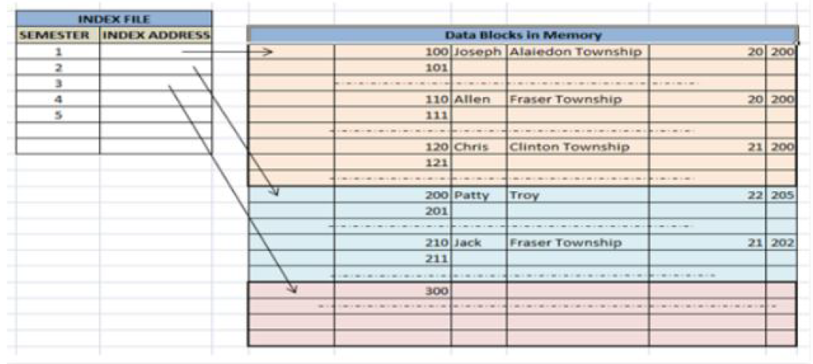
For example, students studying in each semester are grouped together. i.e.
1st Semester students, 2nd semester students, 3rd semester students etc are grouped.

Slide 41
Primary Index
Data is sorted according to search key. It induces sequential file organization.
The primary key of database table is used to create the index. As primary keys are unique and are stored in sorted manner, the performance of searching operation is quite efficient.
The Primary Index is classified in two types:
1. Dense Index
2. Sparse Index

Slide 42
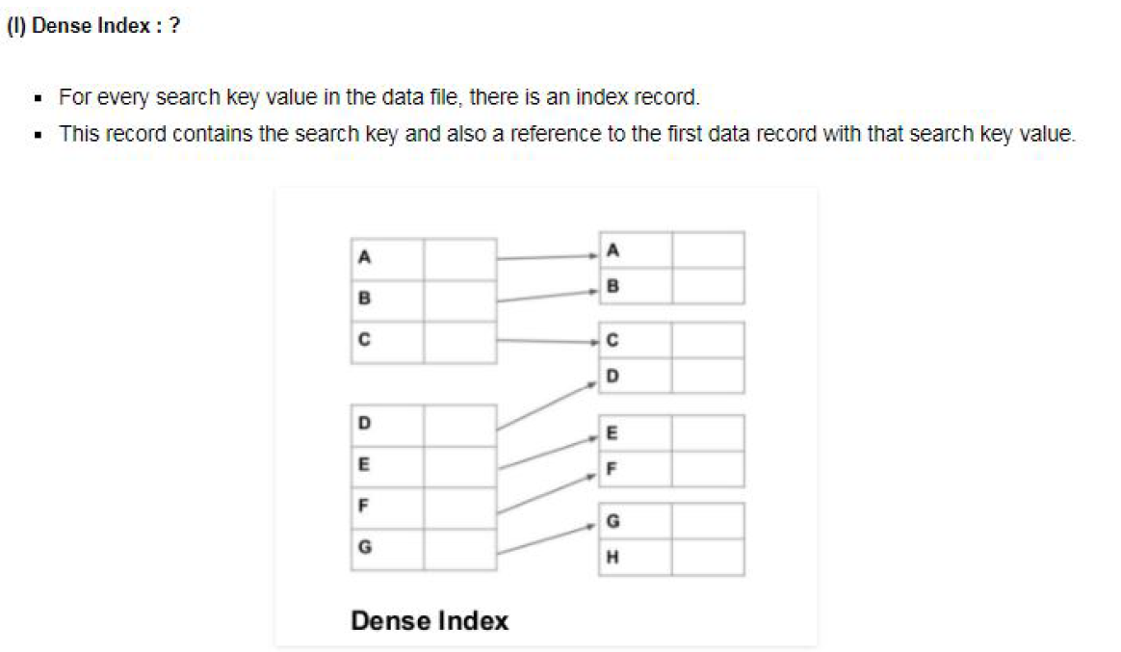

Slide 43
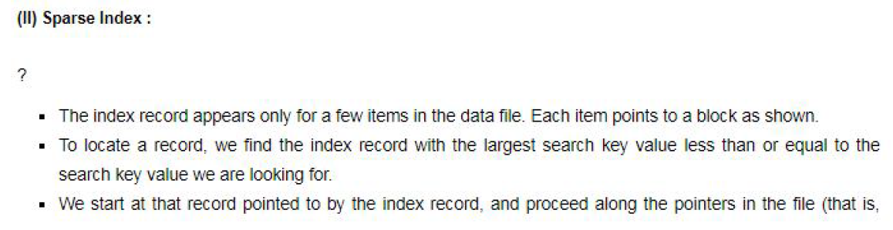
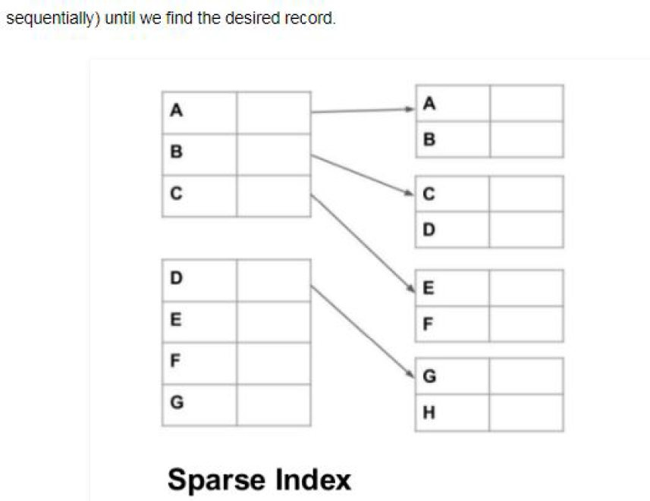

Slide 44
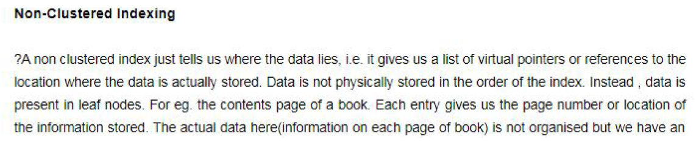

Slide 45
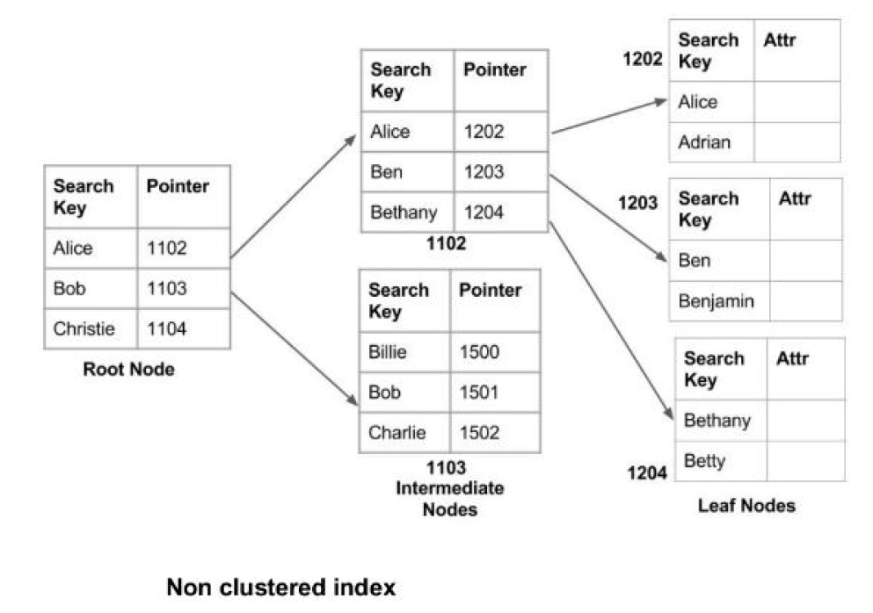

Slide 46
Secondary Index?
It is used to optimize query processing and access records in a database with some information other than the usual search key (primary key). In this two levels of indexing are used in order to reduce the mapping size of the first level and in general. Initially, for the first level, a large range of numbers is selected so that the mapping size is small.
Further, each range is divided into further sub ranges.
In order for quick memory access, first level is stored in the primary memory. Actual physical location of the data is determined by the second mapping level.

Slide 47
