Slide 1
ER MODEL

Slide 2
Introduction
The ER model defines the conceptual view of a database.
It works around real-world entities and the associations among them.
At view level, the ER model is considered a good option for designing databases.

Slide 3
Basic Terms
An entity can be a real-world object, either animate or inanimate, that can be easily identifiable.
For example, in a school database, students, teachers, classes, and courses offered can be considered as entities.
All these entities have some attributes or properties that give them their identity

Slide 4
Basic Terms
Entities are represented by means of their properties, called attributes.
All attributes have values.
For example, a student entity may have name, class, and age as attributes.

Slide 5
Types of Attributes
Simple attribute − Simple attributes are atomic values, which cannot be divided further. For example, a student's phone number is an atomic value of 10 digits.
Composite attribute − Composite attributes are made of more than one simple attribute. For example, a student's complete name may have first_name and last_name.
Derived attribute − Derived attributes are the attributes that do not exist in the physical database, but their values are derived from other attributes present in the database.
For example, average_salary in a department should not be saved directly in the database, instead it can be derived. For another example, age can be derived from data_of_birth.

Slide 6
Types of Attributes
Single-value attribute − Single-value attributes contain single value.
For example − Social_Security_Number.
Multi-value attribute − Multi-value attributes may contain more than one values.
For example, a person can have more than one phone number, email_address, etc.

Slide 7
Basic Terms
Entity-Set and Keys
Key is an attribute or collection of attributes that uniquely identifies an entity among entity set.
For example, the roll_number of a student makes him/her identifiable among students.
Super Key − A set of attributes (one or more) that collectively identifies an entity in an entity set.

Slide 8
Basic Terms
Candidate Key − A minimal super key is called a candidate key. An entity set may have more than one candidate key.
Primary Key − A primary key is one of the candidate keys chosen by the database designer to uniquely identify the entity set.

Slide 9
Basic Terms
Relationship
The association among entities is called a relationship.
For example, an employee works_ata department, a student enrolls in a course. Here, Works_at and Enrolls are called relationships.

Slide 10
Basic Terms
Relationship Set
A set of relationships of similar type is called a relationship set.
Like entities, a relationship too can have attributes. These attributes are called descriptive attributes.

Slide 11
Basic Terms
Degree of Relationship
The number of participating entities in a relationship defines the degree of the relationship.
Binary = degree 2
Ternary = degree 3
n-ary

Slide 12
Basic Terms
Mapping Cardinalities
Cardinality defines the number of entities in one entity set, which can be associated with the number of entities of other set via relationship set.

Slide 13
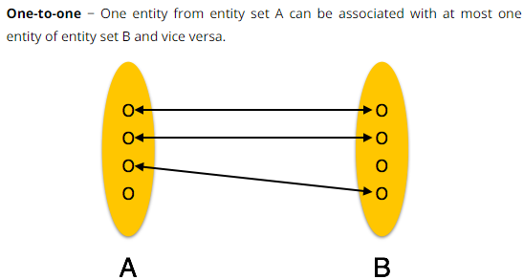
Basic Terms

Slide 14
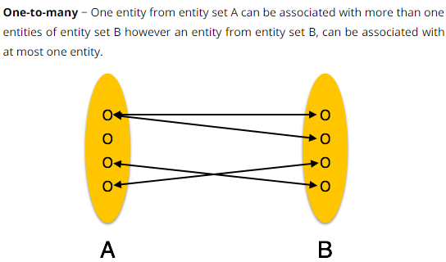
Basic Terms

Slide 15
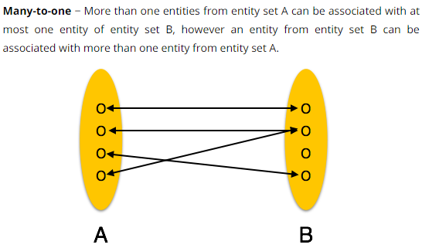
Basic Terms

Slide 16
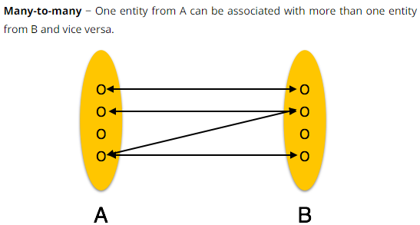
Basic Terms

Slide 17
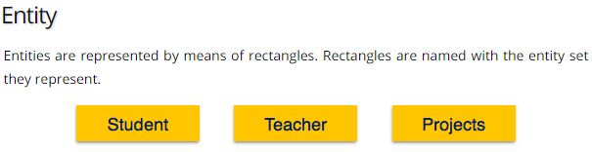
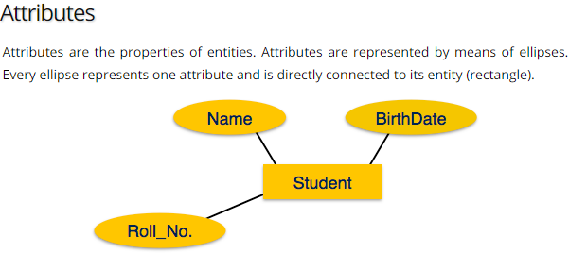
ER Representation

Slide 18
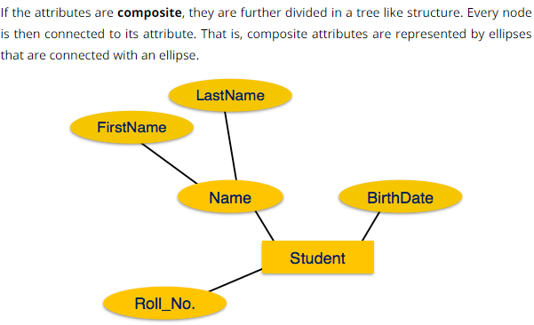
ER Representation

Slide 19
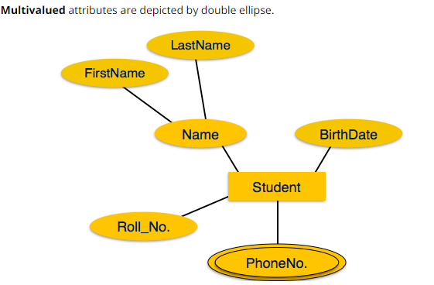
ER Representation

Slide 20
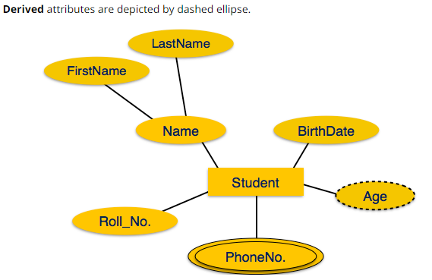
ER Representation

Slide 21
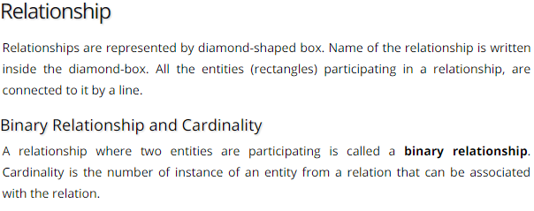
ER Representation

Slide 22
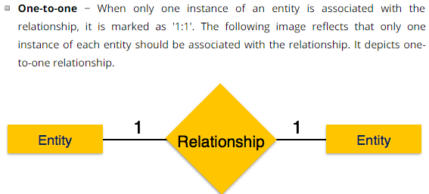
ER Representation

Slide 23
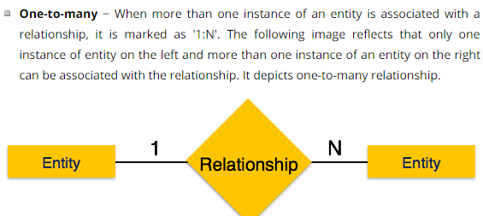
ER Representation

Slide 24
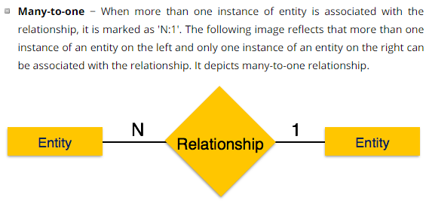
ER Representation

Slide 25
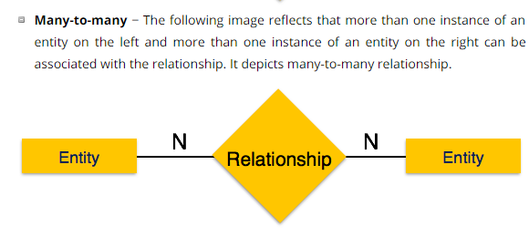
ER Representation

Slide 26
Weak and Strong Entity
A weak entity is an entity that depends on the existence of another entity. In more technical terms it can defined as an entity that cannot be identified by its own attributes.
It uses a foreign key combined with its attributed to form the primary key.
An entity like order item is a good example for this.
The order item will be meaningless without an order so it depends on the existence of order.

Slide 27
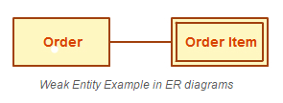
Weak and Strong Entity

Slide 28
Weak and Strong Entity
An entity set that has a primary key is called as Strong entity set.
Consider an entity set Payment which has three attributes: payment_number, payment_date and payment_amount.
Although each payment entity is distinct but payment for different loans may share the same payment number. Thus, this entity set does not have a primary key and it is an entity set

Slide 29
Weak and Strong Entity
A weak entity set does not have a primary key but we need a means of distinguishing among all those entries in the entity set that depend on one particular strong entity set.
The discriminator of a weak entity set is a set of attributes that allows this distinction be made.
For example, payment_number acts as discriminator for payment entity set.

Slide 30
Weak and Strong Entity
A member of a strong entity set is called dominant entity and member of weak entity set is called as subordinate entity.

Slide 31
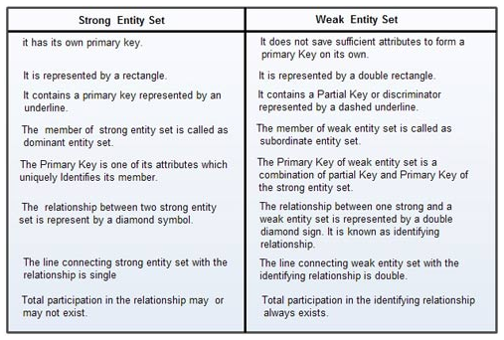
Weak and Strong Entity

Slide 32
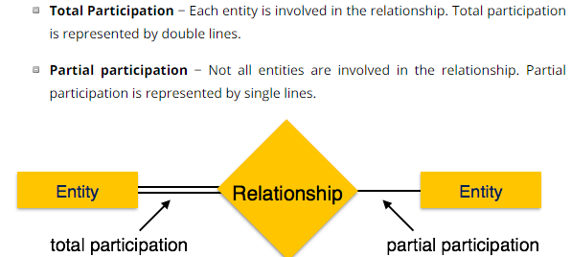
Total and Partial Participation

Slide 33
Total and Partial Participation
Relationships between entities can be optional or compulsory.
In our example, we could decide that a person is considered to be a customer only if they have bought a product.
On the other hand, we could say that a customer is a person whom we know about and whom we hope might buy something—that is, we can have people listed as customers in our database who never buy a product

Slide 34
Total and Partial Participation
In the first case, the customer entity has total participation in the bought relationship (all customers have bought a product, and we can’t have a customer who hasn’t bought a product), while in the second case it has partial participation (a customer can buy a product).
These are referred to as the participation constraints of the relationship.

Slide 35
Total and Partial Participation
Employee head of department
Not all employees become a head, but department will always be headed by one employee.
So employee participated partially in relationship.

Slide 36
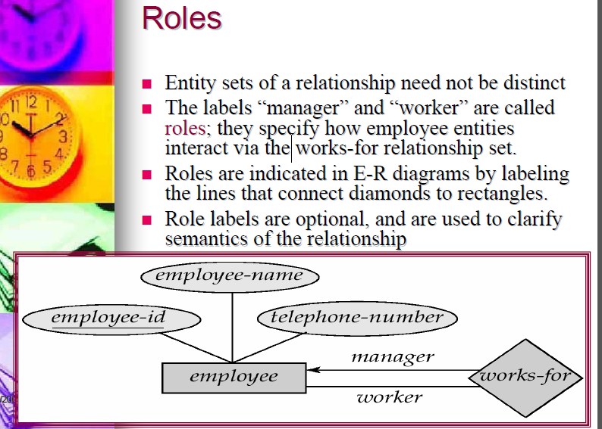
Roles

Slide 37
Example of ER Diagram
In case of college, a college contain many departments
Each dept. can offer any number of courses
Many instructor can work in a dept.
An instructor can work only in one dept.
For each dept. there is head
An instructor can be head of only one dept.
Each instructor can take any no. of courses
A course can be taken by only one instructor
A student can enroll for any no. of courses
Each course can have any no. of students

Slide 38
Example of ER Diagram
Step 1 : Identify the Entities
What are the entities here?
From the statements given, the entities are
Department
Course
Instructor
Student

Slide 39
Example of ER Diagram
Step 2 : Identify the relationships
One department offers many courses. But one particular course can be offered by only one department. hence the cardinality between department and course is One to Many (1:N)
One department has multiple instructors . But instructor belongs to only one department. Hence the cardinality between department and instructor is One to Many (1:N)
One department has only one head and one head can be the head of only one department. Hence the cardinality is one to one. (1:1)
One course can be enrolled by many students and one student can enroll for many courses. Hence the cardinality between course and student is Many to Many (M:N)
One course is taught by only one instructor. But one instructor teaches many courses. Hence the cardinality between course and instructor is Many to One (N :1)

Slide 40
Example of ER Diagram
Step 3: Identify the key attributes
"Departmen_Name" can identify a department uniquely. Hence Department_Name is the key attribute for the Entity "Department".
Course_ID is the key attribute for "Course" Entity.
Student_ID is the key attribute for "Student" Entity.
Instructor_ID is the key attribute for "Instructor" Entity.

Slide 41
Example of ER Diagram
Step 4: Identify other relevant attributes
For the department entity, other attributes are location
For course entity, other attributes are course_name,duration
For instructor entity, other attributes are first_name, last_name, phone
For student entity, first_name, last_name, phone

Slide 42
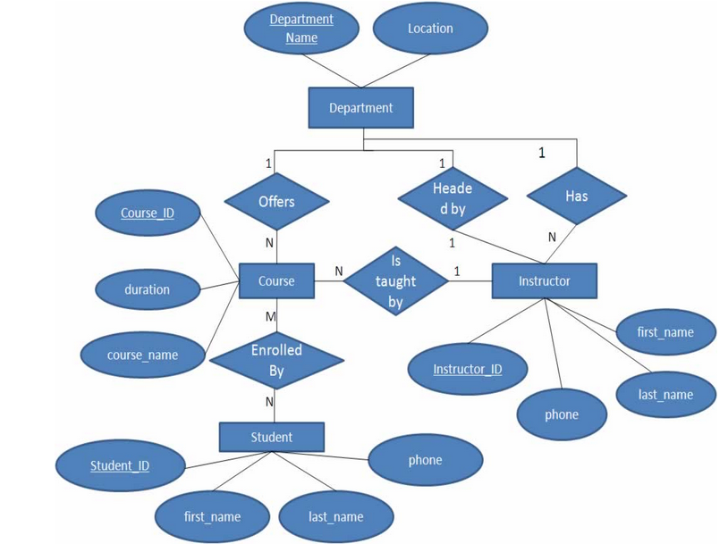
Example of ER Diagram

Slide 43
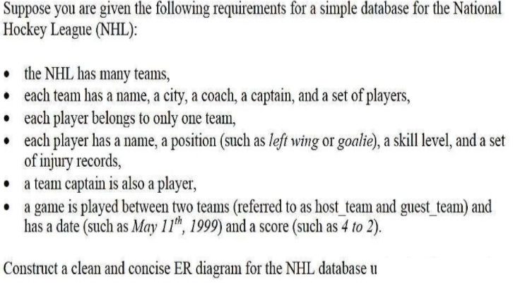

Slide 44
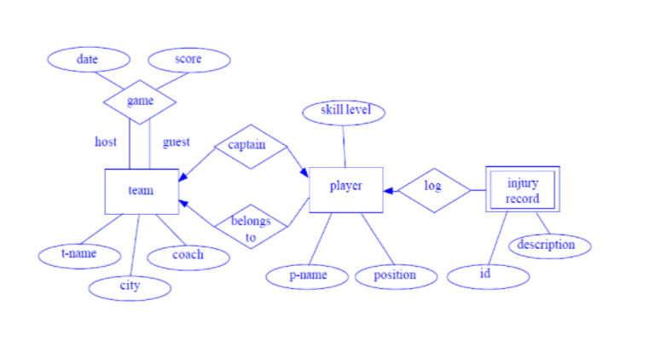

Slide 45
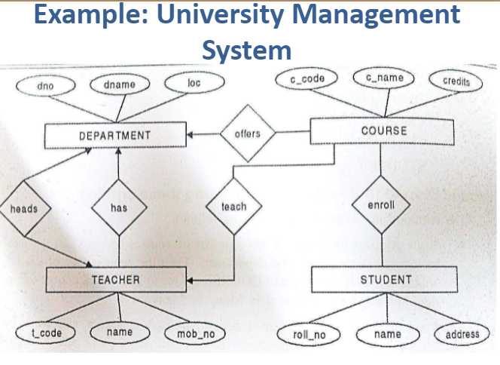

Slide 46
A publishing company produces books on various subjects. The books are written by authors who specialize in one particular subject. The company employs editors who, not necessarily being specialists in a particular area, each take sole responsibility for editing one or more book publications. Every book require some items for publication. These items supplied by suppliers. One supplier can supply many items. Shop owner buys books from the publisher. Shop owner can buy many books but one book can be bought by one shop owner only. Books are uniquely identified by Bookid.

Slide 48
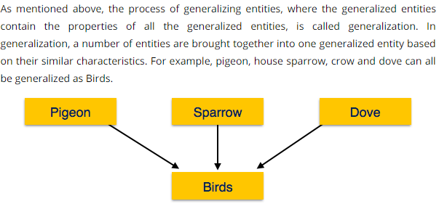
Generalization

Slide 49
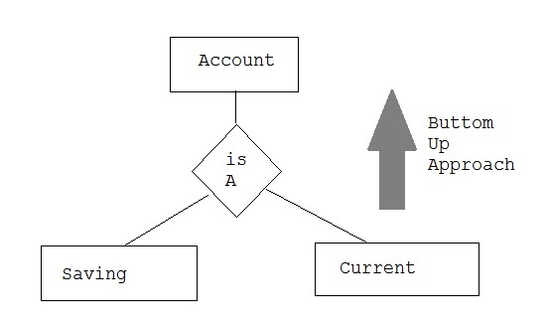
Example

Slide 50
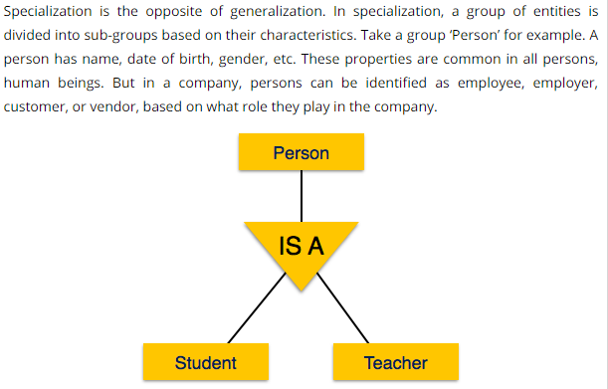
Specialization

Slide 51
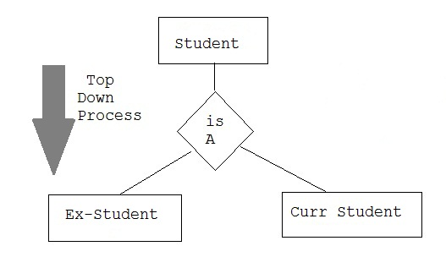
Specialization

Slide 52
Aggregation
Aggregation is a process when relation between two entity is treated as a single entity.
Here the relation between Center and Course, is acting as an Entity in relation with Visitor.

Slide 53
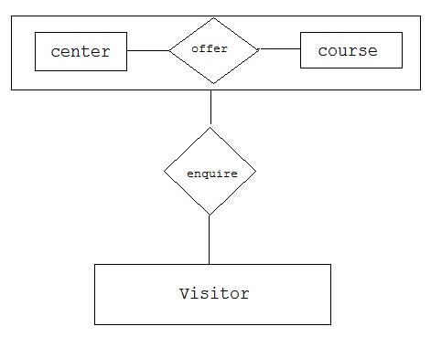
Aggregation

Slide 54
Aggregation
The E-R model cannot express relationships among relationships.
When would we need such a thing?
Consider a DB with information about employees who work on a particular project and use a number of machines doing that work.

Slide 55
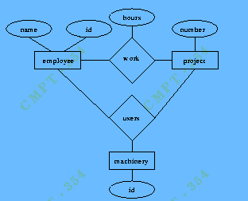
Aggregation

Slide 56
Aggregation
Relationship sets work and uses could be combined into a single set. However, they shouldn't be, as this would obscure the logical structure of this scheme.
The solution is to use aggregation.
An abstraction through which relationships are treated as higher-level entities.
For our example, we treat the relationship set work and the entity sets employee and project as a higher-level entity set called work.

Slide 57
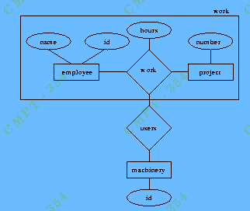
Aggregation

