Slide 1
Normalization

Slide 2
Dependency
A dependency occurs in a database when information stored in the same database table uniquely determines other information stored in the same table.

Slide 3
Functional Dependency
A functional dependency is defined as a constraint between two sets of attributes in a relation from a database.
Given a relation R, a set of attributes X in R is said to functionally determine another attribute Y, also in R, (written X → Y) if and only if each X value is associated with at most one Y value.

Slide 4
A Functional Dependency describes a relationship between attributes within a single relation.
An attribute is functionally dependent on another if we can use the value of one attribute to determine the value of another.
We use the arrow symbol → to indicate a functional dependency. X → Y is read X functionally determines Y

Slide 5
In other words….
X is the determinant set and Y is the dependent attribute. Thus, given a tuple and the values of the attributes in X, one can determine the corresponding value of the Y attribute.

Slide 6
Example
Employee
SSN | Name | JobType | DeptName
557-78-6587 | Lance Smith | Accountant | Salary
214-45-2398 | Lance Smith | Engineer | Product
Note: Name is functionally dependent on SSN because an employee’s name can be uniquely determined from their SSN. Name does not determine SSN, because more than one employee can have the same name..

Slide 7
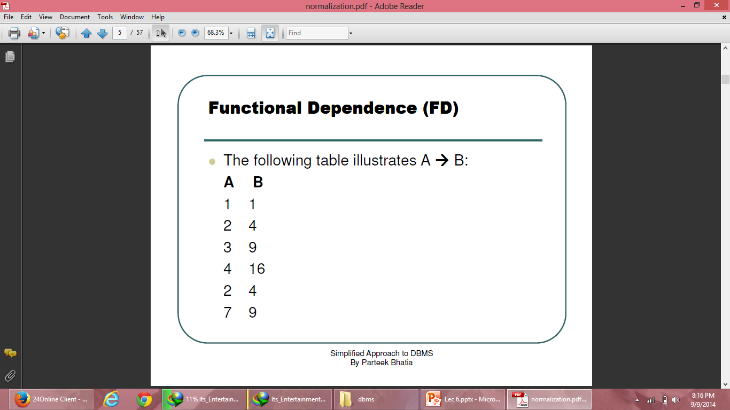
Functional Dependence (FD)

Slide 8
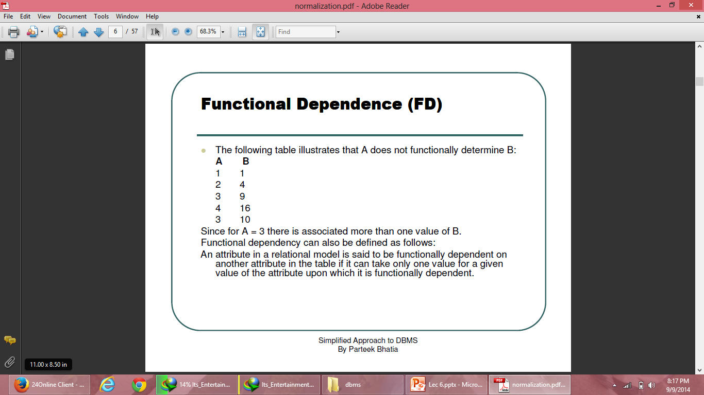
Functional Dependence (FD)

Slide 9
Functional dependency
Full functional dependency
Partial functional dependency
Transitive functional dependency
Multi-valued functional dependency
Join functional dependency

Slide 10
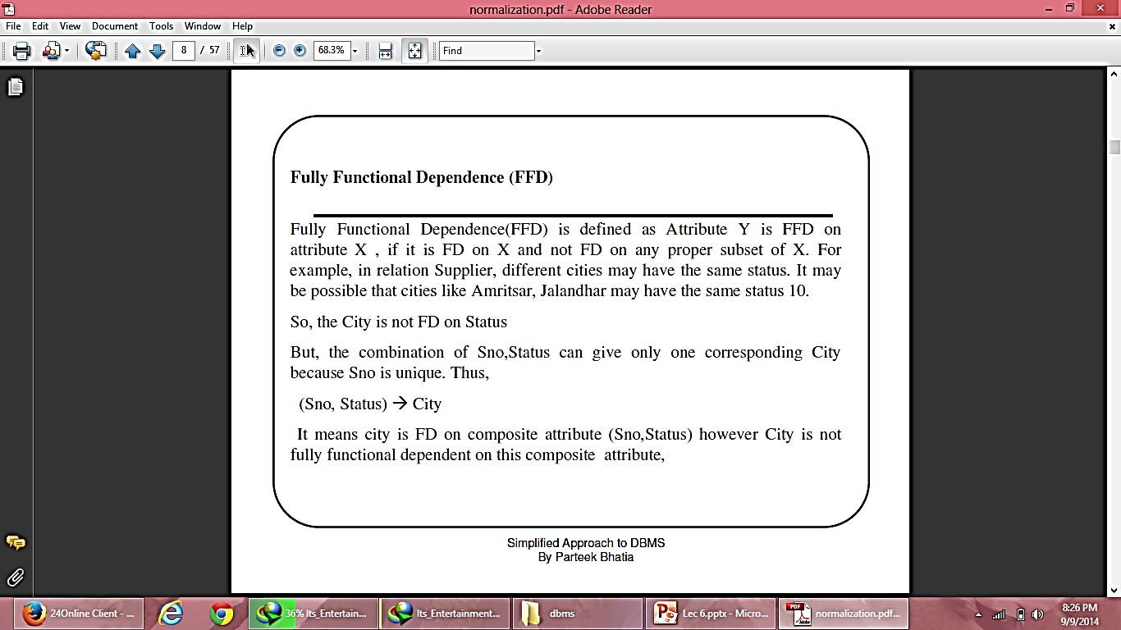
Fully Functional Dependency

Slide 11
Partial dependency
The value of one attribute is dependent on another attribute of relation which is a part of composite key.
Name is partially dependent on roll number.

Slide 12
Transitive functional dependency
Dept_id | Dept_name | Hod_name
1 | CSE | Mr X
2 | IT | Mr Y
3 | ECE | Mr Z
4 | ME | Mr A
Dept_id
Dept_name
Hod_name
A
B
C

Slide 13
Multi-valued functional dependency
Name | Ph_number
Ram | 987217701
Sham | 982271661
Ram | 876622134
Rajesh | 872213477
Raj | 657932721
Ajay | 873539262
A
B
Name
Ph_number

Slide 14
Decomposition of tables
Lossy decomposition
Lossless decomposition

Slide 15
Consider following table
Model | Price | Make
N12 | 10000 | CANON
P20 | 12000 | NIKON
A73 | 15000 | CANON
This can be further divided as following
Model | Make
N12 | CANON
P20 | NIKON
A73 | CANON
price | make
10000 | CANON
12000 | NIKON
15000 | CANON

Slide 16
Now try to re-create original table
model | price | make
N12 | 10000 | CANON
N12 | 15000 | CANON
P20 | 12000 | NIKON
A73 | 10000 | CANON
A73 | 15000 | CANON

Slide 17
Properties of Decomposition
Following are the properties of Decomposition,
Lossless Decomposition
Dependency Preservation
Lack of Data Redundancy

Slide 18

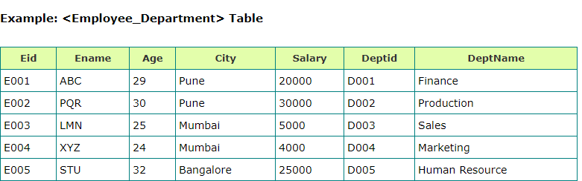

Slide 19
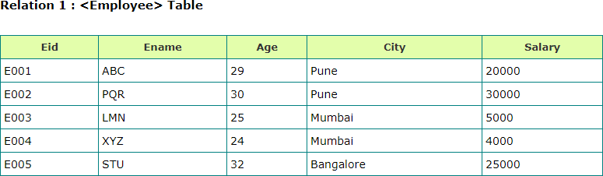
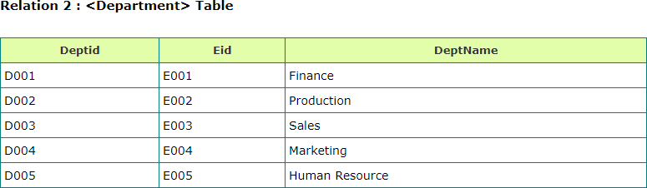

Slide 20
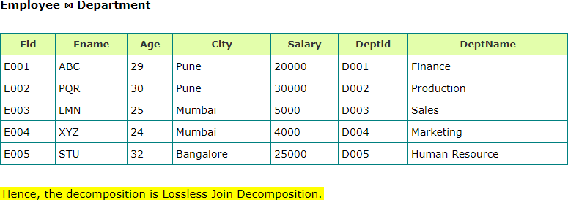

Slide 21
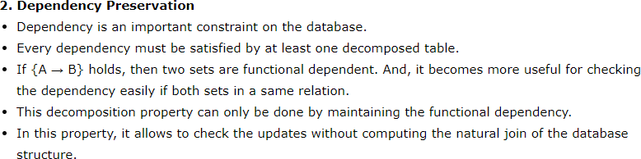
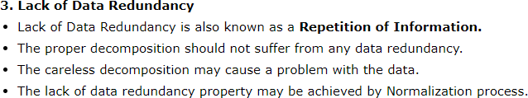

Slide 22
Normalization
Data normalization is a technique of organizing the data in database.
Normalization of data can be defined as a process during which redundant relation schemas are decomposed by breaking up their attributes into smaller relation schemas that process desirable properties.

Slide 23
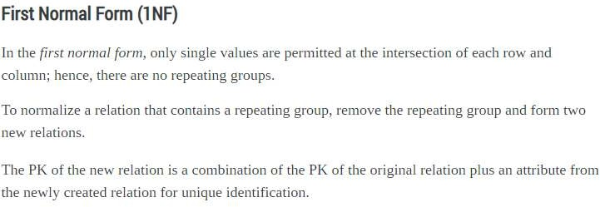

Slide 24
The first normal form states that:
Every column in the table must be unique
Separate tables must be created for each set of related data
Each table must be identified with a unique column or concatenated columns called the primary key
No rows may be duplicated
no columns may be duplicated
no row/column intersections contain a null value
no row/column intersections contain multivalued fields

Slide 25
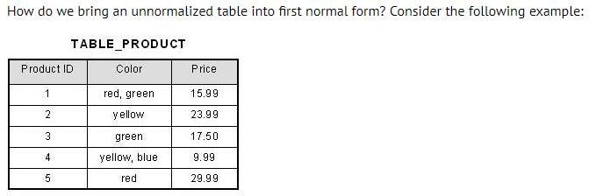
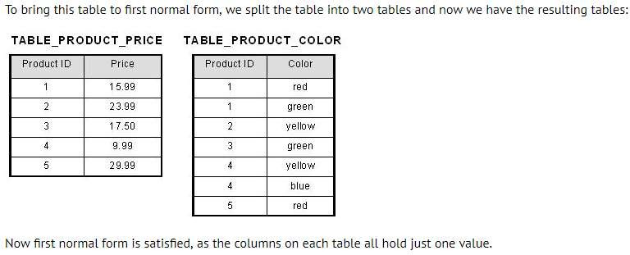

Slide 26
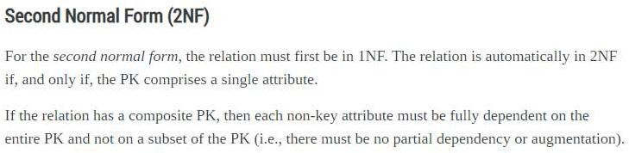

Slide 27
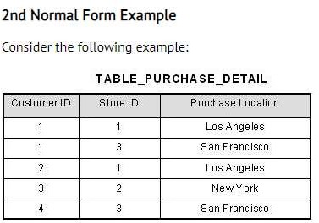
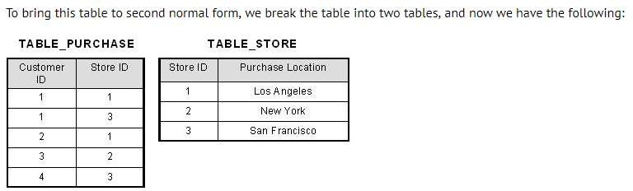
This table has a composite primary key [Customer ID, Store ID]. The non-key attribute is [Purchase Location]. In this case, [Purchase Location] only depends on [Store ID], which is only part of the primary key. Therefore, this table does not satisfy second normal form.
What we have done is to remove the partial functional dependency that we initially had. Now, in the table [TABLE_STORE], the column [Purchase Location] is fully dependent on the primary key of that table, which is [Store ID].

Slide 28
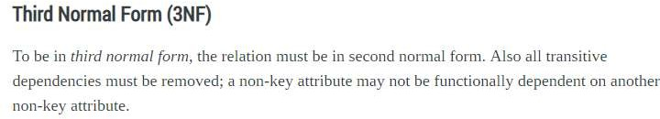
By transitive functional dependency, we mean we have the following relationships in the table: A is functionally dependent on B, and B is functionally dependent on
C. In this case, C is transitively dependent on A via B.

Slide 29
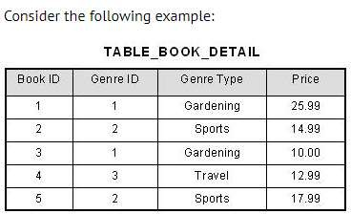
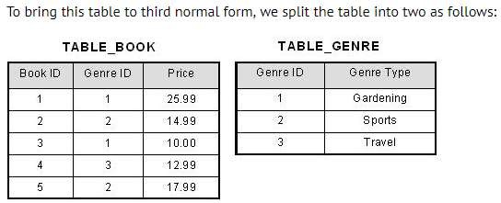
In the table able, [Book ID] determines [Genre ID], and [Genre ID] determines [Genre Type]. Therefore, [Book ID] determines [Genre Type] via [Genre ID] and we have transitive functional dependency, and this structure does not satisfy third normal form.
Now all non-key attributes are fully functional dependent only on the primary key. In [TABLE_BOOK], both [Genre ID] and [Price] are only dependent on [Book ID]. In [TABLE_GENRE], [Genre Type] is only dependent on [Genre ID].

Slide 30
Students
Roll-no | Game | Fee
1 | Cricket | 200
2 | Tennis | 300
3 | Foot ball | 100
4 | Cricket | 200
5 | hockey | 150
Roll-no→game→fee
anomalies
Insert-------no new student added without assigning game
Update---- change in fee of cricket … needs to rows to be update
Delete----- student with roll no 2 is deleted then we loss the info regarding tennis game with its fee.

Slide 31
Student_Game
Roll-no | Game
1 | Cricket
2 | Tennis
3 | Foot ball
4 | hockey
Student_Fee
Game | Fee
Cricket | 200
Tennis | 300
Foot ball | 100
hockey | 150

Slide 32
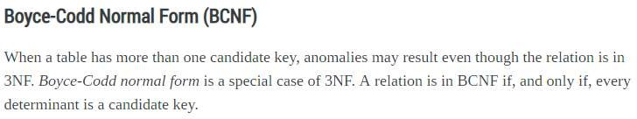
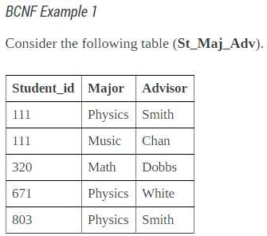
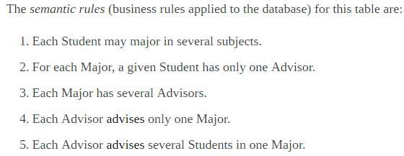

Slide 33
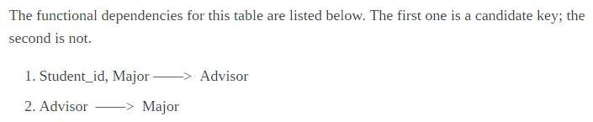
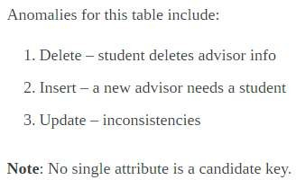

Slide 34
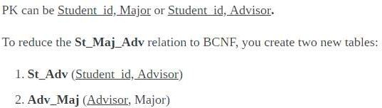
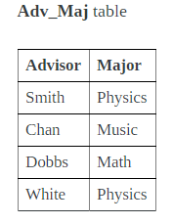
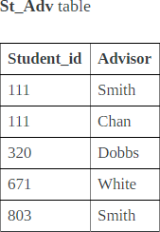

Slide 35
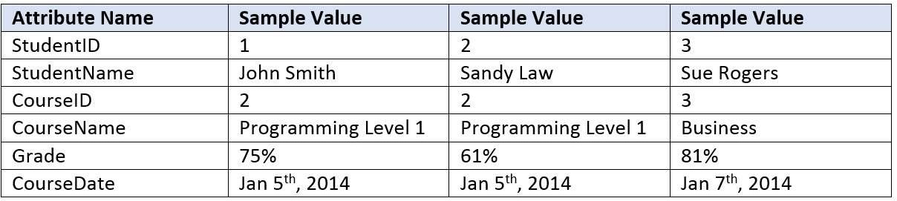
Draw the dependency diagram for this table.

Slide 36
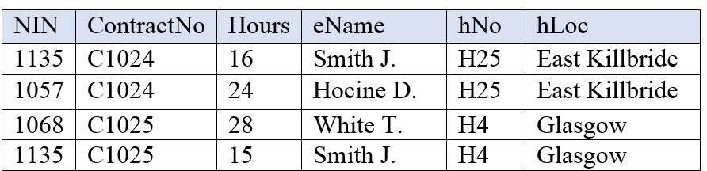
An agency called Instant Cover supplies part-time/temporary staff to hotels in Scotland. Figure 12.4 lists the time spent by agency staff working at various hotels. The national insurance number (NIN) is unique for every member of staff. Use Figure 12.4 to answer questions (a) and (b).
This table is susceptible to update anomalies. Provide examples of insertion, deletion and update anomalies.
Normalize this table to third normal form. State any assumptions.

Slide 37
4th Normal Form
It is in BCNF
There is no multi value dependency in relation

Slide 38
Emp-id | Language | skill
101 | English | Teaching
101 | Hindi | Conversation
101 | English | Conversation
101 | hindi | Teaching
202 | English | Singing
202 | Hindi | Teaching
Multivalued dependencies exist
Emp-id→ → language
Emp-id→ → skill
Anomalies
Delete—if id 101 discontinues teaching skill … then two rows to be delete Update– if id 101 change its skill teaching to singing … then number of changes to be done.

Slide 39
This table could be divided in following two tables:
Emp-id | Language
101 | English
101 | Hindi
202 | English
202 | hindi
Emp-id | skills
101 | Teaching
101 | Conversation
202 | Singing
202 | Teaching

Slide 40
5th Normal Form
A relation R is in Fifth Normal Form (5NF) if and only if the following conditions
are satisfied simultaneously:
1.
2.
R is already in 4NF.
It cannot be further non-loss decomposed.

Slide 41
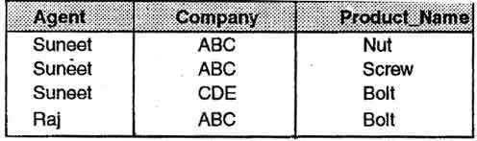
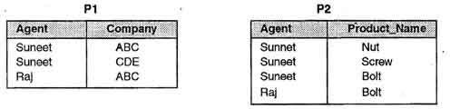
Consider Following data base:
Now this data base is decomposed into following two tables:

Slide 42
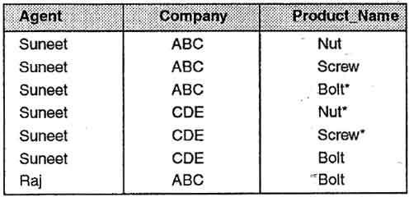
Now try to Re-Join these tables to re-create original table;;:::??????
Now try to find out anomalies it has now?

Slide 43
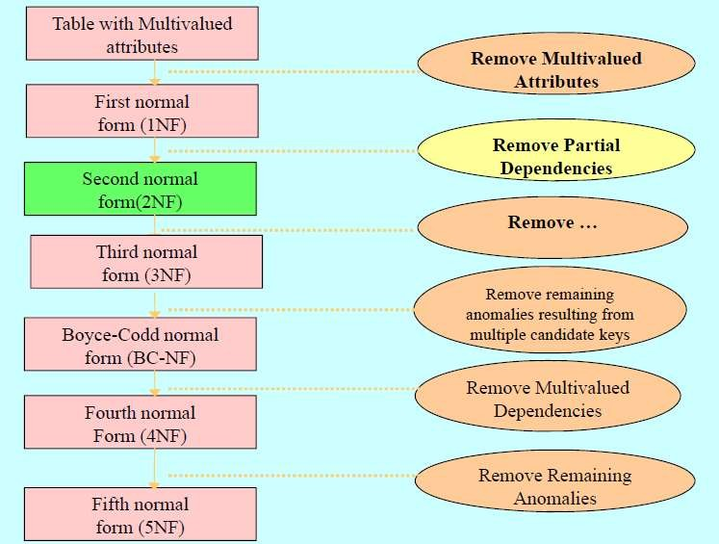
Over all picture of Normalization process:
transitive
dependencies

Slide 44
E.F. Codd’s 12 Rules for RDBMS
Dr E.F.Codd, also known to the world as the ‘Father of Database Management Systems’ had propounded 12 rules which are in-fact 13 in number.
The rules are numbered from zero to twelve.
According to him, a DBMS is fully relational if it abides by all his twelve rules. Till now, only few databases abide by all the eleven rules.

Slide 45
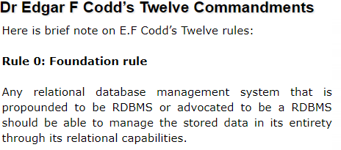
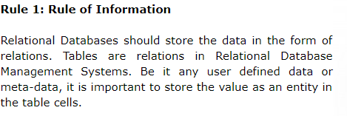
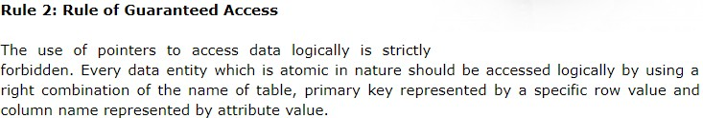
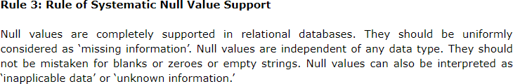

Slide 46
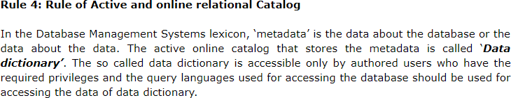



Slide 47




Slide 48



Slide 49
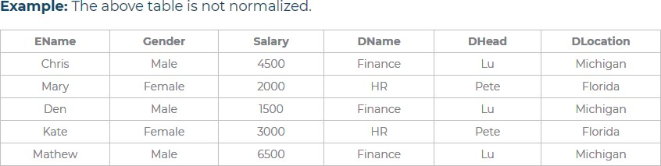
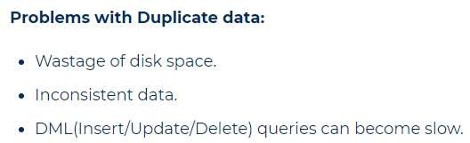

Slide 50
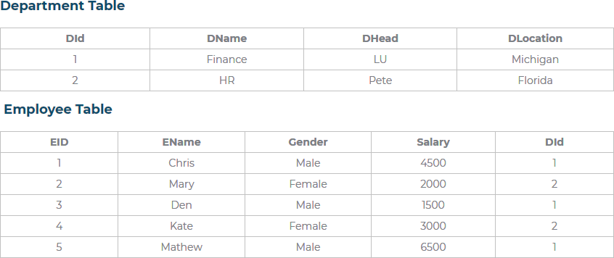
To solve this, we normalize tables. We have broken the above table into 2 tables,
repeating columns we have moved into a separate table

Slide 51
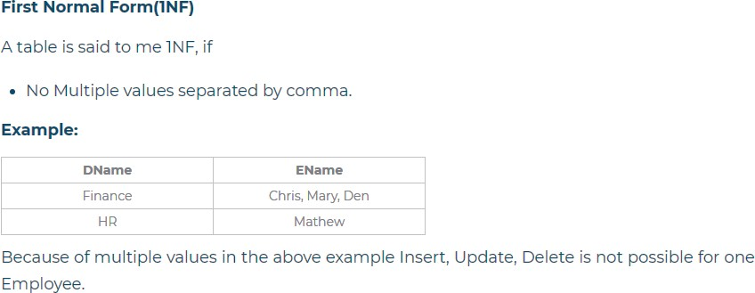
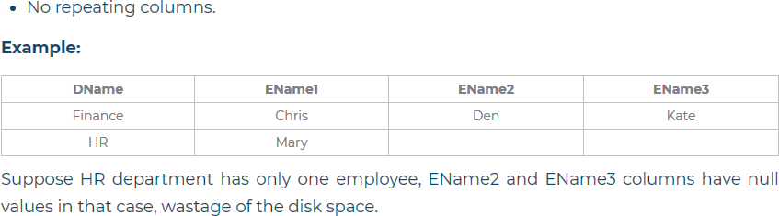

Slide 52
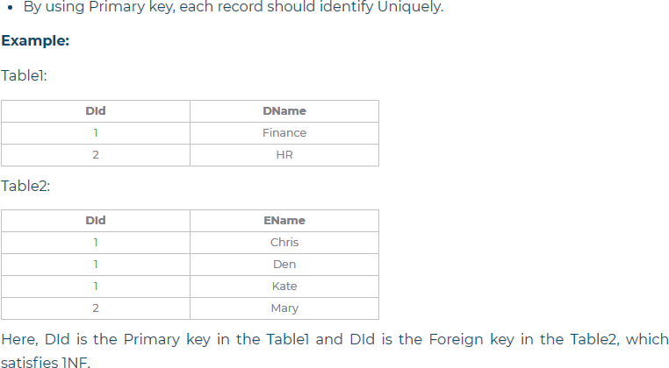

Slide 53
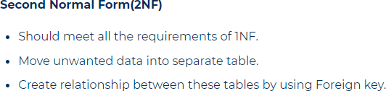
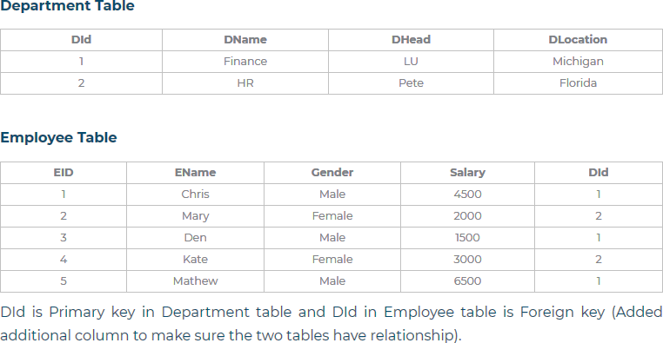

Slide 54

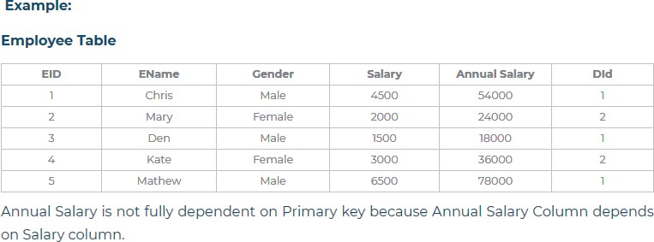

Slide 55
