Slide 1
LECTURE -1 (INTRODUCTION)
INT 306 – DATABASE MANAGEMENT SYSTEM

Slide 2
OUTLINE
The Need for Databases
Data Models
Relational Databases
Database Design
Storage Manager
Query Processing
Transaction Manager

Slide 3
Database Management System
DBMS contains information about a particular enterprise
Collection of interrelated data
Set of programs to access the data
An environment that is both convenient and efficient to use
Its Purpose
To manage large bodies of information
The database system must ensure the safety of the information stored
The system must avoid possible anomalous result

Slide 4
Database Applications
Banking: transactions
Airlines: reservations, schedules
Universities: registration, grades
Credit Card Transaction
Sales: customers, products, purchases
Online retailers: order tracking, customized recommendations
Manufacturing: production, inventory, orders, supply chain
Human resources: employee records, salaries, tax deductions

Slide 5
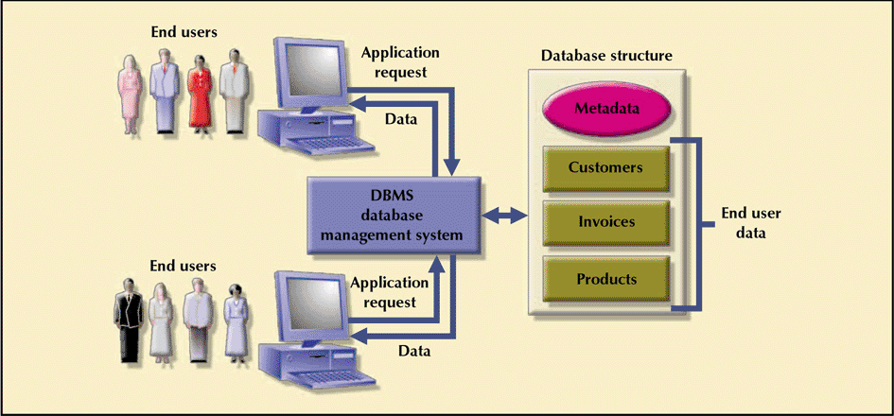
Database Management System
Database Systems: Design, Implementation, & Management: Rob & Coronel

Slide 6
Database Management System vs. File System
Consider an Application Bank System
A program to debit or credit an account
A program to add a new account
A program to find the balance of an account
A program to generate monthly statements
System programmers wrote these application programs to meet the needs of the bank
This typical file-processing system is supported by a conventional operating system.
The system stores permanent records in various files, and it needs different application programs to extract records from, and add records to, the appropriate files.

Slide 7
Drawbacks of using file systems to store data
Data redundancy and inconsistency
File system may have duplicate data
Updating of records is difficult
Difficult in accessing data: accessing customers information of a Particular pin code
Manual search
Extracting Required Information
Data Isolation: information are scattered into multiple files
Integrity Problems: must stratify some constraints
Savings account balance may never fall below a prescribed amount

Slide 8
Drawbacks of using file systems to store data cont…
Atomicity Problem
Handling System Failure issues
Handling of power failure issues
Concurrent – access anomalies
Handling to writing and reading operations
Security Problems
Role-based accessing must be given
It is difficult in application programming

Slide 9
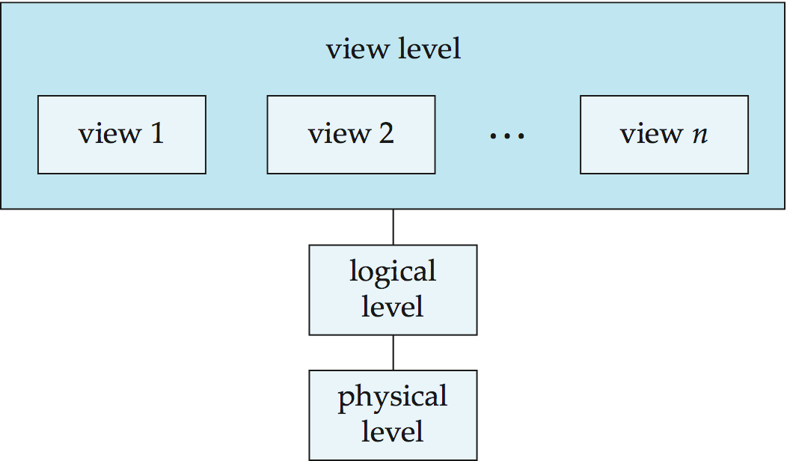
Data Abstraction
Many database-systems users are not computer trained, developers hide the complexity from users through several levels of abstraction, to simplify users’ interactions with the system:
1. Physical Level
Describes how the data are actually stored. The physical level describes complex low-level data structures
2. Logical Level
What type of data will store into database and what type relationships exists between them
3. View Level
Describes only part of the entire database
It simplifies the interaction between the data and the user

Slide 10
Level of Data Abstraction – Bank Application
struct Cust_Record{
int cust_id;
string name;
string state;
string city;
const double min_balance;
};
At the physical level, a customer, account, or employee record can be described as a block of consecutive storage locations (for example, words or bytes).
At the logical level, each such record is described by a type definition, as in the previous code segment, and the interrelationship of these record types is defined as well.
struct accounts{
long long int acco_no;
long double balance;
};
struct employee{
int id;
string name;
long int phone;
string city;
};
Finally, at the view level, computer users see a set of application programs that hide details of the data types. Similarly, at the view level, several views of the database are defined, and database users see these views.

Slide 11
Quiz – 1: What is the purpose of views in database?
It adds lower – level of abstraction
It hides logical and physical details of the database
Views are designed for end users and the database programmers
Views provides a security mechanism to prevent users from accessing certain parts of the database

Slide 12
Quiz – 1: What is the purpose of views in database?
It adds lower – level of abstraction
It hides logical and physical details of the database
Views are designed for end users and the database programmers
Views provides a security mechanism to prevent users from accessing certain parts of the database

Slide 13
Quiz – 2: Identify the correct option, which describes file systems?
Role-based data accessibility is possible
It is a set of system programs handle by application programmers
It can leads to leads to data anomalies
Files are well synchronised and very less chance of data redundancy

Slide 14
Quiz – 2: Identify the correct option, which describes file systems?
Role-based data accessibility is possible
It is a set of system programs handle by application programmers
It can leads to leads to data anomalies
Files are well synchronised and very less chance of data redundancy

Slide 15
Instances and Schemas
Databases change over time as information is inserted and deleted. The collection of information stored in the database at a particular moment is called an instance of the database.
The overall design of the database is called the database schema. Schemas are changed infrequently, if at all.
Example of Database Instances
Example of Schema
Name | Enrolment No. | Dept.
Rahul | 11904252 | CSE
Shivam | 11805147 | ECE
struct Student{
string name;
long int enroll;
string dept;
};

Slide 16
Types of Schemas
Databases change over time as information is inserted and deleted. The collection of information stored in the database at a particular moment is called an instance of the database.
The overall design of the database is called the database schema. Schemas are changed infrequently, if at all.
1. Physical Schema
This schema pertains to the actual storage of data and its form of storage like files, indices, etc. It defines how the data will be stored in a secondary storage.
2. Logical Schema
This schema defines all the logical constraints that need to be applied on the data stored. It defines tables, views, and integrity constraints

Slide 17
Three Tier Architecture
An architecture for a database system

Slide 18
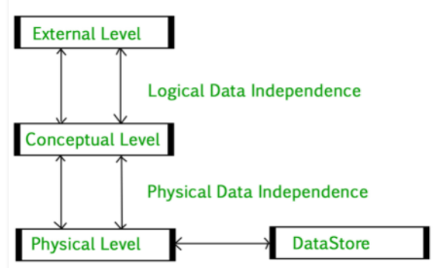
Notes:
Physical Level: At the physical level, the information about the location of database objects in the data store is kept. Various users of DBMS are unaware of the locations of these objects.In simple terms,physical level of a database describes how the data is being stored in secondary storage devices like disks and tapes and also gives insights on additional storage details.
Conceptual Level: At conceptual level, data is represented in the form of various database tables. For Example, STUDENT database may contain STUDENT and COURSE tables which will be visible to users but users are unaware of their storage.Also referred as logical schema,it describes what kind of data is to be stored in the database.
External Level: An external level specifies a view of the data in terms of conceptual level tables. Each external level view is used to cater to the needs of a particular category of users. For Example, FACULTY of a university is interested in looking course details of students, STUDENTS are interested in looking at all details related to academics, accounts, courses and hostel details as well. So, different views can be generated for different users. The main focus of external level is data abstraction.

Slide 19

Users of DBMS
Data Base Administrator
Database Designer
End User
System Analyst and Application Programmer

Slide 20


Data Models
A collection of tools for describing
Data
Data relationships Data semantics Data constraints
Relational model
Entity-Relationship data model (mainly for database design)
Object-based data models (Object-oriented and Object-relational)
Semistructured data model (XML) Other older models:
Network model
Hierarchical model

Slide 21
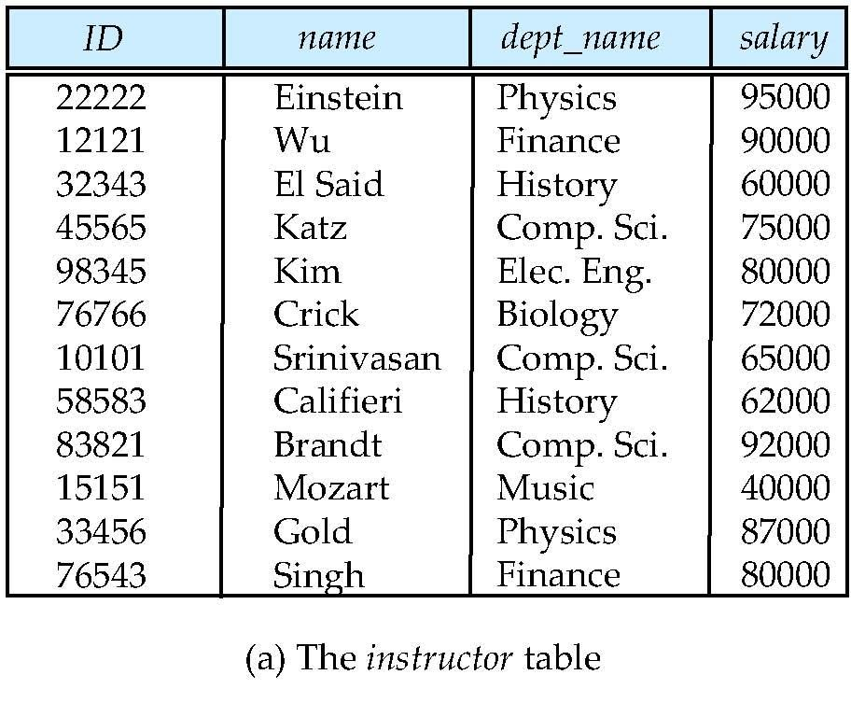
Relational Model
Relational model (Chapter 2)
Example of tabular data in the relational model
Columns
Rows

Slide 22
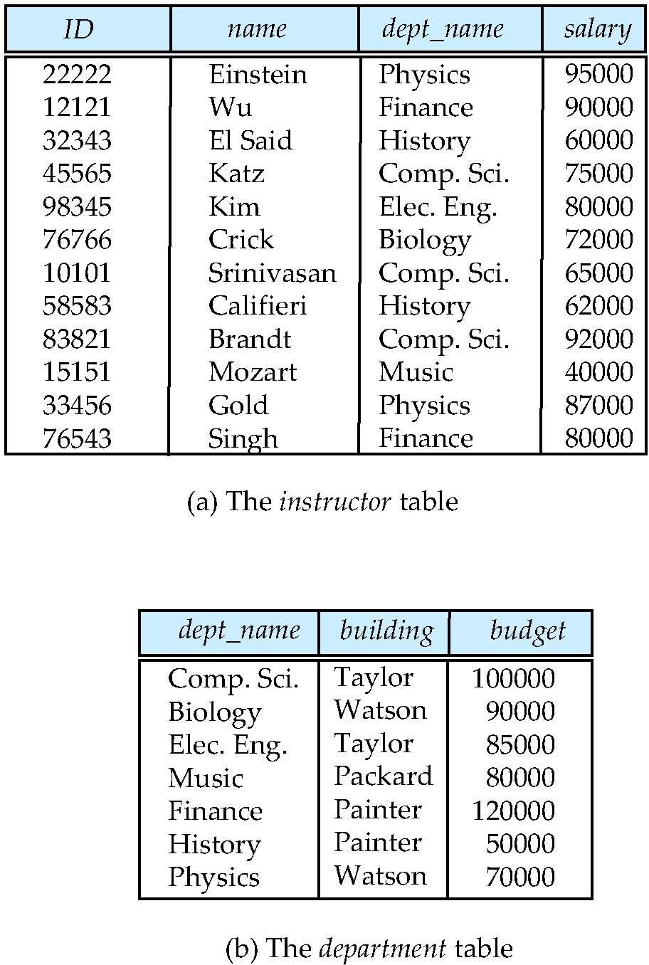
A Sample Relational Database

Slide 23
Database Languages
Language for accessing and manipulating the data organized by the appropriate data model
DML also known as query language
Two classes of languages
Procedural – user specifies what data is required and how to get those data
Declarative (nonprocedural) – user specifies what data is required without specifying how to get those data
SQL is the most widely used query language

Slide 24

Data Manipulation Language (DML)
Specification notation for defining the database schema Example: create table instructor (
ID
name
char(5), varchar(20),
dept_name varchar(20),
salary numeric(8,2))
DDL compiler generates a set of table templates stored in a data dictionary
Data dictionary contains metadata (i.e., data about data) Database schema
Integrity constraints
 Primary key (ID uniquely identifies instructors)
 Referential integrity (references constraint in SQL)
– e.g. dept_name value in any instructor tuple must appear in
department relation
Authorization

Slide 25
Data Control Language (DCL)
DCL includes statements which control access to data and database. Privilege can be granted to user using GRANT statement.
REVOKE command is used to take back the privileges.
Notes:
Data Control Language (DCL)

Slide 26
SQL
SQL: widely used non-procedural language
Example: Find the name of the instructor with ID 22222
select from where
name
instructor instructor.ID = ‘22222’
Example: Find the ID and building of instructors in the Physics dept.
select instructor.ID, department.building
from instructor, department
where instructor.dept name = “physics”
Application programs generally access databases through one of
Language extensions to allow embedded SQL
Application program interface (e.g., ODBC/JDBC) which allow SQL queries to be sent to a database
Notes:
SQL

Slide 27
Database Design
The process of designing the general structure of the database:
Logical Design – Deciding on the database schema. Database design
requires that we find a “good” collection of relation schemas.
Business decision – What attributes should we record in the database?
Computer Science decision – What relation schemas should we have and how should the attributes be distributed among the various relation schemas?
Physical Design – Deciding on the physical layout of the database
Notes:
Database Design

Slide 28
History of Database Systems
1950s and early 1960s:
Data processing using magnetic tapes for storage
 Tapes provided only sequential access Punched cards for input
Late 1960s and 1970s:
Hard disks allowed direct access to data
Network and hierarchical data models in widespread use
Ted Codd defines the relational data model
 Would win the ACM Turing Award for this work
 IBM Research begins System R prototype
 UC Berkeley begins Ingres prototype
High-performance (for the era) transaction processing
Notes:
History of Database Systems

Slide 29
History (cont.)
1980s:
Research relational prototypes evolve into commercial systems
 SQL becomes industrial standard Parallel and distributed database systems Object-oriented database systems
1990s:
Large decision support and data-mining applications Large multi-terabyte data warehouses
Emergence of Web commerce Early 2000s:
XML and XQuery standards
Automated database administration Later 2000s:
Giant data storage systems
 Google BigTable, Yahoo PNuts, Amazon, ..
Notes:
History (cont.)

