Slide 1
Subqueries in SQL

Slide 2
Introduction
Subqueries provide a powerful means to combine data from two tables into a single result. You can also call these nested queries. As the name implies, subqueries contain one or more queries, one inside the other.
you can use subqueries in the SELECT, FROM, WHERE, or HAVING clauses. Depending on how they are used, a subquery may return a single value or multiple rows.

Slide 3
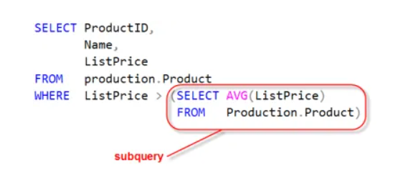
Example Subqueries
Subqueries make it possible for you to write queries that are more dynamic and data driven. For instance using a subquery you can return all products whose ListPrice is greater than the average ListPrice for all products.
You can do this by having it first calculate the average price and then use this to compare against each product’s price.

Slide 4
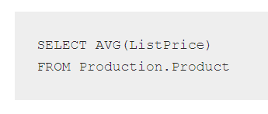
Subquery Breakdown
Let’s break down this query so you can see how it works.
Step 1: First let’s run the subquery:
It returns 438.6662 as the average ListPrice

Slide 5
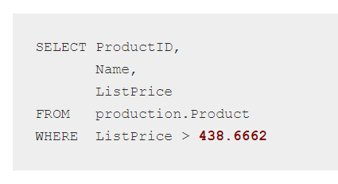
Step 2: Find products greater than the average price by plugging in the average ListPrice value into our query’s comparison

Slide 6
Things to Keep in Mind
A subquery is just a SELECT statement inside of another.
They are always enclosed in parenthesis ().
A subquery that returns a single value can be used anywhere you would use an expression, such as in a column list or filter expression.
A subquery that returns more than one value is typically used where a list of values, such as those used in and IN operator.
Warning! Subqueries can be very inefficient. If there are more direct means to achieve the same result, such as using an inner join, you’re better for it.
You can nest subqueries up to thirty two levels deep on SQL server. To be honest, I can’t imagine why! I’ve see maybe four deep at most. Realistically I think you only go one or two deep.

Slide 7
Where Can you use Subqueries?
In a SELECT clause as a column expression
In a WHERE clause as a filter criteria
In the FROM clause as a table specification
In a HAVING clause as a group selector (filter criteria)

Slide 8
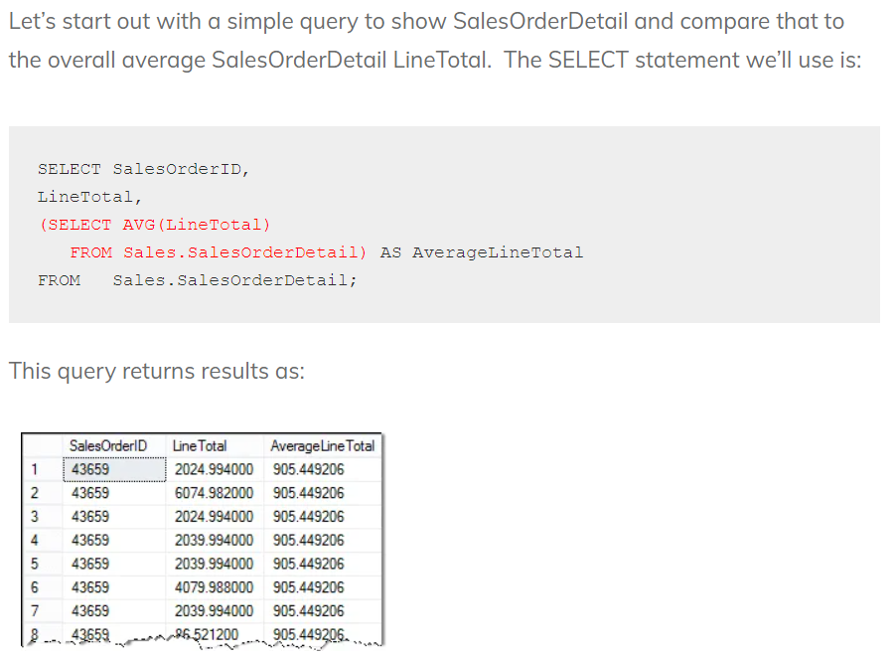
In a SELECT clause as a column expression
-> salerOrderID and LineTotal are columns and sales.SalerOrderDetail is table

Slide 9
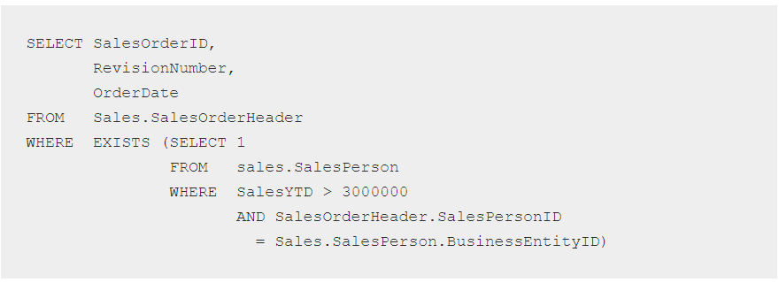
Using Subqueries in the WHERE Clause
Exist and Not Exists
The EXISTS condition is used in combination with a subquery. It returns TRUE whenever the subquery returns one or more values.
Conversely, if we want to test for non-membership we can use NOT EXISTS.
NOT EXISTS returns TRUE if zero rows are returned.

Slide 10
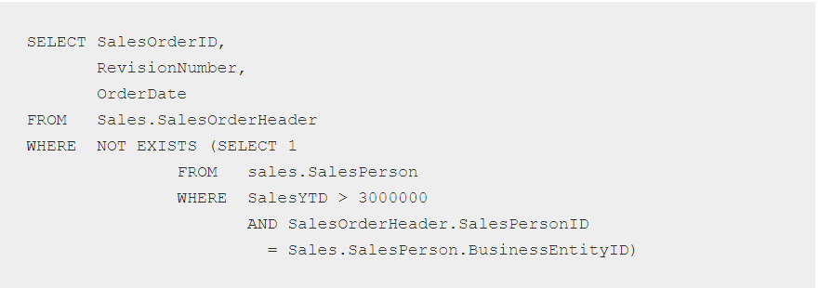

Slide 11
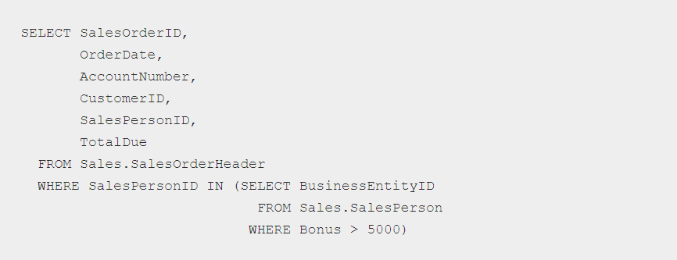
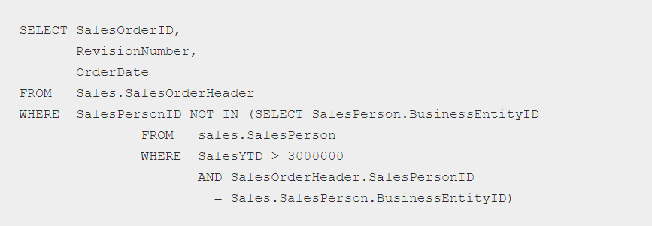
IN and NOT IN

Slide 12
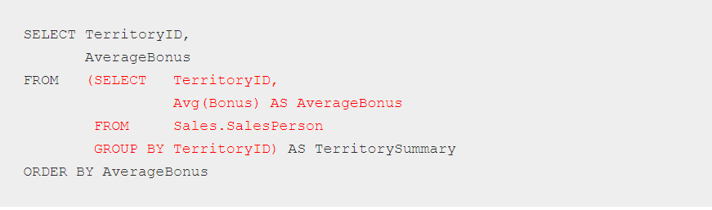
Using a Subquery in the FROM clause

Slide 13
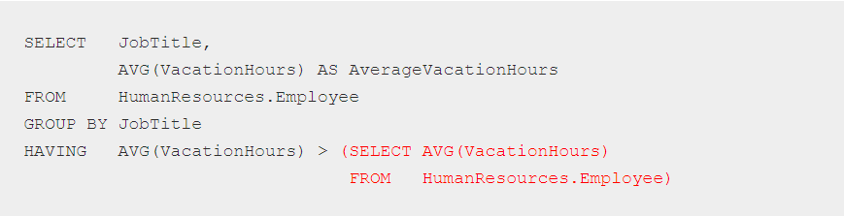
Using Subqueries in the HAVING Clause
This query is executed as:
Compute the remaining average vacation hours for all employees. (subquery)
Group records by JobTitle and computer the average vacation hours.
Only keep groups whose average vacation hours are greater than the overall average.

