Slide 1
Lecture 0
INT 306
Database Management System

Slide 2
Hours to dedicate
L:0
T:0
P:5

Slide 3
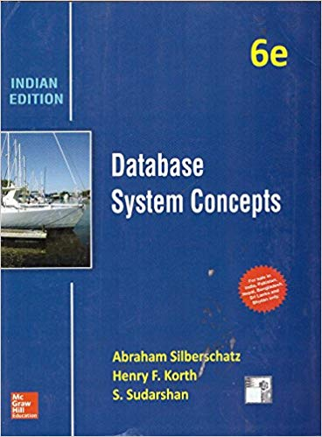
Text BOOK to study
DATABASE SYSTEM CONCEPTS by HENRY F. KORTH, ABRAHAM SILBERSCHATZ, S. SUDARSHAN, MCGRAW HILL EDUCATION

Slide 4

UNIT 1: Introduction to Databases
What is data?
In simple words, data can be facts related to any object in consideration, For example your name, age, height, weight, etc. are some data related to you.
A picture, image, file, pdf etc. can also be considered data.

Slide 5

About database!
Just like a container where your data is stored
What is a database?
A database is a systemic collection of data. Since the data in the database is organized, it makes data management easy.
Database Management system (DBMS) is a collection of programs which enables its users to access Database, manipulate data and help in representation of data.
It also helps control access to the database by various users

Slide 6

Database management system
A collection of programs which enables users to access database, manipulate data and represent data.
A technology to store and retrieve data with utmost efficiency along with appropriate security measures.

Slide 7
Is excel a database?
Excel is a spreadsheet program to store and compute data.
It's a flat file system instead of database system.
WHAT IS FLAT FILE SYSTEM?
A flat file database is a database that stores data in a plain text file.
Each line of the text file holds one record, with fields separated by delimiters, such as commas or tabs.
While it uses a simple structure, a flat file database cannot contain multiple tables like a relational database can.

Slide 8
why excel is not considered as database?
Although we can query data existing on more than one sheet in Excel, it's not considered database system because of missing features which are required to be a database system:
In a database, data are stored as tables. In Excel or any other spreadsheet program data are not necessarily in tabular form.
Volume of data in a database system is very large compared to Excel.
The data type and size of data can be managed in a database system but such kind of features is not available in Excel.
Multi user accessibility is very easy in database systems, although Excel allows multiuser access of an Excel file, there are many limitations compared to database system.
Data security is another important feature in any database system. Excel data are not much secure.

Slide 9
Identify the correct option about excel?
EXCEL is relational database
We can not query of excel sheet
It is a flat file system
It does not support multi user accessibility

Slide 10
Identify the correct option about excel?
EXCEL is relational database
We can not query of excel sheet
It is a flat file system
It does not support multi user accessibility

Slide 11
UNIT 2: Relational query languages
Relational Algebra
Data Definition Language
Data Manipulation Language
Data Control Language

Slide 12
Relational Algebra
Relational algebra is a procedural query language, which takes instances of relations as input and yields instances of relations as output.
It uses operators to perform queries. An operator can be either unary or binary.
Every database management system must define a query language to allow users to access the data stored in the database.
It is used to query the database tables to access data in different ways.

Slide 13
Structured Query Language (sql)
SQL lets you access and manipulate databases
SQL became a standard of the American National Standards Institute (ANSI) in 1986, and of the International Organization for Standardization (ISO) in 1987
Although SQL is an ANSI/ISO standard, there are different versions of the SQL language.
However, to be compliant with the ANSI standard, they all support at least the major commands (such as SELECT, UPDATE, DELETE, INSERT, WHERE) in a similar manner.

Slide 14
Types of SQL Commands
Data Definition Language
CREATE, DROP, ALTER, TRUNCATE, COMMENT, RENAME
Data Query Language
SELECT
Data Manipulation Language
INSERT, UPDATE, DELETE
Data Control Language
GRANT, REVOKE
Transaction Control Language
COMMIT, REVOKE

Slide 15

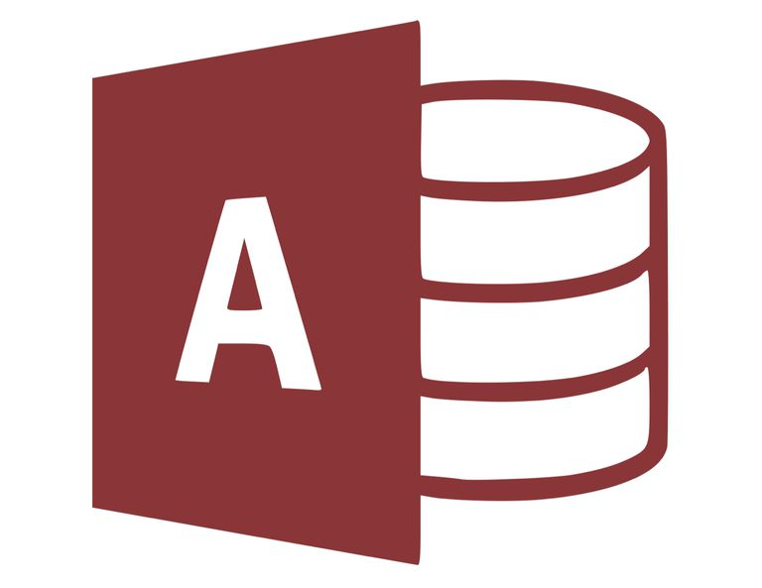




Which databases use SQL?

Slide 16
ORACLE
Oracle database is a relational database management system. It is known as Oracle database, OracleDB or simply Oracle. It is produced and marketed by Oracle Corporation.
Oracle database is the first database designed for enterprise grid computing. The enterprise grid computing provides the most flexible and cost effective way to manage information and applications.
DIFFERENT EDITIONS OF ORACLE DATABASE
Enterprise Edition
Standard Edition
Express Edition
Oracle Lite

Slide 17
What is the type of create command?
Data Definition Language
Data Manipulation Language
Data Control Language
Transaction Control Language

Slide 18
What is the type of create command?
Data Definition Language
Data Manipulation Language
Data Control Language
Transaction Control Language

Slide 19
UNIT 3: Relational database design
Relational database design (RDD) models information and data into a set of tables with rows and columns. Each row of a relation/table represents a record, and each column represents an attribute of data.
The design of a relational database is composed of four stages, where the data are modeled into a set of related tables. The stages are:
Define relations/attributes
Define primary keys
Define relationships
Normalization

Slide 20
How to design a relational database?
Database design is more art than science, as you have to make many decisions. Databases are usually customized to suit a particular application. No two customized applications are alike, and hence, no two database are alike. Guidelines (usually in terms of what not to do instead of what to do) are provided in making these design decision, but the choices ultimately rest on the you - the designer.
Step 1: Define the Purpose of the Database (Requirement Analysis)
Step 2: Gather Data, Organize in tables and Specify the Primary Keys
Step 3: Create Relationships among Tables
Step 4: Refine & Normalize the Design

Slide 21

UNIT 4: database transaction processing
What happens when you send 1000 rs to your friend and he has not received it??

Slide 22
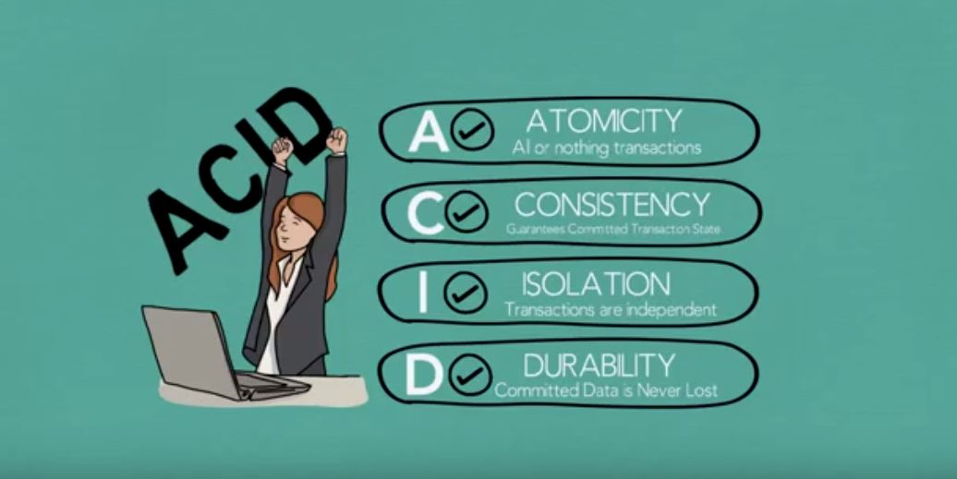
Don’t worry! Acid Properties save that

Slide 23
UNIT 5: Programming constructs in databases
You will study
Flow control statements
Functions
Stored Procedures
Cursors
Triggers
Exception Handling

Slide 24
UNIT 6: file organization and trends in databases
File Organization refers to the logical relationships among various records that constitute the file, particularly with respect to the means of identification and access to any specific record
In simple terms, Storing the files in certain order is called file Organization.
File Structure refers to the format of the label and data blocks and of any logical control record.

Slide 25

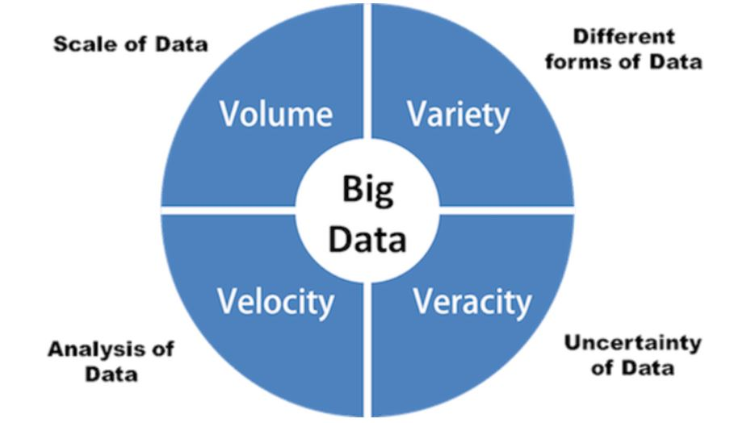
Big data is data that contains greater variety arriving in increasing volumes and with ever-higher velocity. This is known as the three Vs.
The 3 V’s of Big Data
Volume
Velocity
Variety

Slide 26
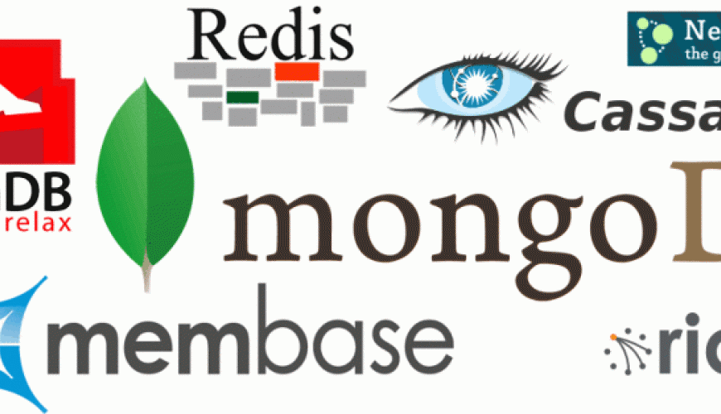
NoSQL- Not Only SQL

