Slide 1
SQL constraints
With Alter table and Update commands…..

Slide 2
SQL constraints
SQL constraints are used to specify rules for data in a table.
Constraints are used to limit the type of data that can go into a table. This ensures the accuracy and reliability of the data in the table. If there is any violation between the constraint and the data action, the action is aborted.
Constraints can be column level or table level. Column level constraints apply to a column, and table level constraints apply to the whole table.
Constraints can be specified when the table is created with the CREATE TABLE statement, or after the table is created with the ALTER TABLE statement.

Slide 3
SQL Constraints types
NOT NULL - Ensures that a column cannot have a NULL value
UNIQUE - Ensures that all values in a column are different
PRIMARY KEY - A combination of a NOT NULL and UNIQUE. Uniquely identifies each row in a table
FOREIGN KEY - Uniquely identifies a row/record in another table
CHECK - Ensures that all values in a column satisfies a specific condition
DEFAULT - Sets a default value for a column when no value is specified
INDEX - Used to create and retrieve data from the database very quickly

Slide 4
Syntax
CREATE TABLE table_name (
column1 datatype constraint,
column2 datatype constraint,
column3 datatype constraint,
....
);

Slide 5
SQL NOT NULL Constraint
By default, a column can hold NULL values.
The NOT NULL constraint enforces a column to NOT accept NULL values.
This enforces a field to always contain a value, which means that you cannot insert a new record, or update a record without adding a value to this field.

Slide 6
SQL NOT NULL on CREATE TABLE
The following SQL ensures that the "ID", "LastName", and "FirstName" columns will NOT accept NULL values when the "Persons" table is created:
CREATE TABLE Persons (
ID int NOT NULL,
LastName varchar(255) NOT NULL,
FirstName varchar(255) NOT NULL,
Age int
);

Slide 7
SQL NOT NULL on ALTER TABLE
To create a NOT NULL constraint on the "Age" column when the "Persons" table is already created, use the following SQL:
ALTER TABLE Persons
MODIFY Age int NOT NULL;

Slide 8
SQL UNIQUE Constraint
The UNIQUE constraint ensures that all values in a column are different.
Both the UNIQUE and PRIMARY KEY constraints provide a guarantee for uniqueness for a column or set of columns.
A PRIMARY KEY constraint automatically has a UNIQUE constraint.
However, you can have many UNIQUE constraints per table, but only one PRIMARY KEY constraint per table.

Slide 9
SQL UNIQUE Constraint on CREATE TABLE
The following SQL creates a UNIQUE constraint on the "ID" column when the "Persons" table is created:
CREATE TABLE Persons (
ID int NOT NULL UNIQUE,
LastName varchar(255) NOT NULL,
FirstName varchar(255),
Age int
);

Slide 10
UNIQUE constraint on multiple columns
To name a UNIQUE constraint, and to define a UNIQUE constraint on multiple columns, use the following SQL syntax:
CREATE TABLE Persons (
ID int NOT NULL,
LastName varchar(255) NOT NULL,
FirstName varchar(255),
Age int,
CONSTRAINT UC_Person UNIQUE (ID,LastName)
);

Slide 11
SQL UNIQUE Constraint on ALTER TABLE
To create a UNIQUE constraint on the "ID" column when the table is already created, use the following SQL:
ALTER TABLE Persons
ADD UNIQUE (ID);
To name a UNIQUE constraint, and to define a UNIQUE constraint on multiple columns, use the following SQL syntax:
ALTER TABLE Persons
ADD CONSTRAINT UC_Person UNIQUE (ID,LastName);

Slide 12
DROP a UNIQUE Constraint
To drop a UNIQUE constraint, use the following SQL:
ALTER TABLE Persons
DROP CONSTRAINT UC_Person;

Slide 13
SQL CHECK Constraint
The CHECK constraint is used to limit the value range that can be placed in a column.
If you define a CHECK constraint on a single column it allows only certain values for this column.
If you define a CHECK constraint on a table it can limit the values in certain columns based on values in other columns in the row.

Slide 14
SQL CHECK on CREATE TABLE
The following SQL creates a CHECK constraint on the "Age" column when the "Persons" table is created. The CHECK constraint ensures that the age of a person must be 18, or older:
CREATE TABLE Persons (
ID int NOT NULL,
LastName varchar(255) NOT NULL,
FirstName varchar(255),
Age int CHECK (Age>=18)
);

Slide 15
CHECK constraint on multiple columns
To allow naming of a CHECK constraint, and for defining a CHECK constraint on multiple columns, use the following SQL syntax:
CREATE TABLE Persons (
ID int NOT NULL,
LastName varchar(255) NOT NULL,
FirstName varchar(255),
Age int,
City varchar(255),
CONSTRAINT CHK_Person CHECK (Age>=18 AND City='Sandnes')
);

Slide 16
SQL CHECK on ALTER TABLE
To create a CHECK constraint on the "Age" column when the table is already created, use the following SQL:
ALTER TABLE Persons
ADD CHECK (Age>=18);
To allow naming of a CHECK constraint, and for defining a CHECK constraint on multiple columns, use the following SQL syntax:
ALTER TABLE Persons
ADD CONSTRAINT CHK_PersonAge CHECK (Age>=18 AND City='Sandnes');

Slide 17
DROP a CHECK Constraint
To drop a CHECK constraint, use the following SQL:
ALTER TABLE Persons
DROP CONSTRAINT CHK_PersonAge;

Slide 18
SQL DEFAULT Constraint
The DEFAULT constraint is used to provide a default value for a column.
The default value will be added to all new records IF no other value is specified.

Slide 19
SQL DEFAULT on CREATE TABLE
The following SQL sets a DEFAULT value for the "City" column when the "Persons" table is created:
CREATE TABLE Persons (
ID int NOT NULL,
LastName varchar(255) NOT NULL,
FirstName varchar(255),
Age int,
City varchar(255) DEFAULT 'Sandnes'
);

Slide 20
CREATE TABLE Orders (
ID int NOT NULL,
OrderNumber int NOT NULL,
OrderDate date DEFAULT GETDATE()
);

Slide 21
SQL DEFAULT on ALTER TABLE
To create a DEFAULT constraint on the "City" column when the table is already created, use the following SQL:
ALTER TABLE Persons
ADD CONSTRAINT df_City
DEFAULT 'Sandnes' FOR City;
OR
ALTER TABLE Persons
MODIFY City DEFAULT 'Sandnes';

Slide 22
DROP a DEFAULT Constraint
To drop a DEFAULT constraint, use the following SQL:
ALTER TABLE Persons
ALTER COLUMN City DROP DEFAULT;

Slide 23
SQL CREATE INDEX Statement
The CREATE INDEX statement is used to create indexes in tables.
Indexes are used to retrieve data from the database more quickly than otherwise. The users cannot see the indexes, they are just used to speed up searches/queries.

Slide 24
CREATE INDEX Syntax
Creates an index on a table. Duplicate values are allowed:
CREATE INDEX index_name
ON table_name (column1, column2, ...);
CREATE UNIQUE INDEX Syntax
Creates a unique index on a table. Duplicate values are not allowed:
CREATE UNIQUE INDEX index_name
ON table_name (column1, column2, ...);

Slide 25
CREATE INDEX Example
The SQL statement below creates an index named "idx_lastname" on the "LastName" column in the "Persons" table:
CREATE INDEX idx_lastname
ON Persons (LastName);
If you want to create an index on a combination of columns, you can list the column names within the parentheses, separated by commas:
CREATE INDEX idx_pname
ON Persons (LastName, FirstName);

Slide 26
DROP INDEX Statement
The DROP INDEX statement is used to delete an index in a table.
DROP INDEX table_name.index_name;
OR
DROP INDEX index_name;

Slide 27
SQL PRIMARY KEY Constraint
The PRIMARY KEY constraint uniquely identifies each record in a table.
Primary keys must contain UNIQUE values, and cannot contain NULL values.
A table can have only ONE primary key; and in the table, this primary key can consist of single or multiple columns (fields).

Slide 28
SQL PRIMARY KEY on CREATE TABLE
The following SQL creates a PRIMARY KEY on the "ID" column when the "Persons" table is created:
CREATE TABLE Persons ( ID int NOT NULL PRIMARY KEY, LastName varchar(255) NOT NULL, FirstName varchar(255), Age int );
OR
CREATE TABLE Persons ( ID int NOT NULL, LastName varchar(255) NOT NULL, FirstName varchar(255), Age int, CONSTRAINT PK_Person PRIMARY KEY (ID,LastName) );

Slide 29
SQL PRIMARY KEY on ALTER TABLE
To create a PRIMARY KEY constraint on the "ID" column when the table is already created, use the following SQL:
ALTER TABLE Persons ADD PRIMARY KEY (ID);
OR
ALTER TABLE Persons ADD CONSTRAINT PK_Person PRIMARY KEY (ID,LastName);

Slide 30
DROP a PRIMARY KEY Constraint
To drop a PRIMARY KEY constraint, use the following SQL:
ALTER TABLE Persons DROP PRIMARY KEY;
OR
ALTER TABLE Persons DROP CONSTRAINT PK_Person;

Slide 31
SQL FOREIGN KEY Constraint
A FOREIGN KEY is a key used to link two tables together.
A FOREIGN KEY is a field (or collection of fields) in one table that refers to the PRIMARY KEY in another table.
The table containing the foreign key is called the child table, and the table containing the candidate key is called the referenced or parent table.

Slide 32
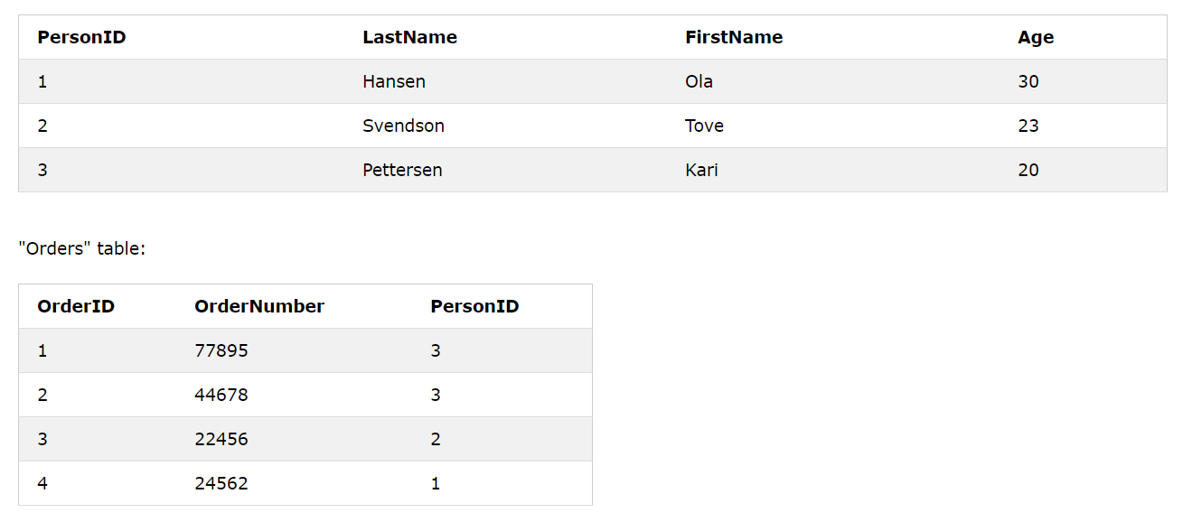
Notice that the "PersonID" column in the "Orders" table points to the "PersonID" column in the "Persons" table.
The "PersonID" column in the "Persons" table is the PRIMARY KEY in the "Persons" table.
The "PersonID" column in the "Orders" table is a FOREIGN KEY in the "Orders" table.
The FOREIGN KEY constraint is used to prevent actions that would destroy links between tables.
The FOREIGN KEY constraint also prevents invalid data from being inserted into the foreign key column, because it has to be one of the values contained in the table it points to.

Slide 33
SQL FOREIGN KEY on CREATE TABLE
The following SQL creates a FOREIGN KEY on the "PersonID" column when the "Orders" table is created:
CREATE TABLE Orders (
OrderID int NOT NULL PRIMARY KEY,
OrderNumber int NOT NULL,
PersonID int FOREIGN KEY REFERENCES Persons(PersonID)
);

Slide 34
SQL FOREIGN KEY on ALTER TABLE
To create a FOREIGN KEY constraint on the "PersonID" column when the "Orders" table is already created, use the following SQL:
ALTER TABLE Orders
ADD FOREIGN KEY (PersonID) REFERENCES Persons(PersonID);
OR
ALTER TABLE Orders
ADD CONSTRAINT FK_PersonOrder
FOREIGN KEY (PersonID) REFERENCES Persons(PersonID);

Slide 35
DROP a FOREIGN KEY Constraint
To drop a FOREIGN KEY constraint, use the following SQL:
ALTER TABLE Orders DROP CONSTRAINT FK_PersonOrder;

Slide 36
SQL ALTER TABLE Statement
The ALTER TABLE statement is used to add, delete, or modify columns in an existing table.
The ALTER TABLE statement is also used to add and drop various constraints on an existing table.

Slide 37
ALTER TABLE - ADD Column
ALTER TABLE table_name
ADD column_name datatype;
The following SQL adds an "Email" column to the "Customers" table:
Example
ALTER TABLE Customers
ADD Email varchar(255);

Slide 38
ALTER TABLE - DROP COLUMN
ALTER TABLE table_name
DROP COLUMN column_name;
The following SQL deletes the "Email" column from the "Customers" table:
Example
ALTER TABLE Customers
DROP COLUMN Email;

Slide 39
ALTER TABLE - ALTER/MODIFY COLUMN
To change the data type of a column in a table, use the following syntax:
Oracle (prior version 10G):
ALTER TABLE table_name
MODIFY COLUMN column_name datatype;
Oracle 10G and later:
ALTER TABLE table_name
MODIFY column_name datatype;

Slide 40
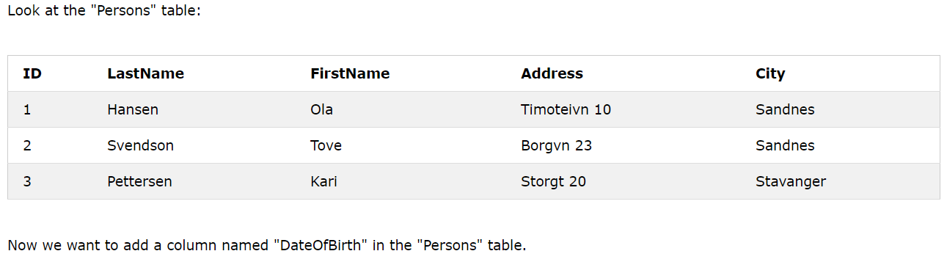
SQL ALTER TABLE Example

Slide 41
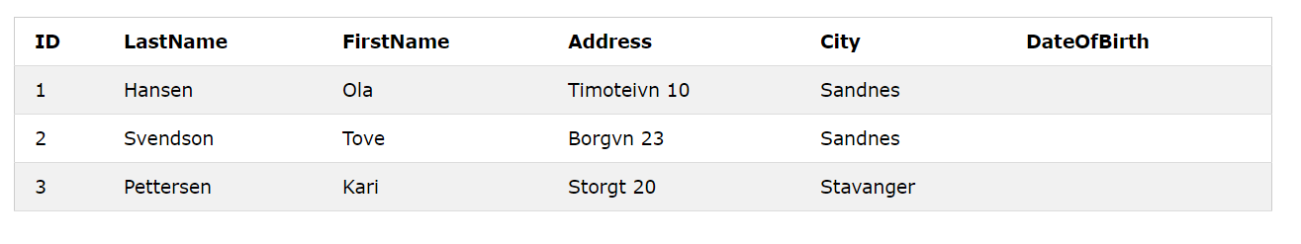
We use the following SQL statement:
ALTER TABLE Persons
ADD DateOfBirth date;

Slide 42
Change Data Type Example
Now we want to change the data type of the column named "DateOfBirth" in the "Persons" table.
We use the following SQL statement:
ALTER TABLE Persons
ALTER COLUMN DateOfBirth year;
Notice that the "DateOfBirth" column is now of type year and is going to hold a year in a two- or four-digit format.

Slide 43
DROP COLUMN Example
We use the following SQL statement:
ALTER TABLE Persons
DROP COLUMN DateOfBirth;

Slide 44
SQL UPDATE Statement
The SQL UPDATE Statement
The UPDATE statement is used to modify the existing records in a table.
UPDATE Syntax
UPDATE table_name
SET column1 = value1, column2 = value2, ...
WHERE condition;

Slide 45
UPDATE Table
The following SQL statement updates the first customer (CustomerID = 1) with a new contact person and a new city.
Example
UPDATE Customers
SET ContactName = 'Alfred Schmidt', City= 'Frankfurt'
WHERE CustomerID = 1;

Slide 46
UPDATE Multiple Records
It is the WHERE clause that determines how many records will be updated.
The following SQL statement will update the contactname to "Juan" for all records where country is "Mexico":
Example
UPDATE Customers
SET ContactName='Juan'
WHERE Country='Mexico';

Slide 47
Thank You

