Slide 1
Practice Problems

Slide 2
Practice Problem 1
Luhn’s Algorithm
Check the validity of Credit card or Debit Card.
Input – 16 digit number
Output – Valid or Invalid

Slide 3
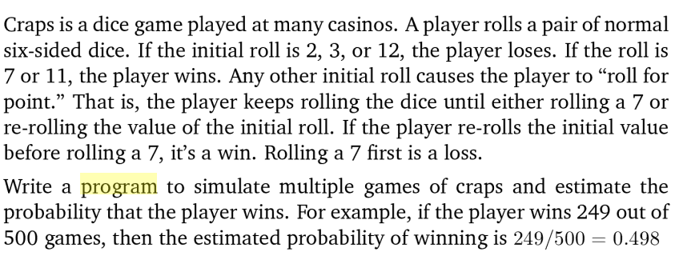
Practice Problem 2

