Slide 1

Course Id :INT 213

Slide 2
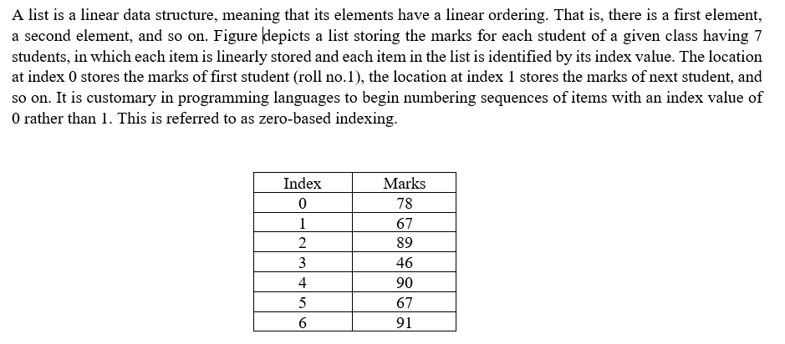
List

Slide 3
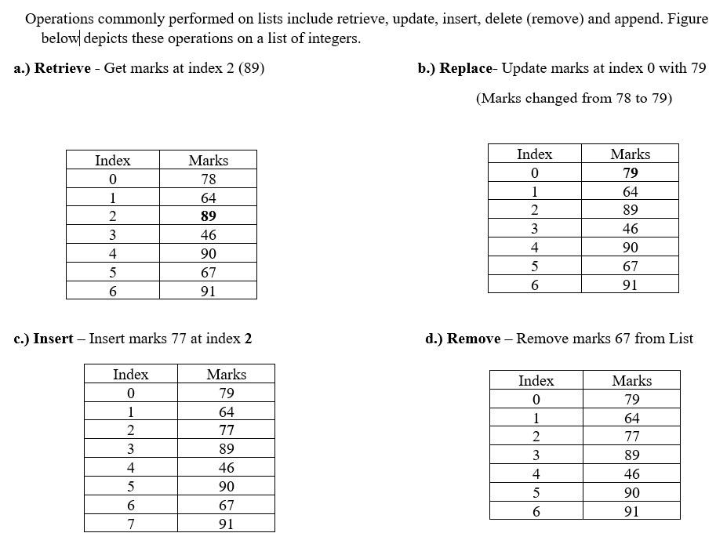
List

Slide 4
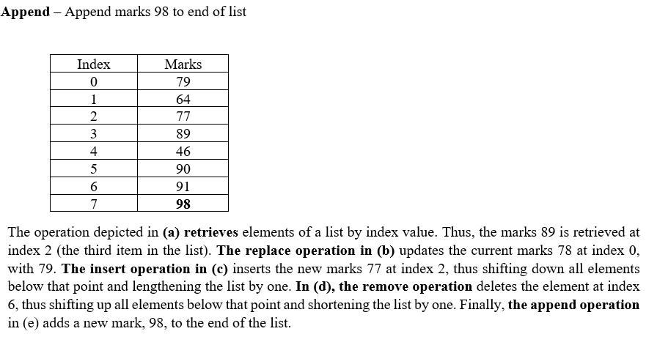
List

Slide 5
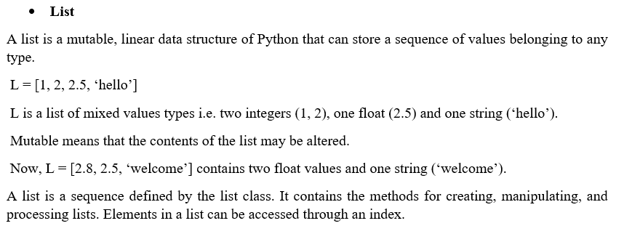
List in Python

Slide 6
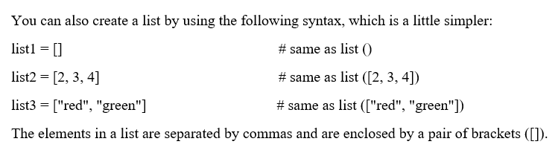
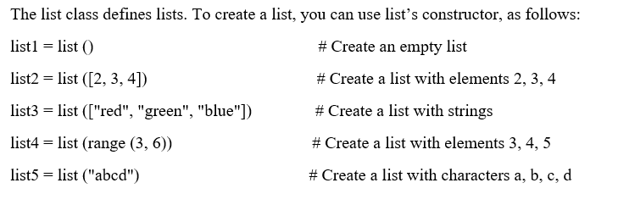
Creating Lists

Slide 7
Access values in Lists
To access values in lists, square brackets are used to slice along with the index or indices to get values stored at that index.
seq =Name of the List[ start : end : step]
seq = List[ : : 2]
Seq = List [ 1: :2]

Slide 8
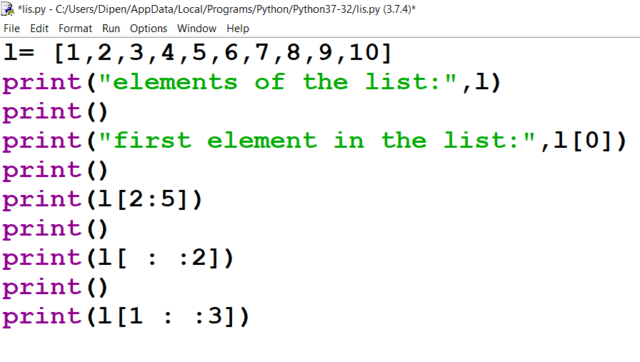
Accessing the elements of the list using slice operation

Slide 9
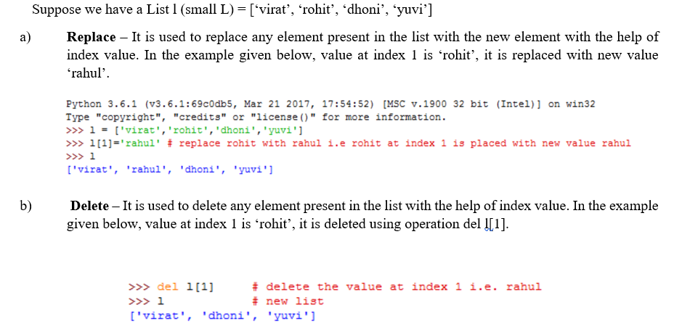
Some List modification operations

Slide 10
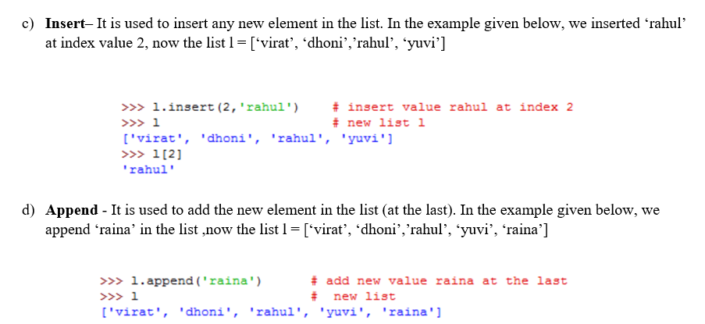
Some List modification operations

Slide 11
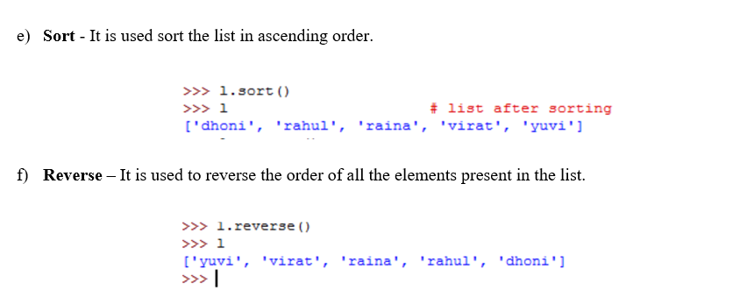
Some List modification operations

Slide 12
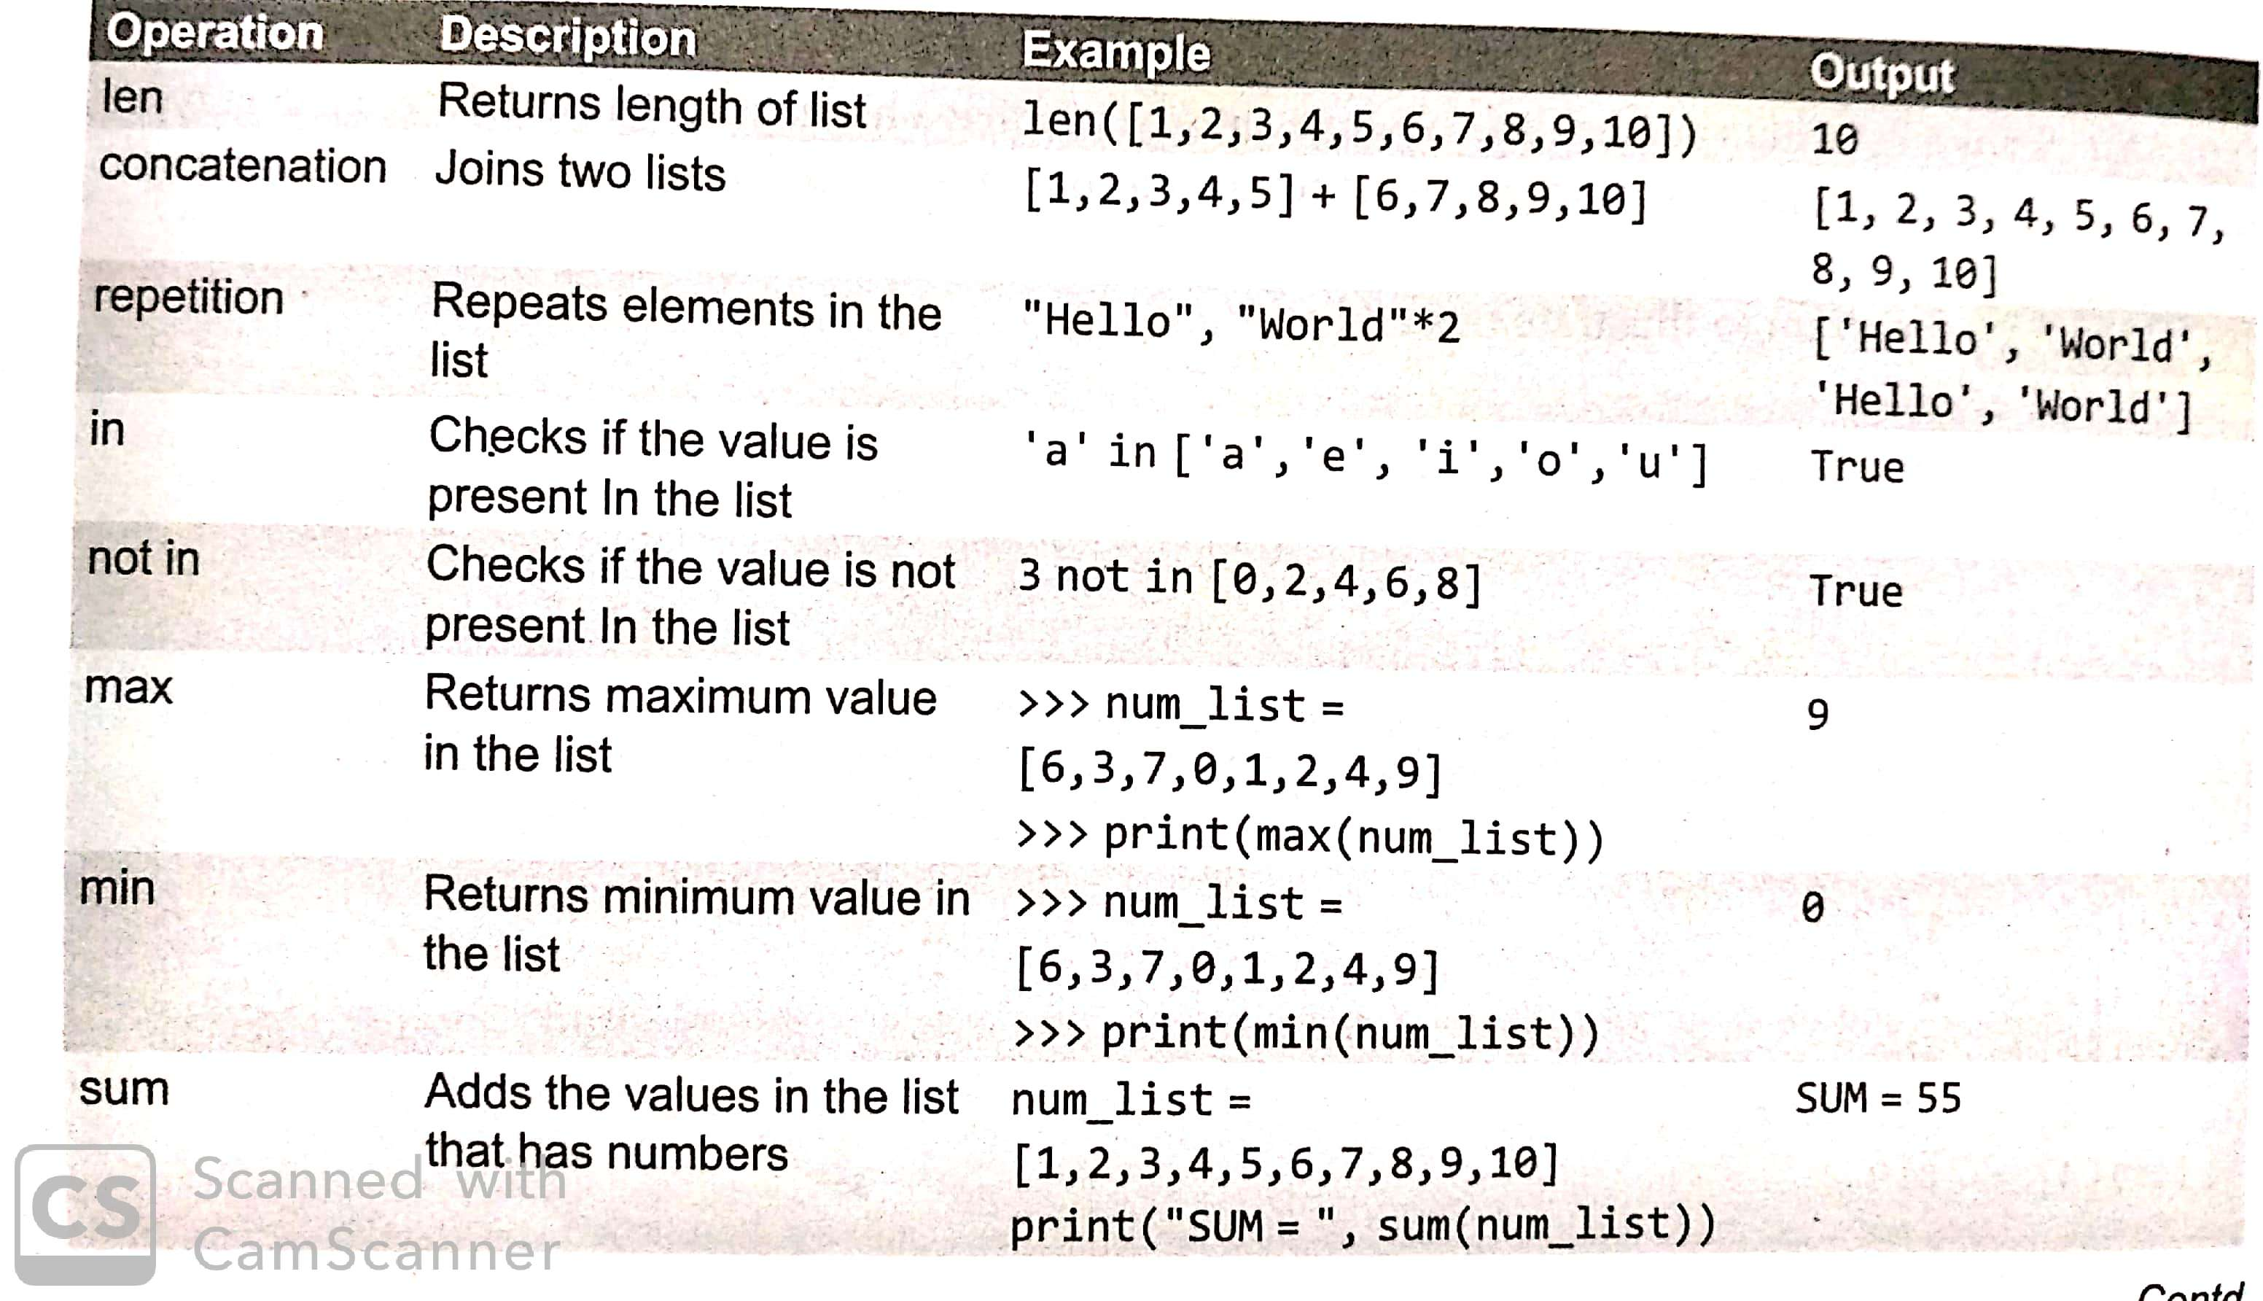
Basic List operations

Slide 13
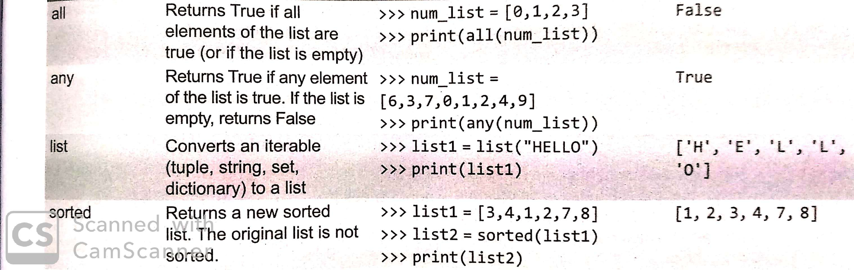
Basic List operations

Slide 14
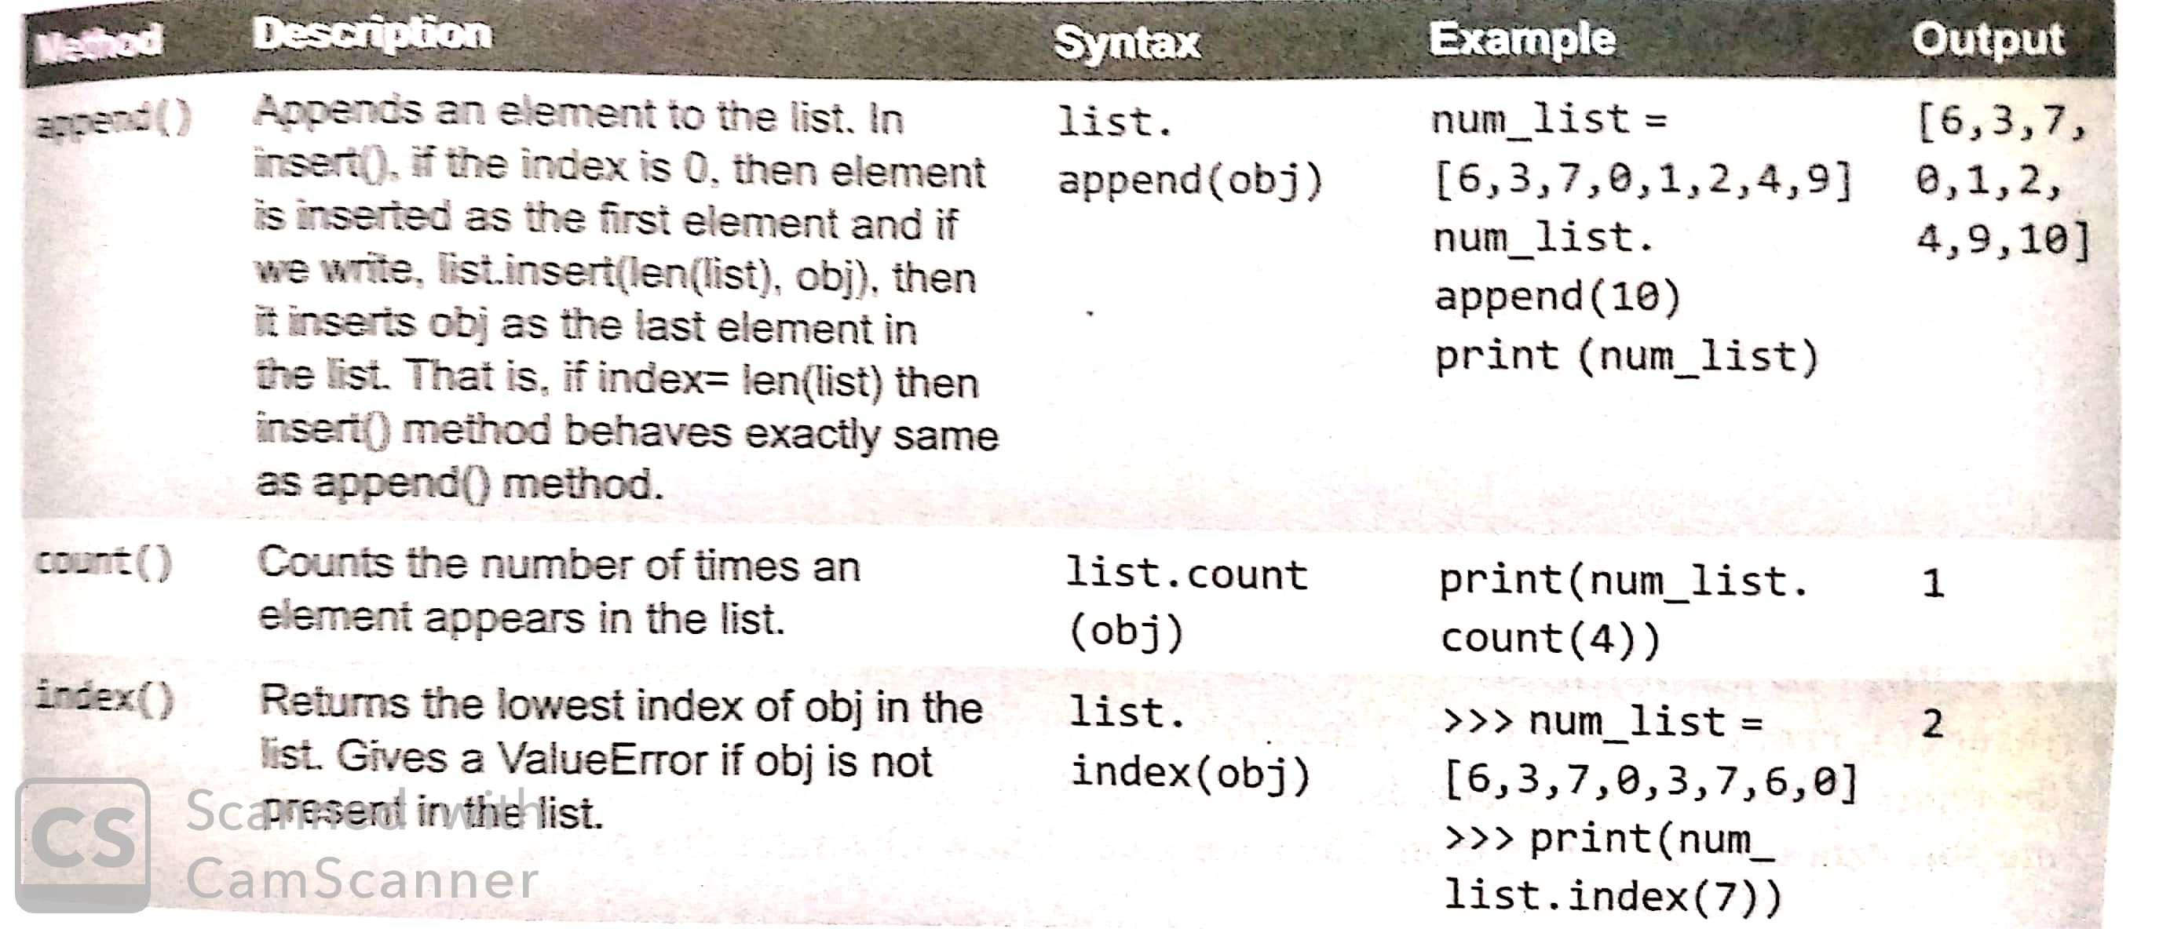
List Methods

Slide 15
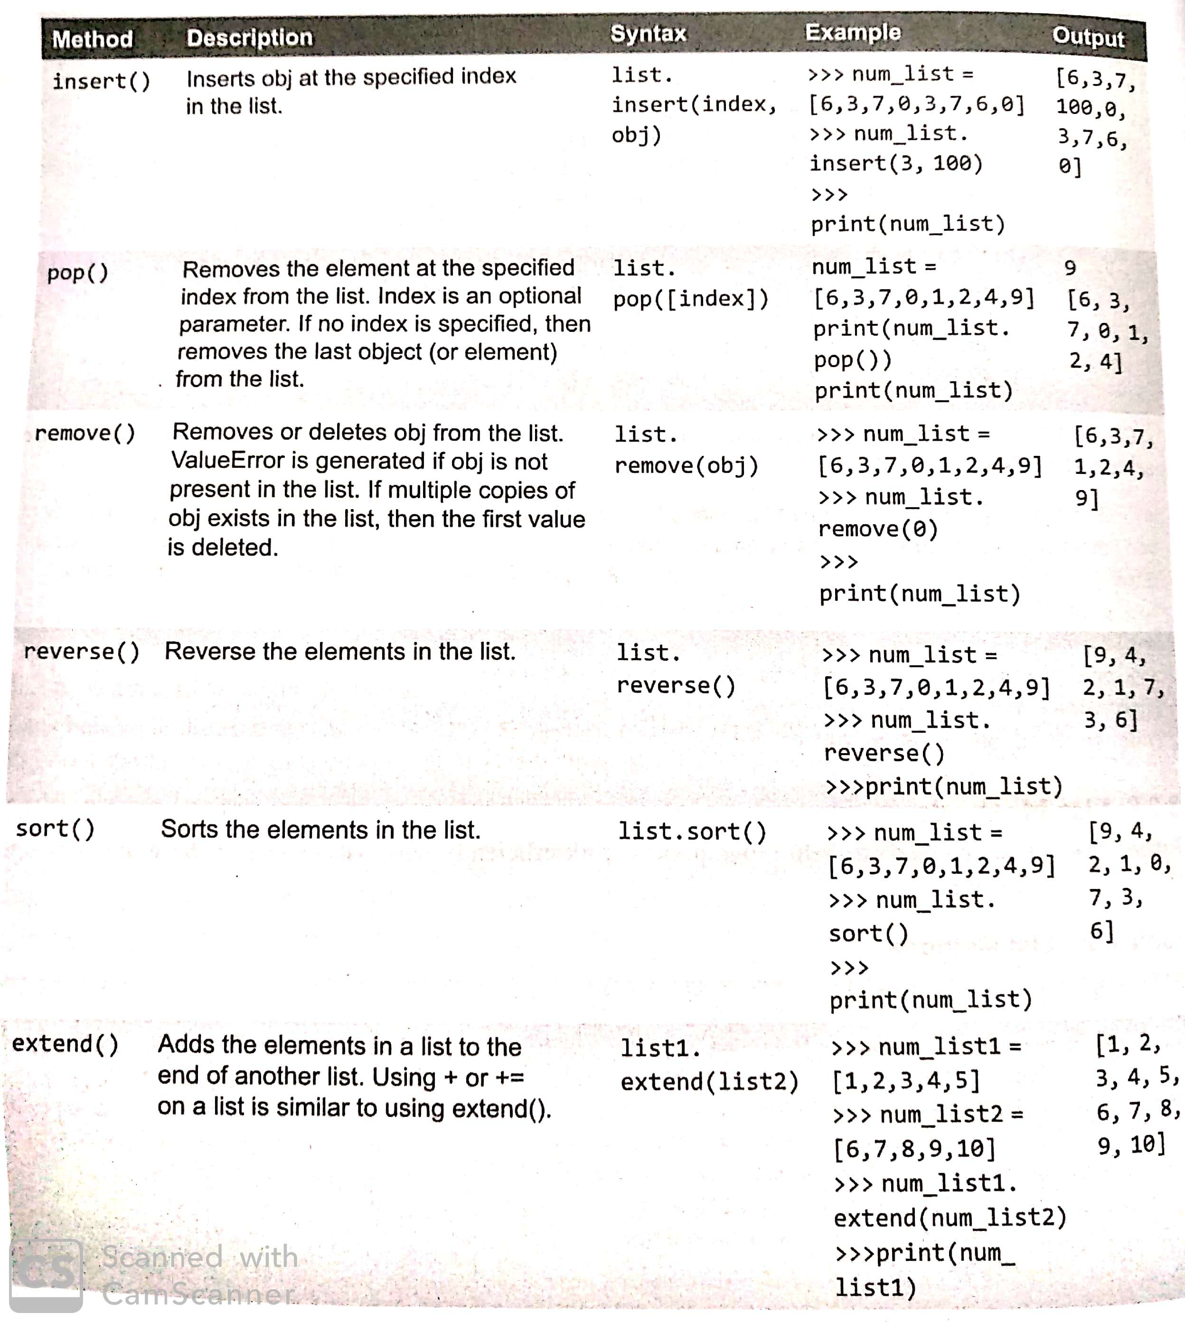
List methods

Slide 16

Aliasing
Since variables refer to objects, if we assign one variable to another, both variables refer to the same object. For example:
>>> a = [1, 2, 3]
>>> b=a
In this case, the state diagram looks like this:
Because the same list has two different names, a and b, we say that it is aliased.
Changes made with one alias affect the other. For example:
>>> b[0] = 5
>>> print a
[5, 2, 3]

Slide 17
Cloning lists
If we want to modify a list and also keep a copy of the original, we need to be able to make a copy of the list itself, not just the reference. This process is sometimes called cloning, to avoid the ambiguity of the word “copy”.
The easiest way to clone a list is to use the slice operator. For example:
>>> a = [1, 2, 3]
>>> b = a[:]
>>> print b
[1, 2, 3]
Taking any slice of a creates a new list. In this case the slice happens to consist of the whole list.

Slide 18
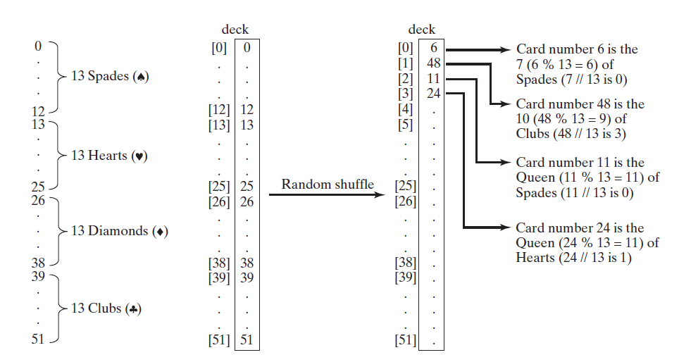
The problem is to write a program that picks 4 cards randomly from a deck of 52 cards.

Slide 19
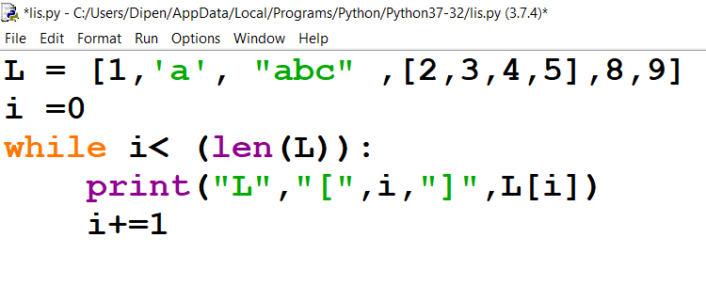
Nested List
Nested list means a list within another list
L = [1,”a”,”abc”,[2,3,4,5],8,9]

Slide 20
Two Dimensional List
A two-dimensional list is a list that contains other lists as its elements.
A two-dimensional list consists of a list of one-dimensional lists, you can use a list to store two-dimensional data, such as a matrix or a table, as well.
For example, the following table, which provides the distances between cities, can be stored in a list named distances.

Slide 21
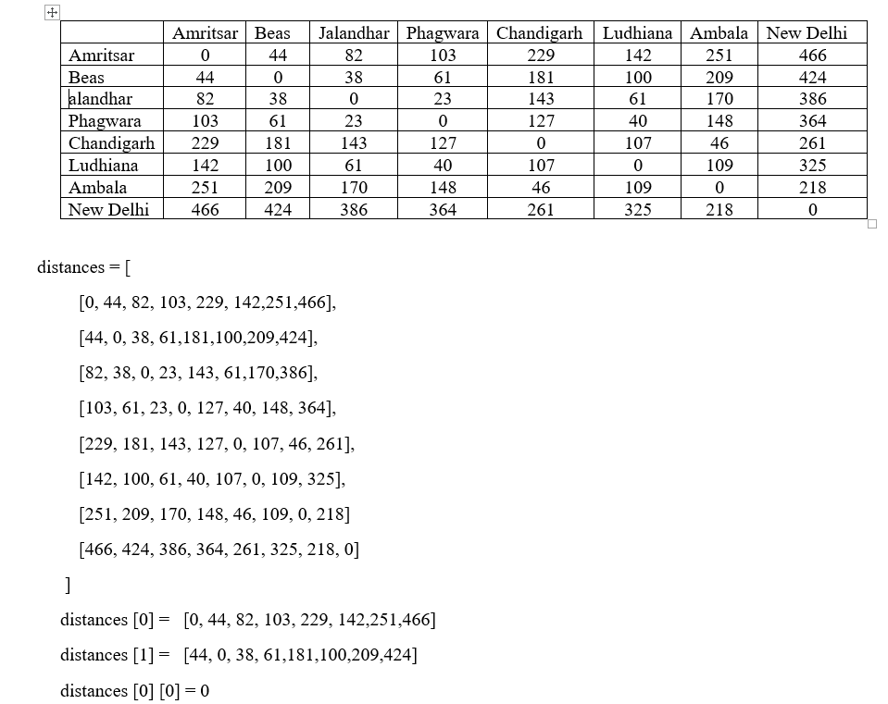

Slide 22
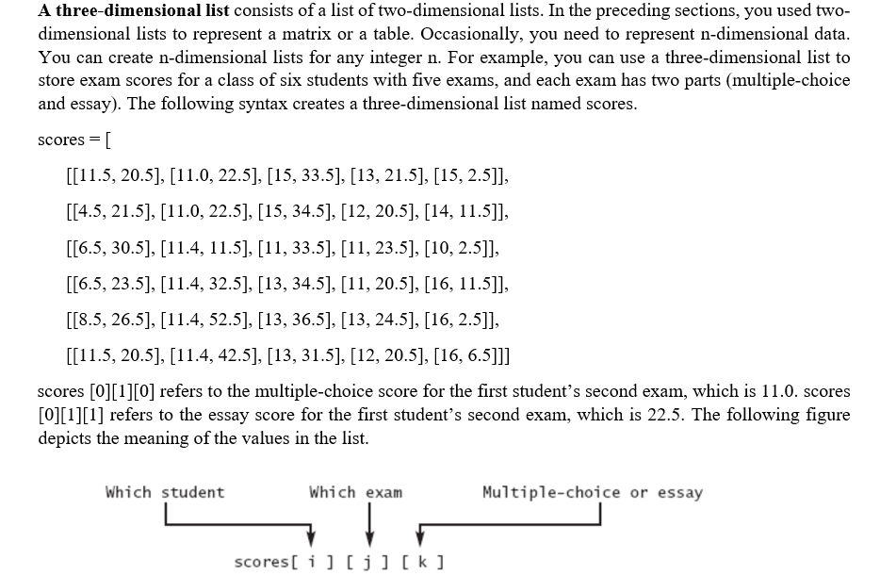
Three Dimensional List

Slide 23
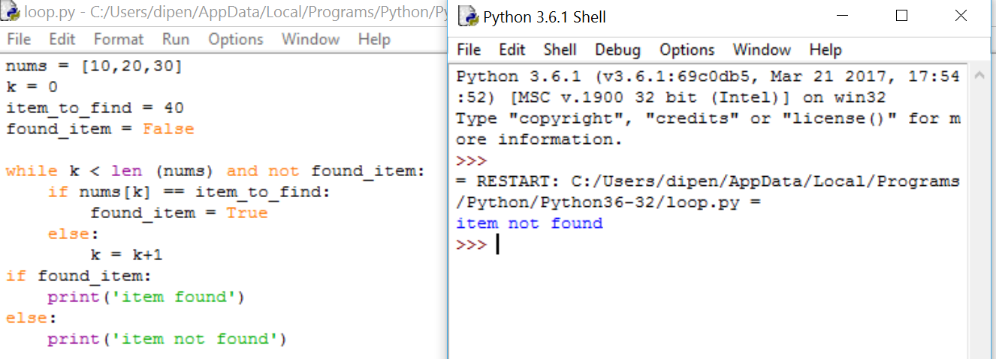
Searching an element in List

Slide 24
Passing Lists to Functions
When passing a list to a function, the contents of the list may change after the function call, since a list is a mutable object.

Slide 25
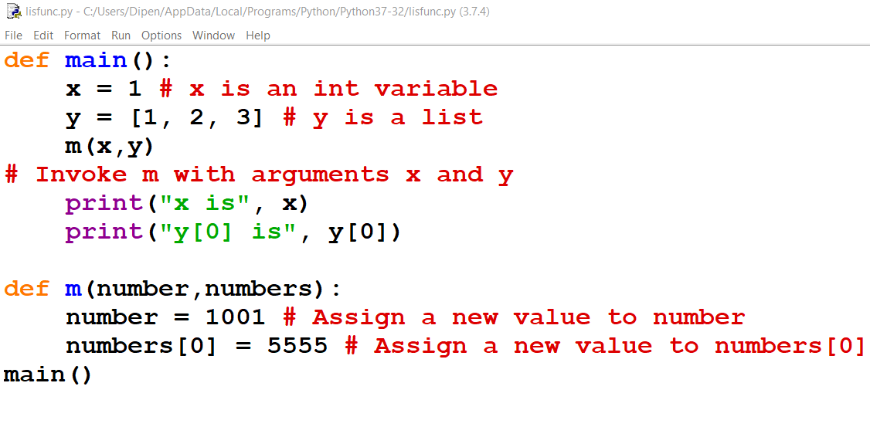
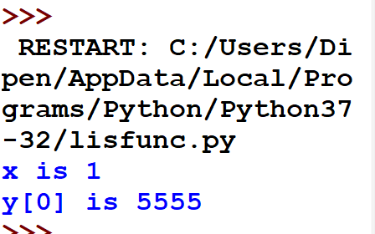
Passing Lists to Functions

Slide 26
enumerate() function
This is used to print both index as well as an item in the list.
N=[1,2,3,4,5]
for i in enumerate(n):
print(i , index)

