Slide 1

Course Id :INT 213

Slide 2
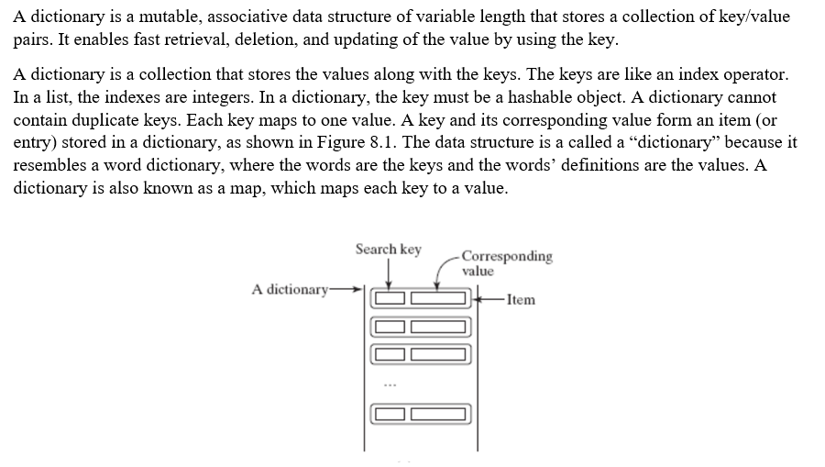
Dictionary

Slide 3
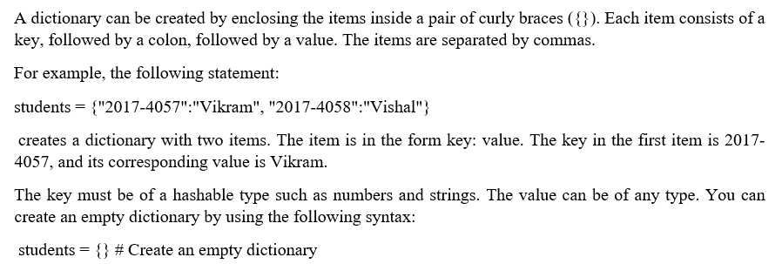
Creating a Dictionary

Slide 4
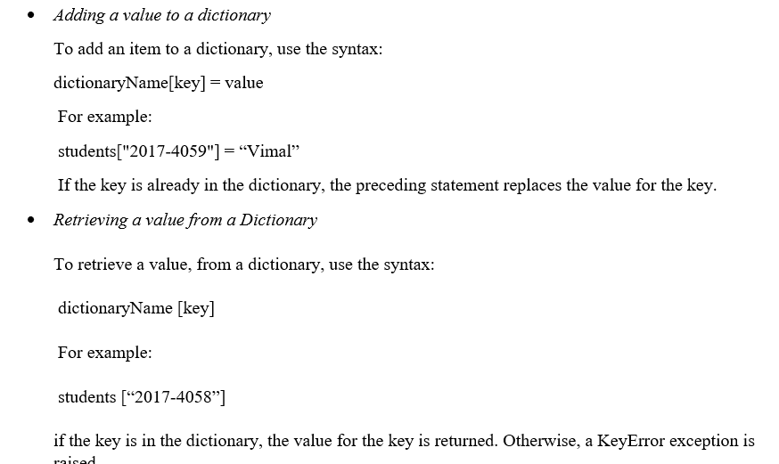
Adding and Retrieving a value.

Slide 5

Adding and Retrieving a value.

Slide 6
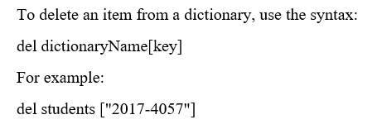

Deleting an item

Slide 7
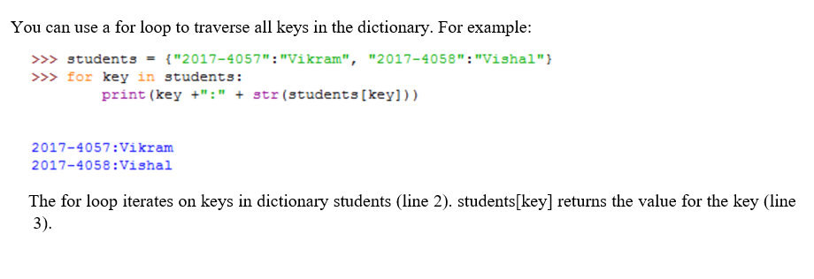
Looping over a Dictionary

Slide 8
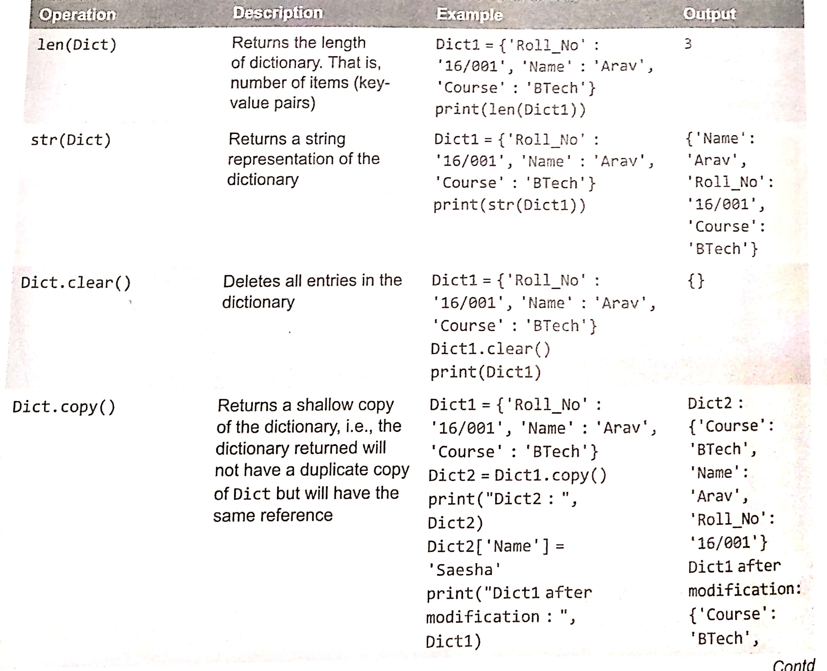
Built in Dictionary Functions and Methods

Slide 9
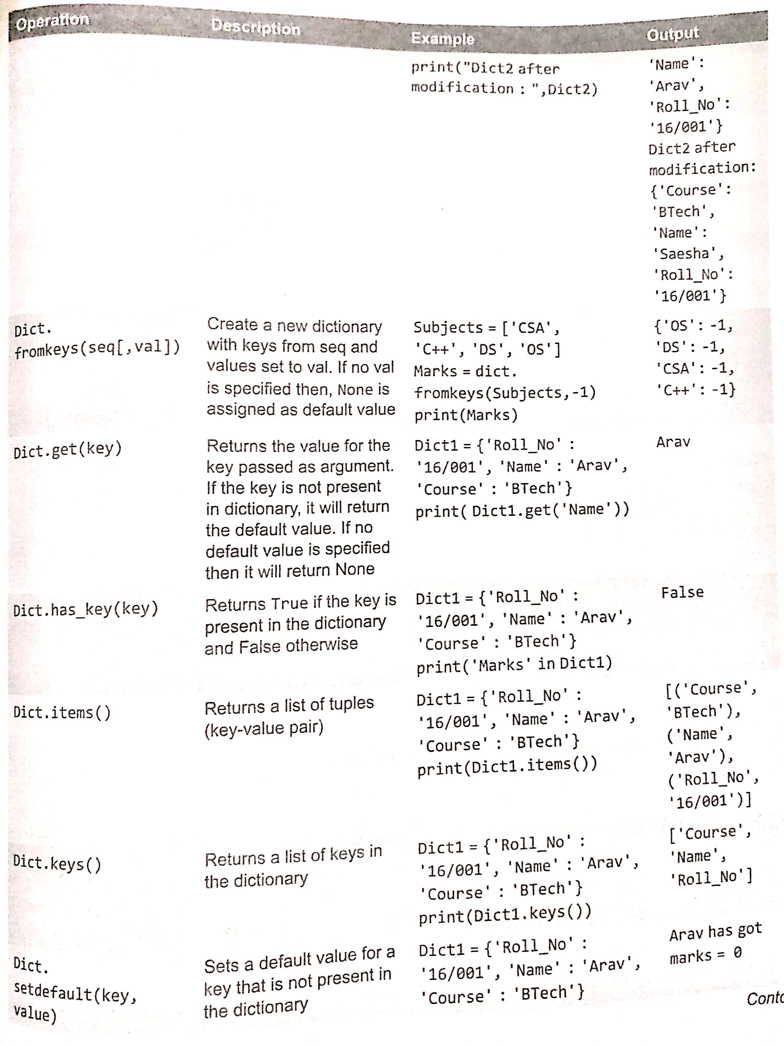

Slide 10
