Slide 1
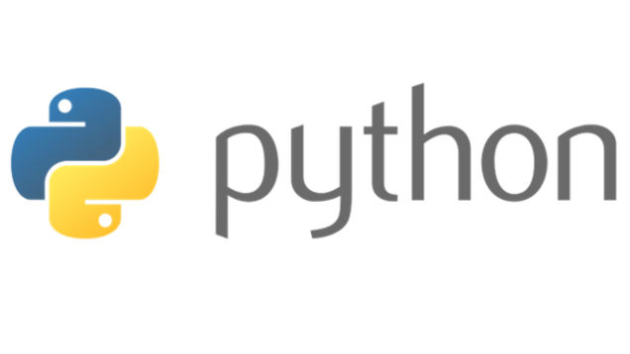
Course Id :INT 213

Slide 2
PART I - NUMPY

Slide 3
I INTRODUCTION

Slide 4
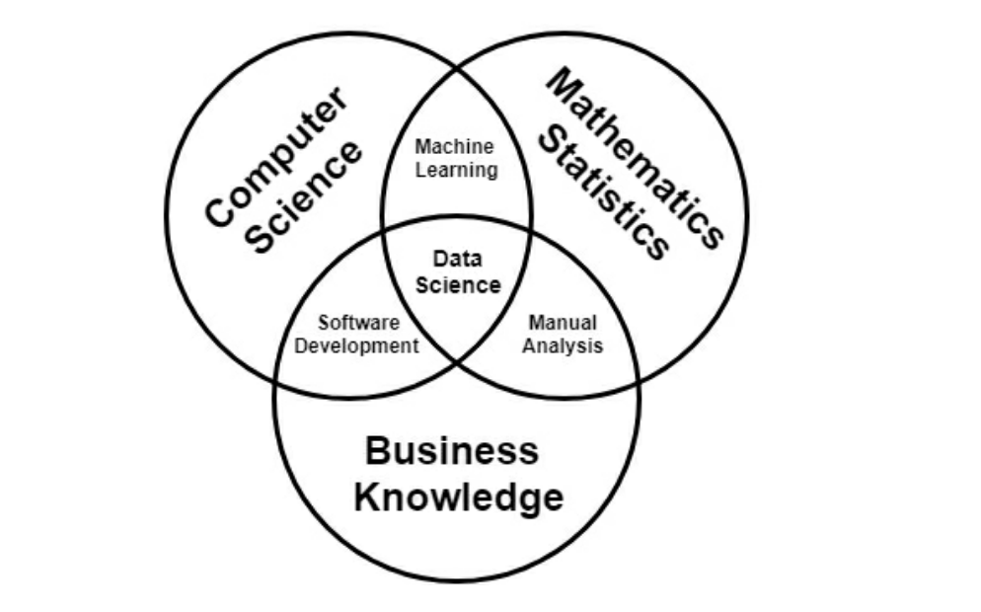
Data Science

Slide 5
Data Analysis and Visualization
Data plays an important role in our lives. For example, a chain of hospitals contain data related to medical reports and prescriptions of their patients.
A bank contains thousands of customers’ transaction details. Share market data represents minute-to-minute changes in the values of the shares. In this way, the entire world is roaming around huge data.

Slide 6
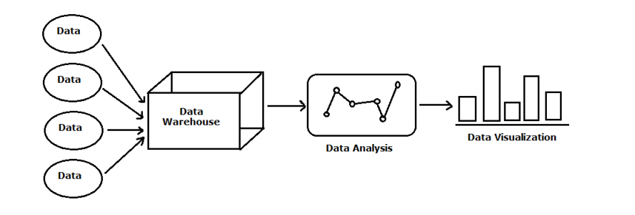
Data Analysis and Visualization
Moreover, data may come from various sources. For example, in a business organization, we may get data from Sales department, Purchase department, Production department, etc. Such data is stored in a system called ‘data warehouse’.
We can imagine data warehouse as a central repository of integrated data from different sources.

Slide 7
Data Analysis and Visualization
Once the data is stored, we should be able to retrieve it based on some pre-requisites. A business company wants to know about how much amount they had spent in the last 6 months on purchasing the raw material or how many items had been found defective in their production unit. Such data cannot be easily retrieved from the huge data available in the data warehouse. We have to retrieve the data as per the needs of the business organization. This is called data analysis or data analytics where the data that is retrieved will be analyzed to answer the questions raised by the management of the organization.

Slide 8
Data Analysis and Visualization
Once the data is analyzed, it is the duty of the IT professional to present the results in the form of pictures or graphs so that the management will be able to understand it easily. Such graphs will also help them forecast the future of their company. This is called data visualization.
The primary goal of data visualization is to communicate information clearly and efficiently using statistical graphs, plots and diagrams. Data science is a term used for techniques to extract information from the data warehouse, analyze them and present the necessary data to the business organization in order to arrive at important conclusions and decisions.

Slide 9
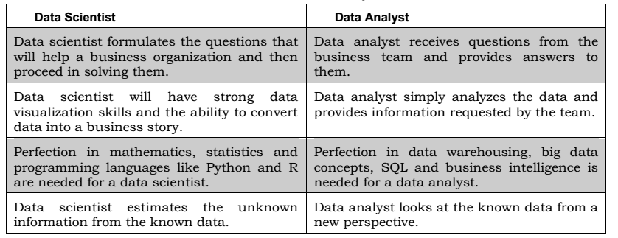
Data Scientist vs Data Analyst

Slide 10
Numpy
Numpy stands for “Numeric Python” or “Numerical Python”. It is a Python module (open source) that provides a faster way of doing mathematical computation on arrays and matrices.
Arrays and matrices are very essential in most machine learning ecosystems, hence when Numpy is combined with other machine learning modules such as Scikit-learn, Matplotlib, TensorFlow, Pandas and others, the machine learning ecosystem becomes complete.
It supports both 1-D Arrays(Vectors) and Multi-Dimensional Arrays(Matrices)

Slide 11
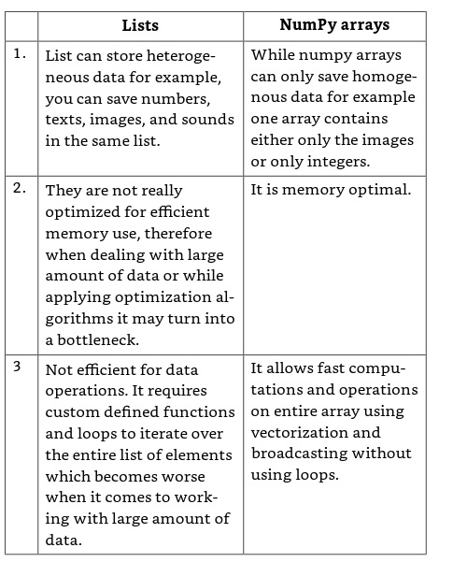
List vs NumPy

Slide 12
II ARRAYS AND DATA TYPES

Slide 13
Arrays and Data Types
Arrays are a way to store data of same kind.
Array1 = (1, 2, 3, 4, 5, 6)
# integer Datatype
Array2 = (‘Bob’,’ Jane’, ’Harry’, ‘Lisa’, ‘Danial’ )
# String Datatype
Both these are examples of arrays with the basic difference of data-types they store.
Data-type is the kind of data you store in an array. Strings are always stored in quotes. A data type basically tells the compiler or interpreter how the programmer intends to use the data.

Slide 14
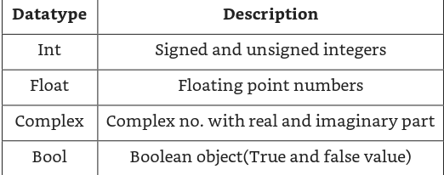
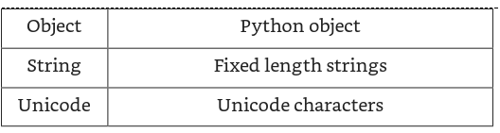
NumPy arrays support various data types, some of them are defined as:

Slide 15
How to use NumPy in Python?
In order to work with NumPy in Python we need to import NumPy library into python by
import numpy as np
.

Slide 16
How to create a one dimensional array using Numpy
1. Creating a ndarray from scratch
import numpy as np
EMP_List=np.array([1,2,3,4,5])
print(EMP_List)

Slide 17
How to create a one dimensional array using Numpy
2. Transforming an existing list into ndarray
import numpy as np
Names=['Harry','Muller','Chang’]
EMP_List=np.array(Names)
print(EMP_List)

Slide 18
How to create a one dimensional array using Numpy
3. Creating Arrays from numpy functions
The arange() is used to fill a numpy array with a series of values with Fixed Interval.
Syntax: numpy.arange([start, ]stop, [step, ]dtype=None) iii)
Example: The following program populates a numpy array with Student Roll Numbers from 1 to 10.
Code:
import numpy as np
RollNo=np.arange(1,11,1)
print(RollNo)

Slide 19
linspace() function
The linspace() is used to fill a numpy array with a series of values with Fixed Interval
Unlike arrange in linspace() we need to specify the number of values we require.
Syntax: numpy.linspace(start, stop, num=<number of values>)
Example: The following program places 3 points from 1 to 10
Code:
import numpy as np
pt=np.linspace(1,10,4)
print(pt)

Slide 20
Complex data type
import numpy as np
a= np.array([1,2,3], dtype = complex)
print (a)

Slide 21
Empty Array
import numpy as np
Sal=np.empty([3,3])
print(Sal)

Slide 22
Random Array
import numpy as np
b=np.random.random((2,3))
print(b)

Slide 23
Zero Array
Zero Array means an array with 0 as the default values filled in all it cells
Numpy uses the zeros() to create an Zero array
Example : The following program creates an Zero array Code:
import numpy as np
Sal=np.zeros([3,3])
print(Sal)

Slide 24
Ones Array
Ones Array means an array with 1 as the default values filled in all it cells
Numpy uses the ones() to create an Ones array
Example : The following program creates an Ones array Code:
import numpy as np
Sal=np.ones([3,3])
print(Sal)

Slide 25
How to create a Multidimensional (2D) array using Numpy
import numpy as np
a= np.array([[1,2],[3,4]])
print (a)

Slide 26
How to create a Multidimensional (2D) array using Numpy
import numpy as np
Names=['Harry','Muller','Chang’]
Age=[45,36,38]
EMP_List=np.array([Names,Age])
print(EMP_List)

Slide 27
How to create a Multidimensional (3D) array using Numpy
Import numpy as np
array3d =np.array([ [[1, 2, 5],[6,0,2]] , [[5,9,8],[0,3,2]] ])
print(array3d)

Slide 28
III Numpy Array Operations

Slide 29
.dtype
It determines the datatype of elements stored in your matrix. Now suppose we have all integer data then dtype in int. But if we have all integer data and 1 float data then the dtype of all matrix is float.
Import numpy as np
my_array=np.array([[1.2, 5.9], [2.7 , 3.59 ]])
print(my_array.dtype)

Slide 30
.ndim
It determines the dimension of your matrix.
Import numpy as np
my_array=np.array([[1.2, 5.9], [2.7 , 3.59 ]])
print(my_array.ndim)

Slide 31
.itemsize
It determines the memory space taken by each element of the matrix in form of bytes.
Import numpy as np
my_array=np.array([[1.2, 5.9], [2.7 , 3.59 ]])
print(my_array.itemsize)

Slide 32
.nbytes
Itemsize and nbytes are almost same. They both show you the memory space occupied by the matrix except the fact that itemsize shows you the memory space occupied by every single element while nbytes gives you the total amount of space occupied by all the elements together in a matrix.
Import numpy as np
my_array=np.array([[1.2, 5.9], [2.7 , 3.59 ]])
print(my_array.nbytes)

Slide 33
IV SHAPE MANIPULATION FUNCTIONS

Slide 34
shape() function
It determines the shape of your matrix in form of MxN matrix.
Where M is the no. of rows and N is the no. of columns.

Slide 35
shape() function
import numpy as np
a= np.array([[1,2,3],[4,5,6]])
print (a.shape)
import numpy as np
a= np.array([[1,2,3],[4,5,6]])
a.shape=(3,2)
print (a)

Slide 36
reshape() function
import numpy as np
a= np.array([[1,2,3],[4,5,6]])
b=a.reshape(3,2)
print (b)

Slide 37
Creating multidimensional arrays is by using reshape function
Import numpy as np
arr=np.arange(6).reshape (3,2)
print( arr)

Slide 38
flatten() function
Returns a flattened one-dimensional copy of the array
import numpy as np
b=np.random.random((2,3))
print(b)
print(b.flatten())

Slide 39
ravel() function
Does the same as flatten but works with the actual array instead of a copy.
import numpy as np
b=np.random.random((2,3))
print(b)
print(b.ravel())

Slide 40
transpose() function
Returns an array with same values but swapped dimensions.
Transpose of an array is done by two methods:
transpose () function
T function

Slide 41
Transpose of an array
import numpy as np
arr= np.arange(15).reshape(3,5)
print(arr)
transarray= arr.T
print(transarray)
import numpy as np
arr= np.arange(15).reshape(3,5)
print(arr)
transarray= np.transpose(arr)
print(transarray)

Slide 42
swapaxes() function
Works like transpose
Returns an array with same values but swapped axes
import numpy as np
b=np.random.random((2,3))
print(b)
print()
print(b.swapaxes(0,1))

Slide 43
V INDEXING AND SLICING

Slide 44
INDEXING
Sometimes you may need only a subset of your data or need value of some individual elements. Then you can do this by indexing and slicing.
This is the way to address individual elements. One important thing to remember is that indexing always starts with ‘0’.
For a single dimensional matrix indexing is pretty easy. Syntax for indexing in 1 dimensional matrix is given as arr[n], this gives you nth number starting with zero index.
For a 2 dimensional matrix you can pass a comma-separated list of indices to select individual elements. It is given as arr[m,n] or arr[m][n], this gives you the element on mth row and nth column starting with zero index.

Slide 45
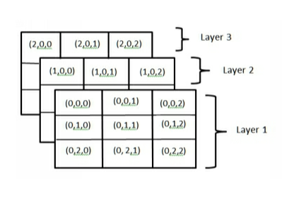
INDEXING
Indexing in a 3d array works like this: syntax: arr[L,M,N] or arr [L][M][N] where L is the first index, M is the row no. and N is the column no.

Slide 46
Find the output of the program
import numpy as np
Array1= np.array([1, 2, 3, 4, 5, 6])
Array1=Array1.reshape(2,3)
print(Array1)
print(Array1[0,1])

Slide 47
Find the output of the program
Import numpy as np
array3d =np.array([ [[1, 2, 5],[6,0,2]] , [[5,9,8],[0,3,2]] ])
print(array3d)
print(array3d[1,0,1])

Slide 48
Find the output of the program
import numpy as np
a=np.array([[1,2],[3,4],[5,6]])
y=a[[0,1,2],[0,1,0]]
print(y)

Slide 49
Find the output of the program
import numpy as np
a=np.array([[0,1,2],[3,4,5],[6,7,8],[9,10,11]])
print("our array is:")
print(a)
rows =np.array([[0,0],[3,3]])
col =np.array([[0,2],[0,2]])
y=a[rows,col]
print(y)

Slide 50
Find the output of the program
import numpy as np
a=np.array([[0,1,2],[3,4,5],[6,7,8],[9,10,11]])
print("our array is:")
print(a)
print(a[a>5])

Slide 51
Slicing
Slicing on the other hand is basically an operation that is used mainly to select a subset of an existing array.
Continues values can be selected separated by colon (:).
In all these cases the returned array are views.
Views are basically virtual table that shows most recent data. However it doesn’t store the data.
This means that the data is not copied, and any modifications will be reflected in the source array.
So it’s better to create an copy of that array if you feel like you will be needing the original data later.

Slide 52
Slicing
import numpy as np
a=np.arange(10)
s= slice(2,7,2)
print(a[s])
import numpy as np
a=np.arange(10)
b=a[2:7:2]
print(b)

Slide 53
VI MATHEMATICAL FUNCTIONS

Slide 54
Addition
np.add(arr1,arr2).
It Add corresponding elements of 2 arrays.
import numpy as np
arr1=np.array([1,2,3,3,6,8,0,1]).reshape(2,4)
print(arr1)
arr2=np.array([3,6,9,9,16,80,10,15]).reshape(2,4)
print(arr2)
print(np.add(arr1,arr2))

Slide 55
Subtraction
np.subtract(arr1,arr2).
It Subtract elements of second array from first array.
import numpy as np
arr1=np.array([1,2,3,3,6,8,0,1]).reshape(2,4)
print(arr1)
arr2=np.array([3,6,9,9,16,80,10,15]).reshape(2,4)
print(arr2)
print(np.subtract(arr1,arr2))

Slide 56
Multiplication
np.multiply(arr1,arr2)
np.multiply(np.multiply(arr1, 5).
It Multiply corresponding array elements. It can also be done by multiplying whole array with a scaler value.
import numpy as np
arr1=np.array([1,2,3,3,6,8,0,1]).reshape(2,4)
print(arr1)
arr2=np.array([3,6,9,9,16,80,10,15]).reshape(2,4)
print(arr2)
print(np.multiply(arr1,arr2))
print(np.multiply(arr1,5))

Slide 57
Divide and Floor divide
np.divide(arr1,arr2):
Divide gives you complete value including remainder
np.floor_divide(arr1,arr2):
floor divide truncates the remainder and only returns integer part
import numpy as np
arr1=np.array([1,2,3,3,6,8,0,1]).reshape(2,4)
print(arr1)
arr2=np.array([3,6,9,9,16,80,10,15]).reshape(2,4)
print(arr2)
print(np.divide(arr1,arr2))
print(np.floor_divide(arr1,arr2))

Slide 58
Power
np.power(arr1,arr2).
Raise elements in first array to powers indicated in second array.
you can also specify same power of all by writing arr1 ** 2
import numpy as np
arr1=np.array([1,2,3,3,6,8,0,1]).reshape(2,4)
print(arr1)
arr2=np.array([3,6,9,9,16,80,10,15]).reshape(2,4)
print(arr2)
print(np.power(arr1,arr2))

Slide 59
Maximum and Minimum
np.maximum(arr1,arr2)
It finds element-wise maximum.
np.minimum(arr1,arr2)
It finds element-wise minimum.
import numpy as np
arr1=np.array([1,2,3,3,6,8,0,1]).reshape(2,4)
print(arr1)
arr2=np.array([3,6,9,9,16,80,10,15]).reshape(2,4)
print(arr2)
print(np.maximum(arr1,arr2))
print(np.minimum(arr1,arr2))

Slide 60
Modulus
np.mod(arr1, arr2)
finds Element-wise modulus i.e remainder of division
import numpy as np
arr1=np.array([1,2,3,3,6,8,0,1]).reshape(2,4)
print(arr1)
arr2=np.array([3,6,9,9,16,80,10,15]).reshape(2,4)
print(arr2)
print(np.mod(arr1,arr2))

Slide 61
Logical operators
greater, greater_equal, less, less_equal, equal, not_equal logical_and, logical_or, logical_xor , all perform element-element-wise comparison, and giving result in terms of boolean array .
import numpy as np
arr1=np.array([1,2,3,3,6,8,0,1]).reshape(2,4)
print(arr1)
arr2=np.array([3,6,9,9,16,80,10,15]).reshape(2,4)
print(arr2)
print(np.greater(arr1,arr2))

Slide 62
VII TRIGNOMETRIC FUNCTIONS

Slide 63
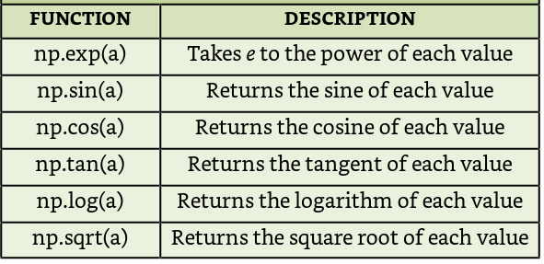
TRIGNOMETRIC FUNCTIONS

Slide 64
TRIGNOMETRIC FUNCTIONS
import numpy as np
b=np.array([[1,2,3,4],[5,6,7,8]])
print(b)
print()
print()
print(np.sin(b))
print(np.cos(b))

Slide 65
VIII BINARY FUNCTIONS

Slide 66
Bitwise functions
binary_repr:represent value in binary form
bitwise_and: It Computes bitwise AND operation of array elements
bitwise_or: It Computes bitwise OR operation of array elements
invert: Computes bitwise NOT
left_shift: Shifts bits of a binary representation to the left by specified digits.
right_shift: Shifts bits of binary representation to the right by specified digits
import numpy as np
a=np.binary_repr(60)
print(a)
b=np.binary_repr(20)
print(b)
c=np.bitwise_and(60,20)
print(c)

Slide 67
IX STASTICAL FUNCTIONS

Slide 68
Statistical functions
np.sum: calculates Sum of all the elements in the array or along a particular axis.
np.amin():Minimum of whole array or minimums along a particular axis.
np.amax():Maximum of whole array or maximums along a particular axis.
np.ptp(): returns range(maximum-minimum). It can be for whole matrix or along a particular axis.

Slide 69
Statistical functions
np.percentile(a, p, axis): Percentile indicates the value below which a given percentage of observations in a array fall. Here x is the input array, p is the percentile to compute(0-100) and the axis along which we need to calculate percentile.
np.median(): Median is defined as the value that separates the higher half of a data sample from the lower half given the fact that they are arranged in an order and sorted.
np.mean(): calculates arithmetic mean.

Slide 70
Statistical functions
np.average(): This is used to compute the weighted average of elements in an array according to their respective weight given in another array. However, if weight is not defined then it is equal to mean.
np.std():Standard deviation shows the amount of variation and dispersion of data from the mean.
np.var(): it informally measures how far numbers in array are spread out from their mean.
np.argmin(): Returns the indices of the minimum values along an axis.

Slide 71
Statistical functions
np.argmax(): returns Indices of maximum elements, respectively.
np.cumsum() : Return the cumulative sum of the elements along a given axis.
np.cumprod(): Return Cumulative product of elements along a given axis.

Slide 72
Various Statistical Functions
import numpy as np
arr1=np.array([1,2,3,3,6,8,0,1]).reshape(2,4)
print(arr1)
arr2=np.array([3,6,9,9,16,80,10,15]).reshape(2,4)
print(arr2)
print(np.sum(arr1))
print(np.amin(arr1))
print(np.amin(arr1,0))

Slide 73
X SORTING

Slide 74
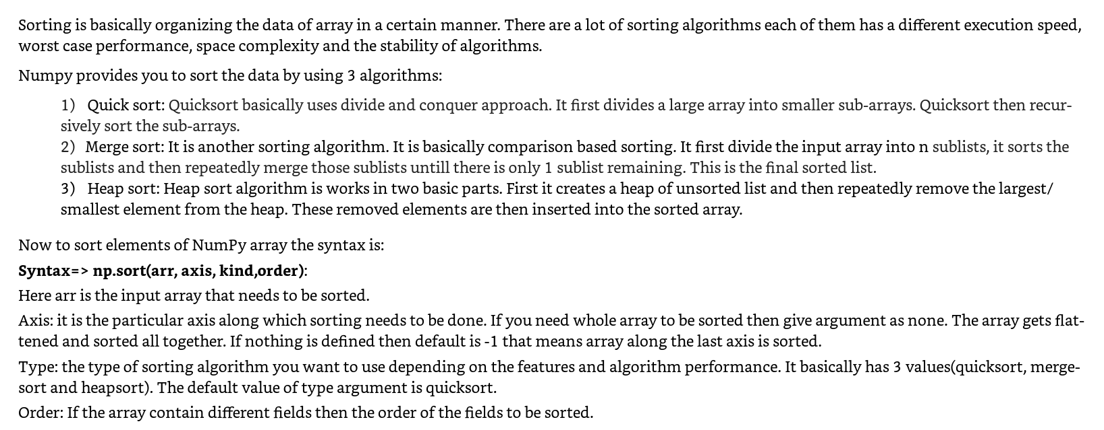
Sorting function

Slide 75
What is the output of the program?
import numpy as np
name=(['Rachel', 'Ross', 'Chandler', 'Monica', 'Phoebe', 'Joey'])
marks=([70, 90, 80, 70, 50, 20])
print(np.sort(name))
print(np.sort(marks))
import numpy as np
name=(['Rachel', 'Ross', 'Chandler', 'Monica', 'Phoebe', 'Joey'])
marks=([70, 90, 80, 70, 50, 20])
print(np.sort(name,axis=None,kind='quicksort'))
print(np.sort(marks,axis=None,kind='quicksort'))

Slide 76
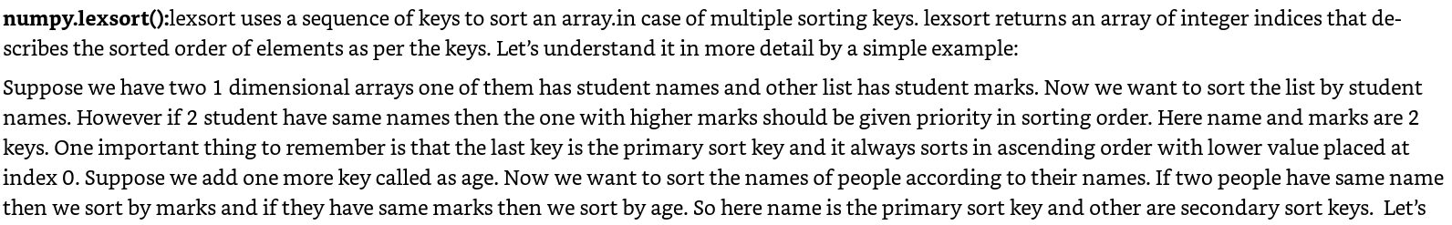
Sorting function

Slide 77
What is the output of the Program?
import numpy as np
name=(['Rachel', 'Ross', 'Chandler', 'Monica', 'Phoebe', 'Joey'])
marks=([70, 90, 80, 70, 50, 20])
a=np.lexsort((name,marks))
print(a)
import numpy as np
name=(['Rachel', 'Ross', 'Chandler', 'Monica', 'Phoebe', 'Joey'])
marks=([70, 90, 80, 70, 50, 20])
a=np.lexsort((marks,name))
print(a)

Slide 78
XI SEARCHING AND COUNTING

Slide 79
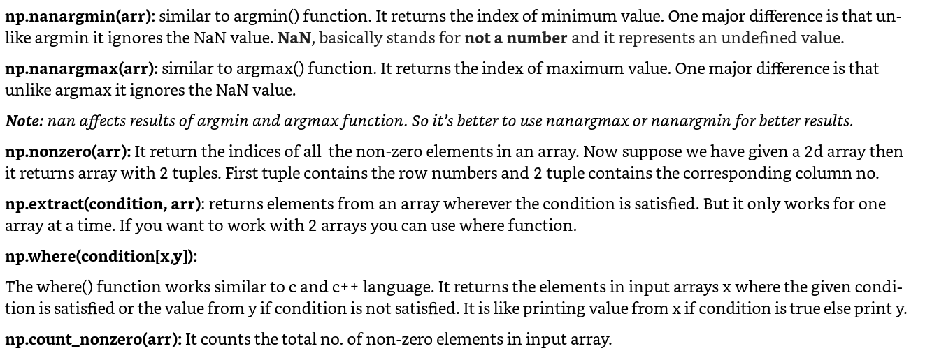
Searching and Counting functions

Slide 80
What is the output of the program?
import numpy as np
arr1=np.array([1,2,3,3,6,8,0,1]).reshape(2,4)
print(arr1)
arr2=np.array([3,6,9,9,16,80,10,15]).reshape(2,4)
print(arr2)
print(np.nanargmax(arr1))
print(np.nanargmin(arr1))
print(np.count_nonzero(arr1))
print(np.extract(arr1>5,arr1))
print(np.where(arr1>7,arr1,arr2))

Slide 81
XII BROADCASTING

Slide 82
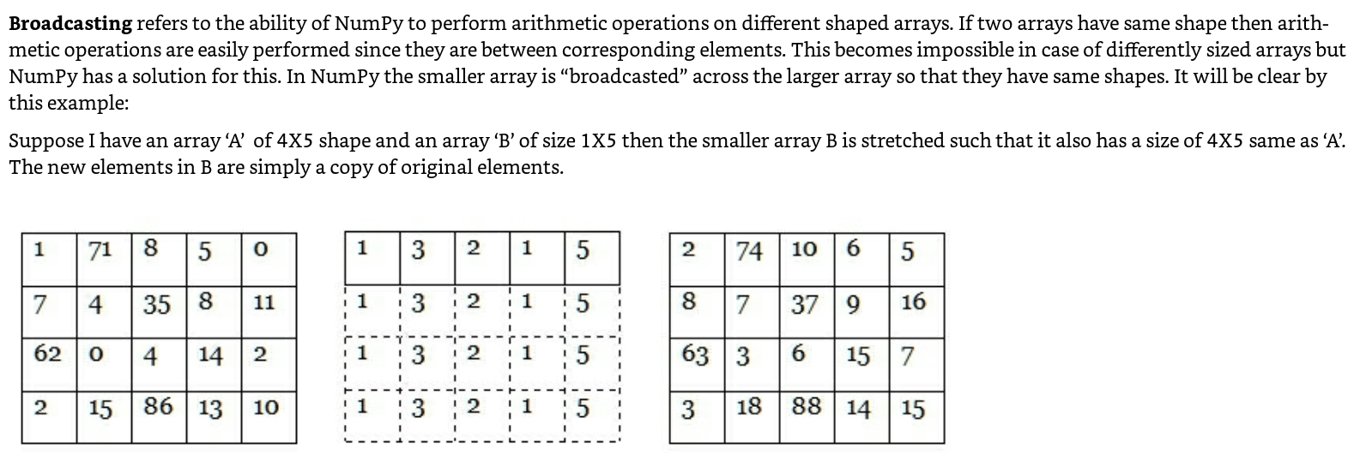
Broadcasting

Slide 83
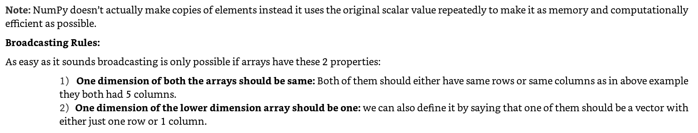
Broadcasting

Slide 84
What is the output of the program?
import numpy as np
A=np.arange(20).reshape(5,4)
print(A)
B=np.arange(5)
print(B)
print(A+B)
import numpy as np
A=np.arange(20).reshape(5,4)
print(A)
B=np.arange(5)
B=B.reshape(5,1)
print(B)
print(A+B)

Slide 85
XIII JOINING FUNCTIONS

Slide 86
concatenate() function
Joins multiple arrays along an existing axis.
import numpy as np
b=np.array([1,2,3])
print(b)
print()
a=np.array([4,5,6])
print(a)
print()
print(np.concatenate((b,a)))

Slide 87
stack () function
Joins multiple arrays along a new axis.
import numpy as np
b=np.array([1,2,3])
print(b)
print()
a=np.array([4,5,6])
print(a)
print()
print(np.stack((b,a)))

Slide 88
Horizontal stack: hstack() vs Vertical stack: vstack()
import numpy as np
b=np.array([1,2,3])
print(b)
print()
a=np.array([4,5,6])
print(a)
print()
print(np.hstack((b,a)))
import numpy as np
b=np.array([1,2,3])
print(b)
print()
a=np.array([4,5,6])
print(a)
print()
print(np.vstack((b,a)))

Slide 89
XIV SPLIT FUNCTIONS

Slide 90
split() function
Split one array into multiple array.
np.split(array_name,x)
x is a integer value into which array will be divided.
import numpy as np
b=np.array([[1,2,3,4],[5,6,7,8]])
print(b)
print()
print()
print(np.split(b,2))

Slide 91
Horizontal split:hsplit() vs Vertical split:vsplit()
import numpy as np
b=np.array([[1,2,3,4],[5,6,7,8]])
print(b)
print()
print()
print(np.hsplit(b,2))
import numpy as np
b=np.array([[1,2,3,4],[5,6,7,8]])
print(b)
print()
print()
print(np.vsplit(b,2))

Slide 92
XV MISCELLANEOUS CONCEPTS

Slide 93
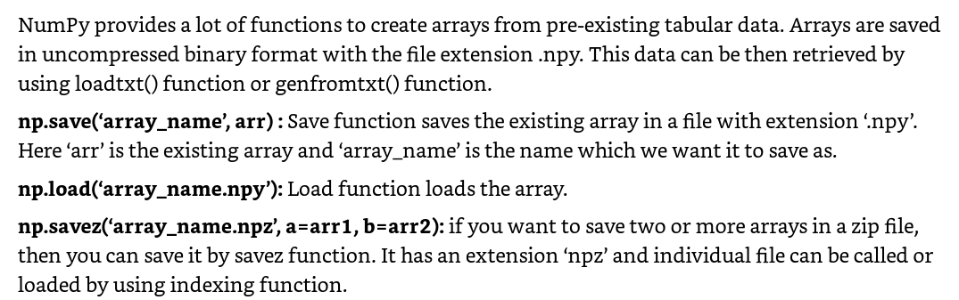
Input/Output operations
import numpy as np
A=np.array([1,2,3,4,5,6,2,6,3,7])
print(np.save('array1',A))
print(np.load('array1.npy'))
B=np.array([3,3,7])
print(np.save('array2',A))
print(np.savez('my_file.npz',a=A,b=B))
myfile=np.load('my_file.npz')
print(myfile['a'])
print(myfile['b'])
print(myfile.files)

Slide 94
Set Theory using numpy
import numpy as np
arr1=np.array([1,2,3,4,5,6,7,8])
arr2=np.array([7,8,9,10,11,12,13])
print(np.unique(arr1))
print(np.union1d(arr1,arr2))
print(np.intersect1d(arr1,arr2))
print(np.setdiff1d(arr1,arr2))

