Slide 1
CLASSICAL WATERFALL MODEL

Slide 2
Classical Waterfall Model
Classical waterfall model divides life cycle into phases:
  feasibility study,
  requirements analysis and specification,
  design,
  coding and unit testing,
  integration and system testing,
  maintenance.

Slide 3
Classical Waterfall Model
Feasibility Study
Req. Analysis
Design
Coding
Testing
Maintenance

Slide 4
Classical Waterfall Model (CONT.)
Most organizations usually define:
  entry and exit criteria for every phase.
They also prescribe specific methodologies for:
  specification,
  design,
  testing,
  project management, etc.

Slide 5
Why to study Waterfall Model?
Every other model is based on Waterfall Model.
To develop an understanding toward various phases of software development.

Slide 6
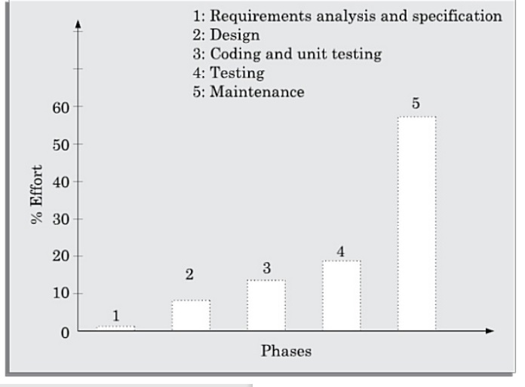
Classical Waterfall Model (CONT.)

Slide 7
Feasibility Study
Main aim of feasibility study:determine whether developing the product
  financially worthwhile
  technically feasible.
First roughly understand what the customer wants:
  different data which would be input to the system,
  processing needed on these data,
  output data to be produced by the system,
  various constraints on the behavior of the system.

Slide 8
Activities during Feasibility Study
Work out an overall understanding of the problem.
Formulate different solution strategies.
Examine alternate solution strategies in terms of:
    resources required,
    cost of development, and
    development time.

Slide 9
Activities during Feasibility Study
Perform a cost/benefit analysis:
  to determine which solution is the best.
  you may determine that none of the solutions is feasible due to:
    high cost,
    resource constraints,
    technical reasons.

Slide 10
Requirements Analysis and Specification
Aim of this phase:
  understand the exact requirements of the customer,
  document them properly.
Consists of two distinct activities:
  requirements gathering and analysis
  requirements specification.

Slide 11
Goals of Requirements Analysis
Collect all related data from the customer:
  analyze the collected data to clearly understand what the customer wants,
  find out any inconsistencies and incompleteness in the requirements,
  resolve all inconsistencies and incompleteness.

Slide 12
Requirements Gathering
Gathering relevant data:
  usually collected from the end-users through interviews and discussions.
  For example, for a business accounting software:
    interview all the accountants of the organization to find out their requirements.

Slide 13
Requirements Analysis (CONT.)
The data you initially collect from the users:
  would usually contain several contradictions and ambiguities:
  each user typically has only a partial and incomplete view of the system.

Slide 14
Requirements Analysis (CONT.)
Ambiguities and contradictions:
  must be identified
  resolved by discussions with the customers.
Next, requirements are organized:
  into a Software Requirements Specification (SRS) document.

Slide 15
Requirements Analysis (CONT.)
Engineers doing requirements analysis and specification:
  are designated as analysts.

Slide 16
Requirements Specification
Organizing requirement analysis into SRS
Important content of document
  Functional Requirements
  Non - Functional Requirements
  The goal of implementation

Slide 17
Design
Design phase transforms requirements specification:
  into a form suitable for implementation in some programming language.

Slide 18
Design
In technical terms:
  during design phase, software architecture is derived from the SRS document.
Two design approaches:
  traditional approach,
  object oriented approach.

Slide 19
Traditional Design Approach
Consists of two activities:
  Structured analysis
  Structured design

Slide 20
Structured Analysis Activity
Identify all the functions to be performed.
Identify data flow among the functions.
Decompose each function recursively into sub-functions.
  Identify data flow among the subfunctions as well.

Slide 21
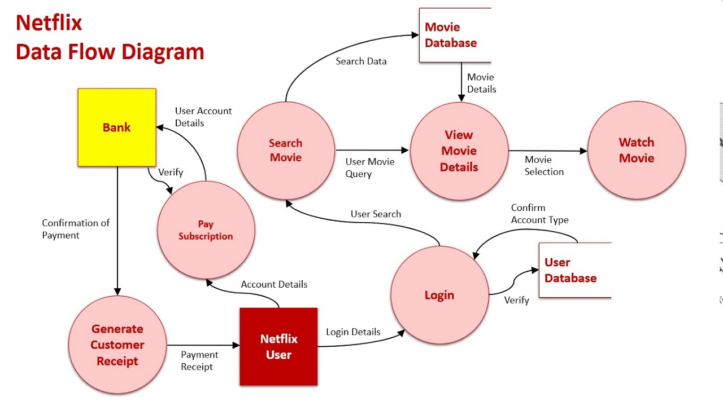
Structure Analysis (cont.)

Slide 22
Structured Analysis (CONT.)
Carried out using Data flow diagrams (DFDs).
After structured analysis, carry out structured design:
  architectural design (or high-level design)
  detailed design (or low-level design).

Slide 23
Structured Design
High-level design:
  decompose the system into modules,
  represent relationships among the modules.
Detailed design:
  different modules designed in greater detail:
    data structures and algorithms for each module are designed.

Slide 24
Object Oriented Design
First identify various objects (real world entities) occurring in the problem:
  identify the relationships among the objects.
  For example, the objects in a pay-roll software may be:
    employees,
    managers,
    pay-roll register,
    Departments, etc.

Slide 25
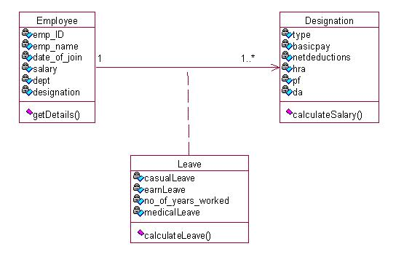
Object Oriented Design

Slide 26
Object Oriented Design (CONT.)
Object structure
  further refined to obtain the detailed design.
OOD has several advantages:
  lower development effort,
  lower development time,
  better maintainability.

Slide 27
Implementation
Purpose of implementation phase (coding phase):
  translate software design into source code.

Slide 28
Implementation
During the implementation phase:
  each module of the design is coded,
  each module is unit tested
    tested independently as a stand alone unit, and debugged,
  each module is documented.

Slide 29
Implementation (CONT.)
The purpose of unit testing:
  test if individual modules work correctly.
The end product of implementation phase:
  a set of program modules that have been tested individually.

Slide 30
Question
With reference to waterfall model, each phase must be completed before the _______ can begin and there is no overlapping in the phases.
Previous Phase
Next Phase
Both a & b
None of the mentioned above

Slide 31
Integration and System Testing
Different modules are integrated in a planned manner:
  modules are almost never integrated in one shot.
  Normally integration is carried out through a number of steps.
During each integration step,
  the partially integrated system is tested.

Slide 32
Integration and System Testing
M1
M2
M3
M4

Slide 33
System Testing
After all the modules have been successfully integrated and tested:
  system testing is carried out.
Goal of system testing:
  ensure that the developed system functions according to its requirements as specified in the SRS document.

Slide 34
Question
A stage in which individual components are integrated and ensured that they are error-free to meet customer requirements.
Coding
Testing
Design
Implementation

Slide 35
Maintenance
Maintenance of any software product:
  requires much more effort than the effort to develop the product itself.
  development effort to maintenance effort is typically 40:60.

Slide 36
Maintenance (CONT.)
Corrective maintenance:
  Correct errors which were not discovered during the product development phases.
Perfective maintenance:
  Improve implementation of the system
  enhance functionalities of the system.
Adaptive maintenance:
  Port software to a new environment,
    e.g. to a new computer or to a new operating system.

Slide 37
Drawbacks of classical water fall model
1. no feedback paths
2. difficult to accommodate changes
3. No overlapping of phases
4. Limited customer interactions

Slide 38
Question
What is the first step in the software development lifecycle?
a) System Design
b) Coding
c) System Testing
d) Preliminary Investigation and Analysis

Slide 39
Iterative Waterfall Model
Classical waterfall model is idealistic:
  assumes that no defect is introduced during any development activity.
  in practice:
    defects do get introduced in almost every phase of the life cycle.

Slide 40
Iterative Waterfall Model (CONT.)
Defects usually get detected much later in the life cycle:
  For example, a design defect might go unnoticed till the coding or testing phase.

Slide 41
Iterative Waterfall Model (CONT.)
Once a defect is detected:
  we need to go back to the phase where it was introduced
  redo some of the work done during that and all subsequent phases.
Therefore we need feedback paths in the classical waterfall model.

Slide 42
Iterative Waterfall Model (CONT.)
Feasibility Study
Req. Analysis
Design
Coding
Testing
Maintenance

Slide 43
Iterative Waterfall Model (CONT.)
Errors should be detected
  in the same phase in which they are introduced.
For example:
  if a design problem is detected in the design phase itself,
    the problem can be taken care of much more easily than, if it is identified at the end of the integration and system testing phase.

Slide 44
Phase containment of errors
The principle of detecting errors as close to its point of introduction as possible:
  is known as phase containment of errors.
Iterative waterfall model is most widely used model.
  Almost every other model is derived from the waterfall model.

Slide 45
NEXT CLASS : PROTOTYPING MODEL

