Slide 1
PLSQL

Slide 2
PL/SQL is a database-oriented programming language that extends Oracle SQL with procedural capabilities.

Slide 3
SQL also has some disadvantages and they are:
SQL can not be used for programming because SQL does not provide the programming techniques of condition checking, looping and branching etc.
SQL statements are passed to Oracle engine one at a time. Thus, it increases the traffic on the network which results in decrease of speed of data processing.
On the occurrence of an error, the Oracle engine displays its own error message. SQL does not allow the programmer to handle the errors.

Slide 4
Advantages of PL/SQL
PL/SQL has SQL features as well as procedural capabilities.
PL/SQL sends entire block of SQL statements to Oracle engine in one go. Thus, it reduces the network traffic which results in an increase of speed of data processing.
PL/SQL allows the programmers to display user-friendly error messages.
PL/SQL programs are portable i.e., these can run on any computer hardware and operating system where Oracle is installed.

Slide 5
SQL | PL/SQL
SQL is a single query that is used to perform DML and DDL operations. | PL/SQL is a block of codes that used to write the entire program blocks/ procedure/ function, etc.
It is declarative, that defines what need to be done, rather than how things need to be done. | PL/SQL is procedural that defines how the things needs to be done.
Execute as a single statement. | Execute as a whole block.
Mainly used to manipulate data. | Mainly used to create an application.
Interaction with a Database server. | No interaction with the database server.
Cannot contain PL/SQL code in it. | It is an extension of SQL, so that it can contain SQL inside it.

Slide 6
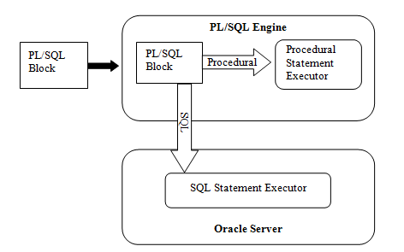
PL/SQL ARCHITECTURE

Slide 7
The PL/SQL architecture mainly consists of following three components:
PL/SQL Block
PL/SQL Engine
Database Server
PL/SQL block:
This is the component which has the actual PL/SQL code.
This consists of different sections to divide the code logically (declarative section for declaring purpose, execution section for processing statements, exception handling section for handling errors)
It also contains the SQL instruction that used to interact with the database server.
All the PL/SQL units are treated as PL/SQL blocks, and this is the starting stage of the architecture which serves as the primary input.

Slide 8
PL/SQL Engine
PL/SQL engine is the component where the actual processing of the codes takes place.
PL/SQL engine separates PL/SQL units and SQL part in the input (as shown in the image below).
The separated PL/SQL units will be handled by the PL/SQL engine itself.
The SQL part will be sent to database server where the actual interaction with database takes place.
It can be installed in both database server and in the application server.
Database Server:
This is the most important component of Pl/SQL unit which stores the data.
The PL/SQL engine uses the SQL from PL/SQL units to interact with the database server.
It consists of SQL executor which parses the input SQL statements and execute the same.

Slide 9
STRUCTURE OF PL/SQL CODE BLOCK
Declare section
Begin section
Exception section
End section

Slide 10
FUNDAMENTALS OF PL/SQL
Character set
Operators
Literals
Variables and constants
Data types
Declarations
Assignments
Comments

Slide 11
Character Set
The PL/SQL character set includes:
Upper and lower-case letters, A .. Z and a .. z
Numerals, 0 .. 9
Symbols, ( ) + - * / < > = ! ~ ^ ; : . ' @ % , " # $ & _ | { } ? [ ]
Tabs and spaces
PL/SQL is not case sensitive, so lower-case letters are equivalent to
corresponding upper-case letters except within string and character literals.

Slide 12
Operators
Arithmetic Operators:
Logical Operators:
Comparison Operators:

Slide 13
Literals
A literal is an explicit numeric, character, string, or Boolean value that is used to initialize the constants and variables.
Numeric Literal:
Character Literal:
String Literal:
Boolean Literal:
'Z' '%' '7' ' ' 'z' '('

Slide 14
Variable and Constant
A variable in PL/SQL is a named variable which is used to hold some data value.
A variable name must start with a character and can be followed by a maximum of 29 other characters.

Slide 15
Data Types
NUMBER: This data type is used to store numeric data (integers, real numbers, and floating-point numbers).
CHAR: This data type is used to store alphanumeric data (words and text). The CHAR datatype can have maximum size up to 32767 bytes.
VARCHAR2: This data type is used to store variable length character data. For a VARCHAR2 that is 2000 bytes longer, PL/SQL dynamically allocates only enough memory to hold the actual valu
DATE: This data type is used to store date and time data.
BOOLEAN: This data type is used to store TRUE, FALSE or NULL.e.

Slide 16
Declarations
Syntax:
Variable-name datatype(size);
Examples:
Age Number(5);
A Number(10,2);
Name Varchar2(20);
DOB Date;

Slide 17
Assignment
Assignment operator (:=) to get the value from the user.
SELECT INTO clause to get the value from database object.
Some examples using assignment operator are:
A := 10;
B := c + d;
Sal := Salary+1000;
Example using SELECT INTO clause:
Select salary into sal from employee where empid = 12;

Slide 18
Comments
Single-line comments and
Multi-line comments
A := 5; ¬¬¬¬-- assign value 5 to variable A
A := b + c; /* the values of variables b and c are added
and result is assigned to variable A */

Slide 19
HOW TO READ A VALUE DURING RUN TIME
Num := :Num;
When the program will execute, the system will ask to enter the value and the user can enter any value. This is shown as follows:
Enter the value of Num: 10

Slide 20
DISPLAYING USER MESSAGE ON THE SCREEN
DBMS_OUTPUT.PUT_LINE(‘Well Come To Computer Lab’);
DBMS_OUTPUT.PUT_LINE (A);
DBMS_OUTPUT.PUT_LINE (‘Value of A is’ || A);

Slide 21
%TYPE
%TYPE attribute provides the data type of a variable or database column.
sal employee.salary%TYPE;

Slide 22
%ROWTYPE
The %ROWTYPE attribute provides a record type that represents a row in a table.
DECLARE
dept_rec dept%ROWTYPE;
dept_rec.deptno;
dept_rec.deptname;

Slide 23
SOME BASIC PL/SQL PROGRAMS
Declare
Begin
dbms_output.put_line ('Hello');
End;

Slide 24
Declare
a number(2);
b number(2);
c number(2);
Begin
a:=5;
b:=4;
c:=a + b;
dbms_output.put_line ('sum='||c);
End;

Slide 25
Exapmle1
Declare
a number(2);
b number(2);
c number(2);
Begin
a:=&a;
b:=&b;
c:=a + b;
dbms_output.put_line('sum='||c);
End;

Slide 26
Example2
Declare
a number(5);
b number(5);
t number(6);
Begin
Select ta, da into a, b from emp where empid = 8;
t := a + b;
Update emp set total = t where empid = 8;
End;

Slide 27
Variable Scope in PL/SQL
PL/SQL allows the nesting of blocks, i.e., each program block may contain another inner block. If a variable is declared within an inner block, it is not accessible to the outer block. However, if a variable is declared and accessible to an outer block, it is also accessible to all nested inner blocks. There are two types of variable scope −
Local variables − Variables declared in an inner block and not accessible to outer blocks.
Global variables − Variables declared in the outermost block or a package.

Slide 28
DECLARE
-- Global variables
num1 number := 95;
num2 number := 85;
BEGIN
dbms_output.put_line('Outer Variable num1: ' || num1);
dbms_output.put_line('Outer Variable num2: ' || num2);
DECLARE
-- Local variables
num1 number := 195;
num2 number := 185;
BEGIN
dbms_output.put_line('Inner Variable num1: ' || num1);
dbms_output.put_line('Inner Variable num2: ' || num2);
END;
END;

Slide 29
Assigning SQL Query Results to PL/SQL Variables
You can use the SELECT INTO statement of SQL to assign values to PL/SQL variables. For each item in the SELECT list, there must be a corresponding, type-compatible variable in the INTO list. The following example illustrates the concept. Let us create a table named CUSTOMERS −
CREATE TABLE CUSTOMERS(
ID INT NOT NULL,
NAME VARCHAR (20) NOT NULL,
AGE INT NOT NULL,
ADDRESS CHAR (25),
SALARY DECIMAL (18, 2),
PRIMARY KEY (ID)
);

Slide 30
INSERT INTO CUSTOMERS (ID,NAME,AGE,ADDRESS,SALARY)
VALUES (1, 'Ramesh', 32, 'Ahmedabad', 2000.00 );
INSERT INTO CUSTOMERS (ID,NAME,AGE,ADDRESS,SALARY)
VALUES (2, 'Khilan', 25, 'Delhi', 1500.00 );
INSERT INTO CUSTOMERS (ID,NAME,AGE,ADDRESS,SALARY)
VALUES (3, 'kaushik', 23, 'Kota', 2000.00 );
INSERT INTO CUSTOMERS (ID,NAME,AGE,ADDRESS,SALARY)
VALUES (4, 'Chaitali', 25, 'Mumbai', 6500.00 );
INSERT INTO CUSTOMERS (ID,NAME,AGE,ADDRESS,SALARY)
VALUES (5, 'Hardik', 27, 'Bhopal', 8500.00 );
INSERT INTO CUSTOMERS (ID,NAME,AGE,ADDRESS,SALARY)
VALUES (6, 'Komal', 22, 'MP', 4500.00 );

Slide 31
The following program assigns values from the above table to PL/SQL variables using the SELECT INTO clause of SQL −
DECLARE
c_id customers.id%type := 1;
c_name customers.name%type;
c_addr customers.address%type;
c_sal customers.salary%type;
BEGIN
SELECT name, address, salary INTO c_name, c_addr, c_sal
FROM customers
WHERE id = c_id;
dbms_output.put_line
('Customer ' ||c_name || ' from ' || c_addr || ' earns ' || c_sal);
END;
/

Slide 32
declare
a int;
n varchar(20);
begin
select salary,name into a,n from customers where id=3;
dbms_output.put_line(a ||' '||n);
update customers set salary=a+500 where id=3;
dbms_output.put_line(a);
end;

Slide 33
Example of %type
Declare
a emp.ta%type;
b emp.da%type;
t emp.total%type;
Begin
Select ta, da into a, b from emp where empid = 8;
t := a + b;
Update emp set total = t where empid = 8;
End;

Slide 34
Example of %rowtype
Declare
Record emp%rowtype;
Begin
Select*into Record from emp where empid = 8;
Record.total := Record.ta + Record.da;
Update emp set total=Record.total where empid = 8;
End;

Slide 35
declare
t customers%rowtype;
begin
select * into t from customers where id=1;
dbms_output.put_line(t.name ||' '||t.id||' '||t.salary);
end;

Slide 36
declare
t customers%rowtype;
begin
select * into t from customers where id=1;
dbms_output.put_line(t.name ||' '||t.id||' '||t.salary||' ' || t.address);
end;

Slide 37
Branching statements
Declare
num1 number(2);
num2 number(2);
Begin
num1:=&num1;
num2:=&num2;
IF num1 > num2 THEN
dbms_output.put_line('greater is num1='||num1);
ELSE
dbms_output.put_line('greater is num2='||num2);
END IF;
End;

Slide 38
Declare
num1 number(2);
num2 number(2);
num3 number(2);
Begin
num1:=&num1;
num2:=&num2;
num3:=&num3;
END IF;
End;
IF num1 > num2 THEN
IF num2 > num3 THEN
dbms_output.put_line('greater is num1='||num1);
ELSE
dbms_output.put_line('greater is num3='||num3);
END IF;
ELSE
IF num2 > num3 THEN
dbms_output.put_line('greater is num2='||num2);
ELSE
dbms_output.put_line('greater is num3='||num3);
END IF;

Slide 39
Loops
Declare
i number(2);
Begin
i:=1;
LOOP
dbms_output.put_line(i);
i:=i + 1;
EXIT WHEN i > 10;
END LOOP;
End;

Slide 40
While
Declare
a number(2);
Begin
a:=1;
WHILE a<=10
LOOP
dbms_output.put_line(a*a);
a:=a+1;
END LOOP;
End;

Slide 41
For
Declare
Total number(4);
i Number(2);
Begin
FOR i IN 1..10
LOOP
Total:=2*i;
dbms_output.put_line('2*' || i || '=' ||Total);
END LOOP;
End;

Slide 42
Declare
num1 number(2);
num2 number(2);
Begin
num1:=&num1;
num2:=&num2;
IF num1 > num2 THEN
GOTO O1;
ELSE
GOTO O2;
END IF;
<<O1>>
dbms_output.put_line('greater is num1='||num1);
GOTO O3;
<<O2>>
dbms_output.put_line('greater is num2='||num2);
<<O3>>
dbms_output.put_line('successful');
End;

Slide 43
Procedure

Slide 44
Declare
Glogal Variable Declarations;
Procedure ProcedureName
( Argument IN/OUT/IN OUT Datatype, ……)
IS/AS
Variable and Constant Declarations;
Begin
PL/SQL Statements;
Exception
Exception Handling Statements;
End ProcedureName;
Begin
Executable Statements;
Procedure Calling;
Exception
Exception Handling Statements;
End;

Slide 45
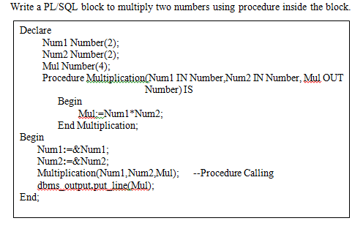

Slide 46
Creating a Function

Slide 47
Declare
Glogal Variable Declarations;
Function FunctionName
( Argument IN Datatype, ……….)
Return DataType
IS/AS
Variable and Constant Declarations;
Begin
PL/SQL Statements;
Exception
Exception Handling Statements;
End FunctionName;
Begin
Executable Statements;
Function Calling;
Exception
Exception Handling Statements;
End;

Slide 48
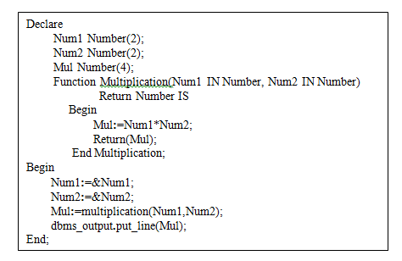

Slide 49
Creating a Stored Procedure

Slide 50
Create Or Replace Procedure ProcedureName
( Argument IN/OUT/IN OUT Datatype, …..)
IS/AS
Variable and Constant Declarations;
Begin
PL/SQL Statements;
Exceptionz
Exception Handling Statements;
End;

Slide 51
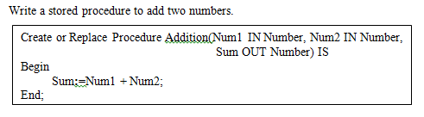

Slide 52
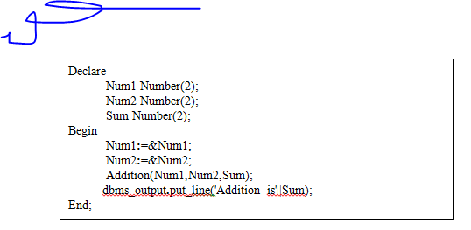

Slide 53
CREATING A TRIGGER

Slide 54
CREATE OR REPLACE TRIGGER TriggerName
BEFORE / AFTER
DELETE / INSERT / UPDATE OF ColumnName
ON TableNamne
REFERENCING OLD AS old, NEW AS new
FOR EACH ROW
WHEN Condition
DECLARE
Variable and Constant Declarations;
BEGIN
SQL and PL/SQL statements;
EXCEPTION
Error Handling Statements;
END;

Slide 55
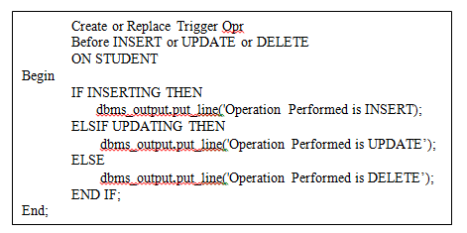

Slide 56
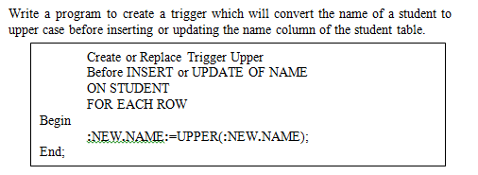

Slide 57
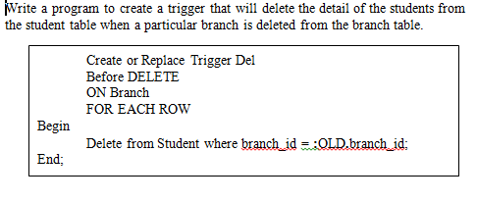

Slide 58
Enabling or Disabling Triggers
Syntax:
SQL> Alter Trigger TriggerName Disable;
Example:
SQL> Alter Trigger Upper Disable;
Syntax:
SQL> Alter Table Tableneme Disable All Triggers;
Example:
SQL> Alter Table Student Disable All Triggers;
Syntax:
SQL> Drop Trigger TriggerName;
Example:
SQL> Drop Trigger Opr;

Slide 59
CURSORS

Slide 60
When a select statement is executed to access the data from a table then, the Oracle engine needs a work area for query execution and to store the result of that query at server side.
The data stored in a cursor is called as ‘active data set’.
A cursor is a work area where the result of a SQL query is stored at the server side.
Declare a cursor
Open a cursor
Fetch or Read from cursor
Close a cursor

Slide 61
Types of Cursors
Implicit Cursor
It is a work area that is declared, opened and closed internally by the Oracle engine. The user is not involved in the process of managing the cursor
SQL%ISOPEN
SQL%FOUND
SQL%NOTFOUND
SQL%ROWCOUNT
Explicit Cursor
It is a work area that is declared, opened and closed externally by the user. It is also called as user-defined cursors.
%ISOPEN
%FOUND
%NOTFOUND
%ROWCOUNT

Slide 62
General Cursor Attributes

Slide 63
Implicit Cursor
Write a PL/SQL block to display a message that whether a record is updated or not using SQL%FOUND and SQL%NOTFOUND.
Begin
Update student set city='pune' where rollno=&rollno;
IF SQL%FOUND THEN
dbms_output.put_line('Recor Updated');
END IF;
IF SQL%NOTFOUND THEN
dbms_output.put_line('Record not Updated');
END IF;
End;

Slide 64
Explicit Cursor
Steps in Handling Explicit Cursor
The explicit cursor handling needs following steps to be followed:
1.Declare the cursor in the DECLARE part of PL/SQL block.
2. Open the cursor.
3. Using a loop, fetch data from cursor one row at a time into memory variables and process the data stored in the memory variables as required.
4.Exit from the loop after the processing is complete.
5. Close the cursor.

Slide 65
Declaring a Cursor
Syntax:
Cursor CursorName IS SELECT statement;
Here, SELECT statement can use all its clauses except INTO clause.
Example:
Cursor C IS SELECT rollno, name from student where branch=’CSE’;

Slide 66
Opening a Cursor
Syntax:
Open CursorName;
Example:
Open C;

Slide 67
Fetching a Record from Cursor
Syntax:
FETCH CursorName INTO Variables;
LOOP
FETCH C INTO my_record;
EXIT WHEN C%NOTFOUND;
-- Process data record
END LOOP;
FETCH C INTO my_rollno, my_name;
LOOP
FETCH C INTO my_record;
EXIT WHEN C%NOTFOUND;
-- Process data record
END LOOP;

Slide 68
Closing a Cursor
Syntax:
CLOSE CursorName;
Example:
CLOSE C;

Slide 69
Write a PL/SQL block to display the name of the students belonging to CSE branch.
Declare
Cursor C Is Select name from student where branch='cse';
my_name student.name%Type;
Begin
Open C;
LOOP
Fetch C into my_name;
Exit When C%Notfound;
dbms_output.put_line(my_name);
END LOOP;
Close C;
End;

Slide 70
Write a PL/SQL block to increase the salary of all engineers by 1000.
Declare
Cursor C1 Is Select empid,salary from emp where job='engineer';
my_id emp.empid%Type;
my_sal emp.salary%Type;
Begin
Open C1;
LOOP
Fetch C1 into my_id,my_sal;
Exit When C1%Notfound;
Update emp set salary=salary+1000 where empid=my_id;
END LOOP;
Close C1;
End;

