Slide 1
UNINFORMED SEARCH
-BFS
-DFS
INT404

Slide 2
State-space search is the process of searching through a state space for a solution by making explicit a sufficient portion of an implicit state-space graph to include a goal node.
  Hence, initially V={S}, where S is the start node;
  when S is expanded, its successors are generated and those nodes are added to V and the associated arcs are added to E.
  This process continues until a goal node is generated (included in V) and identified (by goal test)
During search, a node can be in one of the three categories:
  Not generated yet (has not been made explicit yet)
  OPEN: generated but not expanded
  CLOSED: expanded
  Search strategies differ mainly on how to select an OPEN node for expansion at each step of search

Slide 3
A General State-Space Search Algorithm
open := {S}; closed :={};
repeat
n := select(open); /* select one node from open for expansion */
if n is a goal
then exit with success; /* delayed goal testing */
expand(n)
/* generate all children of n
put these newly generated nodes in open (check duplicates)
put n in closed (check duplicates) */
until open = {};
exit with failure

Slide 4
Some Issues
Search process constructs a search tree, where
  root is the initial state S, and
  leaf nodes are nodes
    not yet been expanded (i.e., they are in OPEN list) or
    having no successors (i.e., they're "deadends")
Some important issue that arises
  The direction in which conduct the search(forward vs. backward reasoning)
  How to select applicable rules(matching).
  How to represent each node of search process(the knowledge representation problem)
  Search tree vs. search graph

Slide 5
Evaluating Search Strategies
Completeness
  Guarantees finding a solution whenever one exists
Time Complexity
  How long (worst or average case) does it take to find a solution? Usually measured in terms of the number of nodes expanded
Space Complexity
  How much space is used by the algorithm? Usually measured in terms of the maximum size that the “OPEN" list becomes during the search
Optimality/Admissibility
  If a solution is found, is it guaranteed to be an optimal one? For example, is it the one with minimum cost?

Slide 6
Algorithm : Breadth-First Search
Create a variable called NODE-LIST and set it to the initial state.
2. Until a goal state is found or NODE-LIST is empty:
Remove the first element from NODE-LIST and call it E. If NODE-LIST was empty, quit.
(b) For each way that each rule can match the state described in E do:
  (i) Apply the rule to generate a new state,
  (ii) If the new state is a goal state, quit and return this state.
  (iii) Otherwise, add the new state to the end of NODE-LIST.
25

Slide 7
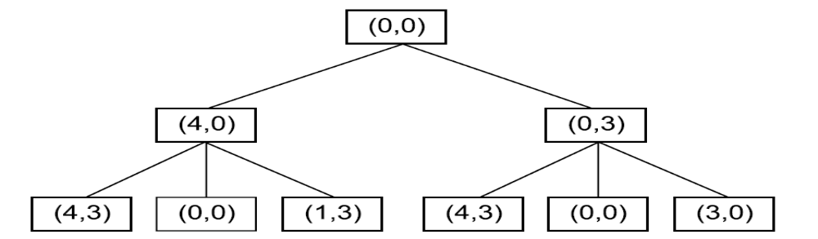
Two Levels of a Breadth-First
Search Tree
26

Slide 8
Breadth-First
s
  A complete search tree of depth d where each non-leaf node has b children, has a total of 1 + b + b^2 + ... + b^d = (b^(d+1) - 1)/(b-1) nodes
  Time complexity (# of nodes generated): O(b^d)
  Space complexity (maximum length of OPEN): O(b^d)
1
1
b
2
b^2
d
b^d
  For a complete search tree of depth 12, where every node at depths 0, ..., 11 has 10 children and every node at depth 12 has 0 children, there are 1 + 10 + 100 + 1000 + ... + 10^12 = (10^13 - 1)/9 = O(10^12) nodes in the complete search tree.
BFS is suitable for problems with shallow solutions

Slide 9



Host
Host
Searcher
Host

Slide 10
Algorithm : Depth-First Search
If the initial state is a goal state, quit and return success.
2. Otherwise, do the following until success or failure is signaled:
  Generate a successor, E, of the initial state. If there are no more successors, signal failure.
  (b) Call Depth-First Search with E as the initial state.
  (c) If success is returned, signal success. Otherwise continue in this loop.
27

Slide 11
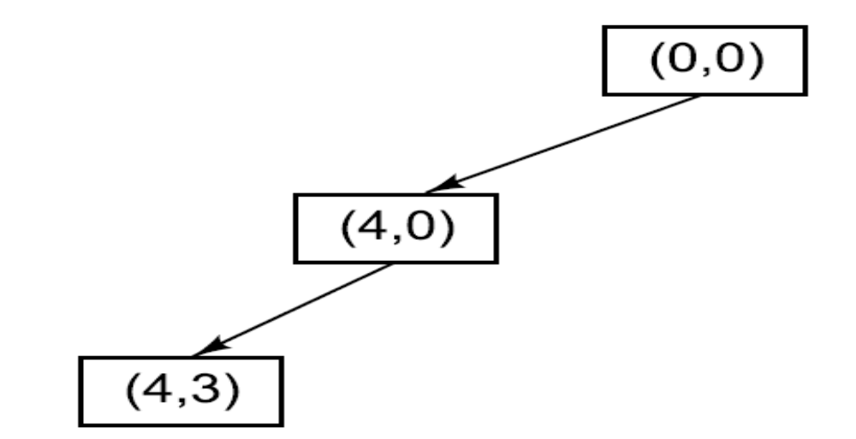
A Depth-First Search Tree
28

Slide 12
Depth-First (DFS)
Algorithm outline:
  Always select from the OPEN the node with the greatest depth for expansion, and put all newly generated nodes into OPEN
  OPEN is organized as LIFO (last-in, first-out) list.
  Terminate if a node selected for expansion is a goal
goal
May not terminate without a "depth bound," i.e., cutting off search below a fixed depth D (How to determine the depth bound?)
Not complete (with or without cycle detection, and with or without a cutoff depth)
Exponential time, O(b^d), but only linear space, O(bd), required
Can find deep solutions quickly if lucky
When search hits a deadend, can only back up one level at a time even if the "problem" occurs because of a bad operator choice near the top of the tree. Hence, only does "chronological backtracking"

Slide 13


