Slide 1
State-space search is the process of searching through a state space for a solution by making explicit a sufficient portion of an implicit state-space graph to include a goal node.
  Hence, initially V={S}, where S is the start node;
  when S is expanded, its successors are generated and those nodes are added to V and the associated arcs are added to E.
  This process continues until a goal node is generated (included in V) and identified (by goal test)
During search, a node can be in one of the three categories:
  Not generated yet (has not been made explicit yet)
  OPEN: generated but not expanded
  CLOSED: expanded
  Search strategies differ mainly on how to select an OPEN node for expansion at each step of search

Slide 2
A General State-Space Search Algorithm
open := {S}; closed :={};
repeat
n := select(open); /* select one node from open for expansion */
if n is a goal
then exit with success; /* delayed goal testing */
expand(n)
/* generate all children of n
put these newly generated nodes in open (check duplicates)
put n in closed (check duplicates) */
until open = {};
exit with failure

Slide 3
Evaluating Search Strategies
Completeness
  Guarantees finding a solution whenever one exists
Time Complexity
  How long (worst or average case) does it take to find a solution? Usually measured in terms of the number of nodes expanded
Space Complexity
  How much space is used by the algorithm? Usually measured in terms of the maximum size that the “OPEN" list becomes during the search
Optimality/Admissibility
  If a solution is found, is it guaranteed to be an optimal one? For example, is it the one with minimum cost?

Slide 4
Algorithm : Breadth-First Search
Create a variable called NODE-LIST and set it to the initial state.
2. Until a goal state is found or NODE-LIST is empty:
Remove the first element from NODE-LIST and call it E. If NODE-LIST was empty, quit.
(b) For each way that each rule can match the state described in E do:
  (i) Apply the rule to generate a new state,
  (ii) If the new state is a goal state, quit and return this state.
  (iii) Otherwise, add the new state to the end of NODE-LIST.
25

Slide 5
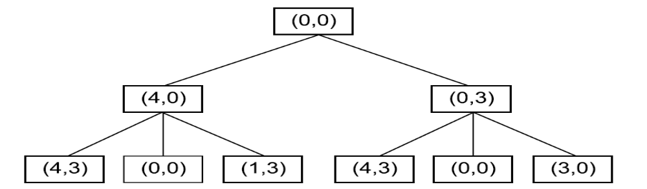
Two Levels of a Breadth-First
Search Tree
26

Slide 6
Breadth-First
s
  A complete search tree of depth d where each non-leaf node has b children, has a total of 1 + b + b^2 + ... + b^d = (b^(d+1) - 1)/(b-1) nodes
  Time complexity (# of nodes generated): O(b^d)
  Space complexity (maximum length of OPEN): O(b^d)
1
1
b
2
b^2
d
b^d
  For a complete search tree of depth 12, where every node at depths 0, ..., 11 has 10 children and every node at depth 12 has 0 children, there are 1 + 10 + 100 + 1000 + ... + 10^12 = (10^13 - 1)/9 = O(10^12) nodes in the complete search tree.
BFS is suitable for problems with shallow solutions

Slide 7
Algorithm : Depth-First Search
If the initial state is a goal state, quit and return success.
2. Otherwise, do the following until success or failure is signaled:
  Generate a successor, E, of the initial state. If there are no more successors, signal failure.
  (b) Call Depth-First Search with E as the initial state.
  (c) If success is returned, signal success. Otherwise continue in this loop.
27

Slide 8
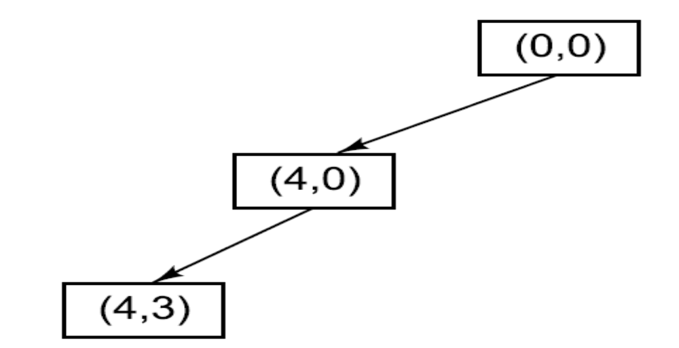
A Depth-First Search Tree
28

Slide 9
Depth-First (DFS)
Algorithm outline:
  Always select from the OPEN the node with the greatest depth for expansion, and put all newly generated nodes into OPEN
  OPEN is organized as LIFO (last-in, first-out) list.
  Terminate if a node selected for expansion is a goal
goal
May not terminate without a "depth bound," i.e., cutting off search below a fixed depth D (How to determine the depth bound?)
Not complete (with or without cycle detection, and with or without a cutoff depth)
Exponential time, O(b^d), but only linear space, O(bd), required
Can find deep solutions quickly if lucky
When search hits a deadend, can only back up one level at a time even if the "problem" occurs because of a bad operator choice near the top of the tree. Hence, only does "chronological backtracking"

Slide 10
Depth-First Iterative Deepening (DFID)
BF and DF both have exponential time complexity O(b^d)
  BF is complete but has exponential space complexity
  DF has linear space complexity but is incomplete
Space is often a harder resource constraint than time
Can we have an algorithm that
  Is complete
  Has linear space complexity, and
  Has time complexity of O(b^d)
DFID by Korf in 1985 (17 years after A*)
  First do DFS to depth 0 (i.e., treat start node as
  having no successors), then, if no solution found,
  do DFS to depth 1, etc.
    until solution found do
    DFS with depth bound d
    d = d+1

Slide 11
Depth-First Iterative Deepening (DFID)
Complete (iteratively generate all nodes up to depth d)
Optimal/Admissible if all operators have the same cost. Otherwise, not optimal but does guarantee finding solution of shortest length (like BF).
Linear space complexity: O(bd), (like DF)
Time complexity is a little worse than BFS or DFS because nodes near the top of the search tree are generated multiple times, but because almost all of the nodes are near the bottom of a tree, the worst case time complexity is still exponential, O(b^d)

Slide 12
Depth-First Iterative Deepening
If branching factor is b and solution is at depth d, then nodes at depth d are generated once, nodes at depth d-1 are generated twice, etc., and node at depth 1 is generated d times.
  Hence
  total(d) = b^d + 2b^(d-1) + ... + db
  <= b^d / (1 - 1/b)^2 = O(b^d).
  If b=4, then worst case is 1.78 * 4^d, I.e., 78% more nodes searched than exist at depth d (in the worst case).

Slide 13
Bidirectional Search
Bidirectional search is a graph search algorithm that finds a shortest path from an initial vertex to a goal vertex in a directed graph.
It runs two simultaneous searches: one forward from the initial state, and one backward from the goal, stopping when the two meet in the middle.
problem complexity in which both searches expand a tree with branching factor b, and the distance from start to goal is d, each of the two searches has complexity O(b^{d/2}), and the sum of these two search times is much less than the O(b^{d}) complexity that would result from a single search from the beginning to the goal.

Slide 14


