Slide 2


Slide 3
Which word best describes the picture?
impetuous
facetious
imperious
insouciant

Slide 4
imperious

Slide 5


Slide 6
Which word best describes the picture?
Impetuous
Facetious
Ebullient

Slide 7
Ebullient

Slide 8
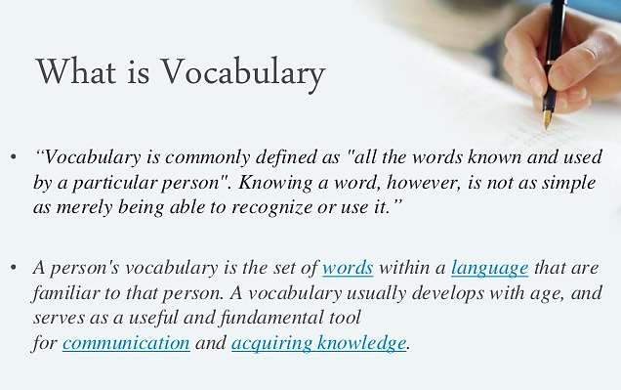

Slide 9
Tips and Tricks to Learn Vocabulary
Read a Lot of Literature and Texts
Reading literature will will help you get to know new words. Every new word you will come across should be jotted down and its meaning should be checked out in a dictionary. Knowing the meaning of the word may help you become familiar with its usage. A habit of reading is an effective way to increase your vocabulary and so it should be incorporated daily by you.

Slide 10
Whenever we come across a new word in a new sentence while reading a text book, we should never look up its meaning. This is the best way to enhance vocabulary
A)TRUE B)FALSE

Slide 11
Whenever we come across a new word in a new sentence while reading a text book, we should never look up its meaning. This is the best way to enhance vocabulary
A)TRUE B)FALSE

Slide 12
1. Find Context of New Words
Learn Synonyms and Antonyms
Learn Root-words Prefixes and Suffixes

Slide 13
A good knowledge of words and their
………………….. is very beneficial from the examination point of view.
SYNONYMS
ANTONYMS
BOTH

Slide 14
A good knowledge of words and their
………………….. is very beneficial from the examination point of view.
SYNONYMS
ANTONYMS
BOTH

Slide 15
4. Learn Tricks and Memorization Techniques
5. Find Words that Might be Related to Job Spheres

Slide 16
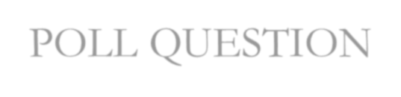
POLL QUESTION
It is good way if You may prepare for vocabulary tests by targeting the words that belong to the domain or field related to the role that the test is being conducted for.
Yes
No

Slide 17
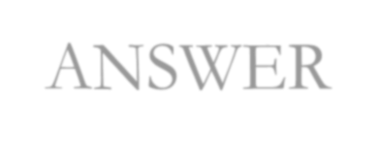
ANSWER
It is good way if You may prepare for vocabulary tests by targeting the words that belong to the domain or field related to the role that the test is being conducted for.
Yes
No

Slide 18
Learn Commonly Used Words in Vocabulary Tests

Slide 19
ROOT WORDS
A root word is a word or word part that can form the basis of new words through the addition of prefixes and suffixes. Understanding the meanings of common roots can help you work out the meanings of new words as you encounter them.

Slide 20

POLL QUESTION
Root words are
a) Words used to make new words
B) Parts of words put onto the end of other words to make new words
c) Parts of words put onto the beginning of other words to change their meaning

Slide 21

ANSWER
Root words are
a) Words used to make new words
B) Parts of words put onto the end of other words to make new words
c) Parts of words put onto the beginning of other words to change their meaning

Slide 22
Root Words That Can Stand Alone
There are some root words that can be used on their own or as part of other common words in the English language. The following root words are provided with their meaning and, in parentheses, a few examples of the root as part of other words:
Act: to move or do (actor, acting, reenact)
Arbor: tree (arboreal, arboretum, arborist)
Crypt: to hide (apocryphal, cryptic, cryptography)
Ego: "I" (egotist, egocentric, egomaniac)
Form: shape (conform, formulate, reform)
Legal: related to the law (illegal, legalities, paralegal)
Norm: typical (abnormal, normality, paranormal)
Phobia: fear (arachnophobia, claustrophobia, hygrophobia)

Slide 23

POLL QUESTION
The root word Aqua means
a) Land b)Water
c) Air

Slide 24

ANSWER
The root word Aqua means
a) Land b)Water
c) Air

Slide 25
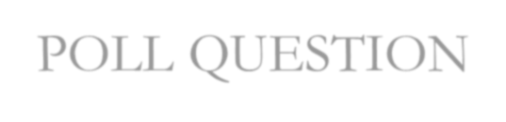
POLL QUESTION
“egotist” has a root word
_
A)EGO B)IST

Slide 26

ANSWER
“egotist” has a root word
_
A)EGO B)IST

Slide 27
Prefixes and Suffixes
Prefixes and suffixes are grammatical “affixes” (prefixes come
before the root word, and suffixes come after).
In very simplistic terms, prefixes change the meaning of words, and suffixes change their form (including plural, tense, comparative, and part of speech).

Slide 28
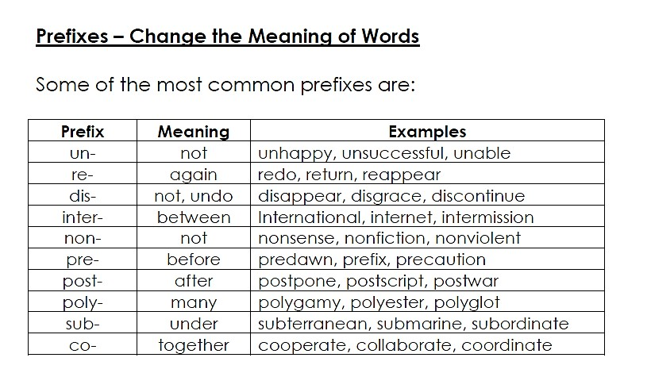

Slide 29

POLL QUESTION
The prefix “re” means
a) First time b)Again
c) For the third time

Slide 30

ANSWER
The prefix “re” means
a) First time b)Again
c) For the third time

Slide 31
POLL QUESTION
The prefix “sub” means
a) Over
b)Under
c) Above

Slide 32
ANSWER
The prefix “sub” means
a) Over
b)Under
c) Above
Example: Subordinate, submarine, Submerge

Slide 33
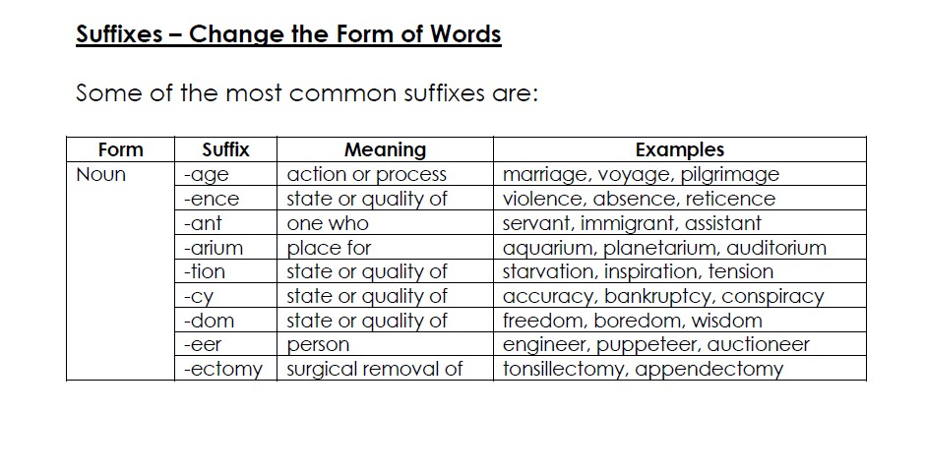

Slide 34

POLL QUESTION
suffixes are
Parts of words put on to the ends of other words to change their meaning
Words used to make new words
Parts of words put on to the beginning of other words to change their meaning

Slide 35

ANSWER
suffixes are
Parts of words put on to the ends of other words to change their meaning
Words used to make new words
Parts of words put on to the beginning of other words to change their meaning

Slide 36
POLL QUESTION
The suffix “age” means
a) Place for
b) Action or process
c) Person

Slide 37
ANSWER
The suffix “age” means
a) Place for
b) Action or process
c) Person
Examples: marriage, voyage, pilgrimage

Slide 38
SYNONYMS AND ANTONYMS
The synonyms and antonyms form an integral part of the English Language. Acquaintance with vocabulary of English language is a necessity for effective expression either in written or in the oral form.

Slide 39
SYNONYMS
Synonyms are the words which have a similar meaning to that of a given word.

Slide 40

POLL QUESTION
Synonym of ABSOLUTE
Division
Complete
Small
Half

Slide 41

ANSWER
Synonym of ABSOLUTE
Division
Complete
Small
Half

Slide 42
POLL QUESTION
Synonym of ILLICIT
a) Ethical
b) Illegal
c) Moral
d) Truthful

Slide 43
ANSWER
Synonym of ILLICIT
a) Ethical
b) Illegal
c) Moral
d) Truthful

Slide 44
ANTONYMS
An antonym is a word that is directly opposite in meaning to a given word.

Slide 45
POLL QUESTION
Antonym of Beautiful
Wonderful
Graceful
Ugly

Slide 46
ANSWER
Antonym of Beautiful
Wonderful
Graceful
Ugly

Slide 47
POLL QUESTION
Antonym of DUBIOUS
a) Reluctant
b) Believable
c) Skeptical
d) Problematic

Slide 48
ANSWER
Antonym of DUBIOUS
a) Reluctant
b) Believable
c) Skeptical
d) Problematic

Slide 49
Supersede (Verb) –
Definition: take the place of (a person or thing previously in authority or use); supplant.
Synonyms: replace, supplant, take the place of, take over from, substitute for, displace, oust, overthrow
Antonyms: keep, stay, accept.
Usage: the older models of car have now been superseded
Turbulence (Noun) –
Definition: violent or unsteady movement of air or water, or of some other fluid.
Antonym: Peace, Serenity, Quenching
Synonym: Upheaval, turbulency, turbulences
Example: Sienna’s year has been marked by violent or overwhelming turbulence.
Deployed (Verb) –
Meaning: move (troops or equipment) into position for military action.
Synonyms: position, station, post, place, install, locate
Antonyms: concentrate
Usage: “Profiting from a mutiny, the rebel forces deployed their troops rapidly and cut the country virtually in
two.”

Slide 50
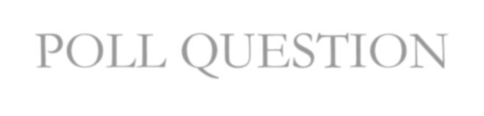
POLL QUESTION
The era was characterized by political and cultural _______________
a) deployed b)Turbulence
c) supersede

Slide 51

ANSWER
The era was characterized by political and cultural _______________
a) deployed b)Turbulence
c) supersede

Slide 52
Outrageous (Adjective) –
Meaning: shockingly bad or excessive. Synonyms: shocking, disgraceful, scandalous Antonyms: acceptable, mild, moderate
Usage: “There had to be a reason why he lost control and watched helplessly as his own body
committed such an outrageous act.”
Dispensation (Noun)
Meaning: exemption from a rule or usual requirement. Synonyms: exemption, immunity, exception Antonyms: responsibility, liability, obligation
Usage: “The political dispensation to follow will be either stable or colonial, but not both.”
Reviled (Verb) –
Meaning: criticize in an abusive or angrily insulting manner.
Synonyms: criticize, censure, condemn
Antonyms: praise, extol, approve
Usage: “People who are creative, who invent and discover new ways are reviled.”

Slide 53

POLL QUESTION
The sport's ruling body gave him to compete in national competitions.
Dispensation
reviled

Slide 54

ANSWER
The sport's ruling body gave him to compete in national competitions.
Dispensation
reviled

Slide 55
Connivance (Noun) –
Meaning: Willingness to secretly allow or be involved in wrongdoing, especially an immoral or illegal act.
Synonyms: collusion, complicity, collaboration
Antonyms: assistance, abetment, aid
Usage: “The culmination of this is the present unfolding catastrophe, which required the moral connivance,
in one way or another, of nearly every sector of civil society.”
Rampage (Noun) –
Meaning: A period of violent and uncontrollable behaviour, typically involving a large group of people.
Synonyms: berserk, out of control, wild, bonkers
Antonyms: calmness, delight, pleasure, amusement
Usage: “Hamer residents say they are living in fear after gangs went on the rampage and vandalised cars.”
Ransacked (Verb) –
Meaning: Go hurriedly through (a place) stealing things and causing damage.
Synonyms: plunder, pillage, steal from
Antonyms: cleaned, found, gave
Usage: “It’s unusual for someone to strike like this during the day and to ransack the place in such a disturbing way.”

Slide 56
Detained (Verb) –
Meaning: Keep (someone) in official custody, typically for questioning about a crime or in politically sensitive situations.
Synonyms: delay, hold up, make late
Antonyms: freed, lost, released
Usage: “If people are unlawfully detained, they have a right to be free?”
Congregated (Verb) –
Meaning: gather into a crowd or mass.
Synonyms: assemble, gather, collect, accumulate, gather
Antonyms: disperse, scatter, dissolve, diffuse
Usage: “As she neared the Village Square, she saw a crowd of people congregated
there.”
Assertions (Noun) –
Meaning: a confident and forceful statement of fact or belief.
Synonyms: declaration, contention, statement, speech, contention, account
Antonyms: disavowals, denial, desertion, repudiations, renunciation, abandonment Usage: “Imposing such a ban requires far more compelling logic than the assertion that we should not play God.”

Slide 57

POLL QUESTION
The ____ of the right to freedom is very important to all people.
a) Connivance b)assertion

Slide 58
ANSWER
The of the right to freedom is very important to all people.
a) Connivance b)assertion

Slide 59
Accorded (Verb) –
Meaning: give or grant someone (power, status, or recognition). Synonyms: give, grant, tender, stretch, allowance, kind-hearted Antonyms: withhold, remove, refuse, confiscate
Usage: “Sand back has never received the recognition accorded his minimalist peers.”
Creeping (Verb)
Meaning: move slowly and carefully in order to avoid being heard or noticed.
Synonyms: crawl, move on all fours, move on hands and knees, Crawling, Slithering, Scrambling
Antonyms: barrelling, bolting, breakneck, fastening, quick
Usage: “She carefully crept around them and made her way to Fiona.”
Expertise (Noun)
Meaning: expert skill or knowledge in a particular field. Synonyms: skill, skilfulness, expertness, ability, astuteness Antonyms: incompetence, ineffectiveness, ineptitude, uselessness
Usage: “Each member casts a ballot for the category of competition in their field of expertise.”

Slide 60
Overdue (Adjective) –
Meaning: not having arrived, happened, or been done by the expected time.
Synonyms: late, not on time, behind, schedule
Antonyms: early, punctual, on time
Usage: “All I’m saying is that we’re 7 years overdue for skinny ties and narrow lapels.”
Devastated (Verb) – Meaning: destroy or ruin.
Synonyms: destroy, ruin, leave in ruins
Antonyms: fixed, repaired, sober
Usage: “the city was devastated by a huge earthquake”
Evacuation (Noun)
Meaning: the action of evacuating a person or a place.
Synonyms: removal, clearance, shifting
Antonyms: retention, holding, preservation, withholding
Usage: “there were waves of evacuation during the blitz”

Slide 61
POLL QUESTION
The jealousy of the provinces, however, against the capital led to a series of disturbances, and for many years continual civil war _____________ every part of the country.
a) Overdue
b)Accorded
c)devastated

Slide 62
ANSWER
The jealousy of the provinces, however, against the capital led to a series of disturbances, and for many years continual civil war _____________ every part of the country.
a) Overdue
b)Accorded
c)devastated

Slide 63
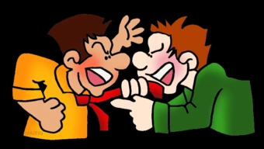
Which word best describes the picture?
Ardour
Abhor
Contentious

