Slide 1
Clustering algorithm analysis, validation and Crop Recommendation
Team Id :
Collage : Faculty of Technology and Engineering
Team Leader : Shah Shubham
Members :
Shah Shubham
Sahil Dharaviya
Marag Modh
Harshad Parmar

Slide 2
AGENDA
Analysis of Kmeans clustering and DBSCAN algorithm
Validation of clusters created using silhouette coeffiecient
Crop Recommendation using soil nutrients values

Slide 3
PROBLEM STATEMENT
We are having a dataset of soil nutrients values (nitrogen, phosphorous and potassium) and the crops suitable according to those nutrients’ values.
We want to recommend crop to the farmers according to nutrient values of their soil.
The data is unlabeled, so we are trying to generate clusters from this dataset and then predict that nutrients values given by farmer belong to which cluster and recommend crops which belongs to that cluster.
Reference : https://pure-good-heroes.fandom.com/wiki/WALL-E

Slide 4
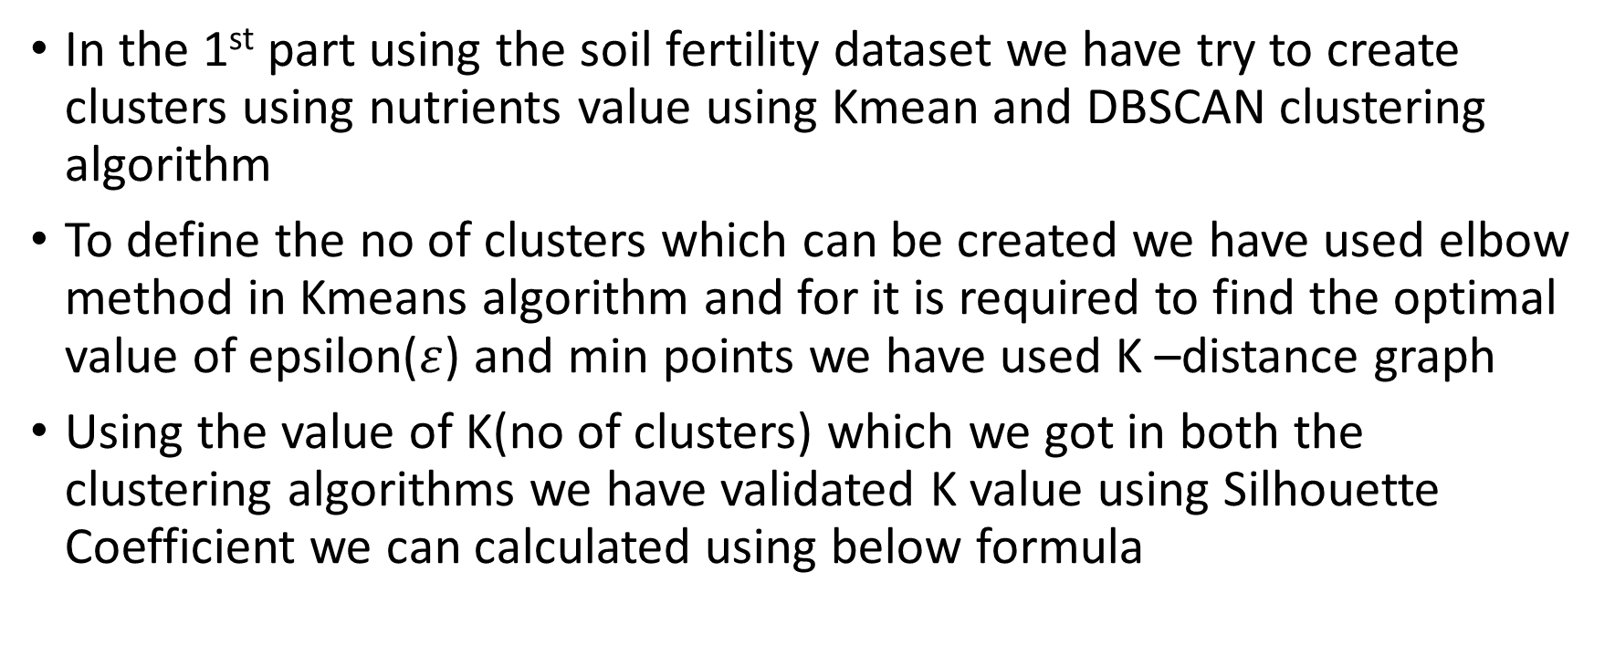
PROJECT OVERVIEW
In the 1st part using the soil fertility dataset we have try to create clusters using nutrients value using Kmean and DBSCAN clustering algorithm
To define the no of clusters which can be created we have used elbow method in Kmeans algorithm and for it is required to find the optimal value of epsilon($ε$) and min points we have used K –distance graph
Using the value of K(no of clusters) which we got in both the clustering algorithms we have validated K value using Silhouette Coefficient we can calculated using below formula

Slide 5
Silhoutte Score = b-a/max(b,a)
Where a = inter cluster distance and b = intra cluster distance
After validating our clusters we have plotted them using scatter plot
In the 2nd part using a different soil fertility dataset using elbow method we generated the clusters and applying Kmeans clustering algorithm we have created clusters from dataset having the best silhouette score and plotted them using 3D scatter plot
In GUI section we have created a user interface using Tkinter library of python in which farmers need to enter the nutrients values of their soil and according to those values Kmeans will predict the crops for them which belong a particular cluster

Slide 6
WHO ARE THE END USERS?
Farmers are the end users of the model that we have developed they just need to enter the nutrients values of their soil i.e. Nitrogen, Phosphorous and Potassium. And just clicking on Recommend crop they will get the list of crops which are suitable for their soil according to their soil nutrients values

Slide 7
THE WOW FACTOR IN OUR SOLUTION
We have designed our clustering model in such a way that their won’t be any chance of random initialization trap( having different centroid for the same no of cluster ) but as we have used Kmeans++ in our model only accurate centroid will be selected for the clusters which are being created
Strong validation of clusters as we have validated our clusters using silhouette score so the no of clusters we have created are accurate as we have considered the best silhouette score for decide K (no of clusters) value

Slide 8
RESULTS
In the 1st part we have analyze Kmeans and DBSCAN clustering algorithm and validated them using Silhouette Coefficient
In the 2nd part the clustering model which we have created is giving the accurate value of crops for the nutrients values ( nitrogen, phosphorous , potassium) we are providing as input in the user interface.
GitHub link : https://github.com/shubham171002/Clustering_Soil

Slide 9
CONCLUSION
From the 1st part of clustering analysis we have concluded that whenever we want to create clusters from a given dataset silhouette score is useful to find the accurate no of clusters that can be created
When the shape of clusters we have created is like oval or circle we can clearly say that Kmeans clustering algorithm should be used and when the points are very much scattered everywhere means clusters are not compact at that time we should use DBSCAN algorithm as this algorithm is robust to the noise points which are actually not part of any clusters and separate them from core and border points which Kmeans algorithm can not separate as it considers all the points to create to generate clusters even if they are scattered to much

Slide 10
In the 2nd part we have concluded from the 3D graph which we have plotted that clusters are compact means dense enough that we can continue with Kmeans algorithm and points in the graph are hardly noisy( which we can not consider to be the part of any cluster) so no need to apply DBSCAN algorithm and analyze between Kmeans and DBSCAN or validate them using Silhouette score but still we have used silhouette score to compare the result with K value of elbow and getting both the result same for value of K .

Slide 11
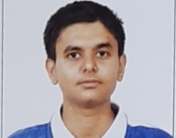
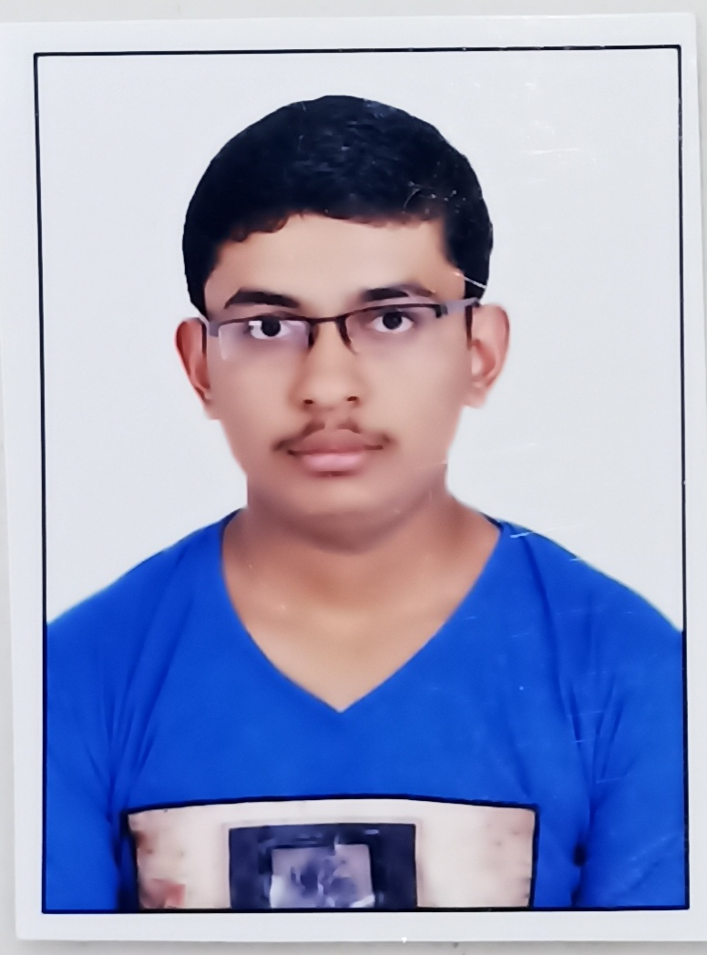


MEET OUR TEAM
SHUBHAM SHAH
SAHIL DHARAVIYA
MARAG MODH
HARSAHD PARMAR

