Slide 1

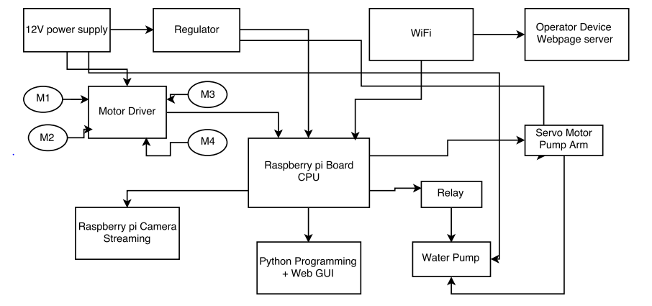
Vasantdada Patil Pratishthan's College of
Engineering & Visual Arts
Department of Information Technology
Fire Fighting Robot Using Raspberry Pi
Abstract:
In this project, we have designed a robot system using Raspberry Pi which is used to extinguish fire without causing any harm to human and can be controlled using Wi-Fi or Internet Services. This kind of robot can be used in nuclear plants, chemical industry.
Academic Year 2022-2013
Algorithm/Flowchart:
1. Start
2. Move the robot to fire location.
3. If fire caught go to step 4 else Step 5.
4. Check the water pump is activated.
5. Move to fire point and pour water.
6. Go to Step 2
7. Stop.
Block Diagram
Introduction:
In this embedded project, we have outlined a robot and heart of the robot is Raspberry Pi which is Linux based computer and it is connected with Wi-Fi to control and give live video output. The robot along with camera can wirelessly transmit real time video with night vision capabilities. At transmitting end ,commands are sent to receiver to control the movement of robot. At receiving end ,two robot are interfaced to the motor driver where they are used for the movement of the robot.
Conclusion:
Thus, we conclude that a robot can be used in place of humans .They provide us greater efficiency to detect the fire using camera which interface before it become uncontrollable and threat to human life.
References:
1) Swati A. Deskmukh and Rashmi A. Pandhere, “Wireless Fire Fighting Robot,” in Science.
2) Kriti Singh, “Advanced Phone Control Robot,” Volume 7.
Group Members:
.
.
Under the Guidance of

