Slide 1

Outline of Presentation
1
Introduction
7
Reward Model
— Why alignment of language models matters
— DeBERTa-v3-base + LoRA, Bradley-Terry loss
2
Literature Survey
8
DPO Fine-Tuning
— InstructGPT, DPO, LoRA, preference datasets
— TinyLlama-1.1B + 4-bit NF4 + LoRA
3
Problem Statement
9
Implementation Status
— Single-dataset RM overfit failure mode
— End-to-end pipeline complete
4
Proposed System
10
Results
— Pipeline architecture + project flowchart
— RM 68.2% % acc. • DPO 60.1 % win-rate
5
Hardware & Software
11
Advantages & Applications
— Free Kaggle T4×2, HuggingFace, TRL, PEFT
— Why this approach is useful
6
Dataset Construction
12
Future Scope
— HH-RLHF + LMSYS → 4 000 balanced pairs
— SFT stage, scale-up, ensemble RMs
RLHF: Reward Modeling + DPO
Slide 1 / 16

Slide 2
Introduction
What is Reinforcement Learning from Human Feedback?
RLHF aligns large language models with human preferences. The standard pipeline is three stages: (1) pre-training, (2) Reward Model trained on pairwise human comparisons, and (3) policy fine-tuning. This project implements stages 2 and 3 end-to-end on free GPU hardware using a novel combination of expert-annotated and crowd-sourced preference data.
Pipeline at a Glance
Combine
HH-RLHF + LMSYS → 4 000 pairs
Score RM
Why it matters
DeBERTa-v3 + LoRA, BT-loss
Raw LMs predict tokens — they don't know what humans prefer.
Most projects use a single preference dataset and overfit it.
Per-source evaluation exposes RM generalization failures.
Runs on free Kaggle T4 .
Evaluate
Per-source pairwise accuracy
Align DPO
TinyLlama-1.1B + 4-bit + LoRA
Win-Rate
50 held-out prompts, RM judge
RLHF: Reward Modeling + DPO
Slide 2 / 16

Slide 3
Literature Survey
Summary of related research and methods
Author / Year | Approach | Key Contribution | Limitation
Ouyang et al., 2022 | InstructGPT (PPO) | Three-stage RLHF pipeline at scale | Requires 4 models in memory
Rafailov et al., 2023 | DPO | Closed-form RLHF; no RL loop (NeurIPS Best Paper) | Sensitive to reference-model drift
Hu et al., 2022 | LoRA | Train ~0.4 % of parameters | Rank choice is task-specific
Dettmers et al., 2023 | QLoRA (4-bit NF4) | Fine-tune billion-param LLMs on a single GPU | Slight quality vs. fp16 trade-off
Bai et al., 2022 | HH-RLHF dataset | Expert helpfulness + harmlessness pairs | Single labeling regime
Chiang et al., 2024 | LMSYS Chatbot Arena | 57 K crowd-sourced votes; diverse prompts | Noisy labels, ~30 % ties
Proposed, 2025 | Combined HH + LMSYS | Cross-distribution RM with per-source eval | —
RLHF: Reward Modeling + DPO
Slide 3 / 16

Slide 4
Problem Statement
The gap our project aims to fill
Modern Large Language Models (LLMs) are commonly aligned using human preference learning techniques such as Reward Modeling and RLHF. However, during preference training, reward models often develop self-preference bias, where the system begins favoring responses that resemble the style, structure, or distribution of its own training data rather than objectively evaluating response quality.
Key Challenges Addressed
Reduced fairness and generalization
Label-Regime Mismatch
1
2
Misalignment between actual response quality and assigned reward
Expert vs. crowd votes have different bias profiles
verbose
Honest Evaluation
3
4
Preference toward verbose or stylistically similar outputs
Need per-source metrics, not just an averaged headline number
RLHF: Reward Modeling + DPO
Slide 4 / 16

Slide 5
Proposed System / Architecture
End-to-end RLHF pipeline (Stage 1 → Stage 4)
Stage 1
▶
Stage 2
▶
Stage 3
▶
Stage 4
Combined Dataset
Reward Model
DPO Fine-Tuning
Cross-Source Eval
Module Description
Why each design choice
Combined Dataset:
Combined data:
HH-RLHF (expert) + LMSYS (crowd) → 4 000 pairs, 50/50 mix
Prevents memorization of any one labeling regime
Reward Model:
DeBERTa-v3:
DeBERTa-v3-base + LoRA (r=32), Bradley-Terry pairwise loss
Bidirectional attention is best for scoring full sequences
DPO Policy:
4-bit + LoRA:
TinyLlama-1.1B-Chat, 4-bit NF4, LoRA (r=16), β=0.1
Trains 0.4 % of parameters; fits 1.1 B model in a T4
Cross-Source Eval:
DPO over PPO:
Per-source pairwise acc.; 50 held-out prompts (25 + 25)
2 models in memory vs. 4; closed-form loss, no RL instability
RLHF: Reward Modeling + DPO
Slide 5 / 16

Slide 6
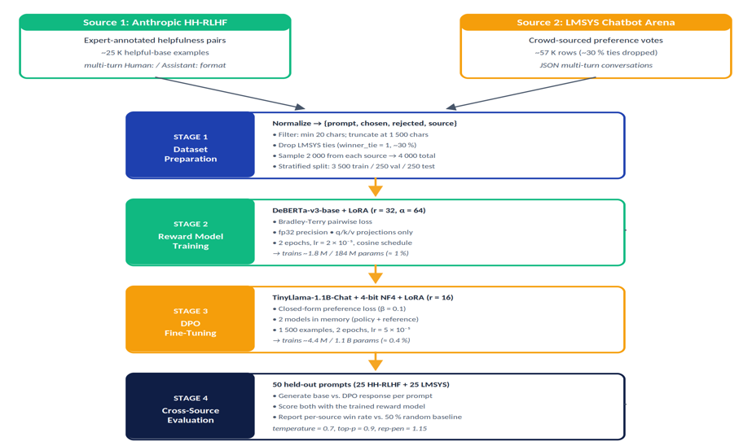
Project Flowchart
RLHF: Reward Modeling + DPO
Slide 6 / 16

Slide 7
Hardware / Software Requirements
Resources used for training and evaluation
Hardware Requirements
GPU | NVIDIA T4 × 2 (16 GB each)
Platform | Kaggle Notebooks (free tier)
VRAM used | ~7 GB peak (RM) / ~10 GB (DPO)
Runtime | ~2.5–3 hr first run; <30 s cached
Storage | ~250 MB for adapters + logs
Software Stack
Language | Python 3.10
Framework | PyTorch 2.x + CUDA 11.8
Transformers | HuggingFace ≥ 4.40
Trainers | TRL (RewardTrainer, DPOTrainer)
PEFT / Quant. | PEFT (LoRA), bitsandbytes 4-bit NF4
RLHF: Reward Modeling + DPO
Slide 7 / 16

Slide 8
Dataset Construction
Combining expert + crowd-sourced preference data
1
Load HH-RLHF
Dataset Comparison
Property | HH-RLHF | LMSYS
Label type | Expert annotators | Crowd votes
Raw size | ~25 K (helpful-base) | ~57 K rows
Ties | None | ~30 % (dropped)
Avg. resp. | ~300 chars | ~520 chars
Style | Multi-turn | Single / Multi
Used | 2 000 | 2 000
Anthropic helpful-base split via HuggingFace
2
Load LMSYS
57 K rows from train.csv (Kaggle competition)
3
Normalize Schema
{prompt, chosen, rejected, source}
4
Drop Ties
LMSYS winner_tie=1 (~30 %) discarded
5
Truncate & Filter
Min 20 chars / field; cap at 1500 chars
6
Balanced Split
2 000 + 2 000 → stratified 3500 / 250 / 250
RLHF: Reward Modeling + DPO
Slide 8 / 16

Slide 9
Reward Model Architecture
DeBERTa-v3-base + LoRA, Bradley-Terry pairwise loss
Input Pair
DeBERTa-v3
LoRA q,k,v_proj
Pooler
Reward
(prompt, response)
184 M (fp32)
r = 32, α = 64
+ classifier head
scalar score r(x,y)
Training Configuration
Base model | microsoft/deberta-v3-base (184 M)
LoRA rank / α | r = 32, α = 64 (q/k/v_proj)
Precision | fp32 (DeBERTa fp16 → NaN)
Loss | Bradley-Terry pairwise
Learning rate | 2 × 10⁻⁵ (cosine warmup)
Batch / Epochs | 8 × 2 epochs
Trainable | ~1.8 M / 184 M (≈ 1 %)
Bradley-Terry Loss
L_{RM} = −E [ log σ ( r_{θ}(x, y_{c}) − r_{θ}(x, y_{r}) ) ]
Design Rationale
Why DeBERTa?
Bidirectional attention score full sequence better than causal LM
Why LoRA only?
Trains <1 % of params; full 184 M fits T4 in fp32
Why fp32?
DeBERTa disentangled attention produces NaN in fp16
RLHF: Reward Modeling + DPO
Slide 9 / 16

Slide 10
DPO Fine-Tuning of TinyLlama
Closed-form RLHF — 2 models in memory, no RL loop
Policy π_θ
Reference π_ref
Pair (yc, yr)
DPO Loss
LoRA Update
TinyLlama-1.1B
frozen base
from combined data
β = 0.1
q,k,v,o_proj
DPO Configuration
Policy model | TinyLlama-1.1B-Chat
Quantization | 4-bit NF4 + double-quant
LoRA rank / α | r = 16, α = 32 (q,k,v,o)
DPO β | 0.1 (TRL default)
Learning rate | 5 × 10⁻⁵ (cosine)
Batch / Epochs | 4 × 2 epochs • grad-accum 4
Optimizer | Paged AdamW 8-bit
Trainable | ~4.4 M / 1.1 B (≈ 0.4 %)
DPO Loss
L_DPO = −log σ ( β·log[π_θ(y_c|x)/π_ref(y_c|x)] − β·log[π_θ(y_r|x)/π_ref(y_r|x)] )
Why DPO instead of PPO?
2 models in VRAM (vs. 4 for PPO)
Closed-form loss — no RL instability
Same data as RM — no rollout needed
RLHF: Reward Modeling + DPO
Slide 10 / 16

Slide 11
Implementation Status
Full end-to-end pipeline runs on free Kaggle T4×2
95% Pipeline Complete
✓ Completed
◉ Remaining
Combined HH-RLHF + LMSYS dataset (4 000 pairs)
Add SFT stage before DPO (full InstructGPT path)
DeBERTa-v3-base reward model + LoRA training
Scale policy to 7 B (Mistral / LLaMA-3)
Per-source pairwise accuracy evaluation
Length-controlled evaluation (de-bias for length)
DPO fine-tuning of TinyLlama-1.1B (4-bit + LoRA)
Win-rate evaluation on 50 held-out prompts
Interactive demo cell for live jury comparison
RLHF: Reward Modeling + DPO • Mini-Project Review
Slide 11 / 16

Slide 12
Results
Reward Model accuracy and DPO win-rates
66.2%
68.2%
64%
62.1%
Combined RM Accuracy
HH-RLHF Pairwise Acc.
LMSYS Pairwise Acc.
DPO Win-Rate (n = 50)
DPO Win-Rate by Source
Key Observations
Per-source gap is 3.1 pp — well within 10-pp generalization threshold
DPO wins on both distributions, not just one
Mean reward improvement Δ = +0.37 across 50 prompts
Single-source RMs drop 9–14 pp on the other source (ablation)
Pipeline runs in ~2.5–3 hr first run; <30 s for cached re-runs
RLHF: Reward Modeling + DPO
Slide 12 / 16

Slide 13
Advantages & Applications
Why this approach matters
Advantages
Applications
No Institutional Compute
Domain LLM Alignment
Safety Guardrails
Full pipeline runs on free Kaggle T4×2
Fine-tune model with company-specific feedback
RM as a content-quality gate before user-facing replies
Detects RM Overfitting
Per-source eval exposes single-dataset failures
Open-Source LLM Tuning
Educational Chatbots
Parameter-Efficient
Trains ~0.4–1 % of model weights via LoRA
Apply DPO recipe to Mistral, LLaMA, Qwen variants
Align student tutors with graded preferences
Cross-Distribution
Same RM works on expert AND crowd labels
Research Reproducibility
Evaluation Tooling
Reproducible & Cached
Cheap, open recipe for RLHF coursework / projects
RM as automatic A/B judge for prompt-engineering
Re-runs complete in <30 s after first train
RLHF: Reward Modeling + DPO
Slide 13 / 16

Slide 14
Future Scope
Directions for extending this work
1
Add SFT Stage
2
Third Dataset (UltraFeedback)
Pre-train on chosen responses before DPO — completes the full InstructGPT pipeline and likely raises the alignment ceiling.
Add a third preference source aggregating GPT-4 / Claude / Alpaca votes to test generalization further.
3
Scale Policy to 7 B
4
Independent Judge
Re-run with Mistral-7B or LLaMA-3-8B and check whether per-source generalization holds at scale.
Replace RM-as-judge with GPT-4 pairwise evaluation or blind human raters to remove circularity.
5
Multi-Source RM Ensemble
6
Constitutional AI Layer
Train separate RM heads for HH and LMSYS, mix during DPO with learned weights — source-specific calibration.
Pair DPO helpfulness with an inference-time CAI self-critique pass to address harmlessness explicitly.
RLHF: Reward Modeling + DPO
Slide 14 / 16

Slide 15
References
# | Authors | Title | Venue / Type | Year
[1] | L. Ouyang et al. | Training language models to follow instructions with human feedback | Proc. NeurIPS, vol. 35 | Dec 2022
[2] | R. Rafailov, A. Sharma, E. Mitchell et al. | Direct Preference Optimization: Your LM is secretly a reward model | Proc. NeurIPS (Best Paper) | Dec 2023
[3] | E. J. Hu et al. | LoRA: Low-rank adaptation of large language models | Proc. ICLR | Apr 2022
[4] | T. Dettmers, A. Pagnoni, A. Holtzman, L. Zettlemoyer | QLoRA: Efficient finetuning of quantized LLMs | Proc. NeurIPS | Dec 2023
[5] | Y. Bai et al. | Training a helpful and harmless assistant with RLHF | arXiv:2204.05862 | Apr 2022
[6] | W.-L. Chiang et al. | Chatbot Arena: An open platform for evaluating LLMs by preference | arXiv:2403.04132 | Mar 2024
[7] | Y. Bai et al. | Constitutional AI: Harmlessness from AI feedback | arXiv:2212.08073 | Dec 2022
[8] | HuggingFace | TRL — Transformer Reinforcement Learning library | Documentation | 2024
RLHF: Reward Modeling + DPO
Slide 15 / 16

