Slide 1
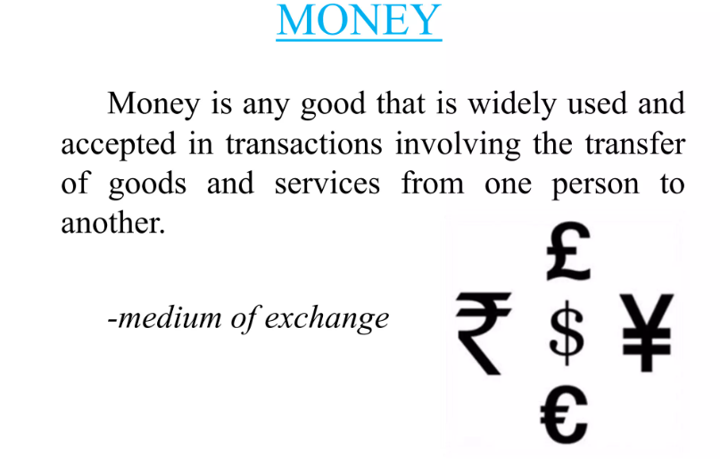
Unit-5

Slide 2
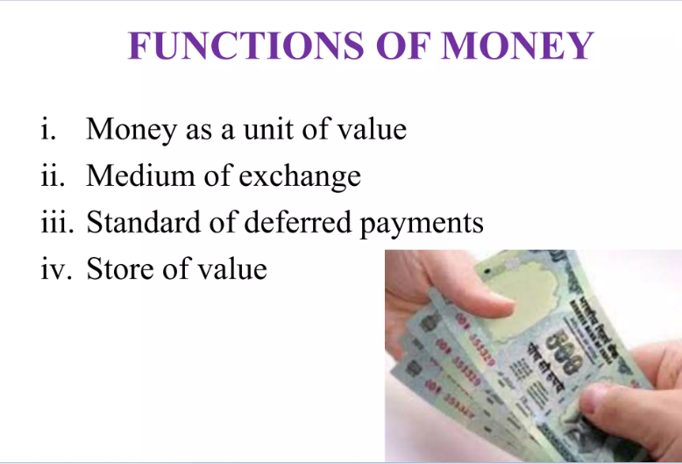
Transfer of Value

Slide 3
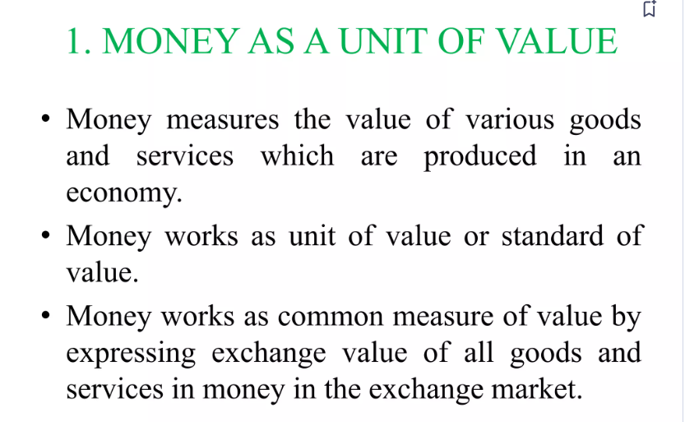

Slide 4
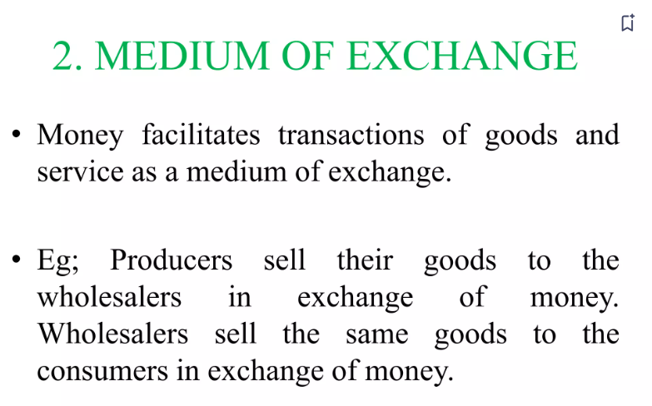


Slide 5
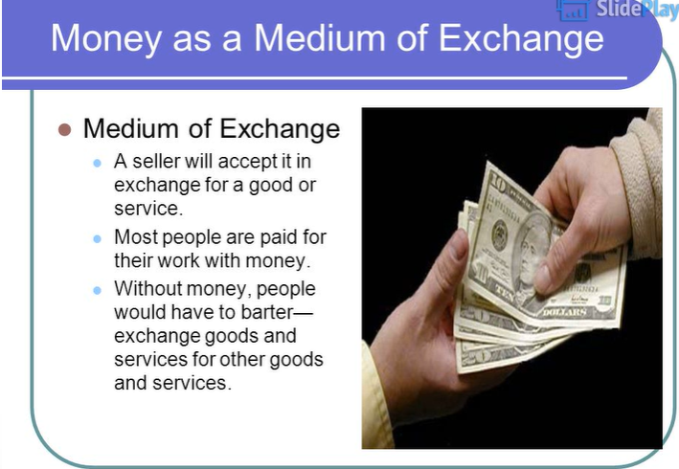

Slide 6
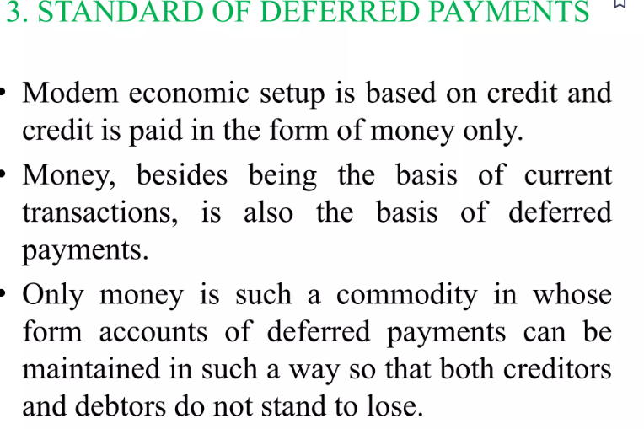

Slide 7
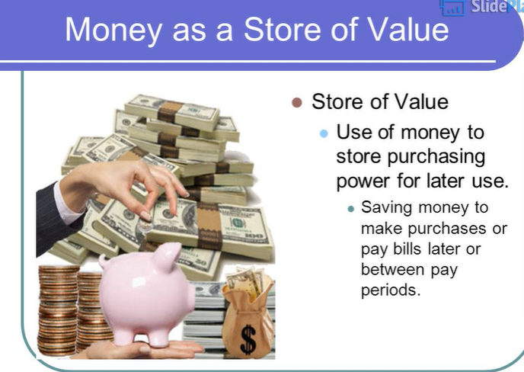
It was virtually impossible to store surplus value under barter system

Slide 8
Transfer of Value
The value paid in the form of money can also be transferred to another place
It facilitates buying and selling of goods not only in the domestic country but also in other parts of the world
E.g., A person earning in Bangalore can transfer it to his Parents in Punjab

Slide 9
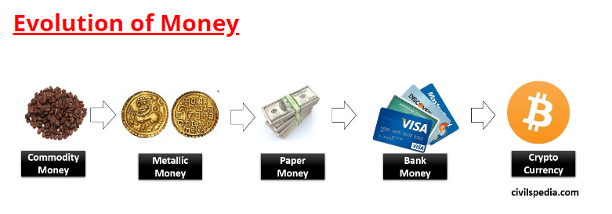

Slide 10
Types of Money
Money in barter system
Fiat money
Fiduciary money
Metalic money
Paper money

Slide 11
Money in barter system
People have been trading with each other even before the advent of money, coin, cash, currency, rupee, dollar, euro or Yuan. They exchanged goods and services with each other through the barter system. E.g.,
1 kg rice for 200 grams of tomatoes
1 kg tomatoes for 50 gm almonds and so on
Problems with Barter System
It can happen only with a Double-Coincidence of wants.
The problem of Divisibility of Value: In Barter System, you cannot always divide the value to buy whatever you want
Don’t favour concentration of wealth: Since all the wealth is perishable. E.g., one can’t store tomatoes for an extended period.
Search Cost / Cost of Transaction is high.

Slide 12
Fiat money
Fiat money is named after the Latin word fiat, which translates to ‘determined by authority’
That’s because the value of the currencies is set by government bodies, not by their relation to another asset
Fiat money is any global currency that is recognised as legal tender by its government
Examples include the Great British pound, United States dollar, euro, Australian dollar, Japanese yen and Chinese yuan

Slide 13
Fiduciary money
Fiduciary money is a money substitute that is often a written statement of debt or intent of payment
It is essentially a promise of money at a later date, which is backed by nothing more than trust between the two parties in a transaction
Examples of fiduciary money include paper cheques, banknotes, token coins or electronic credit
If you were to receive a cheque for £1,000, the paper itself is worthless, it only has value once it has been deposited into an account and converted into fiat money

Slide 14
Metallic Money
Coins made of some metal like gold, silver, copper etc.
Types of Metallic Money-
Standard Money: Whose value is equal to the value of metal contained in it (face value=intrinsic value)
It is unlimited legal tender and subject to free coinage. i.e., anybody can bring his metal and get coins made of it.
Usually made of some precious metals like gold, silver etc.
Token Money: its face value is higher than intrinsic value (value of metal)
It is usually made of cheaper metal
It is not subject to free coinage
E.g. Indian Rupee coin.

Slide 15
Paper Money
Paper money is the authorised medium of exchange in most countries.
These are banknotes of a country with specific values circulated for all manner of transactions. Paper money is also called as paper currency.
Types
Representative paper money: When the paper money is entirely backed by gold and silver reserves
Convertible paper money: Convertible paper money is when one can convert paper currencies into standard coins.
Inconvertible paper money: When one cannot convert paper money into standard coins or valuable metals
Fiat money: It is a type of inconvertible paper, declared to be legal tender govt. has no intrinsic value in itself.

Slide 16
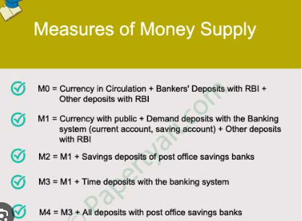
Narrow Money (Most Liquid)= M0,M1,M2
Broad Money(Less Liquid)=M3,M4

Slide 17
https://www.forex.com/en/news-and-analysis/types-of-money/#:~:text=Fiat%20money%20%E2%80%93%20the%20notes%20and,trust%20or%20promise%20of%20payment
chrome-extension://efaidnbmnnnibpcajpcglclefindmkaj/https://jncollegeonline.co.in/attendence/classnotes/files/1622608422.pdf

