Slide 1
JAVA: Working with Arrays

Slide 2
Introduction
An array is a container object that holds a fixed number of values of a single type.
In Java, all arrays are dynamically allocated.
Arrays are stored in contiguous memory [consecutive memory locations].
Since arrays are objects in Java, we can find their length using the object property length.
The variables in the array are ordered, and each has an index beginning with 0.

Slide 3
storage of arrays helps us randomly access the elements of an array [Support Random Access].
The size of the array cannot be altered(once initialized). However, an array reference can be made to point to another array.

Slide 4
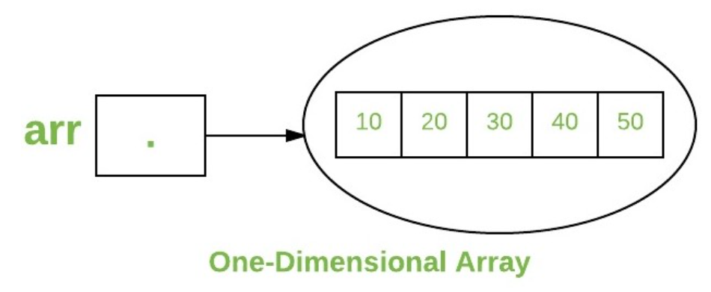
One-Dimensional Arrays:
The general form of a one-dimensional array declaration is
type var-name[];
OR
type[] var-name;
the element type for the array determines what type of data the array will hold.

Slide 5
Instantiating an Array in Java
When an array is declared, only a reference of an array is created.
To create or give memory to the array, you create an array like this:
The general form of new as it applies to one-dimensional arrays appears as follows:
var-name = new type [size];

Slide 6
Example:
int intArray[]; //declaring array
intArray = new int[20]; // allocating memory to array
OR
int[] intArray = new int[20]; // combining both statements in one

Slide 7
Note:
The elements in the array allocated by new will automatically be initialized to zero (for numeric types), false (for boolean), or null (for reference types).

Slide 8
Accessing Java Array Elements using for Loop
Each element in the array is accessed via its index. The index begins with 0 and ends at (total array size)-1. All the elements of array can be accessed using Java for Loop.
// accessing the elements of the specified array
for (int i = 0; i < arr.length; i++)
System.out.println("Element at index " + i + " : "+ arr[i]);

Slide 9
What happens if we try to access elements outside the array size?
JVM throws ArrayIndexOutOfBoundsException to indicate that the array has been accessed with an illegal index. The index is either negative or greater than or equal to the size of an array.

Slide 10
Multidimensional Arrays:
Multidimensional arrays are arrays of arrays with each element of the array holding the reference of other arrays. These are also known as Jagged Arrays. A multidimensional array is created by appending one set of square brackets ([]) per dimension.
Syntax :
datatype [][] arrayrefvariable;
or
datatype arrayrefvariable[][];

Slide 11
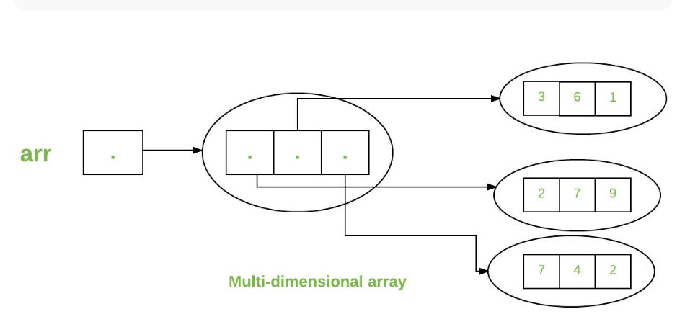
int [][] arr= new int[3][3];

Slide 12
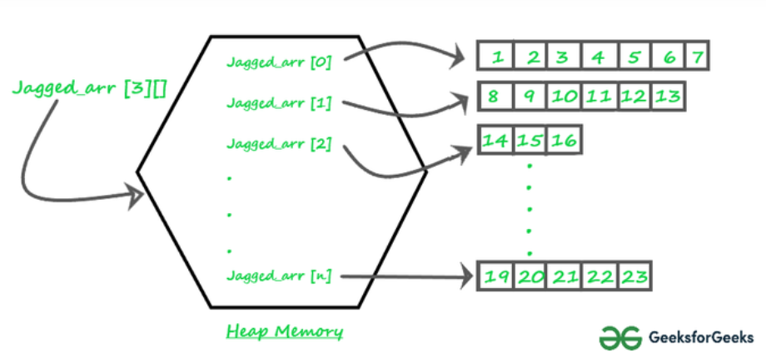
Jagged Array in Java
A jagged array is an array of arrays such that member arrays can be of different sizes, i.e., we can create a 2-D array but with a variable number of columns in each row.
These types of arrays are also known as Jagged arrays.
Jagged Arrays
Notes:
"ragged arrays" or "irregular arrays

Slide 13
Declaration and Initialization of Jagged array :
Syntax:
data_type array_name[][] = new data_type[n][]; //n: no. of rows
array_name[] = new data_type[n1] //n1= no. of columns in row-1
array_name[] = new data_type[n2] //n2= no. of columns in row-2
array_name[] = new data_type[n3] //n3= no. of columns in row-3
.
.
.
array_name[] = new data_type[nk] //nk=no. of columns in row-n

Slide 14
Jagged arrays have the following advantages in Java:
Dynamic allocation: Jagged arrays allow you to allocate memory dynamically, meaning that you can specify the size of each sub-array at runtime, rather than at compile-time.
Space utilization: Jagged arrays can save memory when the size of each sub-array is not equal. In a rectangular array, all sub-arrays must have the same size, even if some of them have unused elements. With a jagged array, you can allocate just the amount of memory that you need for each sub-array.
Flexibility: Jagged arrays can be useful when you need to store arrays of different lengths or when the number of elements in each sub-array is not known in advance.
Improved performance: Jagged arrays can be faster than rectangular arrays for certain operations, such as accessing elements or iterating over sub-arrays, because the memory layout is more compact.

Slide 15
Disadvantages of Jagged Arrays
increased complexity in the code

Slide 16
Java program to create a Jagged array in Java
Scanner sc = new Scanner(System.in);
int JaggedArray[][] = new int[3][];
JaggedArray[0] = new int[2]; //row 1 has 2 columns
JaggedArray[1] = new int[3]; //row 2 has 3 columns
JaggedArray[2] = new int[1]; //row 2 has 1 column
for(int i=0;i<JaggedArray.length;i++)
{
for(int j=0;j<JaggedArray[i].length;j++)
{
System.out.print("Enter element in array at
position["+i+"]["+j+"]::");
JaggedArray[i][j]=sc.nextInt();
}
}

Slide 17
Printing Values of Jagged Arrays
for(int i=0;i<JaggedArray.length;i++) { for(int j=0;j<JaggedArray[i].length; j++) { System.out.println(JaggedArray[i][j]+ " "); } System.out.println(""); }
USING ENHANCED LOOP
for (int k[] : JaggedArray) { for (int l : k) { System.out.println(l + " "); } System.out.println(""); }

