Slide 1
DC COURSE PROJECT -01
GUIDE:RAJESHWARI MAM

Slide 2
TEAM NUMBER-10
MEMBERS NAME
USN
01:SAHIL NADAF
02:AMIR NADAF
03:SHRINIVAS DESAI
04:PAVITRA M
01:01FE22BEC135
02:01FE22BEC136
01FE22BEC137
01FE22BEC138

Slide 3
CONTENTS
01:PROBLEM STATEMENT OF COURSE PROJECT
02:TIMING DIAGRAM WITH MOV INSTRUCTION
03:LOGIC CIRCUIT
04:TIMING DIAGRAM GRAPH
05:NUMBER OF CYCLES REQUIRED TO DO TRANSFER
06:SIMULATION

Slide 4
PROBLEM STATEMENT
DESIGN A DIGITAL CIRCUIT WHICH PERFORMS THE FOLLOWING INSTRUCTION
DRAW THE TIMING DIAGRAM AND COMMENT ON NUMBERS OF CYCLES REQUIRED TO DO THE TRANSFER ,ALSO DETERMINE THE NUMBER OF CYCLES FOR THE TRANSFER

Slide 5
FEATURES AND SPECIFICATION
FEATURES
SPECIFICATION
01:TOUCH/SWITCH BASED I/P
02:INSTRUCTIONS
03:DIGITAL DISPLAY
SWITCH
MOV R3,R2 AND MOV R1,R2 USING CA(COMMON ANODE)

Slide 6
UNDERSTANDING OF PROBLEM STATEMENT
01:OBJECTIVE:-DESIGN A DIGITAL CIRCUIT THAT PERFORMS THE INSTRUCTION “MOV R3,R1” AND “MOV R3,R2”USING UNIVERSAL SHIFT REGISTERS AND DISPLAY THE OUTPUT ON A COMMON ANODE LCD 7-SEGMENT DISPLAY USING A 7447 IC,USR IC NUMBER IS 74194
02:COMPONENTS:-UTILIZE 74194 USR FOR DATA TRANSFER AND TO LOAD DATA INTO THE REGISTER AND A 7447 IC TO CONVERT DATA FOR THE COMMON ANODE DISPLAY 555 TIMER IC.

Slide 7
TIMING DIAGRAM WITH MOV INSTRUCTION
INSTRUCTION:MOV R3,R1 AND MOV R3,R2
EX:MOV R3,R1
GIVEN INSTRUCTION COPY THE CONTENTS OF THE SOURCE REGISTER INTO THE DESTINATION REGISTER AND THE CONTENTS OF THE SOURSE REGISTER ARE NOT ALTERED
OPCODE:MOV
OPERAND:R3 AND R1
R3 IS THE DESTINATION RESISTOR AND R1 IS THE SOURCE RESISTOR WHOSE CONTAINS NEED TO BE TRANSFERED TO THE DESTINATION RESISTOR

Slide 8
ALGORITHM
THE INSTRUCTION R3,R1 IS THE 1 BYTE ; THEREFORE THE COMPLETE INSTRUCTION WILL BE STORED IN A SINGLE MEMORY ADDRESS
EX:4000:MOV R3,R1
ONLY OPCODE FETCHING IS REQUIRED FOR THIS INSTRUCTION AND THUS WE NEED 4T STATES FOR THE TIMING DIAGRAM
FOR THE OPCODE FETCH THE IO/M =0,S1=1,S0=1
IO/M:IT IS THE SIGNAL INDICATES WHETHER THE CPU IS ACCESSING MEMORY OR I/O DEVICES

Slide 9
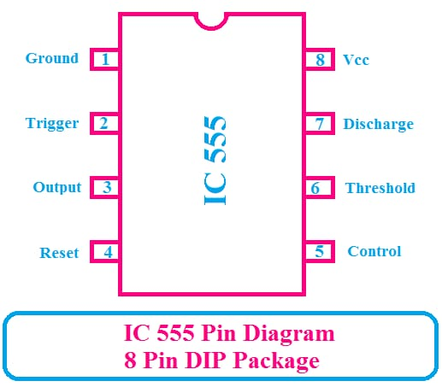
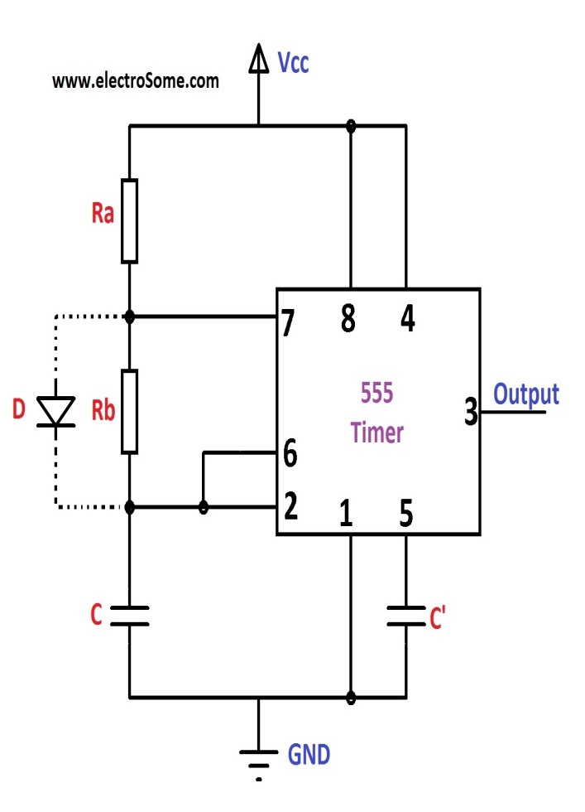
LOGIC CIRCUIT(CLOCK GENERATION):-

Slide 10
CALCULATION OF CLOCK
F=1KHz
T=1/f=1sec
For 60%duty cycle
duty cycle=Ton/Toff*100
60=Ton/Toff*100
Ton=0.6sec
Toff=1-0.6=0.4 sec
Toff=0.693RBC,LET C=100uf
RB=Toff/0.693=5.7K0hm
Ton=0.693(RA+RB)C
RA=2.9kohm

Slide 11
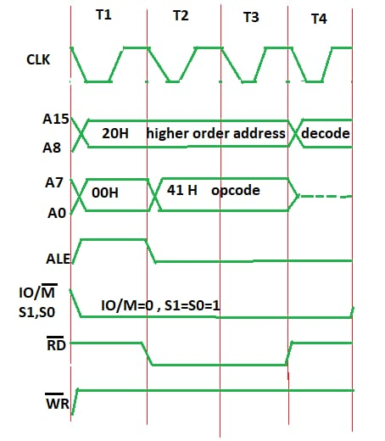
TIMING DIAGRAM
IN OPCODE FETCH(T3-T4 T STATES)

Slide 12
TIMING DIAGRAM EXPLAINATION
00:-LOWER BIT OF ADDRESS WHERE THE OPCODE IS STORED ,i,e:00
20:HIGHER BIT OF ADDRESS WHERE THE OPCODE IS STORED ,I,e:20
ALE:PROVIDES SIGNALS FOR MULTIPLEXED ADDRESS AND DATA BUS.ONLY IN T1 IS IT USED AS AN ADDRESS BUS TO FETCH A LOWER BIT OF ADDRESS OTHERWISE IT WILL BE USED AS THE DATA BUS.
RD:-SIGNAL IS 1 IN T1 AND T4 AS NODATA IS READ BY MICROPROCESSOR .SIGNAL IS 0 INT2 AND T3 BECAUSE HERE THE DATA IS READ BY A MICROPROCESSOR
WR:-SIGNAL IS 1 THROUHGOUT ,NO DAT IS WRITTEN BY A MICROPROCESSOR .
IO/M:-SIGNAL IS 1 THROUGHOUT BECAUSE THE OPRATION IS PERFORMING ON MEMORY
S0 AND S1 :-BOTH ARE 1 IN CASE OF OPCODE FETCHING
S0 AND S1 ARE STATUS BIT.

Slide 13
NUMBER OF CYCLES REQUIRED TO DO THE TRANSFER
A MACHINE CYCLE IS THE TIME TAKES FOR THE MICROCONTROLLER TO FETCH ,DECODE AND EXECUTE AN INSTRUCTION .THE LENGTH OF A MACHINE CYCLE DEPENDS ON THE CLOCK FREQUENCY OF THE MICROCONTROLLER
THE MOV INSTRUCTION MOV R3,R1 COPIES THE CONTENTS OF REGISTER R3 TO R1 .THIS IS ALSO A ONE-BYTE INSTRUCTION THAT TAKES ONE MACHINE CYCLE TO EXECUTE
THEREFORE ,THE TOTAL NUMBER OF CYCLES REQUIRED TO DO THE TRANSFER OF MOV R3,R1 AND MOV R1,R2 IS TWO MACHINE CYCLES.THE NUMBER OF CYCLES REQUIRED FOR THE TRANSFER IS THE SAME AS THE NUMBER OF CYCLES REQUIRED TO DO THE TRANSFER.
THE CLOCK SIGNAL IS ASSUMED TO BE 12 mHz,WHICH MEANS THAT EACH MACHINE CYCLE IS 1usec
But the 8051 microcontroller has clock frequency 11.0592mHz

Slide 14
CALCULATION OF MACHINE CYCLE
1machine cycle=12 clock pulse
1machine cycle=11.0592mHz/12
1machine cycle=921.6KHz
T=1/f=1/921.6KHz
T=1.085usec
Instruction machine cycle time
Mov R3,R1 1 1*1.085usec
Mov R1,R2 1 1*1.085usec
Total number of machine cycles=1+1=2
T=2*1.085usec=2.17usec

Slide 15
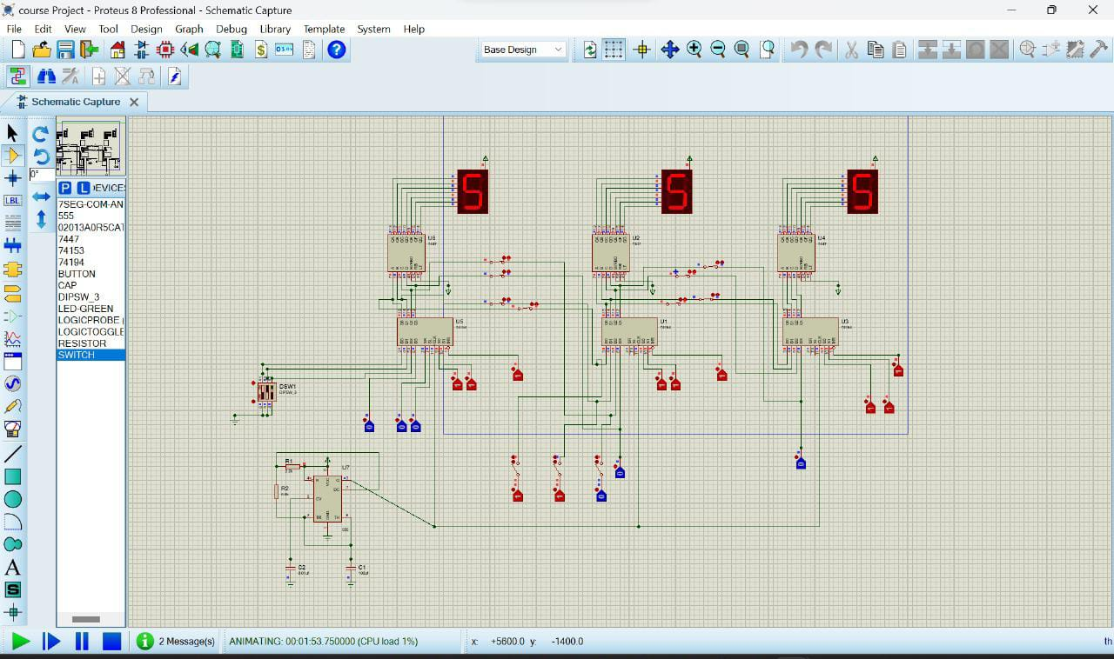
SIMULATION

