Slide 1
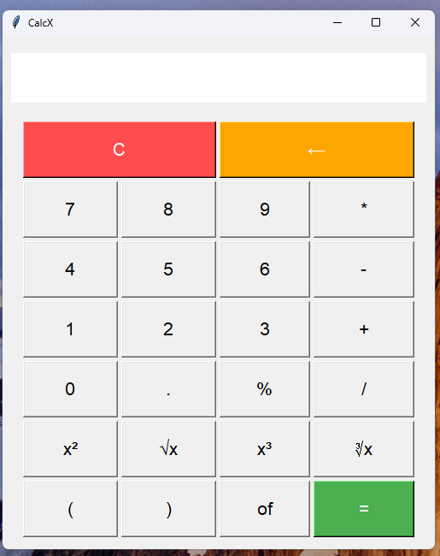
NEXT HIKES IT SOLUTIONS
PROJECT : BUILDING BASIC CALCULATOR
PRESENTED BY : SAHIL KUMAR SINGH

Slide 2
INTRODUCTION
IMPROVES SPEED & ACCURACY IN CALCULATIONS.
PERFORM MATHEMATICAL OPERATION FAST.
IMPORTANCE IN DAILY LIFE & VARIOUS FIELDS.
TYPES : BASIC ,FINANCIAL ETC.
WIDELY USED IN EDUCATION ,FINANCE ETC.

Slide 3
FUNCTIONS
BODMAS STANDS FOR BRACKETS,OF,DIVISION,MULTIPLICATION,ADDITION,SUBTRACTION.
INCLUDES FEATURES LIKE CLEAR (C),BACKSPACE (←),DECIMAL(.).
INCLUDES EVALUTES EXPRESSION USING BODMAS LOGIC.
IMPROVES ACCURACY IN SOLVING MULTI STEP PROBLEMS.
INCLUDE SQUARE,CUBES,SQUARE ROOT,CUBE ROOT ETC
EXAMPLE: 5+2×(30/10) = 11, not 21.

Slide 4
WHAT CHALLENGE FACE
DEBUGGING LOGICAL & SYNTAX ERRORS DURING DEVELPOMENT.
DESIGNING A CLEAN AND USER –FRIENDLY INTERFACE.
IMPLEMENTING THE CORRECT ORDER OF OPERATIONS.
MANAGING REAL TIME INPUT & OUTPUT DISPLAY.
ENSURES RESPONSIVE BUTTON FUNCTIONALITY.

Slide 5
LIBRARY
Tkinter – FOR GUI (GRAPHICAL USER INTERFACE)
math – FOR MATHEMATICAL FUNCTIONS (e .g ., SQUARE ,ROOT ETC)
eval() function – TO EVALUATE EXPRESSIONS (USED WITH CAUTION)

Slide 6
WHAT REFERENCE FOLLOW
OFFICIAL DOCUMENTATION OF PROGRAMMING LANGUAGE.
YOUTUBE TUTORIALS ON CALCULATOR PROJECT.
TUTORIAL POINTS FOR UNDERSTANDING GUI
GITHUB REPOSITORIES FOR INSPIRATION AND CODE STRUCTURE.
W3SCHOOLS FOR LEARNING SYNTAX AND LOGIC.

Slide 7
THANK YOU
GRATEFUL FOR THE GUIDANCE AND SUPPORT FROM OUR MENTOR.
THANK YOU FOR YOUR TIME AND ATTENTION.
LOOKING FORWARD TO FEEDBACK AND SUGGESTIONS.
ALSO THANKFUL TO OUR COMPANY FOR GIVING A PROJECT.
THANK YOU ONE AGAIN.

