Slide 1
Revenue Growth &
Personalization Analytics
Dashboard
Sales Forecast · Customer Segments · Product Recommendation System · Product & Country Revenue
Prophet Forecasting
RFM Segmentation
20K Customers
33.5K Orders

Slide 2
Project Overview
Objective
Build an end-to-end e-commerce analytics platform: clean raw data, engineer RFM customer features and product features, segment customers via KMeans, generate personalized product recommendations using LightFM collaborative filtering, forecast daily revenue with Facebook Prophet, and surface all insights in a live interactive Streamlit dashboard.
1
2
3
4
5
6
Data
Cleaning
Feature
Engineering
RFM
Segmentation
Recommendation
Engine
Sales
Forecasting
Streamlit
Dashboard
Raw Datasets
customers.csv
orders.csv
order_items.csv
products.csv
reviews.csv
sessions.csv
20,000 customers
33,580 orders
59,090 line items
1,197 products
10,780 reviews
120,000 sessions

Slide 3
Data Cleaning
data_cleaning.ipynb
1
2
3
Load Raw Data
Remove Duplicates
Convert Date Columns
7 CSV files loaded:
customers, events, orders,
order_items, products,
reviews, sessions
drop_duplicates() on all
7 datasets — ensures no
duplicate rows in pipeline
signup_date, order_time,
review_time, start_time
→ pd.to_datetime()
4
5
6
Handle Missing Values
Normalise Product Text
Save Cleaned Files
events: product_id→0,
qty→1, cart_size→0,
payment→'none'
name & category:
.str.lower().str.strip()
for clean joins downstream
7 CSVs saved to
/data/processed/
ready for next pipeline step

Slide 4
Feature Engineering
customer_segmentation.ipynb
Customer Features (RFM)
Product Features
recency
Days since last order
popularity_score
Sum of quantities sold per product
frequency
Number of orders placed
avg_rating
Mean review rating from reviews.csv
monetary
Total USD spend
price_band
Low / Medium / High via pd.qcut(q=3)
RFM_total
Sum of R + F + M scores
margin_usd
price_usd − cost_usd
customer_segment
Rule-based label (4 types)
Interaction Matrix
orders + order_items merged
groupby customer_id × product_id
→ purchase_count (58,969 rows)
Sparse user-item matrix → LightFM input

Slide 5
Recommendation Engine
recommendation_engine.ipynb
Collaborative Filtering
Content-Based Filtering
Hybrid Strategy
LightFM · WARP loss
Cosine Similarity
Cold-start handled
→ interaction_matrix → scipy coo_matrix
→ Product feature matrix from
category + price_band (one-hot)
→ hybrid_recommendation(user_id)
→ customer_id & product_id → index maps
→ cosine_similarity() across
1,197 products
→ Known user → LightFM scores
→ LightFM(no_components=30,
learning_rate=0.05, loss='warp')
→ similar_products(pid, top_n=5)
returns nearest neighbours
→ New user → top-10 popular
products by purchase_count
→ model.fit(epochs=20, num_threads=4)
→ Fallback for item-level
similarity queries
→ Output: recommended_products.csv
81,340 customer-product pairs
→ model.predict() scores all items
per user → top-5 selected
Output → recommended_products.csv · 81,340 rows · customer_id + recommended_product · Enriched with product_name & category in dashboard

Slide 6
Business KPIs
Total Revenue
Total Orders
Total Customers
$4,493,217
33,580
20,000
Post-discount
Unique orders
Registered
Active Customers
Avg Order Value
16,268
$133.81
Placed ≥1 order
Per order

Slide 7
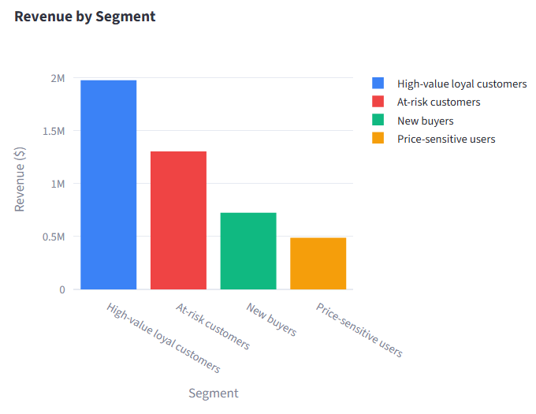
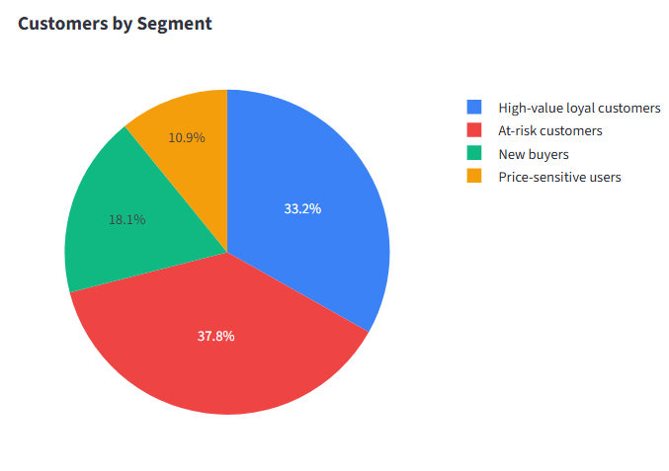
Revenue & Customers by Segment
High-value loyal 5,397 customers · $1,975,934
At-risk 6,155 customers · $1,304,494
New buyers 2,950 customers · $725,305
Price-sensitive 1,766 customers · $487,484

Slide 8
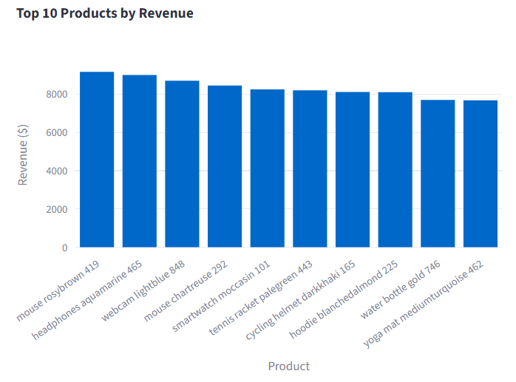
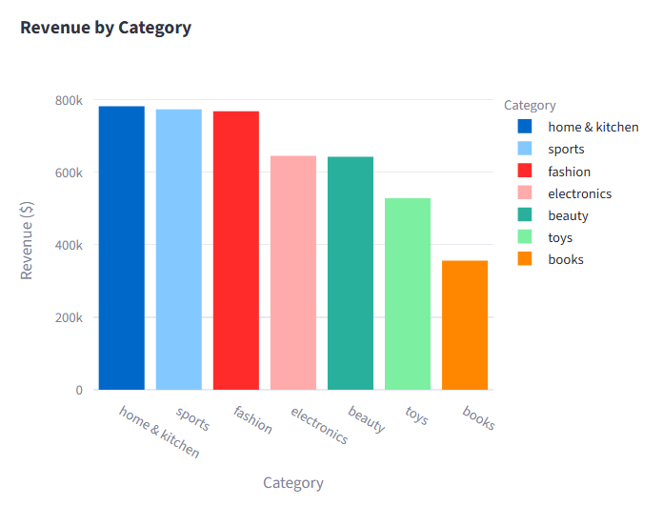
Top Products & Revenue by Category

Slide 9
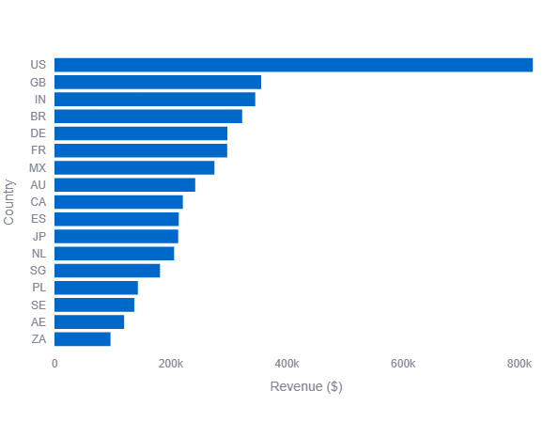
Revenue by Country
1. United States(US) leads at $823K - nearly 2. Great Britain (GB) $355K

Slide 10
Sales Forecast — Facebook Prophet
30 Days Forecasting
Projected Revenue
Avg Daily Revenue
Peak Forecast Day
Lowest Forecast Day
$62,240
$2,075
$2,590
$1,687
60 Days Forecasting
Projected Revenue
Avg Daily Revenue
Peak Forecast Day
Lowest Forecast Day
$121,471
$2,025
$2,590
$1,645
90 Days Forecasting
Projected Revenue
Avg Daily Revenue
Peak Forecast Day
Lowest Forecast Day
$189,542
$2,106
$2,906
$1,645

Slide 11
Dashboard Features & Architecture
5 KPI Cards
Multi-select Filters
Total Revenue · Orders · Total Customers
(20K) · Active Customers · Avg Order Value
Filter by Country, Category & Segment
simultaneously with Select All / Clear
5 Dashboard Tabs
Prophet Forecast
Sales Forecast · Segments · Recommendations
· Top Products · Business Insights
30 / 60 / 90-day selectable horizon
with ±8% confidence band
Segment Analysis
Recommendation Engine
4 clean RFM segments — Regular Customers
excluded, '0' segment removed
Collaborative filtering · product recs
enriched with name & category

Slide 12
Key Insights
Summary of findings from the analytics dashboard
Top Revenue Country
United States — $823,420 (18.3% of total revenue)
Top Revenue Product
Mouse Rosybrown 419 — $9,152 (Electronics)
Top Revenue Category
Home & Kitchen — $781,434, ahead of Sports & Fashion
Highest Revenue Segment
High-value loyal customers — $1,975,934 (44% of revenue)
Monthly Growth
Average 0.75% month-over-month revenue growth

