Slide 1


Minor Project
IntelliScreen: Context-Aware AI Proctoring & Assessment Platform
Presented by:
R2142231198 - Harsh Kumar
R2142230855 - Sahil Agarwal R2142230254 - Omkar Jha
R2142230676 - Nishkarsh Gupta
Mentored By
Dr. Baldivya Mitra

Slide 2
Table of Contents
Introduction
Problem Statement
Literature Review
Objectives
Methodology
References

Slide 3
Introduction
Project Overview
• IntelliScreen is a context-aware, AI-powered online examination and proctoring platform designed specifically for secure, large-scale remote assessments (such as MCQs and text-based exams).
• It operates using a scalable microservice architecture to ensure maximum privacy, high concurrency, and ultra-low latency.
• Unlike legacy systems, IntelliScreen evaluates candidate behavior using a unique temporal sliding window rather than strict, instantaneous rule-based bans, minimizing false alarms from natural cognitive behaviors.

Slide 4
Introduction
Motivation
Remote hiring and online education at scale make manual proctoring heavily inefficient.
Traditional proctoring often misinterprets natural cognitive behavior as cheating.
Need for context-aware screening combining visual behavior with temporal reasoning to prevent false bans.
Problem Statement
High false alarm rates caused by instantaneous thresholding without time-window smoothing.
Lack of explainability (educators receive a binary "cheating suspected" label without an auditable breakdown).
Inability to correlate concurrent visual signals to accurately determine malpractice severity.

Slide 5
Introduction
Area of Application
Human Resources (Talent Acquisition): Automated technical screening and initial candidate shortlisting.
EdTech & Higher Education: Secure, context-aware remote proctoring for online exams and credentialing.
Corporate Compliance: Evaluating employee engagement and comprehension during mandatory remote training.
Dataset and Input Format
Pretrained Datasets:
  COCO Dataset (80 classes) used for YOLOv8n object detection.
  MediaPipe 3D Synthetic Face Model (canonical 3D facial coordinates in mm).
  WIDER FACE dataset used in OpenCV YuNet training.
Input: Live camera feed via HTML5 MediaDevices (640 × 480 JPEG canvas snapshots streamed via Socket.IO/WebRTC at 2 FPS (500ms intervals))

Slide 6
Literature Review
Vision-Based Behavior & Gaze Analysis
Multi-Task Anomaly Detection (Huy et al.)
Decouples spatial object detection (YOLOv12) from temporal behavior classification (frame-wise CNNs).
Achieves 97.15% overall accuracy, outperforming sequence models on brief cues.
Avoids “temporal dilution,” a key weakness of sequence-based approaches.
Proctor Net (Tejaswi et al.)
Maps 3D eye gaze via stacked Hourglass models.
Tracks verbal communication using a Mouth Aspect Ratio (MAR) heuristic.
Serves as a robust architectural baseline for our system.
Gaze Generalization Limits (Ghosh et al.)
Highlights generalization gaps in deep gaze models under unconstrained environments.
Emphasizes head-pose integration and personalized calibration to reduce angular error.

Slide 7
Literature Review
Multimodal & Human-in-the-Loop Systems
Explainable Fusion Framework (Kassab et al.)
Ante-hoc explainable framework fusing temporal visual tracking with structured anomaly evaluation.
Replaces black-box classifiers with transparent constructs that separate cognitive effort from anomalies.
Hybrid Human-ML Decision Framework (Shih et al.)
Maps predicted gaze vectors onto interactive 2D plots for human review.
Prevents ML-only false positives caused by natural cognitive reflection.
Real-Time Full-Stack Blueprint (Dhawale et al.)
Integrates video streaming, coding environments, and client-side neural networks (face-api.js) in a MERN stack.
Maintains sub-100ms latency while preserving biometric privacy.

Slide 8
Literature Review
SWOT ANALYSIS
Strengths Temporal smoothing prevents false alarms Explainable audit logs Lightweight edge models Fair 3-strike rule with cooldown. | Weaknesses Dependent on webcam lighting and stable network connection for frame transmission.
Opportunities Audio speaker diarization integration. Multi-lingual candidate speech evaluation. Integration with Canvas/Moodle LMS. | Threats Sophisticated hardware bypasses (HDMI splitters, smart glasses).

Slide 9
Objectives
Develop a context-aware proctoring model using real-time video streams and browser-level event monitoring.
Detect suspicious testing behaviours while minimizing false positives caused by natural cognitive effort.
Provide context-aware temporal reasoning for explainable evaluation of candidate testing behavior and exam integrity.
Provide a secure full-stack web prototype with an interpretable recruiter dashboard.

Slide 10
Methodology
Reference Software Model:-
Process Model: Iterative & Incremental (Agile-Scrum Framework)
  Sprint-based delivery with continuous empirical threshold tuning.
  Early de-risking of computer vision pipelines before UI integration.
Architectural Style: Decoupled Microservices & Event-Driven Architecture (EDA)
  Client Layer: React 18 SPA with HTML5 camera capture, canvas streaming, and event monitoring.
  Gateway Layer: Node.js / Express 5 with Socket.IO room-based event dispatch.
  AI Microservice: Python FastAPI with a Pipes-and-Filters Vision DAG.
  Persistence Layer: MongoDB document store for test configurations and auditable anomaly logs.
State Machine Integration: Automated 3-Strike Finite State Machine (FSM) with a 15-second fairness cooldown mechanism.

Slide 11
Methodology: Core Technical Concepts
Technical Concepts:
Multi-Metric Identity Verification: Live landmark-based geometric matching (inter-eye distance, face area, aspect ratio) against a baseline check-in photo.
Face Localization: OpenCV YuNet (convolutional face detector via ONNX).
Dense Mesh & Iris Landmarks: MediaPipe FaceLandmarker with 478 3D vertices and Eye Aspect Ratio (EAR).
Head Pose Estimation: Perspective-n-Point (PnP) algorithm with Levenberg-Marquardt optimization matching 2D facial anchors to a 3D anthropometric face model.
Gaze Tracking: Dampened iris horizontal/vertical displacement ratios fused with 3D pose vectors.
Unauthorized Object Detection: Ultralytics YOLOv8n (COCO object classification for phones, books, laptops, secondary persons).
Temporal Event Tracking: Debounced condition state machine with a 30-second rolling sliding window.

Slide 12
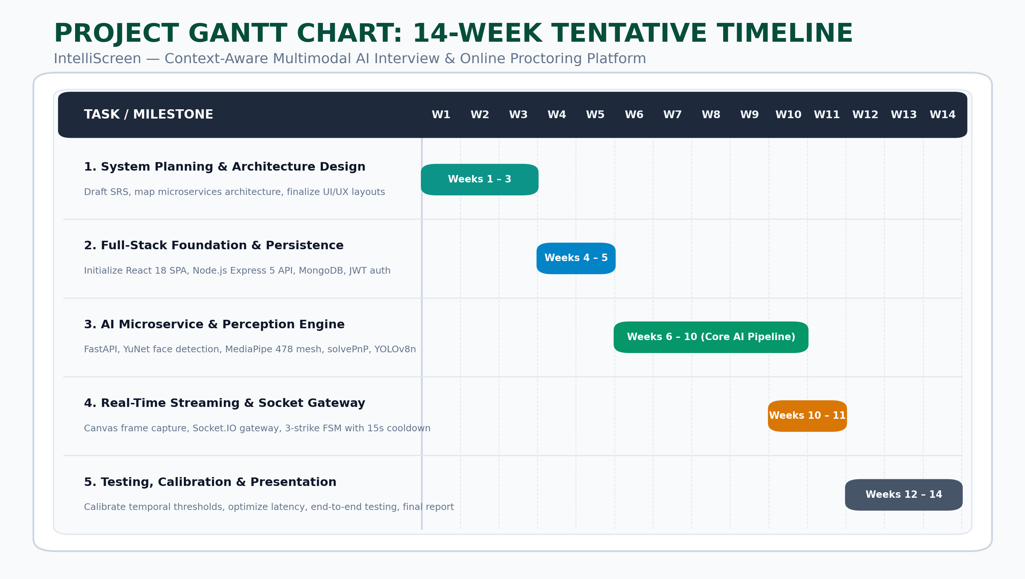

Slide 13
Methodology
Working Module:
Module 1: Client Examination & Canvas Streamer (React 18)
5-Step Smart Check-In wizard; captures baseline biometric photos.
Ingests webcam feed; extracts 640×480 JPEG snapshots at 2 FPS; monitors tab switching & full-screen exits.
Module 2: Socket.IO Gateway & 3-Strike FSM (Node.js)
Bidirectional room broker; executes the 3-strike state machine with a 15-second fairness cooldown; handles auto- termination.
Module 3: Computer Vision Perception Pipeline (Python / OpenCV)
Sequential execution of YuNet face detection, MediaPipe 478 mesh, solvePnP 3D head pose, iris gaze vectors, and YOLOv8n object detection.
Module 4: Temporal Reasoning & Hysteresis Engine
Debounced condition trackers + 30-second rolling sliding window; eliminates false alarms from natural cognitive pauses (<2.5s).
Module 5: Suspicion Scoring & Identity Matching
Translates temporal violation ratios into a 0–100 score and cross-references live facial geometry against the check-in baseline.
Module 6: Educator Analytics & Audit Trail (MongoDB / React)
  Exam authoring, shareable link management, candidate grading, and chronological anomaly timeline review.

Slide 14
Methodology
Attained Deliverable:
Multi-Model Computer Vision Pipeline: Real-time face detection (YuNet), 478-point landmark mesh (MediaPipe), 3D head pose via solvePnP, iris gaze tracking, and secondary device detection (YOLOv8n).
Temporal Reasoning Engine: 30-second sliding-window buffer that eliminates false alarms by distinguishing brief natural pauses (<2.5s) from sustained malpractice (≥4s).
3-Strike Enforcement FSM: Real-time Socket.IO state machine featuring a 15-second fairness cooldown and automatic test termination on Strike 3.
Full-Stack Assessment Platform: Production-ready React 18 exam portal, Node.js/Express 5 REST API, and MongoDB educator dashboard with chronological audit timelines.
Ultra-Low Bandwidth Architecture: 1.5 FPS canvas frame streaming (640×480 JPEG) cutting bandwidth consumption by >90% (<30 KB/s) with sub-100ms inference latency.

Slide 15
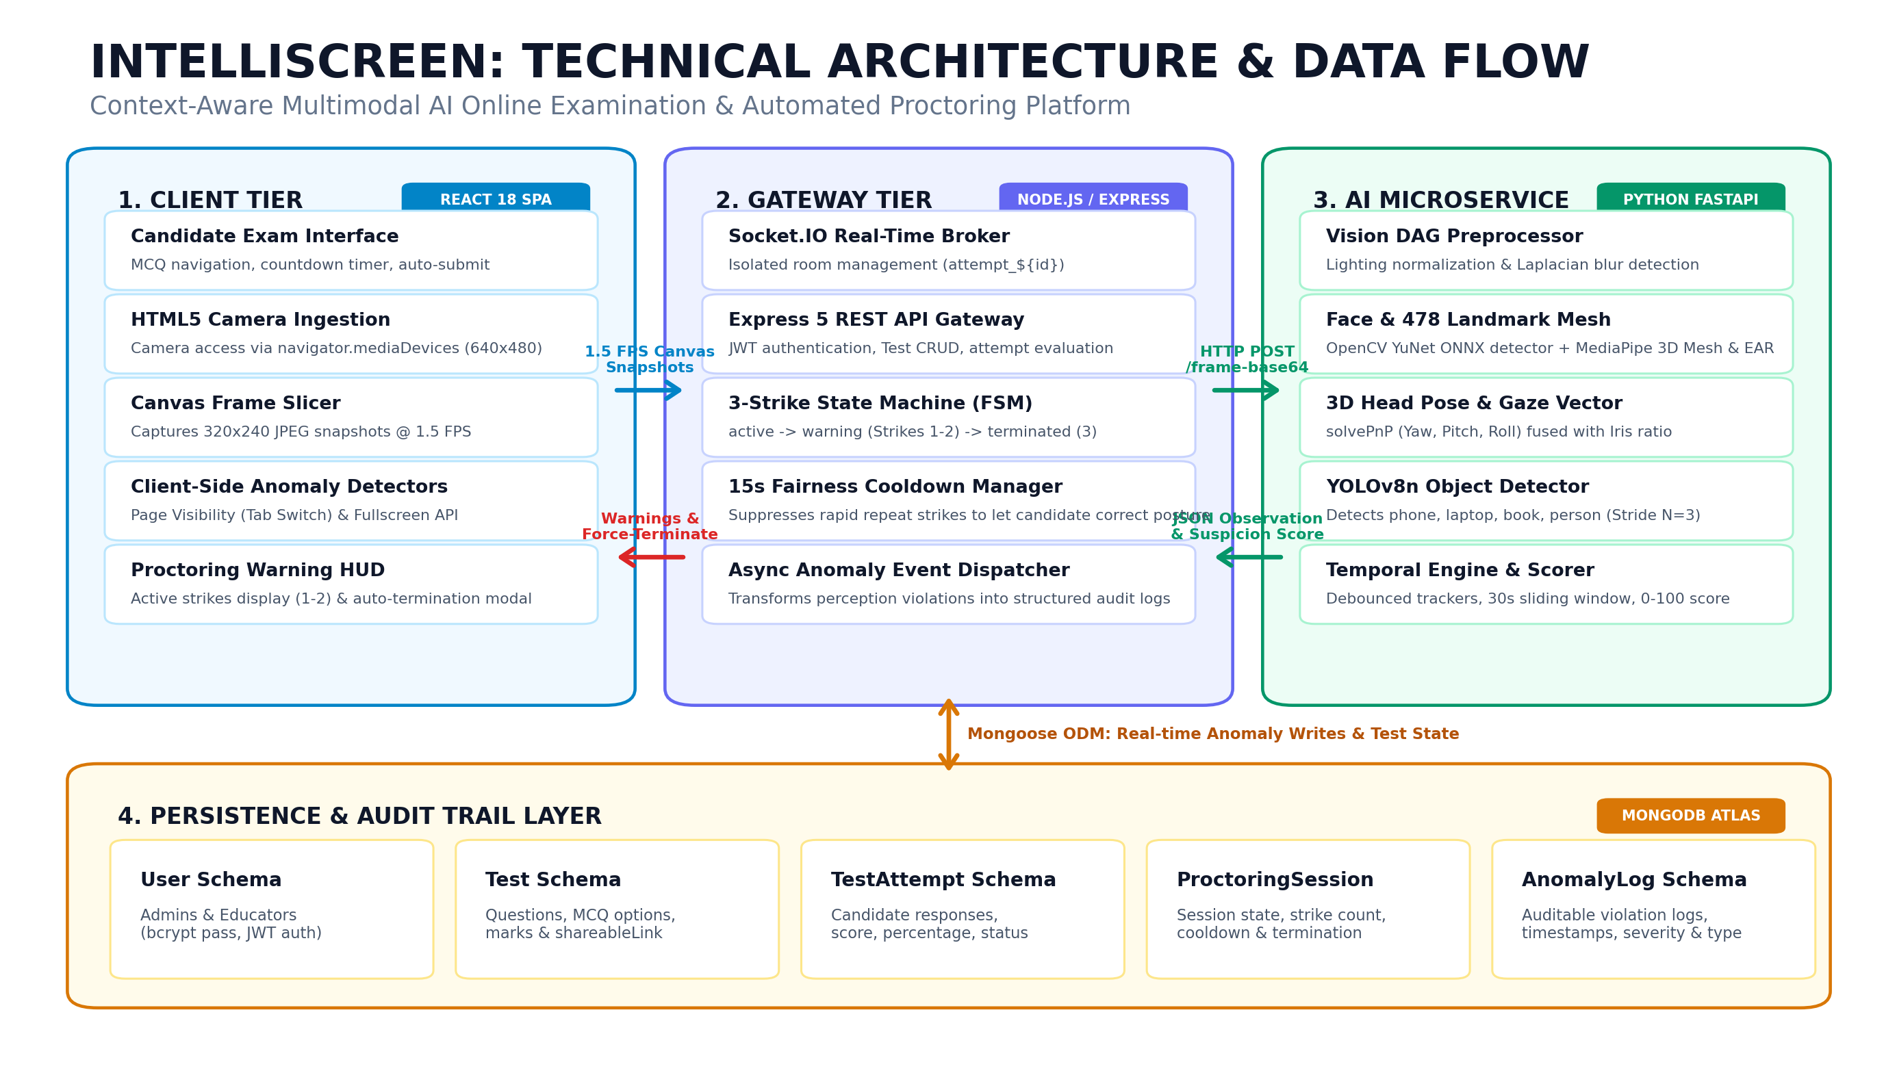
Working Model

Slide 16
References
1. K. Kassab, A. Kashevnik, and I. Shoshina, "Multi-Modal Method for Candidate Interview Assessment Based on Computer Vision and Large Language Models," Big Data Cogn. Comput., vol. 10, no. 4, 106, 2026.
2. P. Tejaswi, S. Venkatramaphanikumar, and K. V. K. Kishore, "Proctor Net: An AI Framework for Suspicious Activity Detection in Online Proctored Examinations," Measurement, vol. 206, 112266, 2023.
3. Y.-S. Shih, Z. Zhao, C. Niu, B. Iberg, J. Sharpnack, and M. B. Baig, "Al-assisted Gaze Detection for Proctoring Online Exams," arXiv preprint arXiv:2409.16923, 2024.
4. E. Gülen and Y. Göktaş, "Facial expression recognition for investigating attention and affective states in synchronous online higher education," Education Technology Research and Development, 2026, doi: 10.1007/s11423-026-10631-0.
5. S. Ghosh, A. Dhall, M. Hayat, J. Knibbe, and Q. Ji, "Automatic Gaze Analysis: A Survey of Deep Learning Based Approaches," IEEE Transactions on Pattern Analysis and Machine Intelligence, vol. 46, no. 1, pp. 61-84, Jan. 2024, doi: 10.1109/TPAMI.2023.3321337.
6. S. Dhawale et al., "HireSafe: A Unified Platform for Meetings and Secure Technical Interviews," 2026 IEEE 1st International Conference on Intelligent Technologies for a Sustainable and Inclusive Future (ICITSIF), Indore, India, 2026, pp. 336-341, doi: 10.1109/ICITSIF69060.2026.11608440.

Slide 17

Thank You!

