Slide 1
Leveraging Machine Learning for Building Layouts
210040054 Harendra Pratap Singh Baghel
210040098 Mohak Vyas
210040125 Rohan Choudhary
210040131 Sahil Barbade

Slide 2
OVERVIEW
.
We have been provided with an
architecture company’s
building layout designs and we
have to classify those images and
predict the class upon giving
dimensions and other relevant
Information about image

Slide 3
INDEX
Introduction of project
Preprocessing of image
Creation of dataframe
Feature Engineering
Classification of image(approach1)
Classification of image(approach2)
Classification of image(approach3)
Classification based on Low, Medium, High Complexity
EDA
Prediction of family
What else can be done
Major Learnings

Slide 4
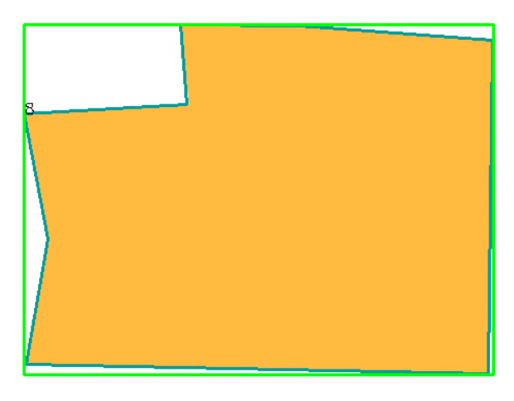
Preprocessing of image
Converted the image to grey scale
Applied gaussian blur for noise reduction
Used canny edge detection to identify object boundaries
Applied thresholding to create binary image( black and white )
Identified Contours

Slide 5
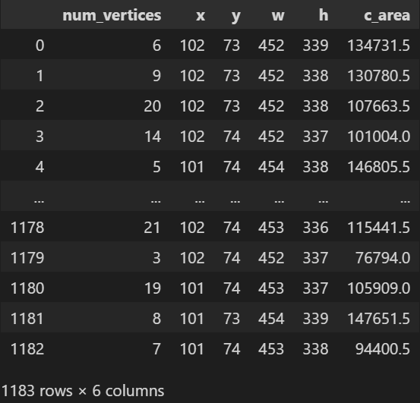
Creation of Data Frame
Iterated through image details in a loop
Extracted specific properties like bounding box coordinates (x, y), width, heigth), number of vertices, and contour are.
Created a new dictionary with these extracted properties as key-value pairs
Appended this dictionary into the list
Converted the list into dataframe

Slide 6
Feature Engineering
Calculated bounding box area as width(w) * height(h)
Created feature – c_area/b_area representing the ratio of
contour area and bounding box area
Created a feature solidity – contour area / convex hull area
Created a feature circularity - (4 * pi * contour area) / (perimeter ** 2)

Slide 7
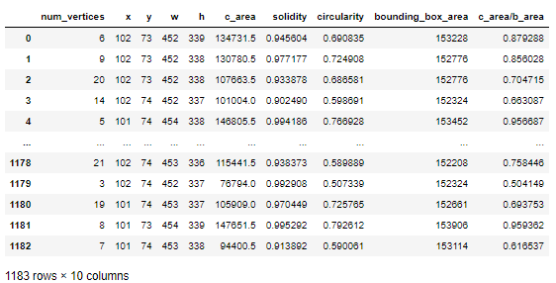

Slide 8
Classification of images(Approach1)
K-means using basic geometric features
Applied standardscalar to standardize the dataset
that we have created
Used Elbow method to find optimal number of
clusters(4, in our case)
Plotted graph of Elbow method
Plotted K-Means for optimal case(4)

Slide 9
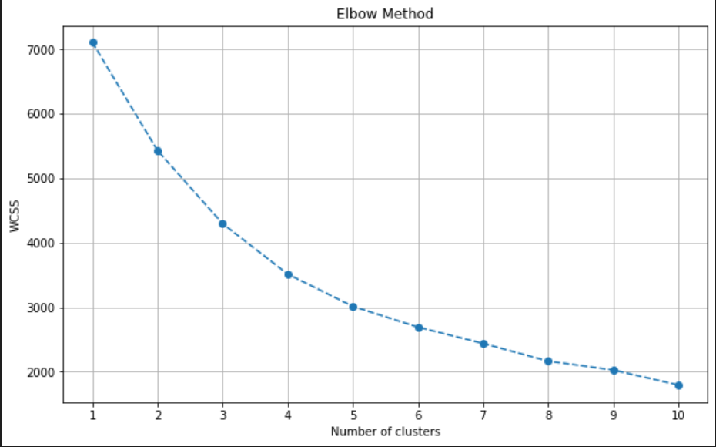
For Geometric features and KMeans algorithm for different no. of clusters

Slide 10
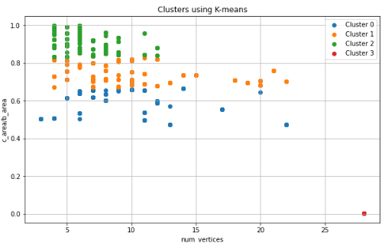
For Geometric features
We can see that clear clusters
are forming using this approach
We will try to improve this in our next approach by using features extracted from VGG19!

Slide 11
Classification of images(Approach2)
K-means using CNN derived features
Applied standardscalar to standardize the dataset
that we have created
Used Elbow method to find optimal number of
clusters(2, in our case)
Plotted graph of Elbow method
Plotted K-Means for optimal case(2)

Slide 12
For CNN features(extracted from VGG19) and KMeans algorithm for different no. of clusters

Slide 13

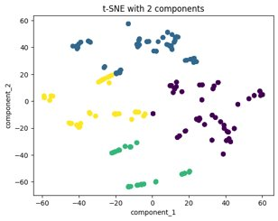
Classification of Images(Approach 3)
Hierarchical Clustering using geometric features:​
Preprocessed Data by standardizing features (except for complexity).​
Using dendrogram, clusters or "families" of blobs with similar geometric features were identified.​
The greater the linkage branch length more distant and recognizable are clusters.​
Here all 4 families are found at almost equal and longer links i.e well seperated.​
T-SNE transformation of 4 families samples in 2-D plot ​

Slide 14
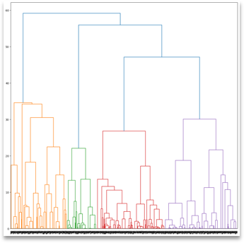
4 distinct families at lower ends of dendogram with bifurcation at similar distance

Slide 15
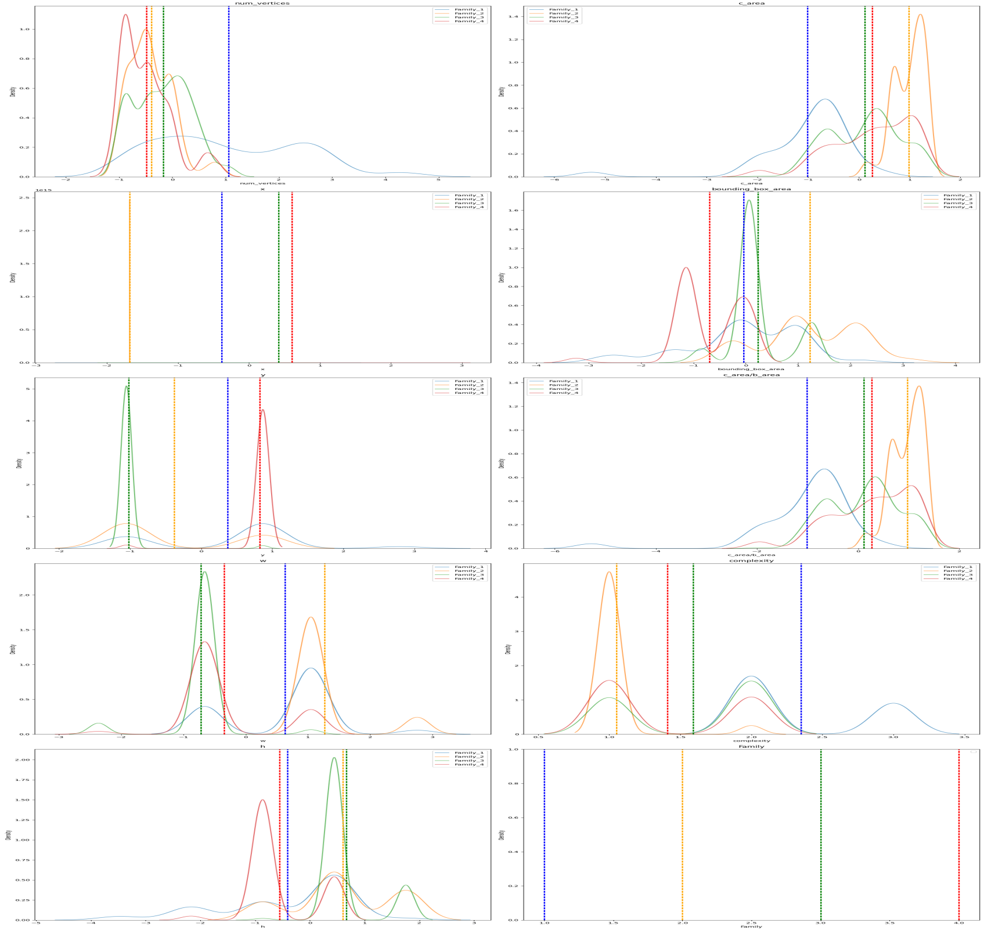
Visualizations of geometric features w.r.t families

Slide 16
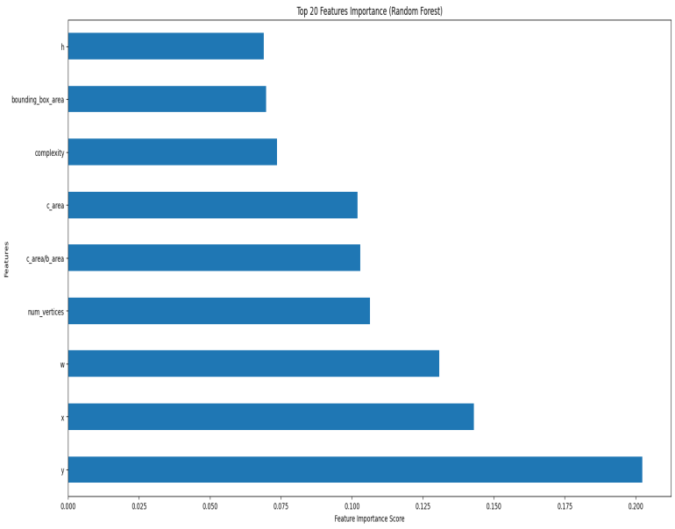
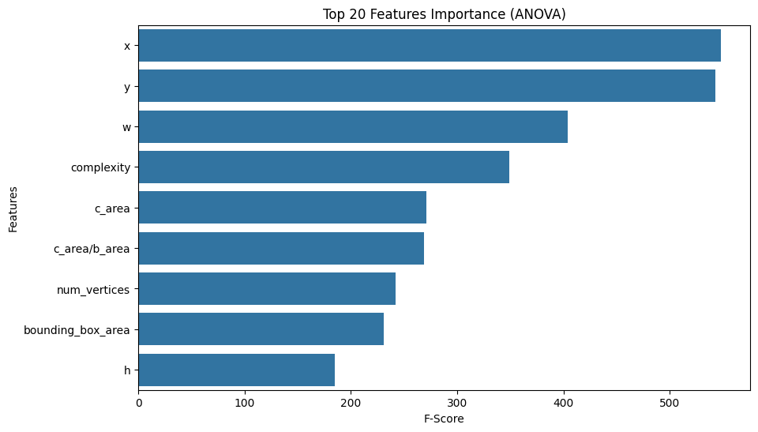
Feature Importance for families creation

Slide 17
How to assign low, medium, high complexity?
After a thorough chat with my team-mates we landed on a threshold
approach wherein we will keep certain thresholds for the
different complexities.
For example,
Low complexity - if there is a triangle
- if num of vertices less than 10 and c_area/b_area >0.85

Slide 18

High complexity - if num of vertices more than 15
Medium Complexity – Rest all are grouped into medium category
Thresholds used:

Slide 19


Following are some of our results using this analogy
Low
Complexity
Low
Complexity

Slide 20


High
Complexity
Medium
Complexity

Slide 21


Medium
Complexity
Medium
Complexity

Slide 22
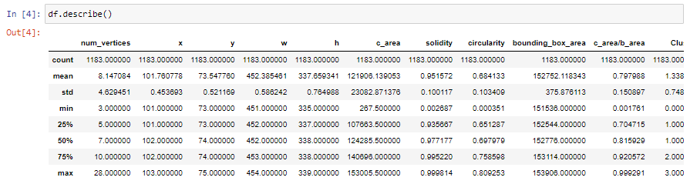
Exploratory Data Analysis
The data is a well balanced data without much outliers which is quite good for our upcoming task
of model building
Max value of number of vertices is 28!
Coordinates x, y, solidity , circularity, width and height have almost equal value with std less than 1!

Slide 23
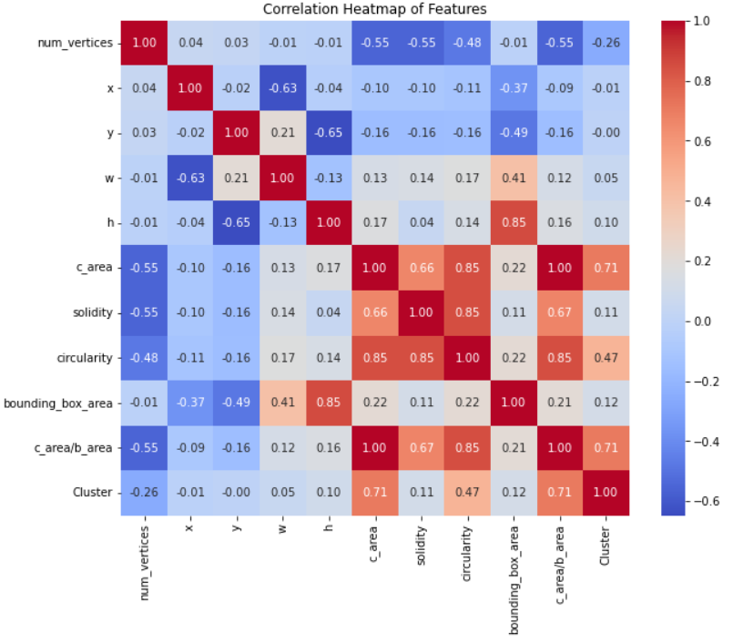
HEAT
MAP

Slide 24
Results from Heatmap:
Bounding box area is highly correlated with height h
Contour area is highly correlated with features solidity and circularity
Number of vertices is negatively correlated with Contour area, solidity and circularity
X coordinate is negatively correlated with width w and bounding box area
Y coordinate is negatively correlated with height h and bounding box area
Cluster is mostly dependent on circularity and contour area and inversely dependent on
no. of vertices

Slide 25
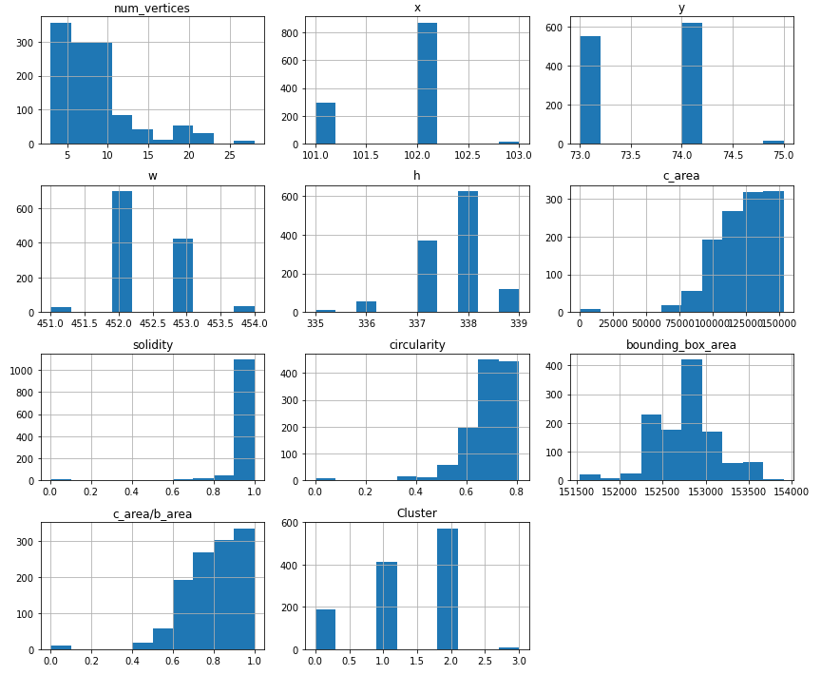
HISTOGRAM
PLOT

Slide 26
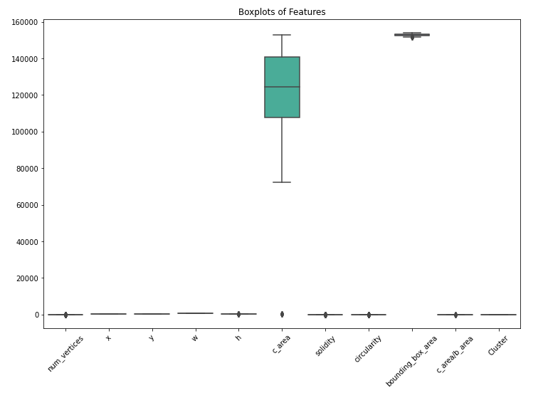
BOX PLOT
Only Contour area has a large spread of values which is also evident from the images we have.

Slide 27
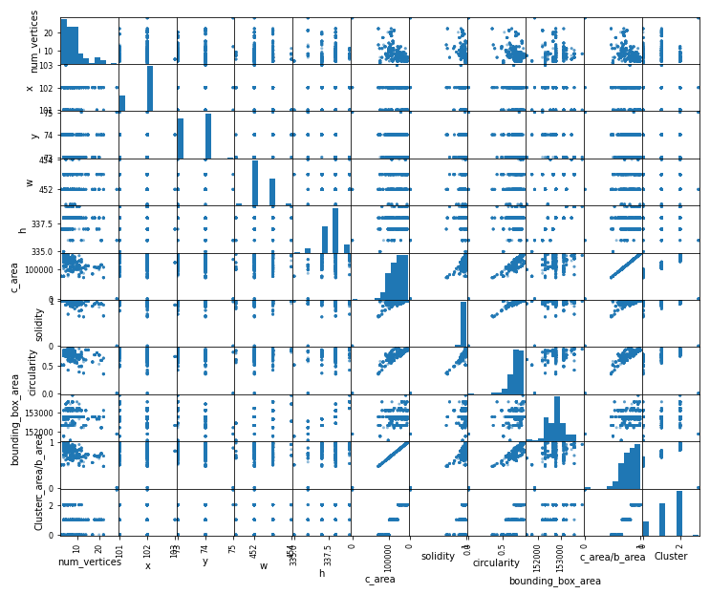
SCATTER
MATRIX

Slide 28
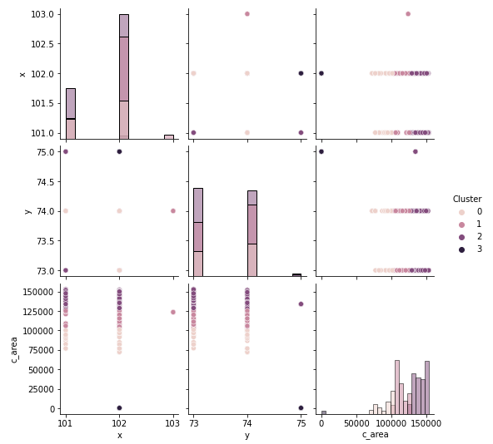
PAIR
PLOT

Slide 29
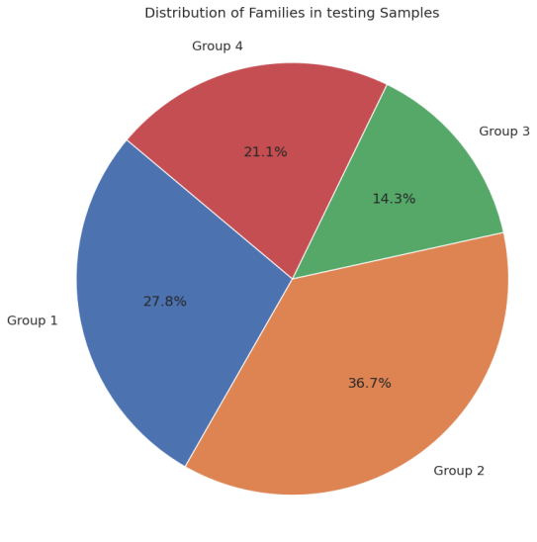
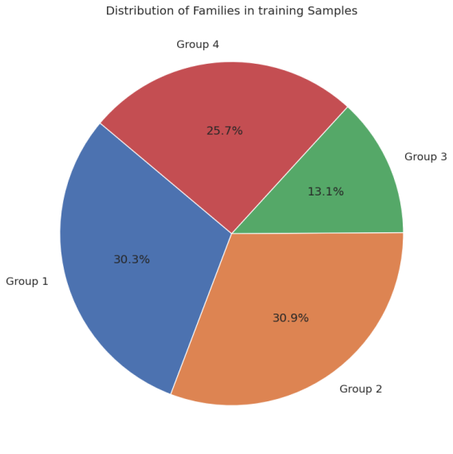
Families Prediction with Architect's gross parameters using ML Classifier Approach
Dataset Preparation - contains geomteric feature in standarized fotm with Complexity feature.
Splitted data into training and testing sets using the train_test_split function.

Slide 30
Families Prediction with Architect's gross parameters using ML Classifier Approach
Model Training:
Trained several classifiers:
XGBoost Classifier (xgboost.XGBClassifier())
Logistic Regression (LogisticRegression())
Support Vector Machine (SVM) with linear kernel (svm.SVC(kernel='linear', probability=True))
SVM with polynomial kernel (svm.SVC(kernel='poly', probability=True))
SVM with radial basis function (RBF) kernel (svm.SVC(kernel='rbf', probability=True))
Random Forest Classifier (RandomForestClassifier(n_estimators=1500, criterion='entropy', random_state=42))
Each model was trained on the training data.

Slide 31
Families Prediction with Architect's gross parameters using ML Classifier Approach
Model Evaluation:
Evaluated the performance of each model using k-FOLD cross-validation as k =5.
Metrics such as accuracy, precision, recall, and F1-score were averaged over these 5-fold validation and stored.
Confusion matrices were generated to visualize the performance of each model in predicting the families of blobs.

Slide 32
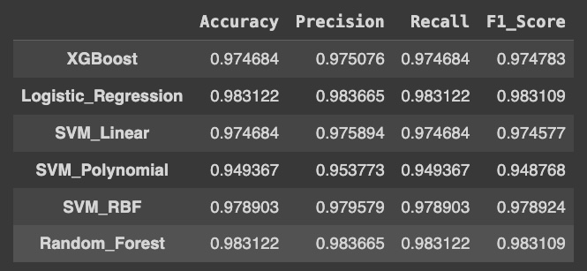
Results - Metrics

Slide 33
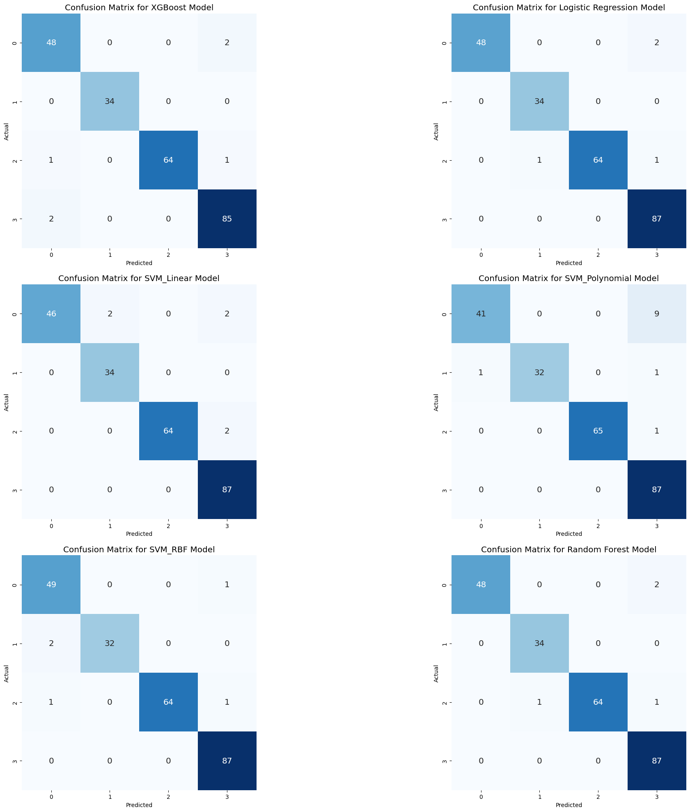
Results – Confusion Matrix

Slide 34
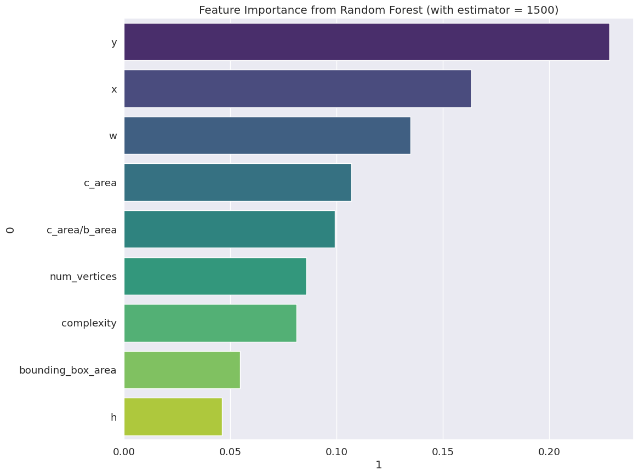
Feature Impotance in family's prediction

Slide 35
What else?
Automated Feature Extraction: Develop algorithms to automatically extract key
features from the building layouts, such as room dimensions, presence of
architectural elements (e.g., windows, doors), and overall spatial arrangements.
These features can then be used for various downstream tasks such as similarity matching,
layout classification, and design recommendation.

Slide 36
Generative Models for Layout Synthesis: Explore the use of generative adversarial networks (GANs) or variational autoencoders (VAEs) to generate new building layouts based on learned patterns from the existing data. This can assist architects in quickly generating diverse design alternatives for exploration and evaluation.
Spatial Analysis for Optimal Design: Apply spatial analysis techniques to identify optimal arrangements of rooms and architectural components within a given layout. This can involve aspects such as maximizing natural lighting, minimizing construction costs, or optimizing energy efficiency.

Slide 37
Major Learnings
Exploratory Data analysis
Feature extraction from images
Handling image data
Different Clustering methods and their applications
Different approach to different solutions exist
Using ML in image analysis

Slide 38
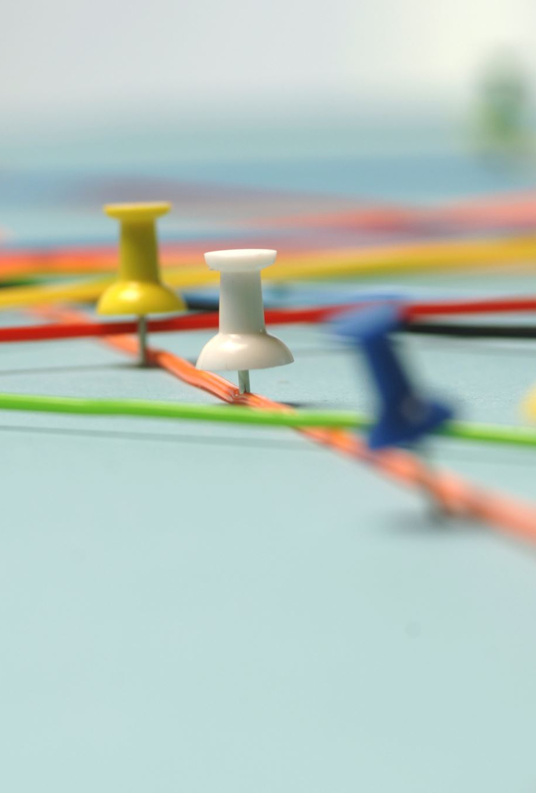
Implementation Links :
1)GitHub Link : https://github.com/SahilBarbade1203/Data-Driven-Architectural-Design-Optimization

