Slide 1
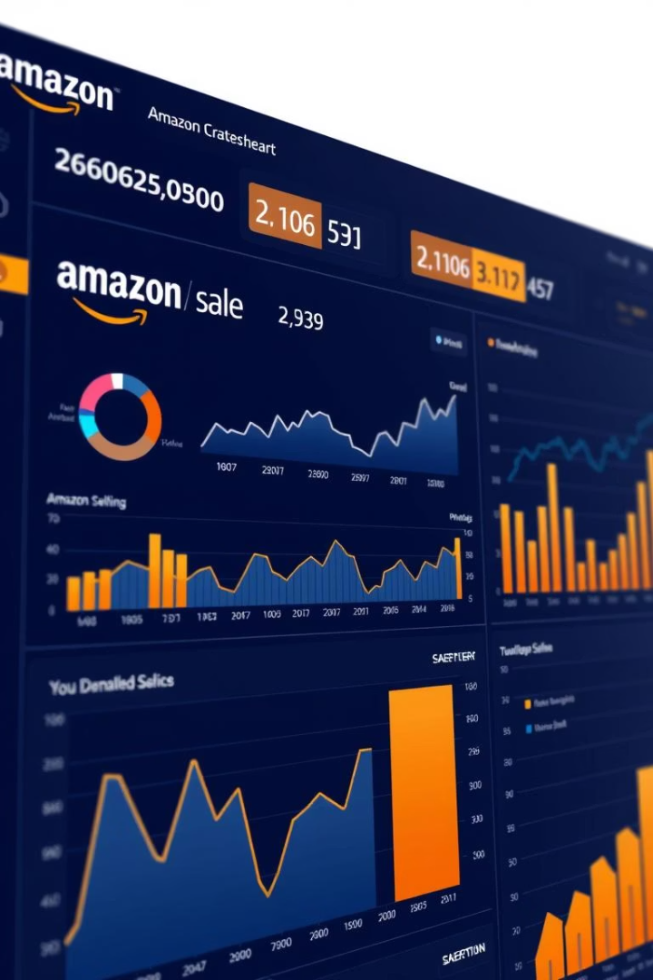
Amazon Sales Dashboard - Business Insights
This presentation introduces a modern, data-driven approach to Amazon sales analytics. Our goal is to streamline decision-making and drive revenue growth by providing actionable insights through a comprehensive dashboard. Authored by Vaibhav Sharma, Data Analyst, this dashboard is designed to empower businesses with critical information at their fingertips.
BY Sahil Chhetri

Slide 2
Objective
Centralized Data
Identify Opportunities
Actionable Intelligence
Boost Sales
Centralize key Amazon sales data to provide quick and easy access to critical insights, eliminating the need to pull data from multiple sources.
Our primary aim is to increase overall Amazon sales by 15% within the next quarter through informed, data-driven decision-making.
Proactively identify trends, untapped opportunities, and potential issues before they escalate, ensuring agile response and strategic adjustments.
Empower all stakeholders with actionable intelligence, transforming raw data into clear, concise, and implementable strategies for growth.

Slide 3






Key Performance Indicators (KPIs)
Total Sales Revenue
Units Sold
Track overall sales performance, with a target of $5M per month, indicating the total monetary value of products sold.
Monitor sales volume across all products, aiming for 50,000 units sold per month, reflecting product demand.
Conversion Rate
Advertising Cost of Sales (ACoS)
Optimize product listings and marketing efforts to achieve a benchmark conversion rate of 10%, maximizing visitor-to-buyer ratios.
Measure advertising efficiency, targeting an ACoS of less than 25%, to ensure profitable ad spending.
Customer Acquisition Cost (CAC)
Return on Ad Spend (ROAS)
Understand the cost of acquiring new customers, aiming for a CAC of less than $10, to maintain cost-effective growth.
Optimize ad spend for maximum return, targeting a ROAS greater than 4, indicating strong advertising effectiveness.

Slide 4
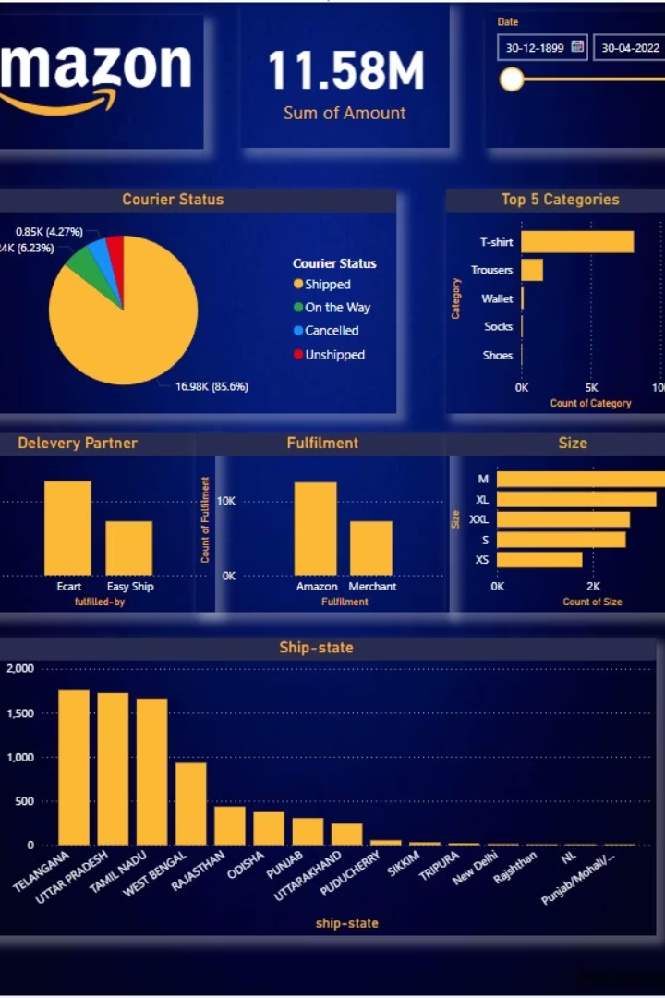
Dashboard Features
Real-time Data
Data updates every 15 minutes, ensuring you always have the most current information for rapid decision-making.
Interactive Visuals
Interactive charts and graphs enable dynamic exploration and analysis of sales trends, allowing for deeper dives into specific metrics.
Customizable Filters
Flexible date ranges and product filters provide granular control over the data displayed, tailored to your analytical needs.
Drill-down Capabilities
Seamless drill-down capabilities allow you to move from high-level summaries to detailed individual transactions for comprehensive insights.

Slide 5
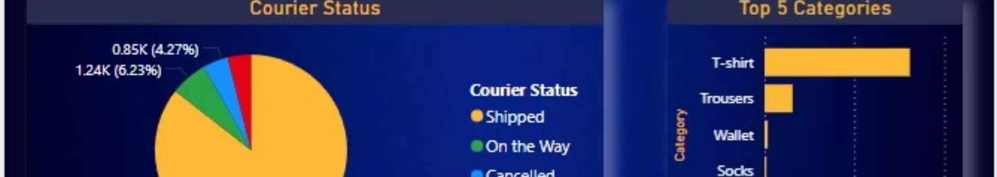




Design and Layout
Color Scheme
Visual Appeal
Readability
Intuitive Navigation
A clean and modern blue-orange color scheme is used throughout, creating a visually cohesive and appealing experience.
Visually appealing charts and graphs are designed for clarity and impact, making complex data easy to digest.
Consistent font style and size ensure maximum readability across all elements of the dashboard.
An intuitive layout with clear section headings ensures easy navigation and a user-friendly experience.
The dashboard features a minimalist design to reduce clutter, along with a placeholder for your company logo, integrating seamlessly into your brand identity.

Slide 6






Key Business Insights
Top-Selling Products
Sales Trends
Identify your most popular products, like Product A and Product B, to leverage their success and focus marketing efforts effectively.
Analyze sales patterns over time, uncovering seasonal trends and peak sales days to optimize inventory and promotional strategies.
1
2
Competitor Analysis
Customer Behavior
Benchmark your performance against key competitors using market share data, identifying areas for competitive advantage.
Understand customer purchasing habits and preferences, including average order value and repeat customer rates, to tailor experiences.
6
3
5
4
Marketing Performance
Geographic Performance
Measure the effectiveness of your marketing campaigns by tracking click-through rates and conversion rates, ensuring ROI on ad spend.
Identify top-performing regions, such as North America and Europe, to target expansion and localized marketing efforts.

Slide 7






Tools Used
Amazon Seller Central API
Utilized for efficient and reliable data extraction from Amazon Seller Central, ensuring accurate and up-to-date sales figures.
SQL Database
Employed for robust data storage, providing a secure and scalable solution for managing vast amounts of sales data.
Tableau/Power BI
Used for dynamic data visualization, transforming raw data into intuitive and interactive dashboards for insightful analysis.
Python/R
Leveraged for advanced data analysis and modeling, enabling deeper insights and predictive analytics for sales forecasting.
Version Control: Git
Git is used for version control, ensuring collaborative development and seamless tracking of all code and analysis changes.
Project Management: Jira
Jira is utilized for comprehensive project management, streamlining workflows and ensuring efficient task tracking and delivery.

Slide 8




Case Study: 30% Increase in ROAS
Challenge
Solution
Action
Result
Product C faced a persistent challenge of low Return on Ad Spend (ROAS), limiting its profitability and growth potential.
A deep dive into the data was conducted, analyzing ACoS, conversion rate, and keyword performance to pinpoint specific areas for improvement.
Based on the analysis, ad campaigns were strategically optimized with highly targeted keywords, focusing on high-converting search terms.
These targeted optimizations led to a remarkable 30% increase in ROAS for Product C within just one month, significantly boosting profitability.
This case study demonstrates the direct impact of data-driven insights and strategic optimization on advertising effectiveness. By identifying and addressing the root causes of low ROAS, we were able to achieve substantial improvements, proving the value of our analytical approach.

