Slide 1
NoSQL Case Study
User Management System
Sahil Dhiman

Slide 2
AGENDA
Application Features
Various features
Building Blocks
Building blocks and Tools Used
Demo

Slide 3
Application Features
Admin can do following operations
Add User
User Update
View User
Delete User

Slide 4
Building Blocks
Environment:
NodeJS
Node.js is a technology that allows to run JavaScript code outside of a web browser. Here, it allows you to run JavaScript code on the server side. It is a popular technology for backend development.
Express
Express, is a back end web application framework for building RESTful APIs with Node.js. It provides a set of features, such as routing, templating, that make it easier to create dynamic and scalable web applications.
JavaScript
JavaScript is a programming language that can be used to create dynamic and interactive web pages. JavaScript is used with Express to create web applications that run on Node.js. JavaScript is the main programming language that Express supports, and we can use it to write the logic and functionality of web application.
Database: MongoDB Atlas
MongoDB Atlas is a fully-managed cloud database that handles all the complexity of deploying, managing, and deployments on the cloud server. MongoDB Atlas is the best way to deploy, run, and scale MongoDB in the cloud. It is used here for store all records of website.

Slide 5
Screenshots(DEMO)
Add User
Home
Update User
MongoDB Atlas Database

Slide 6
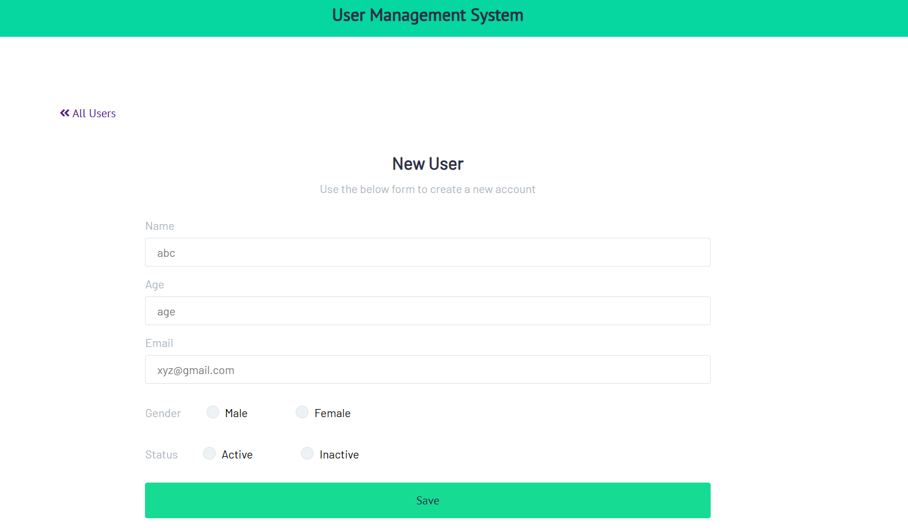
Add User

Slide 7
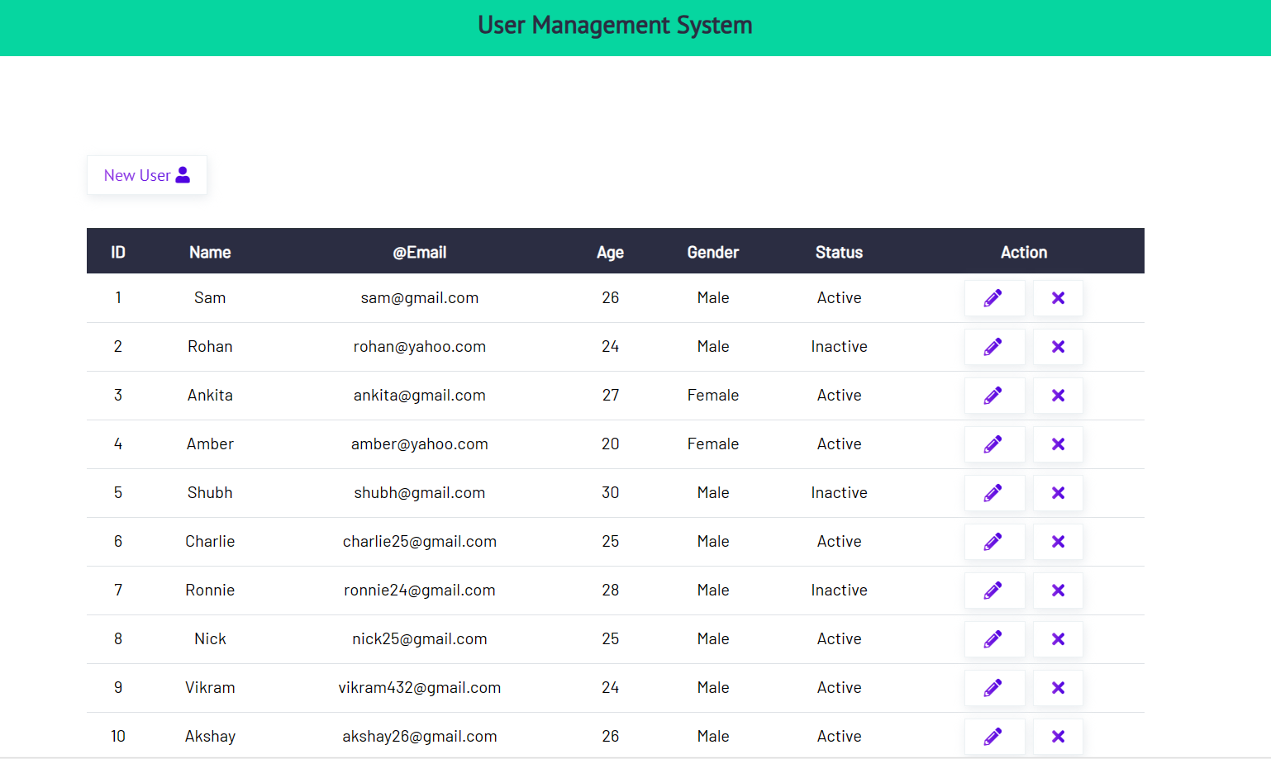
Home Page

Slide 8
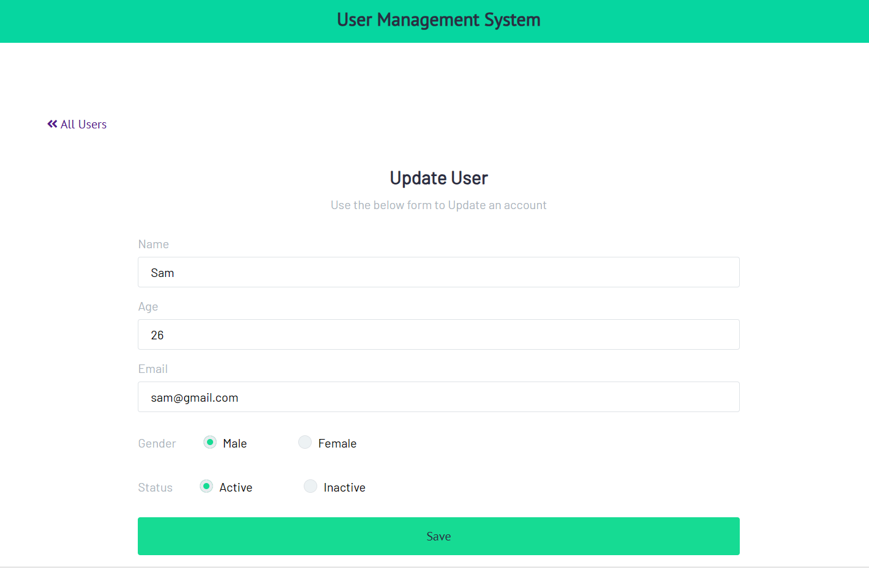
Update User Page

Slide 9
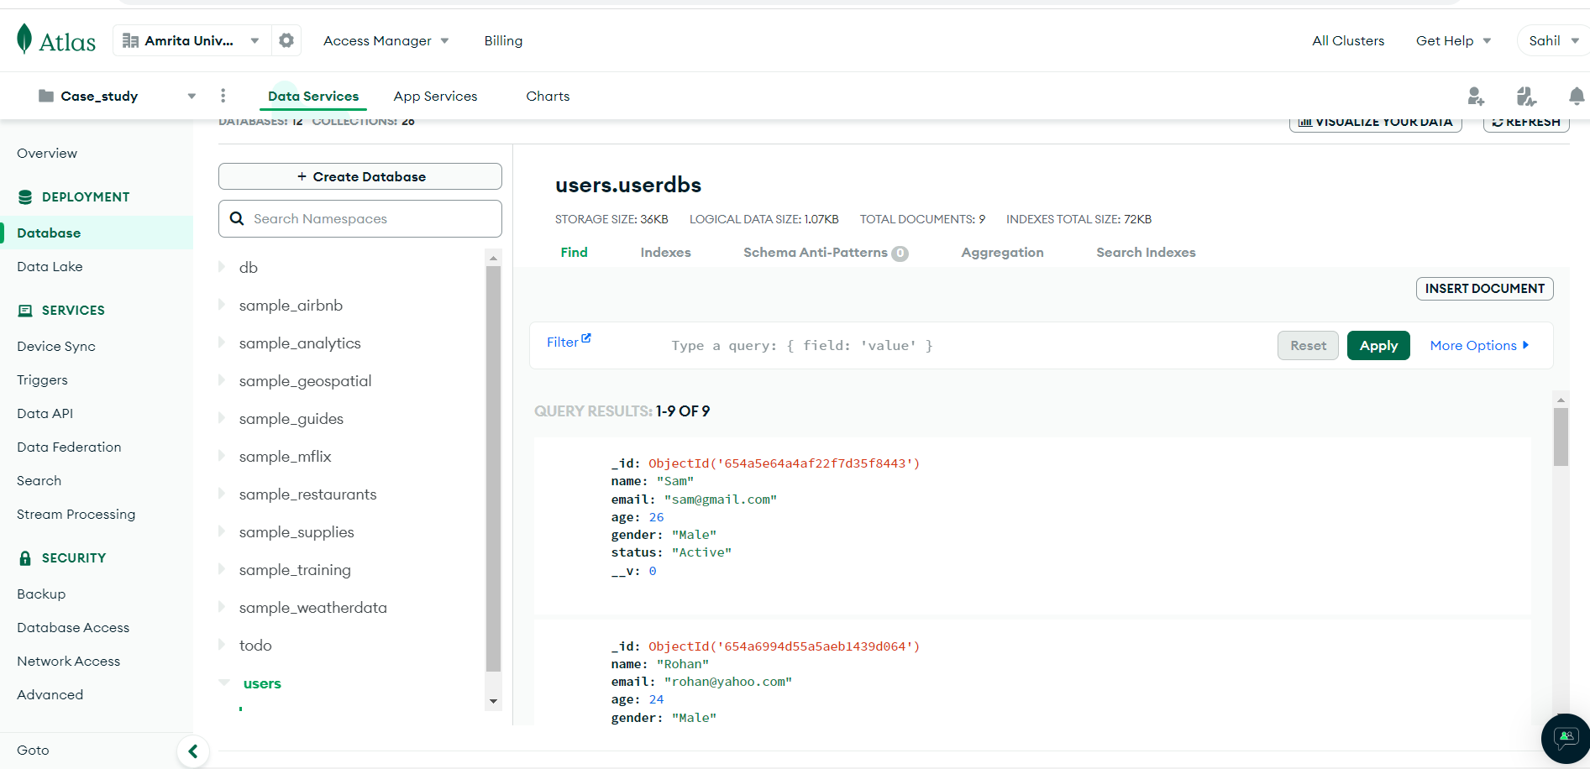
Mongo DB Atlas Database

Slide 10
Thankyou…..

