Slide 1
Samsung Innovation Campus

Slide 2
Project Name : iPhone Sales Analysis
Team Names –
Akanchha Kumari, Anita Singh, Ashish Tiwari, Jay Kishan Dhurwe, Vijay Kashyap
Guided by –
Satish Kumar Dhiwar Sir

Slide 3
Introduction Of Project
In today's fast-paced digital market, firms must understand consumer behavior and sales trends in order to stay competitive. With the popularity of mobile devices, notably iPhones, evaluating sales data on these platforms has become increasingly vital. This project intends to create a comprehensive sales analysis system based on iPhone data, utilizing the power of Python programming to find important insights and make instructed business decisions.
The goal of this project is to design and implement a data-driven solution that can process and analyze large datasets of iPhone sales, providing actionable recommendations to stakeholders. We built an effective and scalable system capable of handling complicated data analysis tasks by utilizing Python's data science ecosystem, which includes popular modules such as pandas, NumPy, and Matplotlib, Seaborn.
We worked with a dataset of iPhone sales, which will be cleaned, processed, and visualized to extract meaningful patterns and correlations.
Notes:
Note:

Slide 4
Problem Statement
The purpose of this analysis is to better understand the sales success and consumer satisfaction of various iPhone models using important data such as sale prices, ratings, and customer reviews. By studying this data, we want to find trends and links between price, discounts, user ratings, and the amount of reviews, allowing us to make better business and marketing decisions.
Specifically, we aim to explore:
How iPhone pricing affects the quantity of ratings and reviews.
The relationship between user ratings and sales results.
Does star ratings really reflect customer happiness and product popularity?
Notes:
Note:

Slide 5
Algorithm used to solve the problem
Algorithm/Steps Used:
Data Collection & Preprocessing:
Collected the dataset of various iPhone models with information such as sale price, number of ratings, number of reviews, star rating, and RAM.
Preprocessing steps included handling missing values and ensuring data consistency (e.g., converting data types where needed).
Exploratory Data Analysis (EDA):
Bar Chart (Visualization): Used to compare the sale prices of different iPhone models to understand pricing trends.
Scatter Plot (Visualization): Used to investigate the relationship between the number of ratings and number of reviews, along with the influence of star ratings.
Statistical Summary: Used basic statistics (mean, median, etc.) to summarize important aspects of the data, such as average ratings, price ranges, and distribution of customer reviews.
Correlations:
Scatter Plots helped identify potential relationships between different variables (e.g., how the number of ratings relates to the number of reviews or star ratings).
Visual inspection of data distributions and relationships through scatter plots enabled the identification of trends that would be crucial in making business decisions.
Notes:
Note:

Slide 6
Technologies Used for iPhone Sales Data Analysis:
Python:
Python was the primary programming language used for data analysis and visualization due to its powerful libraries for handling data, creating plots, and building presentations.
Pandas:
A Python library used for data manipulation and analysis.
It allows easy reading, cleaning, and manipulation of structured data like CSV files.
Matplotlib:
A plotting library for creating static, animated, and interactive visualizations in Python.
Used to generate various types of plots such as bar charts and scatter plots to visualize trends in iPhone sales data.
Seaborn:
A Python data visualization library built on top of Matplotlib.
It provides a high-level interface for creating attractive and informative statistical graphics.
Used to create scatter plots and bar charts with added aesthetic appeal.
Jupyter Notebook:
Although not explicitly mentioned, Jupyter Notebooks are often used to write, test, and run Python code interactively.
Notes:
Note:

Slide 7
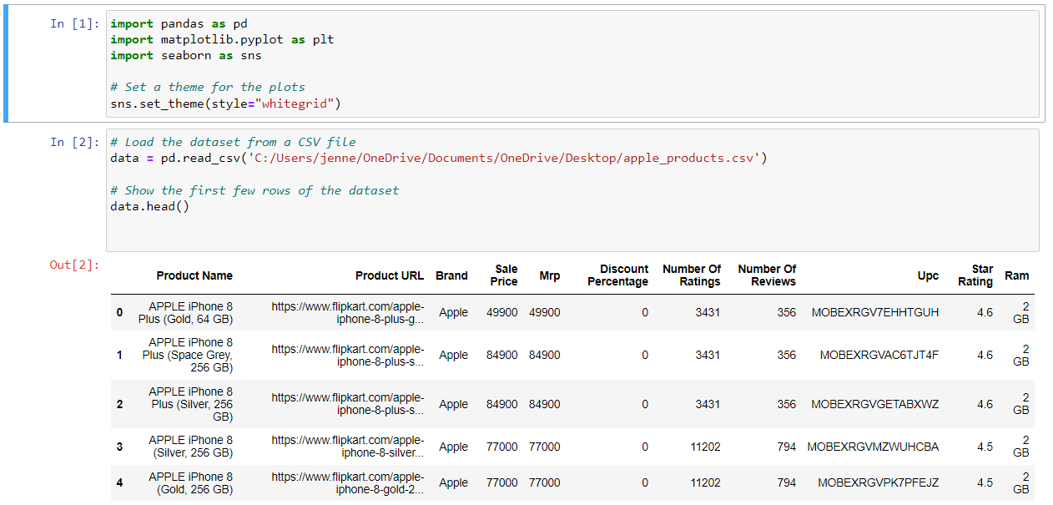
Screenshots of Project
Notes:
Note:

Slide 8
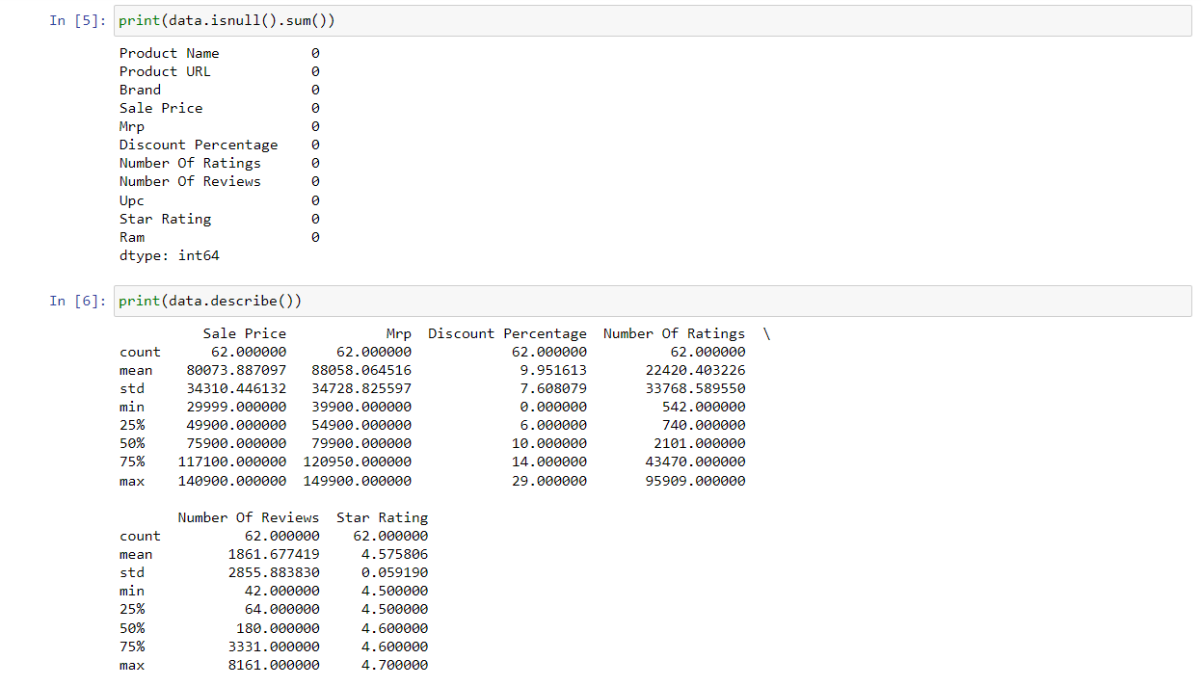
Screenshots of Project
Notes:
Note:

Slide 9
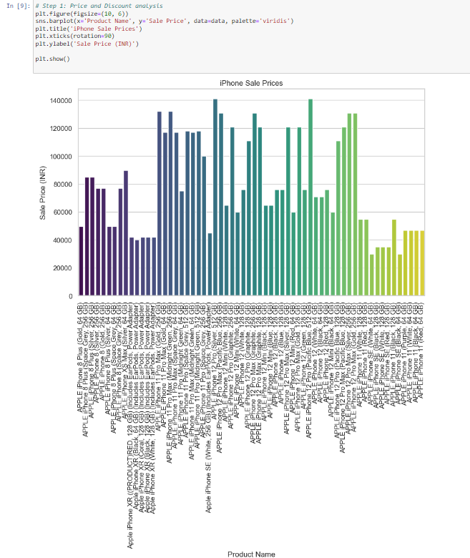
Screenshots of Project
Notes:
Note:

Slide 10
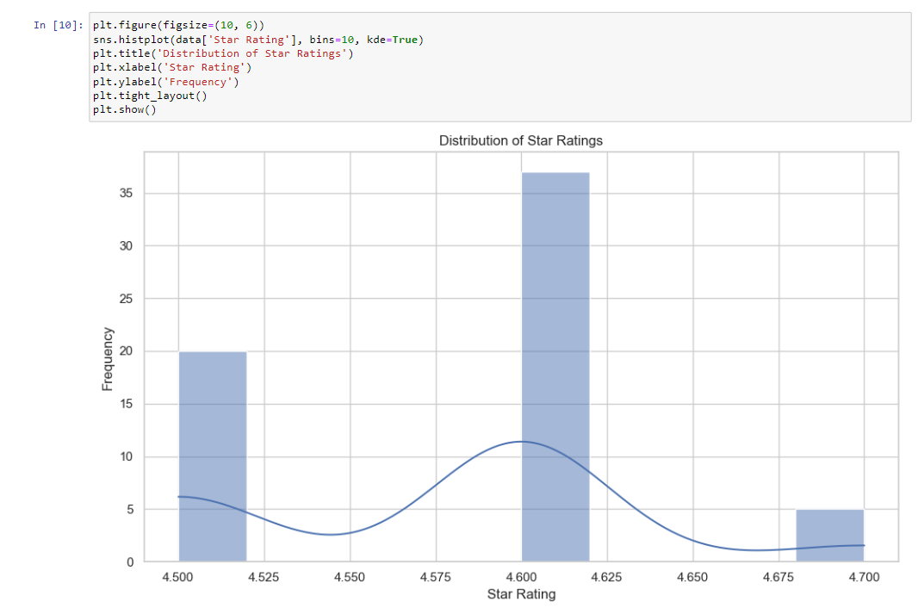
Screenshots of Project
Notes:
Note:

Slide 11
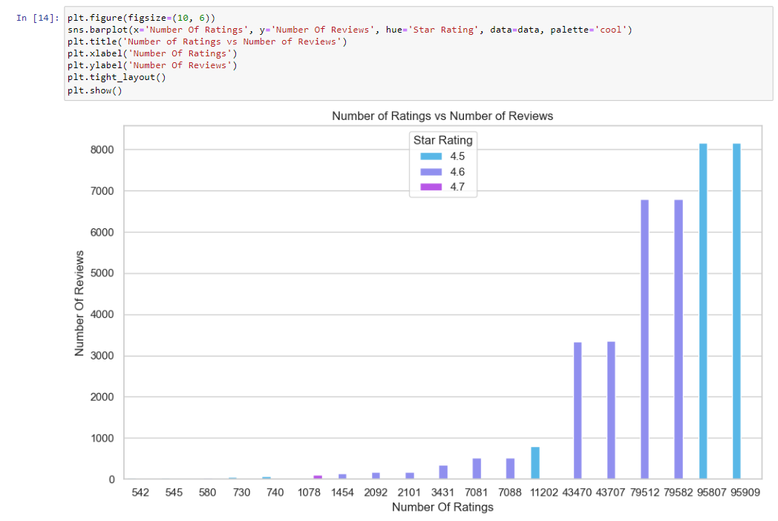
Screenshots of Project
Notes:
Note:

Slide 12
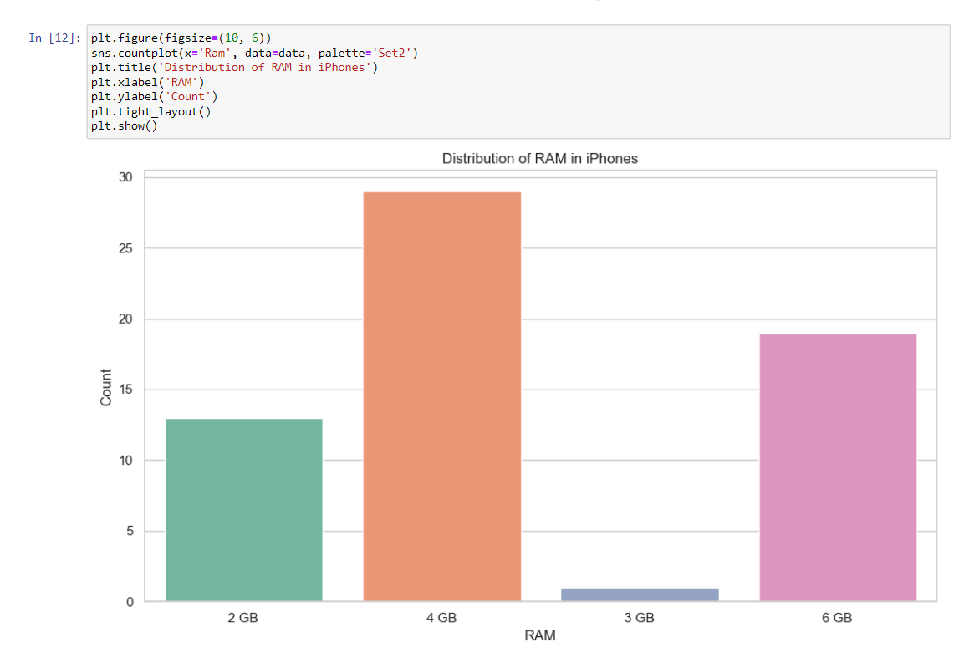
Screenshots of Project
Notes:
Note:

Slide 13
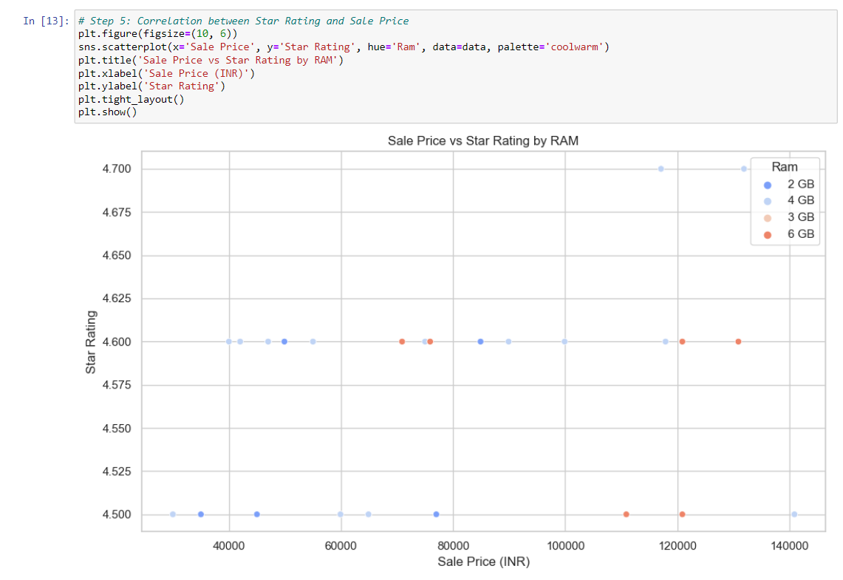
Screenshots of Project
Notes:
Note:

Slide 14
Future Scope
Enhanced Data Collection: Gather more detailed data on additional features like battery life and camera quality.
Advanced Analysis Techniques: Implement machine learning models to predict sales trends and customer ratings.
Interactive Dashboards: Develop interactive dashboards using tools like Plotly or Dash.
Real-time Data Integration: Integrate real-time data feeds to keep the analysis up-to-date.
Comparative Analysis: Compare Apple products with competitors to identify market strengths and weaknesses.
Predictive Analytics: Use predictive analytics to forecast future sales and market opportunities.
User Experience Improvements: Continuously improve the project based on user feedback.
Notes:
Note:

Slide 15
Conclusion
In this project, we conducted a comprehensive analysis of Apple product data, focusing on various aspects such as sale prices, star ratings, and customer reviews. Through visualizations created using Matplotlib and Seaborn, we identified key trends and patterns, such as the distribution of RAM in iPhones and the correlation between sale prices and star ratings. This analysis provides valuable insights into customer preferences and product performance, which can be leveraged for strategic decision-making and future product development.
Additionally, the analysis highlighted the importance of detailed data collection and advanced analytical techniques in understanding market dynamics. By implementing machine learning models and interactive dashboards, future work can enhance the predictive power and user engagement of the project.
Overall, this project lays a solid foundation for ongoing analysis and improvement, offering a clear roadmap for future enhancements that can drive better business outcomes and customer satisfaction.
Notes:
Note:

Slide 16
Books
Reference
Grolemund, G., & Wickham, H. (2017). R for Data Science. O’Reilly Media
VanderPlas, J. (2016). Python Data Science Handbook. O’Reilly Media.
Websites
DataCamp: Provides interactive courses on data science and analytics. DataCamp
Towards Data Science: A Medium publication with articles on data science, machine learning, and analytics. Towards Data Science
GitHub: Explore repositories like iPhone Sales Analysis for practical projects and code examples
Project on Data Analysis in
iPhone Sales

