Slide 1
Lecture 17 Functional synthesis and Verification
Armando Solar-Lezama

Slide 2
Moving beyond Inductive synthesis
We want to synthesize functions that satisfy richer correctness criteria
Key questions
Specification formalisms
How do we describe the intended behavior?
How do we ensure correctness
No longer trivial as in the inductive case
Synthesis approaches
Deductive vs. inductive

Slide 3
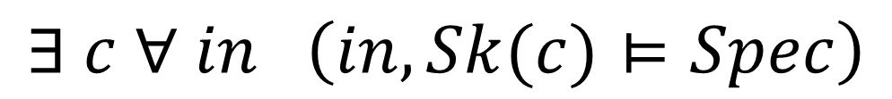
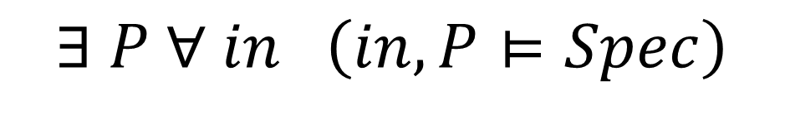
The general synthesis problem
$$∃ c ∀ in \left(in, Sk(c)⊨Spec\right)$$
$$∃ P ∀ in \left(in, P⊨Spec\right)$$

Slide 4


Defining correctness
Attempt 1: Not enough
Precondition:
$$n≥0∧ n ≤ len(in)$$
out=Sort(n, in)
Postcondition:
$$∀i. 0≤i<n−1⇒out\left[i\right]≤out\left[i+1\right]$$
$$len\left(out\right)=n$$

Slide 5

Defining correctness
Attempt 2: Still not enough
Precondition:
$$n≥0∧ n ≤ len(in)$$
out=Sort(n, in)
Postcondition:
$$∀i. 0≤i<n−1⇒out\left[i\right]≤out\left[i+1\right]$$
$$len\left(out\right)=n$$
$$∀i. 0≤i<n−1⇒∃j in\left[j\right]=out[i]$$

Slide 6

Defining correctness
Attempt 3: Still not enough
Precondition:
$$n≥0∧ n ≤ len(in)$$
out=Sort(n, in)
Postcondition:
$$∀i. 0≤i<n−1⇒out\left[i\right]≤out\left[i+1\right]$$
$$len\left(out\right)=n$$
$$∀i. 0≤i<n−1⇒∃j in\left[j\right]=out[i]$$
$$∀i. 0≤i<n−1⇒∃j in\left[i\right]=out[j]$$

Slide 7
Defining correctness
Attempt 4: Is it enough?
Precondition:
$$n≥0∧ n ≤ len(in)$$
out=Sort(n, in)
Postcondition:
$$∀i. 0≤i<n−1⇒out\left[i\right]≤out\left[i+1\right]$$
$$len\left(out\right)=n$$
$$∀i. 0≤i<n−1⇒∃j in\left[j\right]=out[i]$$
$$∀i. 0≤i<n−1⇒∃j in\left[i\right]=out[j]$$
$∃p:int→int. ∀i. i<n⇒ out\left[i\right]=in\left[p\left(i\right)\right]∧∃j∈[0,n). p\left(j\right)=i$

Slide 8
Multimodal Synthesis
Trick:
combine many simple specs in different formalisms to fully constrain the behavior
Concrete scenarios
Abstract scenarios
Correct Code
Synthesizer
Partial specs
Synthesizer
Safety properties
Structural Info

Slide 9
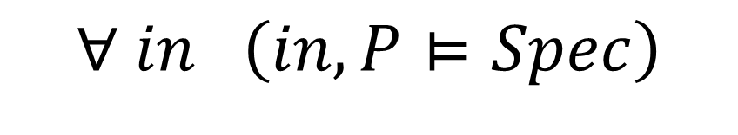
Ensuring correctness
This is a hard problem in general
Two points of view:
Not my problem
This is a synthesis class, not a verification class
Synthesis can make verification simpler
Synthesize code that is easier to prove correct
Ensure correctness by construction
$$∀ in \left(in, P⊨Spec\right)$$

Slide 10
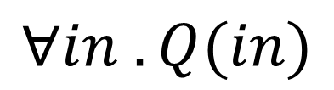
Constraint-based verification
Code
if(x > y){
t = x – y;
while(t > 0){
x = x – 1;
y = y + 1;
t = t – 1;
}
assert y=x_{in}
assert x=y_{in}
}
$$∀in . Q(in)$$
OK
Verification Condition Generation
Solver

Slide 11
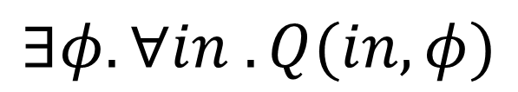
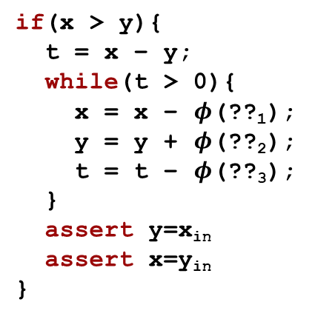

… and Synthesis
Code
if(x > y){
t = x – y;
while(t > 0){
x = x – $φ$(??₁);
y = y + $φ$(??₂);
t = t – $φ$(??₃);
}
assert y=x_{in}
assert x=y_{in}
}
?
$$∃φ. ∀in . Q(in, φ)$$
$$φ$$
Verification Condition Generation
Historically, solvers that can deal with quantifier alternations have not been very scalable

Slide 12
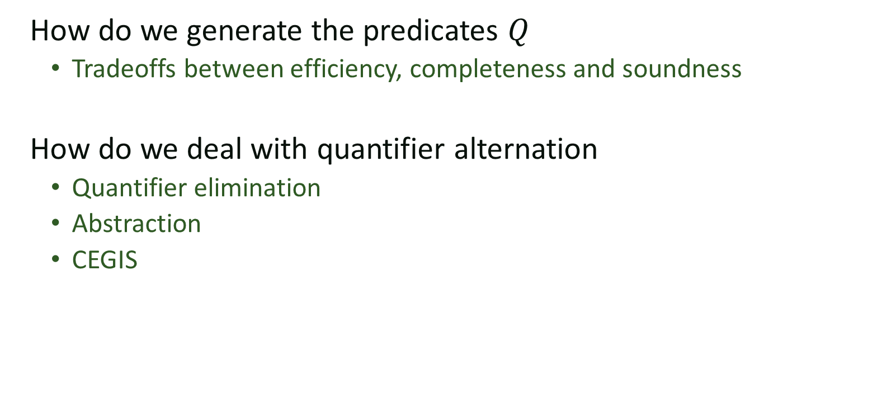
Key challenges
How do we generate the predicates $Q$
Tradeoffs between efficiency, completeness and soundness
How do we deal with quantifier alternation
Quantifier elimination
Abstraction
CEGIS

Slide 13
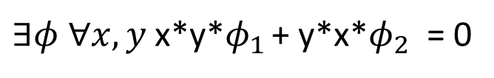
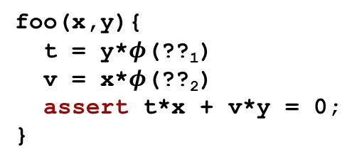

Quantifier Elimination
Use algebraic equalities manipulation to derive relationships between unknowns
powerful, but limited in scope and potentially expensive
foo(x,y){
t = y*$φ$(??₁)
v = x*$φ$(??₂)
assert t*x + v*y = 0;
}
$∃φ ∀x,y$x*y*$φ_{1}$ + y*x*$φ_{2}$ = 0
$$⇒φ_{1}=−φ_{2}$$

Slide 14
CEGIS
Counterexample guided inductive synthesis
Ideas
Rely on an oracle to tell you if your program is correct
If it is not, rely on oracle to generate counterexample inputs
Reduce to an inductive synthesis problem

Slide 15



CEGIS
Synthesize
Check
$$∃P s.t. Correct(P, in_{i})$$
Insert your favorite
checker here
$$in$$
$$\{in_{i}\}$$

Slide 16


Constraint-based CEGIS
a
b
c
d
+
$$Q(c, in)$$
+
+
+
+
+
+
+
+
+
+
+
A
A
A
A
$$\{in_{i}\}$$

Slide 17



Constraint-based CEGIS
a
b
c
d
+
$$Q(φ, in)$$
+
+
+
+
+
+
+
+
+
+
+
A
A
A
A
Synthesize
Check
$$c$$
$$in$$
$$\{in_{i}\}$$

Slide 18
Constraint-based CEGIS
a
b
c
d
+
$$Q(φ, in)$$
+
+
+
+
+
+
+
+
+
+
+
A
A
A
A
Synthesize
Check
$$c$$
$$in$$
$$\{in_{i}\}$$

Slide 19

Constraint-based CEGIS
a
b
c
d
+
$$Q(φ, in)$$
+
+
+
+
+
+
+
+
+
+
+
A
A
A
A
Synthesize
Check
$Q(φ, in_{0})$
$$c$$
$$in$$
$$\{in_{i}\}$$

Slide 20
Constraint-based CEGIS
a
b
c
d
+
$$Q(φ, in)$$
+
+
+
+
+
+
+
+
+
+
+
A
A
A
A
Synthesize
Check
$Q(φ, in_{0})$
$$c$$
$$in$$
$$\{in_{i}\}$$

Slide 21

Constraint-based CEGIS
a
b
c
d
+
$$Q(φ, in)$$
+
+
+
+
+
+
+
+
+
+
+
A
A
A
A
Synthesize
Check
$Q(φ, in_{0})$
$$c$$
$¬Q(φ, in_{1})$
$$in$$
$$\{in_{i}\}$$

Slide 22

Constraint-based CEGIS
a
b
c
d
+
$$Q(φ, in)$$
+
+
+
+
+
+
+
+
+
+
+
A
A
A
A
Synthesize
Check
$Q(φ, in_{0})$
$Q(φ, in_{1})$
$$c$$
$$in$$
$$\{in_{i}\}$$

Slide 23
Constraint-based CEGIS
a
b
c
d
+
$$Q(φ, in)$$
+
+
+
+
+
+
+
+
+
+
+
A
A
A
A
Synthesize
Check
$Q(φ, in_{0})$
$Q(φ, in_{1})$
$$c$$
$$in$$
$$\{in_{i}\}$$

Slide 24

Constraint-based CEGIS
a
b
c
d
+
$$Q(φ, in)$$
+
+
+
+
+
+
+
+
+
+
+
A
A
A
A
Synthesize
Check
$Q(φ, in_{0})$
$Q(φ, in_{1})$
$$c$$
$¬Q(φ, in_{2})$
$$in$$
$$\{in_{i}\}$$

Slide 25

Constraint-based CEGIS
a
b
c
d
+
$$Q(φ, in)$$
+
+
+
+
+
+
+
+
+
+
+
A
A
A
A
Synthesize
Check
$Q(φ, in_{0})$
$Q(φ, in_{1})$
$$c$$
$Q(φ, in_{2})$
$$in$$
$$\{in_{i}\}$$

Slide 26
Constraint-based CEGIS
a
b
c
d
+
$$Q(φ, in)$$
+
+
+
+
+
+
+
+
+
+
+
A
A
A
A
Synthesize
Check
$Q(φ, in_{0})$
$Q(φ, in_{1})$
$$c$$
$Q(φ, in_{2})$
$$in$$
$$\{in_{i}\}$$

Slide 27

Constraint-based CEGIS
a
b
c
d
+
$$Q(φ, in)$$
+
+
+
+
+
+
+
+
+
+
+
A
A
A
A
Synthesize
Check
$Q(φ, in_{0})$
$Q(φ, in_{1})$
$$c$$
$¬Q(φ, in_{3})$
$Q(φ, in_{2})$
$$in$$
$$\{in_{i}\}$$

Slide 28

Constraint-based CEGIS
a
b
c
d
+
$$Q(φ, in)$$
+
+
+
+
+
+
+
+
+
+
+
A
A
A
A
Synthesize
Check
$Q(φ, in_{0})$
$Q(φ, in_{1})$
$$c$$
$Q(φ, in_{2})$
$Q(φ, in_{3})$
$$in$$
$$\{in_{i}\}$$

Slide 29
Constraint-based CEGIS
a
b
c
d
+
$$Q(φ, in)$$
+
+
+
+
+
+
+
+
+
+
+
A
A
A
A
Synthesize
Check
$Q(φ, in_{0})$
$Q(φ, in_{1})$
$$c$$
$Q(φ, in_{2})$
$Q(φ, in_{3})$
$$in$$
$$\{in_{i}\}$$

Slide 30

Constraint-based CEGIS
a
b
c
d
+
$$Q(φ, in)$$
+
+
+
+
+
+
+
+
+
+
+
A
A
A
A
Synthesize
Check
$Q(φ, in_{0})$
$Q(φ, in_{1})$
$$c$$
$¬Q(φ, in_{4})$
$Q(φ, in_{2})$
$Q(φ, in_{3})$
$$in$$
$$\{in_{i}\}$$

Slide 31
Constraint-based CEGIS
a
b
c
d
+
$$Q(φ, in)$$
+
+
+
+
+
+
+
+
+
+
+
A
A
A
A
Synthesize
Check
$Q(φ, in_{0})$
$Q(φ, in_{1})$
$$c$$
$¬Q(φ, in_{4})$
$Q(φ, in_{2})$
$Q(φ, in_{3})$
$$in$$
$$\{in_{i}\}$$

Slide 32

CEGIS
Inputs
Most candidates work for
most inputs.
This is a problem for CEGIS
because each counterexample input
eliminates very few candidates
Candidate Programs

Slide 33
CEGIS
Inputs
CEGIS works well
in the case where aside from
a few almost-correct programs,
most buggy programs will fail
on large sets of inputs, so each
counterexample can eliminate
many programs.
Candidate Programs

Slide 34
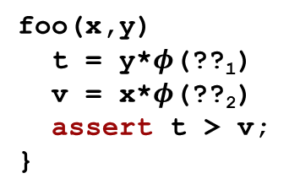
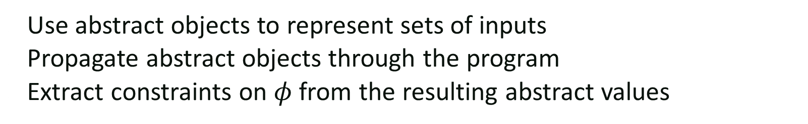

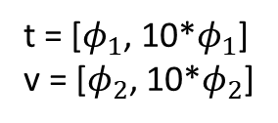
Abstraction
Use abstract objects to represent sets of inputs
Propagate abstract objects through the program
Extract constraints on $φ$ from the resulting abstract values
foo(x,y)
t = y*$φ$(??₁)
v = x*$φ$(??₂)
assert t > v;
}
x = [1, 10]
y = [1, 10]
so
$$φ_{1}>10φ_{2} ⇒t>v$$
t = [$φ_{1}$, 10*$φ_{1}$]
v = [$φ_{2}$, 10*$φ_{2}$]

Slide 35
Example
You want to partition N elements over P procs
How many elements should a processor get?
Obvious answer is N/P
Obvious answer is wrong!
N = 18
P = 5

Slide 36
Synthesizing a partition function
What do we know?
The interface to the function we want
Not all processors will get the same # of elements
The kind of expressions we expect
void partition(int p, int P, int N, ref int ibeg, ref int iend){
if(p< expr({p, P, N, N/P, N%P},{PLUS,TIMES}) ){
iend = expr({p, P, N, N/P, N%P},{PLUS,TIMES});
ibeg = expr({p, P, N, N/P, N%P},{PLUS,TIMES});
}else{
iend = expr({p, P, N, N/P, N%P},{PLUS,TIMES});
ibeg = expr({p, P, N, N/P, N%P},{PLUS,TIMES});
}
}
N
P
N%P
*
+
p
N/P

Slide 37
Synthesizing a partition function
How does the system know what a partition is?
harness void testPartition(int p, int N, int P){
if(p>=P || P < 1){ return; }
int ibeg, iend;
partition(p, P, N, ibeg, iend);
assert iend - ibeg < (N/P) + 2;
if(p+1 < P){
int ibeg2, iend2;
partition(p+1, P, N, ibeg2, iend2);
assert iend == ibeg2;
}
if(p==0){ assert ibeg == 0; }
if(p==P-1){ assert iend == N; }
}
Partitions should be balanced
Adjacent partitions should match
First and last partition should go all the way to the ends

Slide 38
Beyond Constraints
The constraint-based approach to verification works well but is limited by the capabilities of the verifier
Incorporation of deductive reasoning can help!
We will explore two additional directions
Synthesis from Refinement Types
Deductive Synthesis
Hybrids

Slide 39
Synthesis from refinement types
Polikarpova, Kuraj, Solar-Lezama PLDI 2015
replicate :: n: Int → x: β → ν: List β
replicate :: n: Nat → x: β → { ν: List β | len ν = n }

Slide 40
Example: insert
Polikarpova, Kuraj, Solar-Lezama PLDI 2015
Goal type:
Components:
x: β → xs: IncList β → { ν: IncList β | elems ν = elems xs + [x] }
data IncList α where
Nil :: { ν: IncList α | elems ν = [] }
Cons :: x: α → xs: IncList { ν: α | ν ≥ x }
→ { ν: IncList α | elems ν = elems xs + [x]}
Notes:
A more involved example: insertion into a sorted list. Demo.

Slide 41
Insert solution
Goal type:
Solution:
x: β → xs: IncList β → { ν: IncList β | elems ν = elems xs + [x] }
insert x xs = match xs with
Nil → Cons x Nil
Cons y ys → if x ≤ y
then Cons x (Cons y ys)
else Cons y (insert x ys)
:: IncList { ν: Int | ν ≥ y }
Notes:
Let’s look closer at the solution. Verifying this solution requires complex reasoning: we need to know that inserting something >= y into a list of things >= y gives back a list >= y, that is we can do automatically strengthen the specification of insert with a nontrivial property. Our tool can automatically infer a refined polymorphic instantiation for beta at the site of the recursive call. Our tool is the first to synthesize a verified implementation of insert.
But how do we do all this verification automatically?

