Slide 1
Lecture 18 Proving program correctness
Armando Solar-Lezama

Slide 2
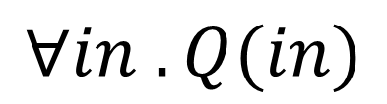
Constraint-based verification
Code
if(x > y){
t = x – y;
while(t > 0){
x = x – 1;
y = y + 1;
t = t – 1;
}
assert y=x_{in}
assert x=y_{in}
}
$$∀in . Q(in)$$
OK
Verification Condition Generation
Solver

Slide 3
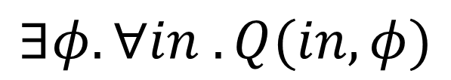
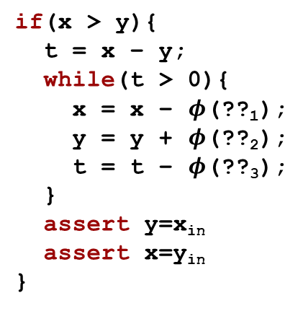

… and Synthesis
Code
if(x > y){
t = x – y;
while(t > 0){
x = x – $φ$(??₁);
y = y + $φ$(??₂);
t = t – $φ$(??₃);
}
assert y=x_{in}
assert x=y_{in}
}
?
$$∃φ. ∀in . Q(in, φ)$$
$$φ$$
Verification Condition Generation
Historically, solvers that can deal with quantifier alternations have not been very scalable

Slide 4
Example
Consider the following program
I claim that for any values of x and y
the loop will terminate
when it does, if x > y, the values of x and y will be swapped
How could I prove this?
...
if(x > y){
t = x – y;
while(t > 0){
x = x – 1;
y = y + 1;
t = t – 1;
}
}

Slide 5
Axiomatic Semantics/Program Logics
A system for proving properties about programs
Key idea:
we can define the semantics of a construct by describing its effect on assertions about the program state
Two components
A language for stating assertions
can be First Order Logic (FOL) or a specialized logic such as separation logic.
many specialized languages developed over the years
Z, Larch, JML, Spec#
Deductive rules for establishing the truth of such assertions

Slide 6
The basics
{A} stmt {B}
Precondition
Postcondition
Hoare triple
If the precondition holds before stmt and stmt terminates postcondition will hold afterwards
This is a partial correctness assertion
we sometimes use the notation
to denote a total correctness assertion
that means you also have to prove termination
[A] stmt [B]

Slide 7


What do assertions mean?
We first need to introduce a language
For today we will be using Winskel’s IMP
e:= n | x | e₁ + e₂
c:= x := e | c₁ ; c₂ | if e then c₁ else c₂ | while e do c
Big Step Semantics have two kinds of judgments
expressions result in values commands change the state

Slide 8
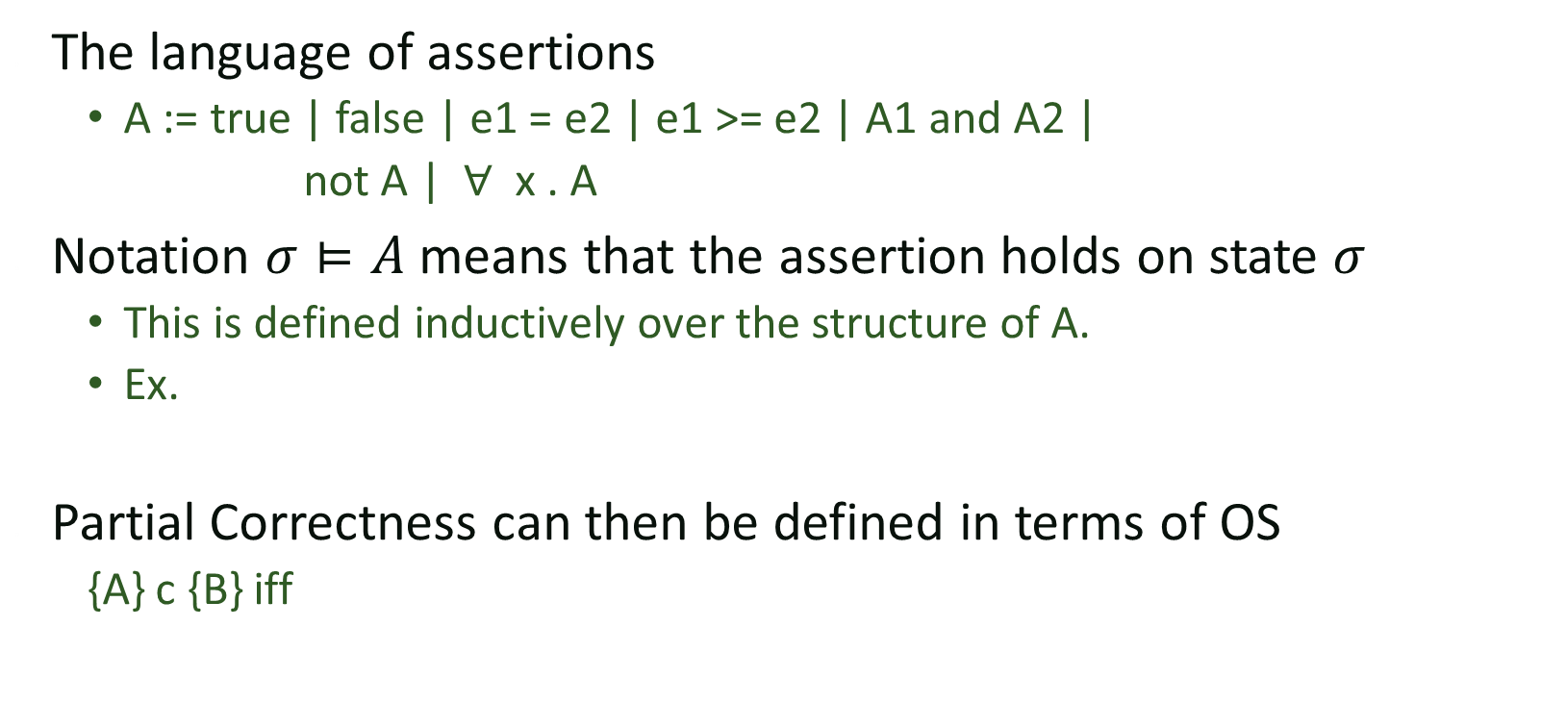
What do assertions mean?
The language of assertions
A := true | false | e1 = e2 | e1 >= e2 | A1 and A2 |
not A | $∀$ x . A
Notation $σ⊨A$ means that the assertion holds on state $σ$
This is defined inductively over the structure of A.
Ex.
Partial Correctness can then be defined in terms of OS
{A} c {B} iff

Slide 9


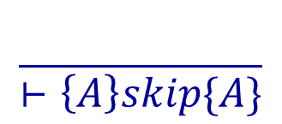



Derivation Rules
Derivation rules for each language construct
Can be combined together with the rule of consequence

Slide 10


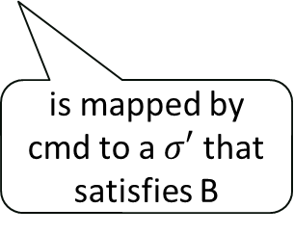
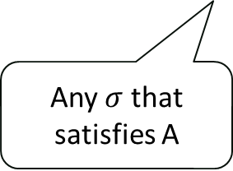

Visualizing the rules
A
cmd
B
$$σ′$$
$$σ$$
Any $σ$ that satisfies A
is mapped by cmd to a $σ′$ that satisfies B
$$\left\{A\right\} cmd \{B\}$$

Slide 11





Visualizing the rules
A
$$c_{1}$$
$$c_{2}$$
B
C
$$σ′$$
$$σ′′$$
$$σ$$

Slide 12


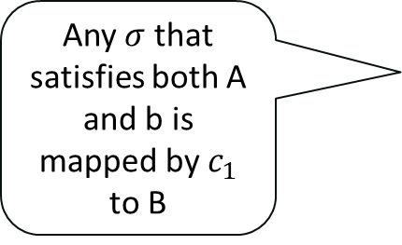







Visualizing the rules
$$c_{1}$$
A
B
b
$¬$b
Any $σ$ that satisfies both A and b is mapped by $c_{1}$ to B
$$σ_{1}$$
$$σ_{1}′$$
$$σ′$$
$$σ_{2}′$$
$$σ_{2}$$
$$c_{2}$$
$$σ$$

Slide 13


Visualizing the rules
A
b
$¬$b
If $c$ maps any point in A and b to another point in A, by the time iteration stops, we are guaranteed to be in $A∧¬b$
$$σ′$$
$$σ$$

Slide 14
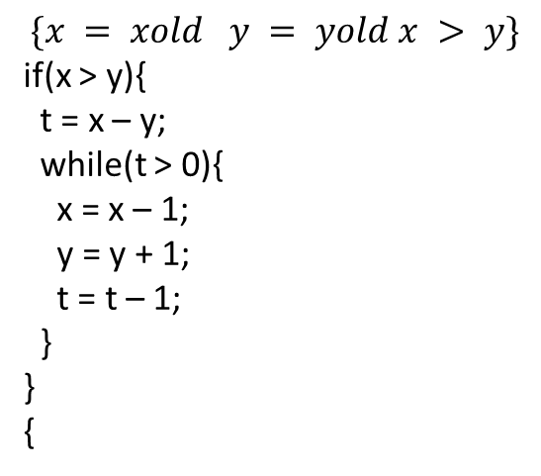
Running Example
$$\{x = xold y = yold x > y\}$$
if(x > y){
t = x – y;
while(t > 0){
x = x – 1;
y = y + 1;
t = t – 1;
}
}
{

Slide 15
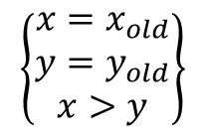

Example
$$\left\{\begin{matrix}x=x_{old} \\ y=y_{old} \\ x>y\end{matrix}\right\}$$
if(x > y)
t = x – y;
while(t > 0)
x = x – 1;
y = y + 1;
t = t – 1;
$$\left\{\begin{matrix}y=x_{old} \\ x=y_{old}\end{matrix}\right\}$$

Slide 16
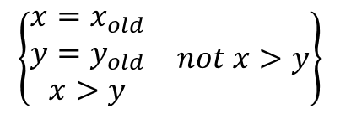


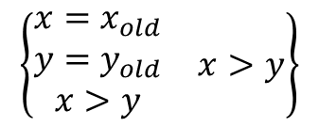
Example
t = x – y;
while(t > 0)
x = x – 1;
y = y + 1;
t = t – 1;
$$\left\{\begin{matrix}\begin{matrix}x=x_{old} \\ y=y_{old} \\ x>y\end{matrix} & x>y\end{matrix}\right\}$$
$$\left\{\begin{matrix}y=x_{old} \\ x=y_{old}\end{matrix}\right\}$$
$$\left\{\begin{matrix}\begin{matrix}x=x_{old} \\ y=y_{old} \\ x>y\end{matrix} & not x>y\end{matrix}\right\}$$
skip
$$\left\{\begin{matrix}y=x_{old} \\ x=y_{old}\end{matrix}\right\}$$
$$\left\{\begin{matrix}x=x_{old} \\ y=y_{old} \\ x>y\end{matrix}\right\}$$
if(x > y)
t = x – y;
while(t > 0)
x = x – 1;
y = y + 1;
t = t – 1;
$$\left\{\begin{matrix}y=x_{old} \\ x=y_{old}\end{matrix}\right\}$$

Slide 17



Example
$$\left\{False\right\}⇒\left\{\begin{matrix}y=x_{old} \\ x=y_{old}\end{matrix}\right\}$$
$$\left\{\begin{matrix}y=x_{old} \\ x=y_{old}\end{matrix}\right\}$$
skip
$$\left\{\begin{matrix}y=x_{old} \\ x=y_{old}\end{matrix}\right\}$$
t = x – y;
while(t > 0)
x = x – 1;
y = y + 1;
t = t – 1;
$$\left\{\begin{matrix}\begin{matrix}x=x_{old} \\ y=y_{old} \\ x>y\end{matrix} & x>y\end{matrix}\right\}$$
$$\left\{\begin{matrix}y=x_{old} \\ x=y_{old}\end{matrix}\right\}$$
$$\left\{\begin{matrix}\begin{matrix}x=x_{old} \\ y=y_{old} \\ x>y\end{matrix} & not x>y\end{matrix}\right\}$$
False
skip
$$\left\{\begin{matrix}y=x_{old} \\ x=y_{old}\end{matrix}\right\}$$
$$\left\{\begin{matrix}x=x_{old} \\ y=y_{old} \\ x>y\end{matrix}\right\}$$
if(x > y)
t = x – y;
while(t > 0)
x = x – 1;
y = y + 1;
t = t – 1;
$$\left\{\begin{matrix}y=x_{old} \\ x=y_{old}\end{matrix}\right\}$$

Slide 18

Example
$$\frac{}{⊢\left\{A\right\}skip\{A\}}$$
$$\left\{False\right\}⇒\left\{\begin{matrix}y=x_{old} \\ x=y_{old}\end{matrix}\right\}$$
$$\left\{\begin{matrix}y=x_{old} \\ x=y_{old}\end{matrix}\right\}$$
skip
$$\left\{\begin{matrix}y=x_{old} \\ x=y_{old}\end{matrix}\right\}$$
t = x – y;
while(t > 0)
x = x – 1;
y = y + 1;
t = t – 1;
$$\left\{\begin{matrix}\begin{matrix}x=x_{old} \\ y=y_{old} \\ x>y\end{matrix} & x>y\end{matrix}\right\}$$
$$\left\{\begin{matrix}y=x_{old} \\ x=y_{old}\end{matrix}\right\}$$
$$\left\{\begin{matrix}\begin{matrix}x=x_{old} \\ y=y_{old} \\ x>y\end{matrix} & not x>y\end{matrix}\right\}$$
False
skip
$$\left\{\begin{matrix}y=x_{old} \\ x=y_{old}\end{matrix}\right\}$$
$$\left\{\begin{matrix}x=x_{old} \\ y=y_{old} \\ x>y\end{matrix}\right\}$$
if(x > y)
t = x – y;
while(t > 0)
x = x – 1;
y = y + 1;
t = t – 1;
$$\left\{\begin{matrix}y=x_{old} \\ x=y_{old}\end{matrix}\right\}$$

Slide 19



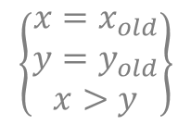



Example
$$\left\{False\right\}⇒\left\{\begin{matrix}y=x_{old} \\ x=y_{old}\end{matrix}\right\}$$
$$\left\{\begin{matrix}y=x_{old} \\ x=y_{old}\end{matrix}\right\}$$
skip
$$\left\{\begin{matrix}y=x_{old} \\ x=y_{old}\end{matrix}\right\}$$
t = x – y;
while(t > 0)
x = x – 1;
y = y + 1;
t = t – 1;
$$\left\{\begin{matrix}\begin{matrix}x=x_{old} \\ y=y_{old} \\ x>y\end{matrix} & x>y\end{matrix}\right\}$$
$$\left\{\begin{matrix}y=x_{old} \\ x=y_{old}\end{matrix}\right\}$$
$$\left\{False\right\}$$
skip
$$\left\{\begin{matrix}y=x_{old} \\ x=y_{old}\end{matrix}\right\}$$
$$\left\{\begin{matrix}x=x_{old} \\ y=y_{old} \\ x>y\end{matrix}\right\}$$
if(x > y)
t = x – y;
while(t > 0)
x = x – 1;
y = y + 1;
t = t – 1;
$$\left\{\begin{matrix}y=x_{old} \\ x=y_{old}\end{matrix}\right\}$$

Slide 20
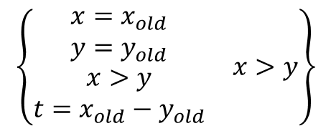


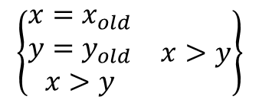
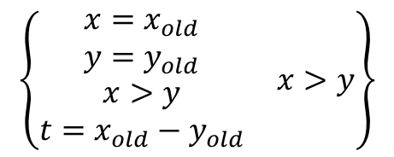
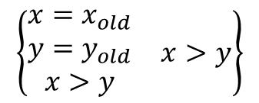
Example
while(t > 0)
x = x – 1;
y = y + 1;
t = t – 1;
$$\left\{\begin{matrix}\begin{matrix}x=x_{old} \\ y=y_{old} \\ x>y\end{matrix} & x>y\end{matrix}\right\}$$
$$\left\{\begin{matrix}\begin{matrix}x=x_{old} \\ y=y_{old} \\ \begin{aligned}x>y \\ t=x_{old}−y_{old}\end{aligned}\end{matrix} & x>y\end{matrix}\right\}$$
$$\left\{\begin{matrix}\begin{matrix}x=x_{old} \\ y=y_{old} \\ \begin{aligned}x>y \\ t=x_{old}−y_{old}\end{aligned}\end{matrix} & x>y\end{matrix}\right\}$$
$$\left\{\begin{matrix}y=x_{old} \\ x=y_{old}\end{matrix}\right\}$$
t = x – y;
t = x – y;
while(t > 0)
x = x – 1;
y = y + 1;
t = t – 1;
$$\left\{\begin{matrix}\begin{matrix}x=x_{old} \\ y=y_{old} \\ x>y\end{matrix} & x>y\end{matrix}\right\}$$
$$\left\{\begin{matrix}y=x_{old} \\ x=y_{old}\end{matrix}\right\}$$

Slide 21

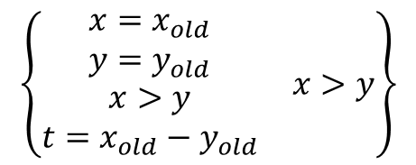

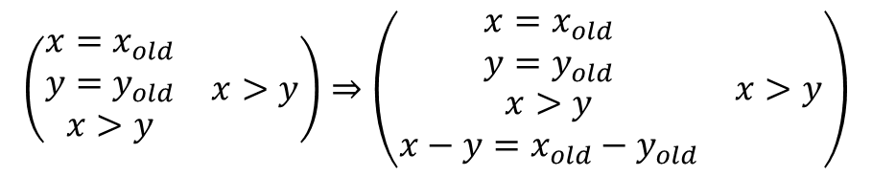
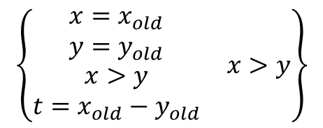
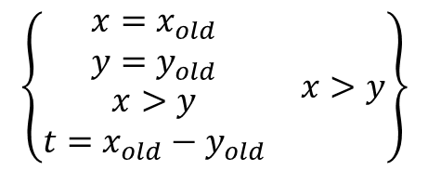
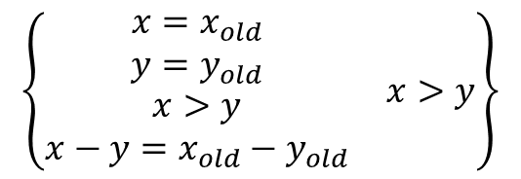
Example
$$\left(\begin{matrix}\begin{matrix}x=x_{old} \\ y=y_{old} \\ x>y\end{matrix} & x>y\end{matrix}\right)⇒\left(\begin{matrix}\begin{matrix}x=x_{old} \\ y=y_{old} \\ \begin{aligned}x>y \\ x−y=x_{old}−y_{old}\end{aligned}\end{matrix} & x>y\end{matrix}\right)$$
$$\left\{\begin{matrix}\begin{matrix}x=x_{old} \\ y=y_{old} \\ \begin{aligned}x>y \\ x−y=x_{old}−y_{old}\end{aligned}\end{matrix} & x>y\end{matrix}\right\}$$
$$\left\{\begin{matrix}\begin{matrix}x=x_{old} \\ y=y_{old} \\ \begin{aligned}x>y \\ t=x_{old}−y_{old}\end{aligned}\end{matrix} & x>y\end{matrix}\right\}$$
t = x – y;
while(t > 0)
x = x – 1;
y = y + 1;
t = t – 1;
$$\left\{\begin{matrix}\begin{matrix}x=x_{old} \\ y=y_{old} \\ x>y\end{matrix} & x>y\end{matrix}\right\}$$
$$\left\{\begin{matrix}\begin{matrix}x=x_{old} \\ y=y_{old} \\ \begin{aligned}x>y \\ t=x_{old}−y_{old}\end{aligned}\end{matrix} & x>y\end{matrix}\right\}$$
$$\left\{\begin{matrix}\begin{matrix}x=x_{old} \\ y=y_{old} \\ \begin{aligned}x>y \\ t=x_{old}−y_{old}\end{aligned}\end{matrix} & x>y\end{matrix}\right\}$$
$$\left\{\begin{matrix}y=x_{old} \\ x=y_{old}\end{matrix}\right\}$$
t = x – y;
t = x – y;
while(t > 0)
x = x – 1;
y = y + 1;
t = t – 1;
$$\left\{\begin{matrix}\begin{matrix}x=x_{old} \\ y=y_{old} \\ x>y\end{matrix} & x>y\end{matrix}\right\}$$
$$\left\{\begin{matrix}y=x_{old} \\ x=y_{old}\end{matrix}\right\}$$

Slide 22

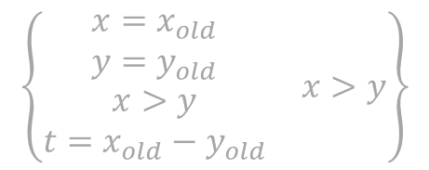
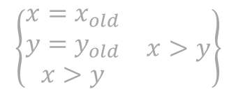
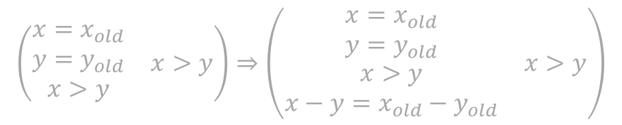
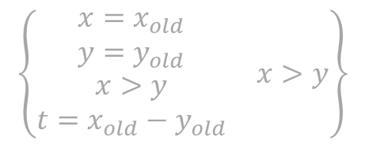
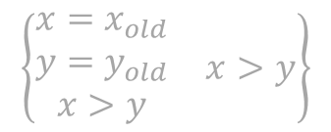
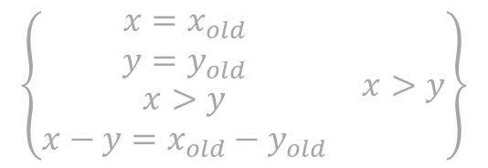
Example
$$\left(\begin{matrix}\begin{matrix}x=x_{old} \\ y=y_{old} \\ x>y\end{matrix} & x>y\end{matrix}\right)⇒\left(\begin{matrix}\begin{matrix}x=x_{old} \\ y=y_{old} \\ \begin{aligned}x>y \\ x−y=x_{old}−y_{old}\end{aligned}\end{matrix} & x>y\end{matrix}\right)$$
$$\left\{\begin{matrix}\begin{matrix}x=x_{old} \\ y=y_{old} \\ \begin{aligned}x>y \\ x−y=x_{old}−y_{old}\end{aligned}\end{matrix} & x>y\end{matrix}\right\}$$
$$\left\{\begin{matrix}\begin{matrix}x=x_{old} \\ y=y_{old} \\ \begin{aligned}x>y \\ t=x_{old}−y_{old}\end{aligned}\end{matrix} & x>y\end{matrix}\right\}$$
t = x – y;
while(t > 0)
x = x – 1;
y = y + 1;
t = t – 1;
$$\left\{\begin{matrix}\begin{matrix}x=x_{old} \\ y=y_{old} \\ x>y\end{matrix} & x>y\end{matrix}\right\}$$
$$\left\{\begin{matrix}\begin{matrix}x=x_{old} \\ y=y_{old} \\ \begin{aligned}x>y \\ t=x_{old}−y_{old}\end{aligned}\end{matrix} & x>y\end{matrix}\right\}$$
$$\left\{\begin{matrix}\begin{matrix}x=x_{old} \\ y=y_{old} \\ \begin{aligned}x>y \\ t=x_{old}−y_{old}\end{aligned}\end{matrix} & x>y\end{matrix}\right\}$$
$$\left\{\begin{matrix}y=x_{old} \\ x=y_{old}\end{matrix}\right\}$$
t = x – y;
t = x – y;
while(t > 0)
x = x – 1;
y = y + 1;
t = t – 1;
$$\left\{\begin{matrix}\begin{matrix}x=x_{old} \\ y=y_{old} \\ x>y\end{matrix} & x>y\end{matrix}\right\}$$
$$\left\{\begin{matrix}y=x_{old} \\ x=y_{old}\end{matrix}\right\}$$

Slide 23
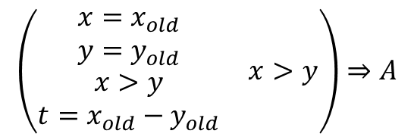


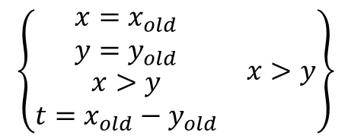




Example
x = x – 1;
y = y + 1;
t = t – 1;
$$\left\{A∧t>0\right\}$$
$$\left\{A\right\}$$
while(t > 0)
x = x – 1;
y = y + 1;
t = t – 1;
$$\left(\begin{matrix}\begin{matrix}x=x_{old} \\ y=y_{old} \\ \begin{aligned}x>y \\ t=x_{old}−y_{old}\end{aligned}\end{matrix} & x>y\end{matrix}\right)⇒A$$
$$\left\{A\right\}$$
$$\left\{\begin{matrix}A∧ & not t>0\end{matrix}\right\}$$
$$A∧not t>0⇒\left(\begin{matrix}y=x_{old} \\ x=y_{old}\end{matrix}\right)$$
while(t > 0)
x = x – 1;
y = y + 1;
t = t – 1;
$$\left\{\begin{matrix}\begin{matrix}x=x_{old} \\ y=y_{old} \\ \begin{aligned}x>y \\ t=x_{old}−y_{old}\end{aligned}\end{matrix} & x>y\end{matrix}\right\}$$
$$\left\{\begin{matrix}y=x_{old} \\ x=y_{old}\end{matrix}\right\}$$

Slide 24

Loop Invariant
{Pre} while(p) c {Post}
Need to find invariant A such that
$Pre⇒A$
$A∧¬ p⇒Post$
$\left\{A∧p\right\}c \{A\}$

Slide 25
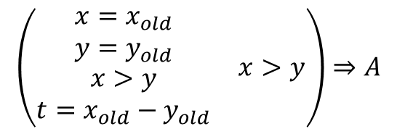



Example
x = x – 1;
y = y + 1;
t = t – 1;
$$\left\{A∧t>0\right\}$$
$$\left\{A\right\}$$
$$\left(\begin{matrix}\begin{matrix}x=x_{old} \\ y=y_{old} \\ \begin{aligned}x>y \\ t=x_{old}−y_{old}\end{aligned}\end{matrix} & x>y\end{matrix}\right)⇒A$$
$$A∧not t>0⇒\left(\begin{matrix}y=x_{old} \\ x=y_{old}\end{matrix}\right)$$
Notes:
x=y0+t and y=x0-t and t>=0

Slide 26

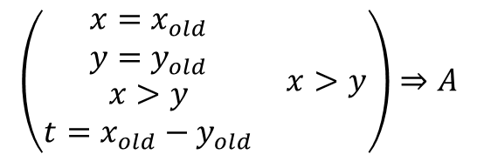
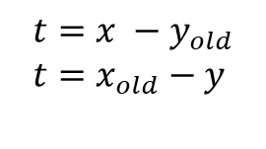




Example
x = x – 1;
y = y + 1;
t = t – 1;
$$\left\{A∧t>0\right\}$$
$$\left\{A\right\}$$
How about:
$$A≔$$
$$t=x −y_{old} \\ t=x_{old}−y$$
$$t≥0$$
$$\left(\begin{matrix}\begin{matrix}x=x_{old} \\ y=y_{old} \\ \begin{aligned}x>y \\ t=x_{old}−y_{old}\end{aligned}\end{matrix} & x>y\end{matrix}\right)⇒A$$
$$A∧not t>0⇒\left(\begin{matrix}y=x_{old} \\ x=y_{old}\end{matrix}\right)$$
Notes:
x=y0+t and y=x0-t and t>=0

Slide 27
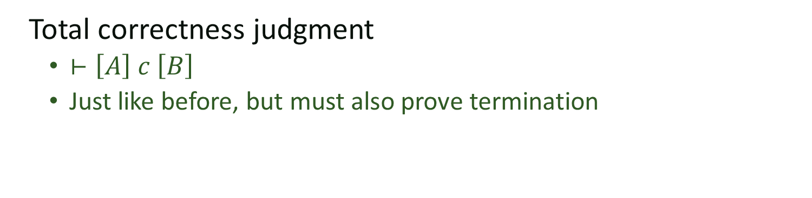
From partial to total correctness
Total correctness judgment
$⊢\left[A\right] c \left[B\right]$
Just like before, but must also prove termination
What about loops

Slide 28
Rank function
Function F of the state that
a) Maps state to an integer
b) Decreases with every iteration of the loop
c) Is guaranteed to stay greater than zero
Also called variant function
z is just a fresh variable not used elsewhere in the expressions

Slide 29
Example
Can we prove this?
[ x=x0 and y=y0 and x > y ]
if(x > y){
t = x – y;
while(t > 0){
x = x – 1;
y = y + 1;
t = t – 1;
}
}
[y=x0 and x=y0 ]

Slide 30



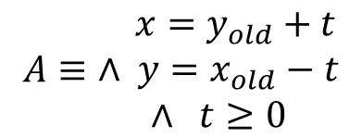



Example
$$A≡\begin{matrix} x=y_{old}+t \\ ∧ y=x_{old}−t \\ ∧ t≥0\end{matrix}$$
$$F≡t$$
x = x – 1;
y = y + 1;
t = t – 1;
$$\left[A∧t>0∧t=z\right]$$
$$\left[A∧(t<z)\right]$$
$$A∧t>0⇒t≥0$$
while(t > 0)
x = x – 1;
y = y + 1;
t = t – 1;
$$\left[A\right]$$
$$\left[\begin{matrix}A∧ & not t>0\end{matrix}\right]$$
Notes:
x=y_{old}+t \\
\wedge& y=x_{old}-t \\
\wedge & t>=0

Slide 31
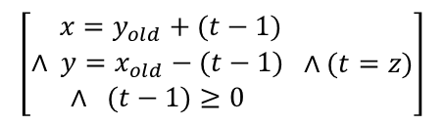

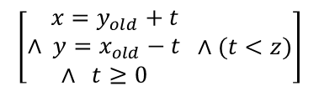

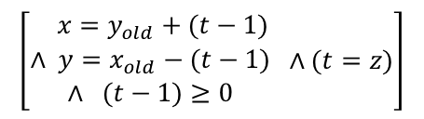

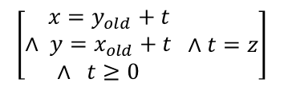
Example
$$\left[\begin{matrix} x=y_{old}+t \\ ∧ y=x_{old}+t \\ ∧ t≥0\end{matrix} ∧t=z\right]$$
x = x – 1;
y = y + 1;
$$\left[\begin{matrix} x=y_{old}+(t−1) \\ ∧ y=x_{old}−(t−1) \\ ∧ (t−1)≥0\end{matrix} ∧(t=z)\right]$$
$$\left[\begin{matrix} x=y_{old}+(t−1) \\ ∧ y=x_{old}−(t−1) \\ ∧ (t−1)≥0\end{matrix} ∧(t=z)\right]$$
t = t – 1;
$$\left[\begin{matrix} x=y_{old}+t \\ ∧ y=x_{old}−t \\ ∧ t≥0\end{matrix} ∧(t<z)\right]$$
x = x – 1;
y = y + 1;
t = t – 1;
$$\left[A∧t>0∧t=z\right]$$
$$\left[A∧(t<z)\right]$$
$$A∧t>0⇒t≥0$$
while(t > 0)
x = x – 1;
y = y + 1;
t = t – 1;
$$\left[A\right]$$
$$\left[\begin{matrix}A∧ & not t>0\end{matrix}\right]$$
Notes:
x=y_{old}+t \\
\wedge& y=x_{old}-t \\
\wedge & t>=0

Slide 32
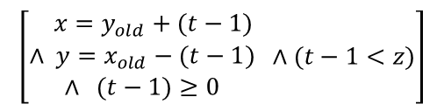
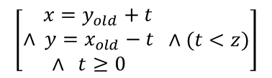

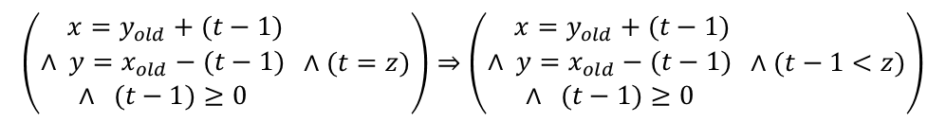
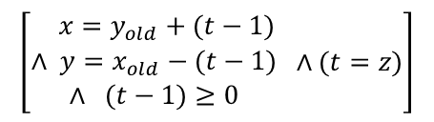
Example
$$\left(\begin{matrix} x=y_{old}+(t−1) \\ ∧ y=x_{old}−(t−1) \\ ∧ (t−1)≥0\end{matrix} ∧(t=z)\right)⇒\left(\begin{matrix} x=y_{old}+(t−1) \\ ∧ y=x_{old}−(t−1) \\ ∧ (t−1)≥0\end{matrix} ∧(t−1<z)\right)$$
$$\left[\begin{matrix} x=y_{old}+(t−1) \\ ∧ y=x_{old}−(t−1) \\ ∧ (t−1)≥0\end{matrix} ∧(t−1<z)\right]$$
t = t – 1;
$$\left[\begin{matrix} x=y_{old}+t \\ ∧ y=x_{old}−t \\ ∧ t≥0\end{matrix} ∧(t<z)\right]$$
$$…$$
$$\left[\begin{matrix} x=y_{old}+(t−1) \\ ∧ y=x_{old}−(t−1) \\ ∧ (t−1)≥0\end{matrix} ∧(t=z)\right]$$
t = t – 1;
$$\left[\begin{matrix} x=y_{old}+t \\ ∧ y=x_{old}−t \\ ∧ t≥0\end{matrix} ∧(t<z)\right]$$
x = x – 1;
y = y + 1;
t = t – 1;
$$\left[A∧t>0∧t=z\right]$$
$$\left[A∧(t<z)\right]$$
$$A∧t>0⇒t≥0$$
while(t > 0)
x = x – 1;
y = y + 1;
t = t – 1;
$$\left[A\right]$$
$$\left[\begin{matrix}A∧ & not t>0\end{matrix}\right]$$
Notes:
x=y_{old}+t \\
\wedge& y=x_{old}-t \\
\wedge & t>=0

Slide 33


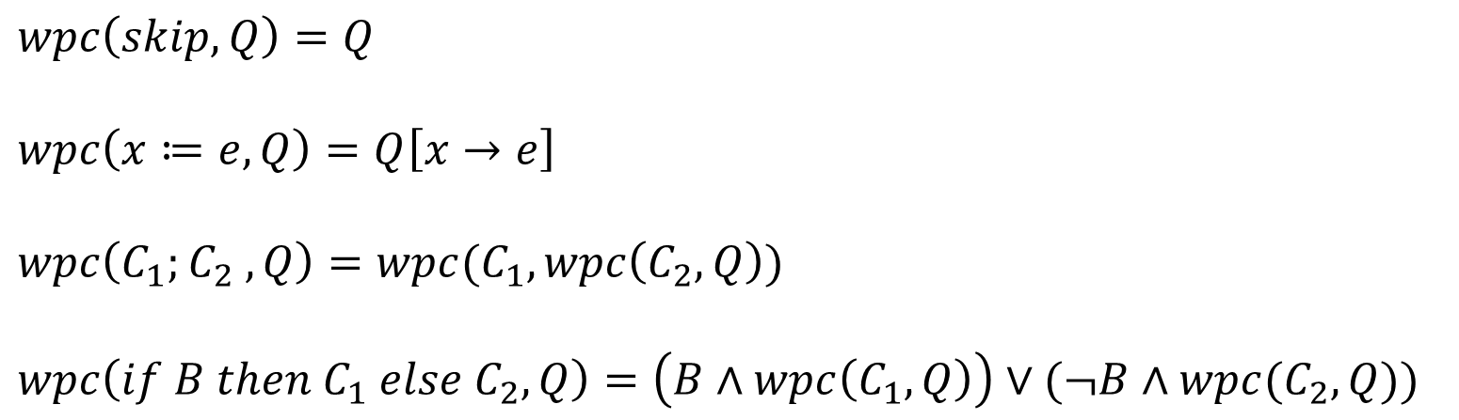
Weakest Preconditions
$$P=wpc(c, A)$$
Command
Predicate
Weakest predicate P such that $\left\{P\right\} c \{A\}$
P weaker than Q iff $Q⇒P$
P
Q
$$wpc\left(skip, Q\right)=Q$$
$$wpc\left(x≔e, Q\right)=Q\left[x→e\right]$$
$$wpc\left(C_{1};C_{2} , Q\right)=wpc(C_{1}, wpc\left(C_{2}, Q\right))$$
$$wpc\left(if B then C_{1} else C_{2}, Q\right)=\left(B∧wpc\left(C_{1}, Q\right)\right)∨(¬B∧wpc(C_{2}, Q))$$

Slide 34

Weakest Precondition
While-loop is tricky
Let W $=wpc\left(while e do c, B\right)$
then,
W = $e⇒wpc\left(c, W\right) ∧ ¬e⇒B$

Slide 35

Verification Condition
Stronger than the weakest precondition
Can be computed by using an invariant
$VC\left(while_{I} e do c, B\right)=$
$$I∧ ∀x_{1}, …x_{n} I⇒\left(e⇒VC\left(c,I\right)∧¬e⇒B\right)$$
Where x_i are variables modified in c.

